Slide 1
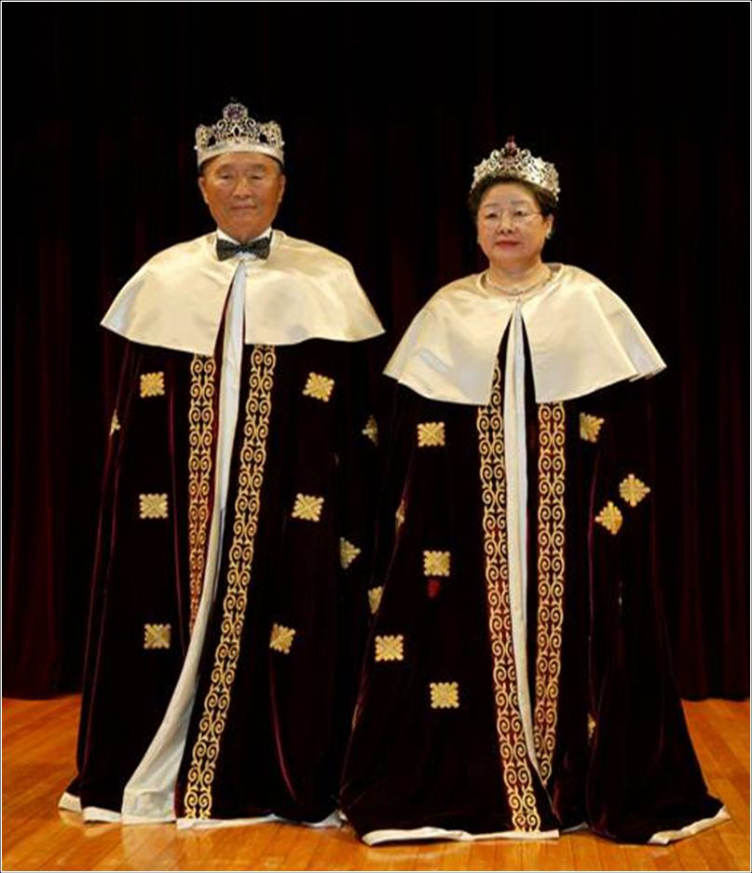
The Value of True Parents
- True Parents are the Master Key-
Jan.27, Heavenly Calendar
(Feb. 18, 2012)
D-370
Jin Choon Kim, Ph.D.
President,
CheongShim Graduate School of Theology

Slide 2
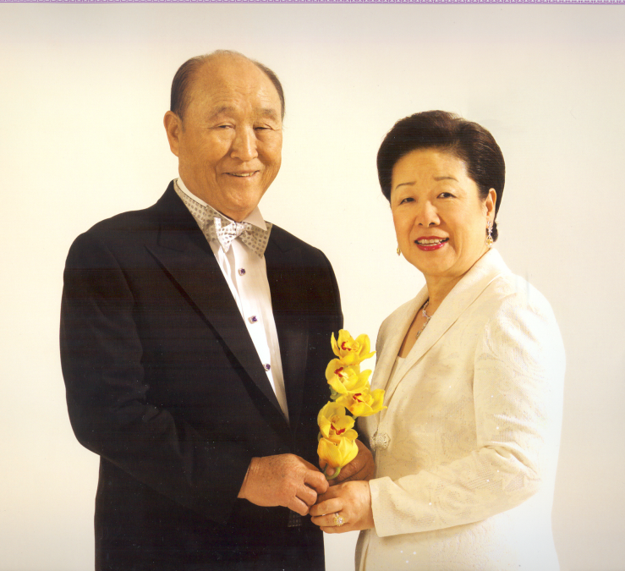
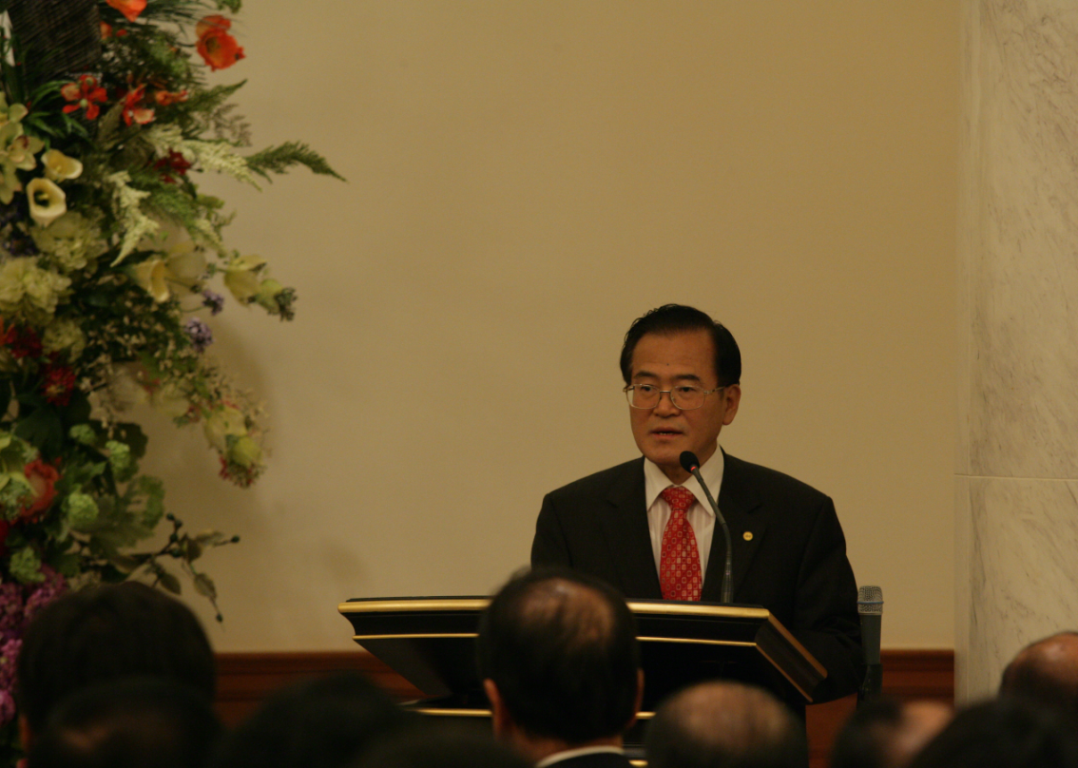
True Parents
are
The Master Key !
Hoon Dok Hoe
at Cheon Jeong Goong
2011.10.16

Slide 3
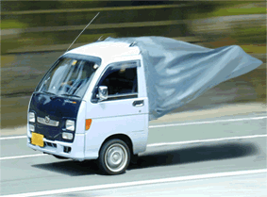
My Life: A Premium Life ?
Who am I?
For what am I busy?
Where am I heading?

Slide 4
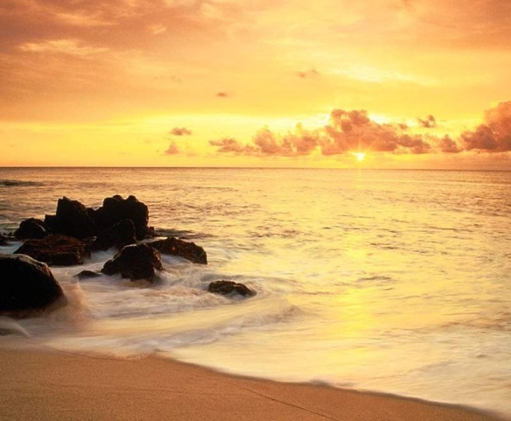
Substantial CIG
1st
Coming
2nd
Coming
1st Age:
This Age
(Rule of Satan)
2nd Age:
Age of Church
(Beginning of KoG)
3rd Age:
Age of Millennium
(Rule of LSA)
4th Age:
Orig. World
Creation
(Original World)
440billion
Ab.G.Sprits
Cleansing
Fallen Natures & Bad Habits
Now
Settlement of
God’s Sovereignty
TP of HEH
CIG (Kingdom of Heaven)
Three Great Blessings
True Love, Life, Blood Lineage
True Peace, Unification, Happiness
Interreligious, International,
Interracial, Intercultural World
Harmony between S. World & P. World
One Cosmic Family under God
Era After the Coming
of Heaven
(Original World)
Coming Era
(Original World)
Now
(Light + Darkness)

Slide 5
1st
Coming
2nd
Coming
3rd Age
(Rule of LSA)
4th Age
(Substantial CIG)
Creation
(Original World)
1st Age
2nd Age
440billion
Ab.Good Sprits
3rd Blessing
Ideal World :
Kingdom of God
In Heaven & on Earth
Original
World
2nd Blessing
CIG Age
1st Blessing
God
2001
2012
3rd Age
CT Age
Human Fall :
Int. Ignorance
Ext. Ignorance
True Parents
1992
2nd Age
Age of the Prolongation
of Prov. of Restoration
(NT Age)
Restoration
Jesus
1st Age
Age of the Providence of Restoration
(OT Age)
A
E
Age of the Foundation for Restoration
(Offering Age)
Fallen A/E

Slide 6
True Parents are the Master Key
“The Wish of humankind is meeting TP.
The fruit of history is meeting TP.
The center of this era is meeting TP.
The beginning point of the future is meeting TP.
You who are engrafted on to TP will be a branch,…
Your connection with TP is only once in eternity.
It is a very special event only one time in your life.
Your ancestors didn’t have this chance and
your descendants will not have this, either. (Cheon Seong Gyeong, pp.233-234; 71.8.13)

Slide 7
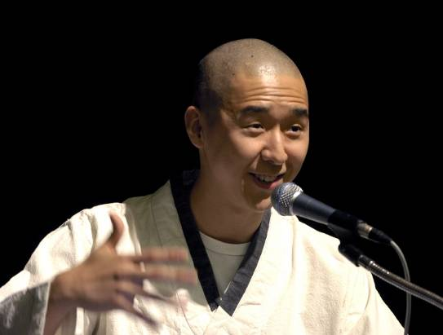
“Understanding TPs” : Why is it so important?
“Understanding TP” is
● Setting the true value of True Parents
* TPs are only one, and there will be no other one.
* TPs are our everlasting center and
the center of the physical world and spiritual world.
● Enabling us to understand our identity
* We can reach God through TPs.
* We can complete salvation and resurrection through TPs.
● Keeping the value of True Parents
* We can explain the value of TPs to people.
* We can appreciate True Mother’s value, also. (True Mother enables True Father as TP)
● Giving untold influence to us and to our descendants
* How we understand TPs will have a big influence on our life, vision and future.
HJ Moon, 2006.2.6
World leader conference

Slide 8
Unification Church : Community for Unification
Ideal World :“Unification” centered on True Love
God
God
God
T.Father
T.Husb
T.Mother
T.Wife
True Love
Mind
S.Self
True Love
Body
P.Self
T.Parent
T.H&W
True Love
All
Things
True
Family
True
Self
Soc., Nation
Cosmos
Global Family
Unity between
-God and Human
-Mind and Body
-Spirit Self and Physical Self
Cosmic Family
Unity between
-God, Human, and All Things
-Human and All Things
-Human, Nature, and Cosmos
Unity between
-Husband and Wife
-Parents and Children
-Ancestors and Descendants
-Family & Family, Nation & Nation

Slide 9
Ideal View :
Original, Essential, Ultimate, Universal
Absolute, Unique, Unchanging, Eternal
Essential, ultimate “Beings”
Essential, ultimate “Principles”
God
● First Cause of Everything
● Origin of
True Parent/Teacher/Owner
True Love
● Essential attribute of God
● Principle of Creation/Providence
● Source of True Life/Lineage
● Center of Family Pledge
True
Parent
● TP of HEH, OS of Human Being
● T. Parent/Teacher/Owner
God’s Word
● God’s Logos
● Specifying Word
● Design of Creation/Providence
● Purposiveness and Laws
CIG
(Kingdom
of God)
● Ideal World of Peace
● Kingdom of Heaven
on Earth and in Heaven
● International, Interreligious
Intercultral, Interracial
3 Great
Blessings
● Structure/System of CIG
● Harmony of cosmic 1st, 2nd, 3rd Blessing
● Harmony of Heaven/Earth/Human Being
Cosmic
Family
● Ideal feature of CIG
● One Cosmic Family under God
● Harmony of Earthly men/Spirits
● Harmony of Ph.World/Sp.World

Slide 10
The Value of TPs : from “Ideal” Perspectives
Ideal Views
● Original, Essential, Ultimate,
Universal, Comprehensive
● Absolute, Unique, Unchanging,
Eternal
I.
From the view of
God
II.
From the view of
True Parent
VII.
From the view of
Cosmic Family
Subject
(Value of TPs)
III.
From the view of
CIG
VI.
From the view of
3GBs
IV.
From the view of
True Love
V.
From the view of
God’s Word

Slide 11
The Value of TPs : from “Ideal” Perspectives
Ideal Views
● Original, Essential, Ultimate,
Universal, Comprehensive
● Absolute, Unique, Unchanging,
Eternal
I.
From the view of
God
II.
From the view of
True Parent
VII.
From the view of
Cosmic Family
European
CIG Assembly
2012
III.
From the view of
CIG
VI.
From the view of
3GBs
IV.
From the view of
True Love
V.
From the view of
God’s Word

Slide 12
Value of TPs (I) : From the view of “God”
God wants to
love, embrace , comfort, appreciate, hold in bosom,
and bestow greatly
God
I, the God of all people, love True Parents! I love you
greatly! I hold you dearly!
Because the TP have, in my place, endured countless difficult paths, I now want to bestow upon you all of the gratitude, inspiration, excitement and joy that I have been feeling I want you to inherit all that is mine.
True Parents! My beloved True Parents! I want to hold you in my bosom and not let you go. It is a waste for me to walk the floor with my two legs. (2001.12.28. Midnight)
True Parents

Resurrection from 7 Deaths : Deep love/protection of God

Slide 13
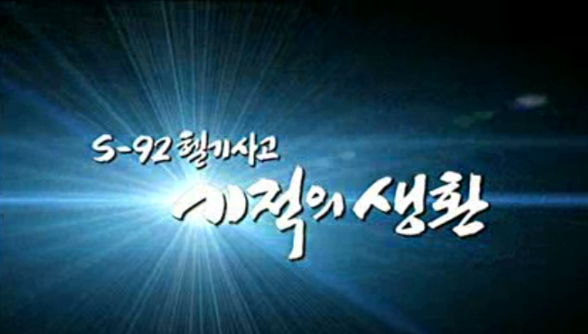
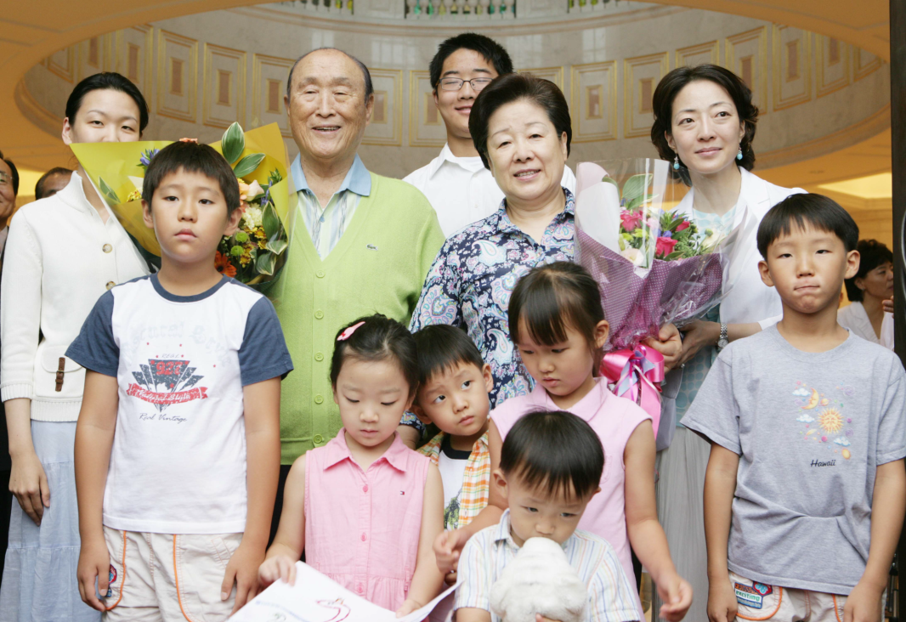
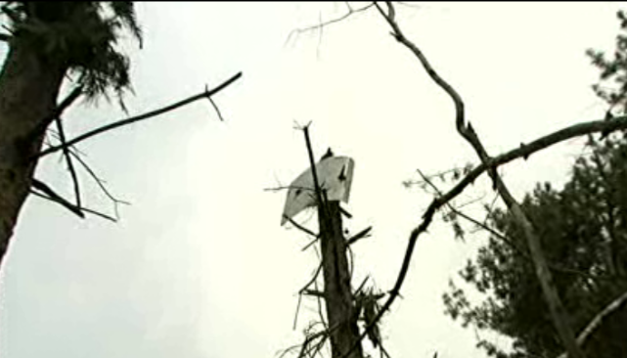
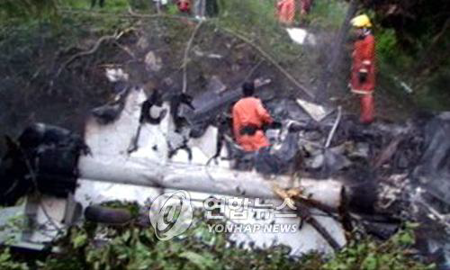
God’s love to TPs : Escape from helicopter accident
Miracle #1. Branch didn’t impale pilot  Pilot is saved [Mr. Joo’s Report, Aug. 2008]
Miracle #2. Tail caught by branch  Helicopter blade stopped spinning
Miracle #3. Main wings were stuck into mud  Prevent moving/spinning
Miracle #4. Fuselage came to rest 7-8 m short of a big rock  Not being hit
Miracle #5. Fuel tank avoided rock  Prevention of explosion of tank
Miracle #6. Exit door towards sky  Easy to open the door
Miracle #7. Vice captain could find exit.  Shortening escape time
Miracle #8. Mr. Lee and Mr. Yoon moved to TPs’ seat.
 They rescued TPs in darkness. Avoid sharp branch
Miracle #9. 16 people moved fast in darkness  Escape in 7 min.
Miracle #10. Small explosion after 20 min.  Safe escape
Miracle #11. CS International Hospital opened orthopedics, hosting International Symposium, purchasing new equipment
 Doctor/Nurse/Technician immediately response/operation
Miracle #12. Teacher of orthopedics was on vacation only 5 min away from
CheongPyeong  Safe operation
2008.7.19, 천성산

Slide 14
Value of TPs (II) : From the view of “True Parent”
For God
TP of Heaven, Earth, and Humankind
God
Feel, Think, Determine, and Do
In God’s Position
One mind/One body
/One mindset with God
* Fallen Nature No.1 : Not God’s Position
True Parents
First ideal ancestors
Original Substance
Savior/Messiah/TP
For Humankind
Original Substance of Humankind
Feel, Think, Determine, and Do
For the sake of Humankind
Ph. World
Sp. World
True Family
Soc, Nat, World, Cos.
Angel
Blessed Family
Mineral, Universe
Animal, Plant
Human
(Earthly men, Spirits)
● Branch
All things
(Ph.World, Sp.World)
● Circumstance
CIG
(Kingdom of God)

Slide 15
TPs’ life : As TP of HEH, Original substance of Human Being
■ Life as TP of HEH : One mind/body/mindset with God
● Deep understanding about God : Heart of Han, God’s will
● Life for God, Liberating God, Returning God’s original position
● Substance of God’s nature, Representative/Inheritor of God ;
Completion of God’s Providence
■ Life as Original substance of human being : Savior, Messiah, LSA
● Completion of the mission of First Adam and Second Adam
● Life as Savior, Messiah, LSA, and TP : Mission from God
● Life for Rebirth and Resurrection of Humankind : Ph. World, Sp. World

Slide 16
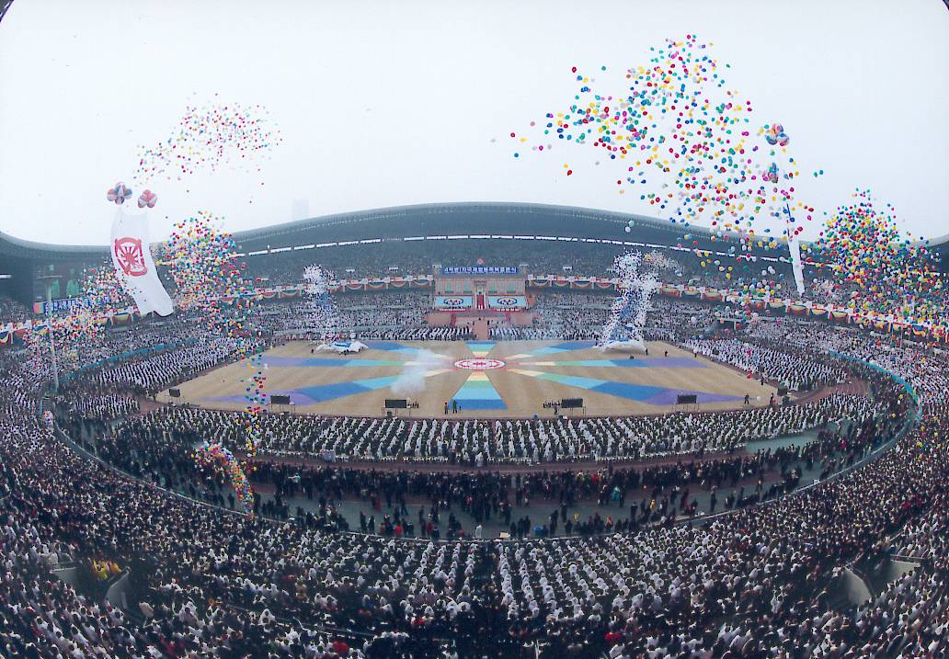
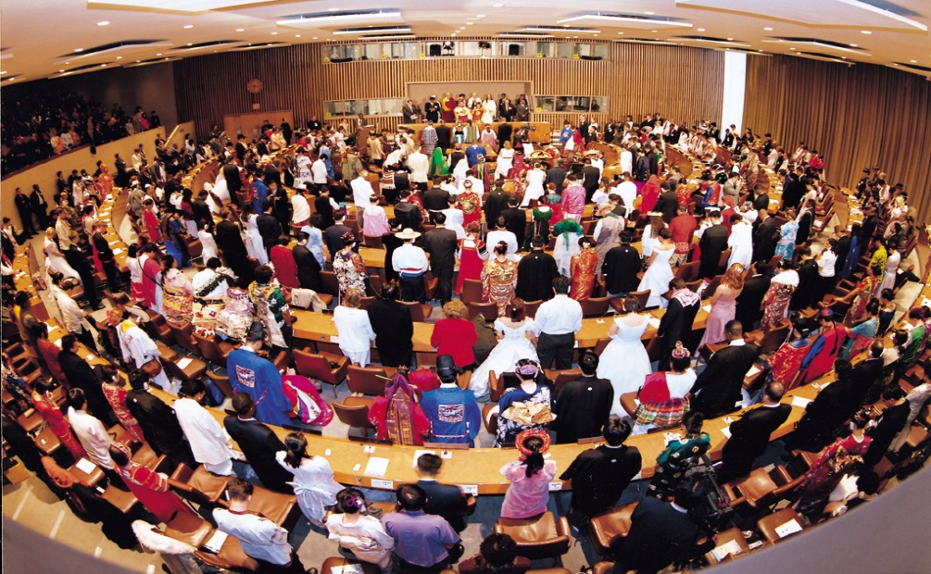
Blessing ceremonies for Rebirth, Resurrection
● Significance of Blessing
▪ Blessing of God
▪ Special Authority of Messish
▪ Transition of Blood lineage (Original sin)
▪ Model of Ideal family (Base of KoH)
▪ Cross-cultural marriage : Final means for
realizing a Peaceful, ideal world
● Blessing ceremonies of TPs
▪ 36, 72, 124, 430, 777, 1800
▪ 6000, 2075, 6500, 1275
▪ 30,000, 360,000, 3,600,000
▪ 39,600,000, 400million
144,000 religious leaders
▪ World Peace Blessing Ceremony
▪ Cosmic Blessing Ceremony
▪ Many Pre-married couple Blessings
▪ Many 2nd Generation Blessings
2000.2.13. Seoul Jamsil Olympic Stadium
World Peace Blessing (2001.1.27. UN)

Slide 17
Value of TPs (III) : From the view of “CIG”
○ Ideal of Heavenly Kingdom
● First Adam : Fail
● Second Adam : Fail
● Third Adam (TPs) :
Surely success
○ Victory of TPs
● Complete establishment
of CIG Model/Frame
● Preparation of Foundation
for Substantial CIG life of
humankind
• Name : CIG (Cosmic nation of Peace & Unification)
• Sovereignty : Inauguration of God’s sovereignty, King of Kings, King of Cosmic Peace
TP of HEH, OS of humankind
• People : Blessed Family, Absolute good spirits
• Land : Heaven & Earth (land/sea/Earth/Cosmos)
• Palace : Cheon Jeong Goong (Peace Palace)
• Law : CIG Constitution, 8 text books
• Government : UPF (Peace UN, TP UN)
• National Flag, Anthem : Unification Flag, Holysong#3
• Army, Police : Army/Police of Peace Kingdom
• ID card : CIG Citizen Card
• Ambassador, Embassy : Peace Ambassador/ Embassy
• Civilization : Cosmic Peace Divine Civilization
• All things : Light, Soil, Plant , Animal

Slide 18
TPs’ Accomplishments in Every Area for CIG
CIG must be realized
in every area of life
● Worldwide speech tour
● Education of New Truth
● Establishment of Values/VOC
Inter-faith (ICC),
● Character education/training
● Holy harmony ceremony
■ One Cosmic Family under God
■ Mutual Existence/Prosperity/Righteousness
■ Inter-religious/national/cultural/racial
■ True unification, peace, happiness
1st Blessing
CIG
True Parents
● School/Media
● Science/Technology
● Industry/Economy
● Culture/Arts
● Relief/Service/Welfare
● Sports/Martial arts
● Service/Leisure
God
3rd Blessing
Marriage blessing
True Family movement
● Absolute sex education
● WFWP, YFWP, CARP, SCWP
● Unification of Korea
● Spiritual Movement
3 Great Blessings
2nd Blessing

Slide 19
Value of TPs (IV) : From the view of “True Love”
The Most Essential Attribute of God
Forgiving Enemy ,
Power of Natural Subjugation
Heavenly Law of Eternal World
For the Sake of
Others
True
Love
Sincerely
Continually
Uncondi
-tionally
Better
than
Me

Slide 20
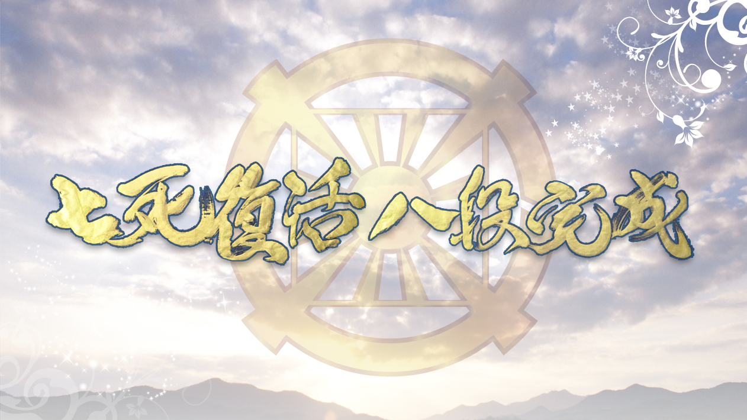
Practice of True Love : Resurrection of 7 Deaths
Stages of Res. |  | Suffering | Practice of True Love
7th | Helicopter crash (2008.7.19) | Death situation | Thank first to God. Concerning for others in helicopter. Keeping HDH tradition even during hospitalization
6th | Danbury Prison (1984.7.20-1985.8.20) | Life in danger Culmination of wilderness | Love without complaint/resentment to God. Volunteer work for others. Sincerity life for God’s will. Receiving respect from other prisoners as Saint of Danbury
5th | Seodaemoon Prison (1955.7.4-10.4) | Persecution of Christianity | Continuous sincere and exemplary life. Concerned about the future of Korea. Oneness with God even in the most miserable situation. Forgive and bless the family of Mary Park
4th | Heungnam Labor Camp (1948.2.22-1950.10.14) | Terrible death camp | Not praying for himself. Labor with prayer and offering. Giving clothes, shoes, rice powder for others. Work instead of others. Calling church members 3 times in prayer everyday
3rd | Security Forces Police (1946.8.11-11.21) | Severe torture. Near death | Pray to comfort God. Bless torturers though harshness and contemptuous treatment. Understanding God’s parental heart which cannot interfere with child’s suffering
2nd | Jeongju Police (1945.10.) | Going beyond physical family | Heartist determination for public course(similar to Jesus’ start of public course). Public life by heavenly matters rather than human matters. Following the Cross of love and heart
1st | Gyeonggi Police (1944.10-1945.2) | Severe torture | Keep silent for others. Love for torturers(God, please forgive them!). Agony for how to bless them. Help Japanese torturer return to Japan safely
Resurrection of Seven Death
and
Completion of Eight Stages

Slide 21
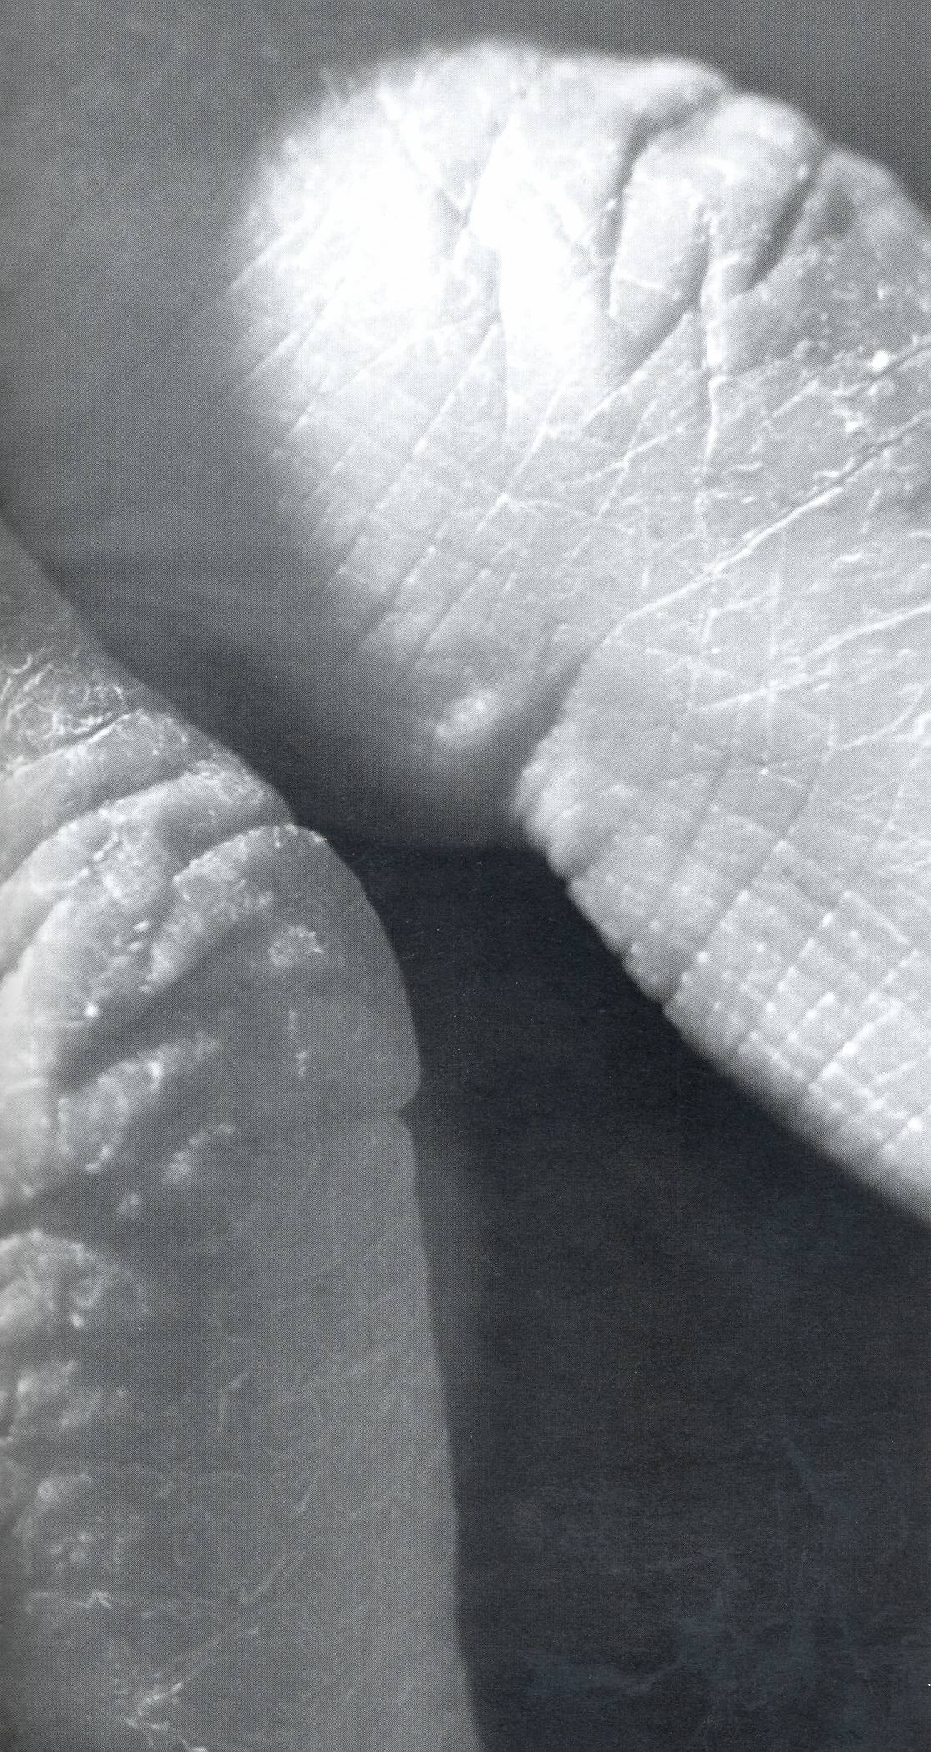
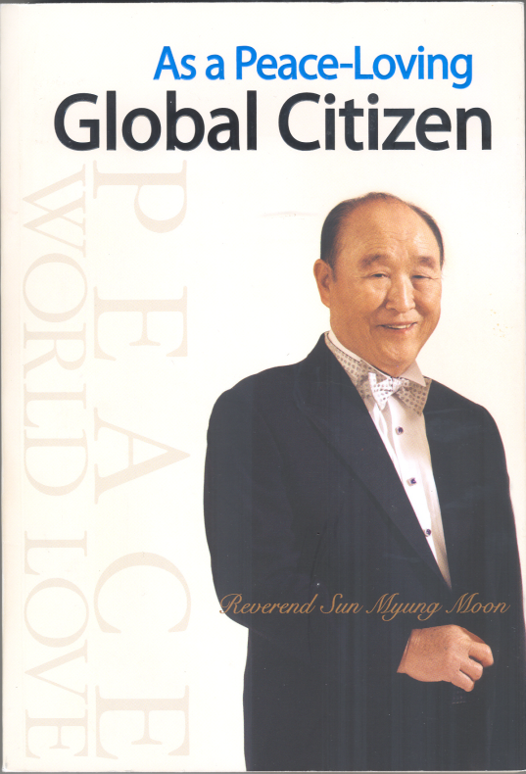
“True Love life
for God and Humankind”
: Tears, Prayer, Sincerity, Indemnity,
Sweat, Imprison, Torture,
Fishing prayer, Solitary life, 7Deaths and Resurrections…
“I was beaten so hard that the flesh was torn from my body. Today, though, not even the slightest wound remains in my heart.
Wounds easily disappear in the presence of true love. Even enemies melt away without a trace in the presence of true love.
I have lived my entire life intoxicated in such love. The path of love was so difficult that my knees buckled under me, but even then I felt happy in my heart, dedicated to loving humanity. Even now, I am filled with love that I have not yet been able to give.”
(As a Peace-Loving Global Citizen, Foreword)

Slide 22
Value of TPs (V) : From the view of “God’s Word”
True Parent’s Speech :
■ Original, essential, ultimate new truth
● New revelation about God, Creation, Providence, Human, All Things, universe
● New revelation about Human fall, Fallen natures, sins, Fallen world
● New revelation about Messiah, Restoration, Last days, Rebirth, Resurrection, Indemnity
■ Including every area
● Every area in view of 3 Great Blessings
- 1st Blessing (True Individual) - 2nd Blessing (True Family) - 3rd Blessing (True Dominion)
■ Including the whole world
● Individual, Family, Society, Tribe, Nation, World, Cosmos (Unity of sp.world & ph.world)
● Interreligious, International, Interracial, Intercultural Matters
■ Including all of human history
● The origin, direction, process, and goal of human history
● The significance of each age in providential history (parallels of history)
■ Including the Spirit World
● The Structure of spirit world, spirits, ancestors, angels, all things, cosmos

Slide 23
True Father : Champion of God’s Word
Champion in 8 Fields
■ Creation
● Know God
● Know the human being
● Know the value of true family
● Know the spirit world
■ Fall, Restoration
● Know Satan
● Know Jesus
Know the Bible and scriptures
● Know human history
3rd Blessing
3rd Blessing
2nd Blessing
Kingdom of Heaven
On Earth and
in Heaven
2nd Blessing
1st Blessing
1st Blessing
God
God
Creation
CT Age
True Parents
True Love/
Word
+
Responsibility
Fall
NT Age
Jesus
Restoration
OT Age
Abraham
A/E
Offering Age
Original Human
Fallen
A/E

Slide 24
Value of TPs (VI) : From the view of “3 GBs”
3GBs(Structure of CIG) are only through TPs
True Parents :
Life Model for 2nd Blessing
True Parents :
Life Model for 1st Blessing
True Parents :
Life Model for 3rd Blessing
God
God
God
T.Father
T.Husb
T.Mother
T.Wife
True Love
Mind
S.Self
True Love
Body
P.Self
T.Parent
T.H&W
True Love
All
Things
True
Family
True
Self
Soc., Nation
Cosmos
Global Family
Child of God
Image of God
Temple of God
Substantial Object of God
2nd God
Cosmic Family
Human: Seek/Real. of Values
(T.Owner: T,G,B)
A.Things: 2nd Self of Human
Heavenly Environment
4 Great Heart/Love
True Parent/Teacher/Owner

Slide 25
Areas |  | Activities (Organization, Institute, Conference, Rally, Training, Campaign)
1st Bless ing | 새진리 | 50주순회강연 (미), 대학순회강연, FFPWP결성/UPF창설 세계순회강연, 천일국 선포강연, 세계 순회강연, 8대교재교본
 | 사상, 승공 | 통일사상연구원, 국제승공연합, 국제여성승공연합, 세계반공연맹, 국제안보회의, CAUSA, 통일사상국제세미나
 | 종교화합 | 국제종교재단, 세계종교의회, 세계종교협의회, 한국종교협의회, 초교파기독교협의회, ACLC, RYS, 국제크리스찬교수협의회, 세계평화종교연합, 세계경전, 주간종교, 이스라엘평화행진, 초종교스포츠 페스티벌, 평양교회, 세계종교화합회의,
 | 인격교육 심신수련 | 1일/2일/3일/7일/21일/40일/120일 수련, 국제교육재단 (IEF), 국가메시아/목회자/지도자 수련, 유초등/성화학생/대학생 수련, 평화대사/ 산수원회원 수련, 세계선교본부, 천주청평수련원, 천정궁, 천복궁, 라스베가스, 해양 천정궁
2nd Bless ing | 축복결혼, 참가정 | 참가정실천운동본부, 세계평화이상가정교육본부, 천주평화통일가정당, 축복결혼, 교차교체축복결혼,
 | 순결 (절대성) | 순결다짐식, 중고교 순결서약식, 군인 순결교육, 대학생 순결교육, 세계평화순결민족연합, 한국청소년순결운동본부, 에이즈퇴치운동, 순결운동 교재 및 자료 보급, 참가정윤리세미나, 순결캔디/성주 캠페인, 청소년 순결교육,
 | 여성, 청년 대학생 | 세계대학연합, 세계대학원리연구회, 전국교사원리연구회, 국제청년학생지도자회의, 성화학생회, STF, 16만명 한일 자매결연, 한중 여성지도자 세미나, 세계평화여성연합, 세계평화청년연합, 세계평화교수회의, 청심국제청소년수련원
 | 세계정상, 지도자 | 김일성 주석, 아이젠하워/닉슨/포드/리건/부시/고르바쵸프 대통령 회담, 세계평화정상회의
 | 세계평화 | 세계평화연합, 평화UN, 평화왕국경찰/평화왕국군, 국경철폐, 세계평화초종교초국가연합(IIFWP) , 세계평화 대륙국가반도국가도서국가연합, 초종교초국가평화의회, 유엔본부 IIFWP 세계지도자 대회, 만국평화상 수상, 평화대사 임명식, 국제평화재단, 세계평화문인연합, 세계평화몰골연합, 평화의 왕관 봉헌식, 천주평화연합(UPF), 청심평화월드센터
 | 남북통일 | 남북통일운동국민연합, 국제학생지도자 평화세미나, 대북 구호물자 기증, 평화자동차 (북한), 보통강 호텔 (북한)
 | 조상, 영계 | 청평수련소, 총해원식, 영계메시지, 청평역사, 천주청평수련원, 210대 조상해원/축복식, 4200억 절대선령, 성화예식
3rd Bless ing | 육영 | 복지농도원, 향토학교, 통일신학교, 선문대학교, 브리지포트대학교 (미), 통일신학대학원 (미), 청심신학대학원대학교, 선화예술중고등학교, 선정중고등학교, 청심국제중고등학교, 경복초등학교, HOPE School(유치원)
 | 언론, 출판 | 세계언론인회의, 노스티아스 델문도 (우루과이), 미들이스트 타임즈 (중동), 티엠포스 델문도 (남미16개국), 월드 앤 아이 (미국), 워싱턴 타임스 (미), 세계일보 (한,일), UPI 통신사, 성화출판사, 광언사 (일), Paragon House (미)
 | 과학, 기술 | 국제과학통일회의, 세계과학기술연구소, 문선명연구소, WACOM, 세계평화의 왕 다리 터널, 한일해저터널, 국제고속도로
 | 기업, 산업 | 일흥, 통일그룹 (한), HAPPY WORLD GROUP (일), TRUE WORLD GROUP (미), UCI (미), 일상농원, 통일중공업, 한국티타늄, 일화, 일신석재, 국제해양산업(IOE), United Vision Group, 새소망농장 (브), 일성건설, 선원건설, 통일항공, 평애재단
 | 문화, 예술 | 한국문화재단, 리틀엔젤스예술단, 유니버설 발레단, 뉴욕 심포니 오케스트라, 새소망합창단, 한선무용단, Atlantic Video 센터, 맨하튼 센터, 한일문화교류협회, One Way Production (미), 평일기획
 | 구호, 봉사, 복지 | 국제구호친선재단, 국제의료봉사단, 자원봉사 애원, Service for Peace, 청심국제병원, 청심빌리지
 | 스포츠, 무술 | WCSF, 세계평화무도연합, 원화도, 통일무도, 일화천마 축구단, 소로까바 축구단, 피스컵 대회, 피스퀸컵 대회, 원구피스컵
 | 서비스, 레저 | 산수원, 센트럴시티, 용평 리조트, 여수 프로젝트 (Ocean Resort), 하와이 코나 커피농장, 파인리즈골프장
Victorious accomplishments
that were possible only when God works and which only Messiah can do
● General, total accomplishment for CIG
● For humankind, all areas, human history,
the whole world, the whole spirit world
● Interreligious, International, Interracial, Intercultural
 Realization of the Cosmic 3 Great Blessings

Slide 26
Value of TPs (VII) : From the view of “the Cosmic Family”
■ Ultimate restoration of spirits and the spirit world
● Understanding God, Creation, Providence, Human being, and All Things from the view
of the spirit world
● Cleansing the fallen natures of spirits and angels
● Cleansing the original, hereditary, collective, and personal sins of spirits
■ Restoration of spirits in all areas
● Professional spirits in all areas
■ Restoration of spirits in all countries
● Every level of spirits : Individual, Family, Society, Nation, World
● All spirits beyond religion, nation, race, and culture
■ Restoration of spirits in all ages
● All central figures in providential human history
● Spirits in the Offering age, the OT age, the NT age, and the CT age
■ Restoration of numberless spirits
● Now more than 440 billion absolute good spirits

Slide 27
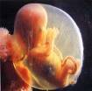
Life
in SW
Spirit
TPs’ Cosmic Providence through CheongPyeong Works
Life as a CIG citizen
(in Spirit World)
SS
2nd Birth
(Holy Harmony Ceremony)
Life as a CIG citizen
(in Physical World)
● Restoration of SW, Help of Abs. Good Sprits
: Ancestors’ liberation/blessing,
Rebirth/Resurrection of spirits
Cooperation of ancestors with
descendants
● Understanding/Preparation for Death & Life in SW
: Cosmic life on earth in 3 stages.
Preparation on earth for eternal life
● Total Health (Mind & Body, Spirit & Physical)
: Physical & Spiritual Healing
Mind & body healing (Holistic healing)
● Training of Principled life
: Principled life by separating evil spirits
● Providential Events, Educating Leaders/Members
● Establishing CIG Model Town
Earthly men
3rd Blessing Life
2nd Blessing Life
SS
PS
1st Blessing Life
Marriage Blessing
God
Good Spirits
Evil Spirits
SM
PM
True Love/
Word
+
Responsibility
Spirit
Self
Physical
Self
1st Birth
SS
PS
Embryo
Notes:
인간은 원래 태아에서 지상생활을 온전하게 준비한 다음, 지상생활의 성장과정을 통해 인격을 갖춘 후(제1축복 완성) 축복결혼을 받아 참된 부부와 부모 더 나아가 천주대가족의 구성원으로서(제2축복완성) 만물을 주관함으로써(제3축복 완성) 3대축복을 이루어 참사랑을 중심한 지상천국적 삶을 살게 되어 있다. 그러다가 영계에 입적한 후에는 천상천국 생활을 통하여 인생의 목적과 가치를 온전히 향유함으로써 영원히 행복한 삶을 살게 되어 있다.

Slide 28
● Original, Essential, Ultimate, Universal, Comprehensive Value
● Absolute, Unique, Unchanging, Eternal Value
I.
From the view of
God
True Parents :
The highest hope of God
II.
From the view of
True Parent
VII.
From the view of
Cosmic Family
True Parents :
TP of HEH, OS of Humankind
The Value
of
True Parents
Restoration of Sp.World by TP :
Ancestor liberation/blessing
Rebirth/Resurrection of spirits
III.
From the view of
CIG
VI.
From the view of
3GBs
True Parents :
Model/Frame of CIG
TP’s Accomplishment of 3GBs :
Every area for CIG
IV.
From the view of
True Love
V.
From the view of
God’s Word
TP’s Speeches :
Profound depth, Huge amount
Original, Essential, Ultimate New truth
True Love Practice of TP :
Resurrection of 7 Deaths

Slide 29
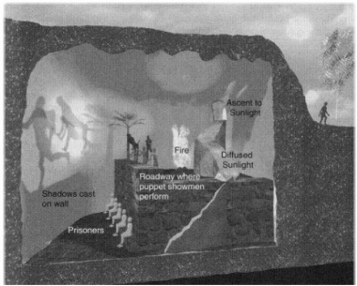
Plato, Allegory of the Cave 「 Theory of the State 」vol.7
Allegory of the cave : Process for fallen human beings to find Original Place
1st Step : Realizing Fallen world
2nd Step : Establishing my identity
3rd Step : Researching Truth (Truth: 8 texts)
4th Step : Experiencing Ideal world (CIG Vision)
5th Step : Abel (Tribal Messiah) Mission
Outside Cave
(Original World)
Sun
(God)
Inside Cave
(Fallen World)
Fire
(Satan)
Ascent to
Sunlight
(Unification
Church)
Philosopher
(Messiah)
Diffused
Sunlight
(Religious
teaching)
Roadway where puppet
Showmen perform
(Evil spirits)
Shadows cast on wall
(Fallen realities)
Prisoners
(Fallen human)

Slide 30
Determination
centered on
True Parents :
Registration as CIG citizen
Sovereignty
God
● Coronation of God’s Kingship
● Coronation of God’s liberation
● God of Night, God of Day
● Holy marriage of God
God
True Parents
True Parents
● Settlement of TP of HEH
● Original Substance of humankind
● King of Kings, King of Cosmic peace
● Holy Blessing of True Parents
● Savior/Messiah/LSA/True Parent
Substantial
CIG
Registration
● Substantialization
of Original nature
● Cleansing Fallen
natures & Sins
● Tribal Messiah
activities
● Ancestor
liberation/blessing
Always ON
CIG (Kingdom of God)
● Foundation Day (Origin/Start of Sub.CIG)
● Offering Foundation/Frame of CIG
Individual
Angel
Nation, World, Cosmos
Mineral, Universe
Family, Society
Animal, Plant
People
Land
● Blessed families
● Absolute good spirits
● Humankind, all spirits
● Fatherland/Hometown of God
● Restoration of All things
● Physical world, Spirit world

Slide 31
True Parents are the Master Key
“The Wish of humankind is meeting TP.
The fruit of history is meeting TP.
The center of this era is meeting TP.
The beginning point of the future is meeting TP.
You who are engrafted on to TP will be a branch,…
Your connection with TP is only once in eternity.
It is a very special event only one time in your life.
Your ancestors didn’t have this chance and
your descendants will not have this, either. (Cheon Seong Gyeong, pp.233-234; 71.8.13)
Do I meet TP? Do I become a branch?

Slide 32
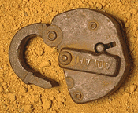
Do I meet TP? Do I become a branch?
My Conviction ?
■ God’s will will be definitely achieved : Substantial CIG will be achieved!!!
■ TPs is the Master Key : Whole answer Is in TPs !!!
■ Myself/Family, Unificationism : Abel Community after the Foundation Day !!!
 Leading Community of Ideal World : Centering on God and True Parents
Question of TP
“Who do you say I am”
(Matthew 8:29; Luke 9:20)
“Do you love me more than these?”
(John 21:15)

Slide 33
How about my Life? : Expert, Enthusiasm, Execution
1st
Coming
2nd
Coming
Creation
(Original World)
1st Age:
This Age
(Rule of Satan)
2nd Age:
Age of Church
(Beginning of KoG)
4th Age:
Orig. World
3rd Age: Age of
Millennium
(Rule of LSA)
(Rule of God)
(CIG, CIG Citizen)
(World of 3GBs)
(Completed KoG)
(Ideal World of God)
400billion
A.G.Sprits
Now
My Life: Premium Life ?
For what am I busy?
Where am I heading?
Who am I?

Slide 34
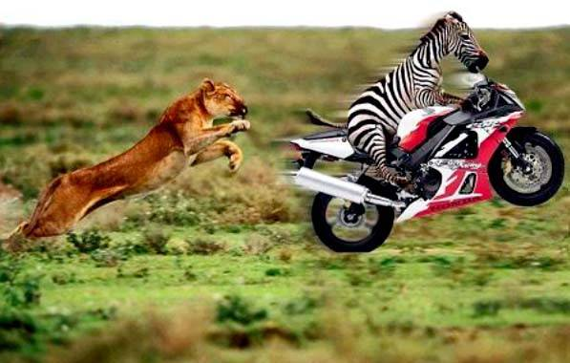
Alignment : One Mind, One Body, One Mindset
Individual
Family
Church
Nation
World
Satan, Evil Spirits
Fallen Natures & Habits
Secular Temptation
God
True Parents
CIG Ideal
True Love
Word
Daily Life centered on
God, True Parents, CIG Ideal
True Love, Word
3Great Blessings, Spirit World
Alignment with Goal

Slide 35
Thank You
for
Your Attention

