Slide 1
The Vision for the World
after Foundation Day
- Substantial CIG centered on True Parents -
Jan.28, 3rd Year of Heavenly Calendar
(Feb. 19, 2012)
D-369 day
Jin Choon Kim, Ph.D.
President,
CheongShim Graduate School of Theology
Substantial
CIG

Slide 2
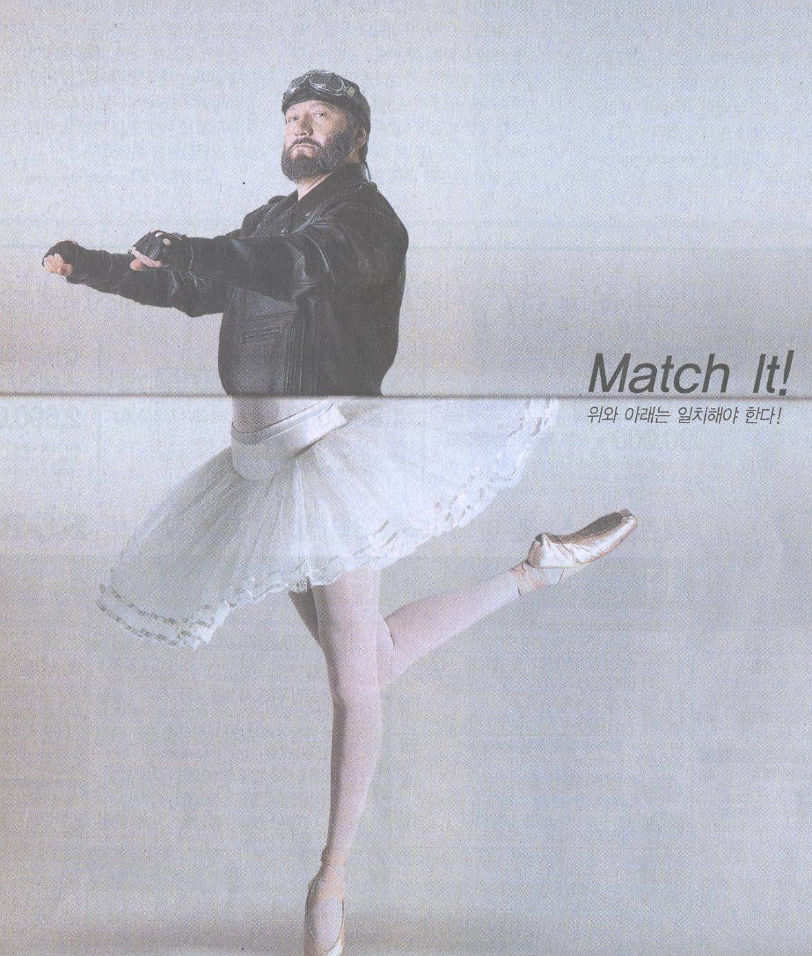
Life for Substantial CIG : Harmony, Consistency
Double-faced Character :
Mind vs. Speech
Speech vs. Behavior
Beginning vs. End
When good vs. When bad
Title vs. No Title
How about Myself,
My family, My church,
My nation?
Notes:
2

Slide 3
Perspective :
● Original, Essential, Ultimate, Universal, Comprehensive
● Absolute, Unique, Unchanging, Eternal
I.
From the view of
God
God’s Ideal of creation should be realized : Not realized yet. ( Many atheists/agnostics )
II.
From the view of
True Parent
VII.
From the view of
Cosmic Family
Our Self
Our Family
Our Society
Our World
Spirit World
True Parent should be recognized as OS to humankind : Not realized yet
The spirit and physical worlds should be unified/harmonized : Not realized yet
III.
From the view of
CIG
VI.
From the view of
3GBs
Kingdom of God should be realized :
Not realized yet
Every being should live according to 3GBs :
Not realized yet
IV.
From the view of
True Love
V.
From the view of
God’s Word
A world of True Love should be realized : Not realized yet
God’s Words should be substantialized : Not realized yet

Slide 4
TPs’ Course Completing the Last Days Prov.
3rd Blessing
Kingdom of Heaven
On Earth and In Heaven
Direct Dominion Course
2nd Blessing
Direct Dominion Course
(Coronation of
God’s Kingship, CIG)
1st Blessing
12yrs
2012
God
2001
New
H/E ?
Original course
1952
1992
2000
7years
7yrs
(7년노정
1차 탕감)
7yrs
(7년노정
2차 탕감)
Creation
Proclamation
of Messiah
Age of
C. Testament & True Parent
2nd Coming
1905
1920
1945
1985
1993
True Parents
Fall
40years
(Foundation of Faith)
40years
(Indemnity for F/F)
NT
Age
How about Now?
-Myself?
-My Family?
-Our Church?
-Our Nation?
-The World?
-The Spirit World?
Jesus
Preparation
for receiving Messiah
Preparation
for receiving Messiah
Restoration
OT
Age
A/E
Offering
Age
Fallen
A/E

Slide 5
Areas |  | Activities (Organization, Institute, Conference, Rally, Training, Campaign)
1st Bless ing | 새진리 | 50주순회강연 (미), 대학순회강연, FFPWP결성/UPF창설 세계순회강연, 천일국 선포강연, 세계 순회강연, 8대교재교본
 | 사상, 승공 | 통일사상연구원, 국제승공연합, 국제여성승공연합, 세계반공연맹, 국제안보회의, CAUSA, 통일사상국제세미나
 | 종교화합 | 국제종교재단, 세계종교의회, 세계종교협의회, 한국종교협의회, 초교파기독교협의회, ACLC, RYS, 국제크리스찬교수협의회, 세계평화종교연합, 세계경전, 주간종교, 이스라엘평화행진, 초종교스포츠 페스티벌, 평양교회, 세계종교화합회의,
 | 인격교육 심신수련 | 1일/2일/3일/7일/21일/40일/120일 수련, 국제교육재단 (IEF), 국가메시아/목회자/지도자 수련, 유초등/성화학생/대학생 수련, 평화대사/ 산수원회원 수련, 세계선교본부, 천주청평수련원, 천정궁, 천복궁, 라스베가스, 해양 천정궁
2nd Bless ing | 축복결혼, 참가정 | 참가정실천운동본부, 세계평화이상가정교육본부, 천주평화통일가정당, 축복결혼, 교차교체축복결혼,
 | 순결 (절대성) | 순결다짐식, 중고교 순결서약식, 군인 순결교육, 대학생 순결교육, 세계평화순결민족연합, 한국청소년순결운동본부, 에이즈퇴치운동, 순결운동 교재 및 자료 보급, 참가정윤리세미나, 순결캔디/성주 캠페인, 청소년 순결교육,
 | 여성, 청년 대학생 | 세계대학연합, 세계대학원리연구회, 전국교사원리연구회, 국제청년학생지도자회의, 성화학생회, STF, 16만명 한일 자매결연, 한중 여성지도자 세미나, 세계평화여성연합, 세계평화청년연합, 세계평화교수회의, 청심국제청소년수련원
 | 세계정상, 지도자 | 김일성 주석, 아이젠하워/닉슨/포드/리건/부시/고르바쵸프 대통령 회담, 세계평화정상회의
 | 세계평화 | 세계평화연합, 평화UN, 평화왕국경찰/평화왕국군, 국경철폐, 세계평화초종교초국가연합(IIFWP) , 세계평화 대륙국가반도국가도서국가연합, 초종교초국가평화의회, 유엔본부 IIFWP 세계지도자 대회, 만국평화상 수상, 평화대사 임명식, 국제평화재단, 세계평화문인연합, 세계평화몰골연합, 평화의 왕관 봉헌식, 천주평화연합(UPF), 청심평화월드센터
 | 남북통일 | 남북통일운동국민연합, 국제학생지도자 평화세미나, 대북 구호물자 기증, 평화자동차 (북한), 보통강 호텔 (북한)
 | 조상, 영계 | 청평수련소, 총해원식, 영계메시지, 청평역사, 천주청평수련원, 210대 조상해원/축복식, 4200억 절대선령, 성화예식
3rd Bless ing | 육영 | 복지농도원, 향토학교, 통일신학교, 선문대학교, 브리지포트대학교 (미), 통일신학대학원 (미), 청심신학대학원대학교, 선화예술중고등학교, 선정중고등학교, 청심국제중고등학교, 경복초등학교, HOPE School(유치원)
 | 언론, 출판 | 세계언론인회의, 노스티아스 델문도 (우루과이), 미들이스트 타임즈 (중동), 티엠포스 델문도 (남미16개국), 월드 앤 아이 (미국), 워싱턴 타임스 (미), 세계일보 (한,일), UPI 통신사, 성화출판사, 광언사 (일), Paragon House (미)
 | 과학, 기술 | 국제과학통일회의, 세계과학기술연구소, 문선명연구소, WACOM, 세계평화의 왕 다리 터널, 한일해저터널, 국제고속도로
 | 기업, 산업 | 일흥, 통일그룹 (한), HAPPY WORLD GROUP (일), TRUE WORLD GROUP (미), UCI (미), 일상농원, 통일중공업, 한국티타늄, 일화, 일신석재, 국제해양산업(IOE), United Vision Group, 새소망농장 (브), 일성건설, 선원건설, 통일항공, 평애재단
 | 문화, 예술 | 한국문화재단, 리틀엔젤스예술단, 유니버설 발레단, 뉴욕 심포니 오케스트라, 새소망합창단, 한선무용단, Atlantic Video 센터, 맨하튼 센터, 한일문화교류협회, One Way Production (미), 평일기획
 | 구호, 봉사, 복지 | 국제구호친선재단, 국제의료봉사단, 자원봉사 애원, Service for Peace, 청심국제병원, 청심빌리지
 | 스포츠, 무술 | WCSF, 세계평화무도연합, 원화도, 통일무도, 일화천마 축구단, 소로까바 축구단, 피스컵 대회, 피스퀸컵 대회, 원구피스컵
 | 서비스, 레저 | 산수원, 센트럴시티, 용평 리조트, 여수 프로젝트 (Ocean Resort), 하와이 코나 커피농장, 파인리즈골프장
Victorious accomplishments
that were possible only when God worked and which only the Messiah could do
● Accomplishment of the missions of 1st and 2nd Adams
● Final conclusion of the providence of human history
● General, total accomplishment for CIG
● For humankind, all areas, all of human history,
the whole world, the entire spirit world
● Interreligious, International, Interracial, Intercultural
 Incredible Foundation for Substantial CIG

Slide 6
○ God’s will of
the Ideal world
of creation
● 1st Adam : Not realized
● 2nd Adam : Not realized
● 3rd Adam (TPs) :
Should realize
○ Victory of TPs
● Complete establishment
of Model/Frame
for Substantial CIG
● Preparation of
the Foundation
for Substantial CIG
• Name : CIG (Cosmic nation of Peace & Unification)
• Sovereignty : Inauguration of God’s sovereignty, King of Kings, King of Cosmic Peace
TP of HEH, OS of humankind
• People : Blessed Family, Absolute good spirits
• Land : Heaven & Earth (land/sea/Earth/Cosmos)
• Palace : Cheon Jeong Goong (Peace Palace)
• Law : CIG Constitution, 8 text books
• Government : UPF (Peace UN, TP UN)
• National Flag, Anthem : Unification Flag, Holysong#3
• Army, Police : Army/Police of Peace Kingdom
• ID card : CIG Citizen Card
• Ambassador, Embassy : Peace Ambassador/ Embassy
• Civilization : Cosmic Peace Divine Civilization
• All things : Light, Soil, Plant , Animal

Slide 7
I.
From the view of
God
God’s Ideal of creation should be realized : Not realized yet. ( Many atheists/agnostics )
II.
From the view of
True Parent
?
VII.
From the view of
Cosmic Family
?
Our Self
Our Family
Our Society
Our World
Spirit World
?
True Parent should be recognized as OS to humankind : Not realized yet
The spirit and physical worlds should be unified/harmonized : Not realized yet
?
?
III.
From the view of
CIG
VI.
From the view of
3GBs
?
?
Kingdom of God should be realized :
Not realized yet
Every being should live according to 3GBs :
Not realized yet
IV.
From the view of
True Love
V.
From the view of
God’s Word
A world of True Love should be realized : Not realized yet
God’s Words should be substantialized : Not realized yet

Slide 8
TPs’ Mission : Establishing the Kingdom of God
According to the Exposition of Divine Principle,
● the LSA will come on earth
- to complete the providence of restoration
- to surely complete the providence fulfilling God’s purpose of creation
- to engraft humankind physically and spiritually as God’s children
- to realize God’s will absolutely
- to restore the world realizing the 3GBs physically and spiritually
- to definitely establish the kingdom of heaven on earth
● the LSA will never die until he fulfills the purpose of the providence
In the Peace Message
Father proclaimed publicly many times the conviction to fulfill God’s ideal, the Kingdom of the Peaceful, Ideal World and God’s Fatherland.
In the Speech Volume
the LSA need fulfill the mission of the 1st and 2nd Adams in his generation
● Originally the 1st Adam should have realized the Kingdom of God in his age,
and 2nd Adam should have done so as well.
● Father as 3rd Adam sought to complete the mission by 2012

Slide 9
The 2nd 12 year Course
■ By 2024 (104 years old) it should be completed (speech after 2009)
“ 2013년 1월 13일, … 문 총재가 90세를 넘어 가지고 만왕의 왕을 만들고 하나님을 왕으로 만들었으니 104세까지 살 수 있는 터를 다 정리했어요. 구약시대에도 120세까지 살 수 있었잖아요.”(09.2.26; 통일세계 2009년 4월호)
“ 100세를 넘어서 살아서 지상에서 뜻을 이루어야 한다. 104세까지 선생님이 관리를 하여 나가는 새로운 천지가 벌어지는 것을 알아야 한다.”(09.3.27, 라스베가스 천화궁)
“ 섭리의 마지막 디데이(D-day)가 되는 2013년 1월 13일까지 이제 4년이 남았어요. … 12년 후 104세까지 끝을 내야 돼요. 그렇지 않으면 큰일이 일어납니다.”(09.5.6; 통일세계 2009년 6월호)
“ 선생님이 90세를 중심삼고 104세까지 넘어가야 돼요. 92세에 이 일이 끝납니다. 그러니까 104세까지 넘어가야 돼요. 104수, 100수를 넘어 가지고 억만수까지 연결지을 수 있는 길이 생겼어요.”(09.8.16; 통일세계 2009년 10월호)
“ 문총재, 104살 될 때까지 이것 정리 못하면 ‘실패자’라는 (것을) 내가 알고 있습니다. 104살 이상까지 끝마치려고 그래. 그래 104살이 되려면 얼마야 해요.”(11.6.4)
“120세 이전까지는 내가 영계에 가겠다고 결심하기 전에는 안 간다. (11.7.17, 나이지리아 대회 5시간말씀 중)
“우리 모두는 참부모님 재세 시에 하늘이 임재할 수 있는 가정, 종족, 민족, 국가, 세계까지 지옥권을 해방시켜야 한다 (11.9.12)

Slide 10
TPs want to realize by 2024 : Foundation Day
Direct Dominion Course
12yrs
2013
2024
New
H/E
3rd Blessing
Kingdom of Heaven
On Earth and In Heaven
2nd Blessing
Direct Dominion Course
(Coronation of
God’s Kingship, CIG)
1st Blessing
12yrs
2012
God
2001
New
H/E
Original course
1952
1992
2000
7years
7yrs
(7년노정
1차 탕감)
7yrs
(7년노정
2차 탕감)
Creation
Proclamation
of Messiah
Age of
C. Testament & True Parent
2nd Coming
1905
1920
1945
1985
1993
True Parents
Fall
40years
(Foundation of Faith)
40years
(Indemnity for F/F)
NT
Age
Jesus
Preparation
for receiving Messiah
Preparation
for receiving Messiah
Restoration
OT
Age
Foundation Day (2013.1.13)
● Origin/Start of S.CIG
● Start of 2nd 12yrs
A/E
Offering
Age
Fallen
A/E

Slide 11
The Vision for the World after Foundation Day
I.
From the view of
God
The Vision for the World should be centered on God
II.
From the view of
True Parent
VII.
From the view of
Cosmic Family
The Vision for the World should be centered on
True Parent (TP/HEH, OS)
The Vision
for the World
after
Foundation Day
The Vision for the World should form a Cosmic Family
III.
From the view of
CIG
VI.
From the view of
3GBs
The Vision for the World should realize
the ideal of CIG
The Vision for the World should be centered on 3GBs
IV.
From the view of
True Love
V.
From the view of
God’s Word
The Vision for the World should be centered on True Love
The Vision for the World should be centered on God’s Word

Slide 12
3rd Age
4th Age
Original
World
Jesus
LSA
Before
1st Coming
Before
^{2nd} Coming
Millennium
Completed CIG
(Substantial CIG)
1st Age
2nd Age
Now
Restoration of Fallen World
Kingdom of TPs
(Vertical & Horizontal TP)
God
God of Night/Day
Vertical TP
God
✗
Adam
Eve
✗
Restoration
❒
Jesus
HS
❒
True Parents
(TPs/HEH, OS)
Embodiment of God
Orig. Holy Temple
TPs of H, E & H
Orig. Subs. of Humankind
True Parents
(TPs/HEH, OS)
Non-Blessed
Blessed
Family
True
Family
Human
Being
Human
Being
Human
Being
Fallen World
(Sins, Fallen Natures/Habits/Systems/Cultures
Fighting/Struggle/Conflict/Misuse/False
Individual/Family/Social Disease)
Original World
(Original Natures/Habits/Systems/Cultures,
True Freedom/Peace/Unification/Happiness,
(Individual/Family/Social Health)

Slide 13
What to do? : We should inherit TP’s Life
3GBs(Structure of CIG) are only through TPs
Inheriting True Parents’
2nd Blessing Life
Inheriting True Parents’
1st Blessing Life
Inheriting True Parents’
3rd Blessing Life
God
God
God
T.Father
T.Husb
T.Mother
T.Wife
True Love
Mind
S.Self
True Love
Body
P.Self
T.Parent
T.H&W
True Love
All
Things
True
Family
True
Self
Soc., Nation
Cosmos
Global Family
Child of God
Image of God
Temple of God
Substantial Object of God
2nd God
Cosmic Family
Human: Seek/Real. of Values
(T.Owner: T,G,B)
A.Things: 2nd Self of Human
Heavenly Environment
4 Great Heart/Love
True Parent/Teacher/Owner

Slide 14
1st
Coming
2nd
Coming
3rd Age
(Rule of LSA)
4th Age
(Substantial CIG)
Creation
(Original World)
1st Age
2nd Age
440billion
Ab.Good Sprits
12yrs
2013
2024
New
H/E
3rd Blessing
Kingdom of Heaven
On Earth and In Heaven
2nd Blessing
Direct Dominion Course
(Coronation of
God’s Kingship, CIG)
1st Blessing
12yrs
2012
God
2001
New
H/E
Original course
1952
1992
2000
7years
7yrs
(7년노정
1차 탕감)
7yrs
(7년노정
2차 탕감)
Creation
Proclamation
of Messiah
Age of
C. Testament & True Parent
2nd Coming
1905
1920
1945
1985
1993
True Parents
Fall
40years
(Foundation of Faith)
40years
(Indemnity for F/F)
NT
Age
Jesus
Preparation for receiving Messiah
Preparation for receiving Messiah
Restoration
OT
Age
1st 12yrs : For Offering CIG
2nd 12yrs : For Substantial CIG
2012 : Conclusion of 1st 12yrs
Preparation for 2nd 12yrs
 Life or Death Dedication
A/E
Offering
Age
Fallen
A/E

Slide 15
Substantial CIG (I) : Centered on God/TPs/CIG Ideal
● Existence
● Nature
● Creation
● Providence
God
CIG
True Parents
● Value
● Character
● Life
● Speech
God
True Parents
S. World
P. World
Society, Nation
Mineral, Universe
Family
World, Cosmos
Angel
Animal, Plant
● Value
● Feature
● Establishment
True Parents Studies
: God, True Parents, CIG
C I G

Slide 16
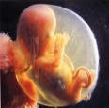
Substantial CIG (II) : Centered on Cosmos
3 Stage Life
S.World, Spirits, All things
3rd Stage
Never Die
S.Self
CIG Life in S.World
S.Self
Death = Separation
Holy Harmony
2nd Birth
Holy Harmony
Ceremony
100%
Record
CIG Life on Earth
S.Self
P.Self
3rd Blessing
2nd Blessing
P.Self
1st Blessing
God
Surely Die
2nd Stage
P.Self
P.World, Earthly men, All things
CIG Spirituality Studies
: Death, Life after Death, Cosmic Life
S.Self
P.Self
1st Birth
1st Stage

Slide 17
Substantial CIG (III) : Centered on Management
Mission
言 + 成
目標
Dream
True Parents
Vision
Execution
誠
God
1
Setting Goals
Alignment
CIG
Diagnosis
Feedback
SWOT, PDSF
4
Goal
Strategy
Core Competencies
Expert, 3C
Strategic Choices
Enthusiastic Execution
Setting Priorities
2
3
Church Management Studies

Slide 18
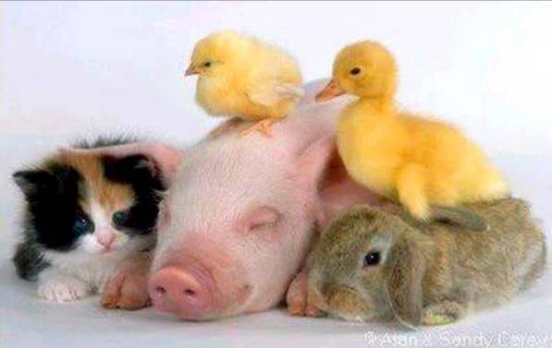
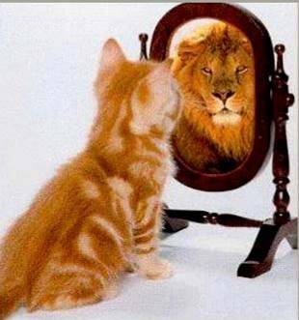
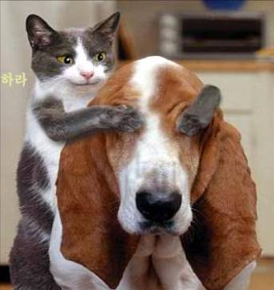
Good Relationship with others
Keep smiling
Mind
Sub. CIG
Be
proud
of
myself
Have a
childlike
mind

Slide 19
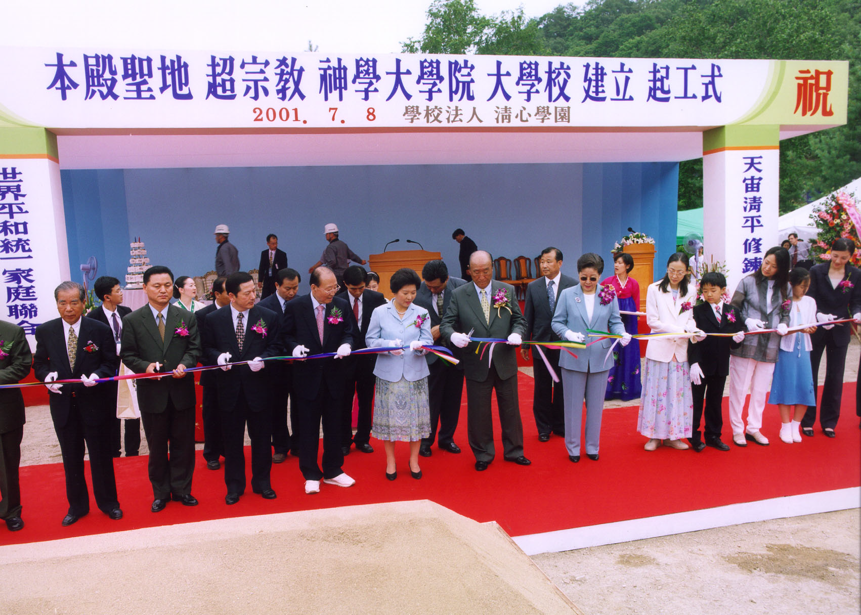
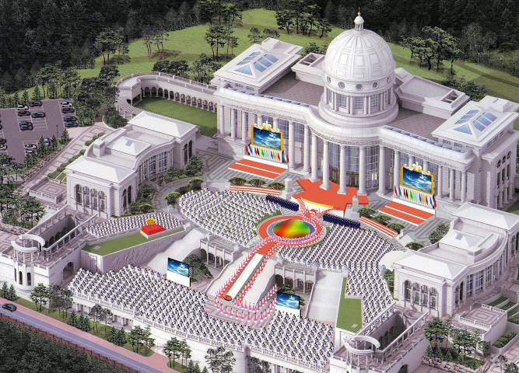
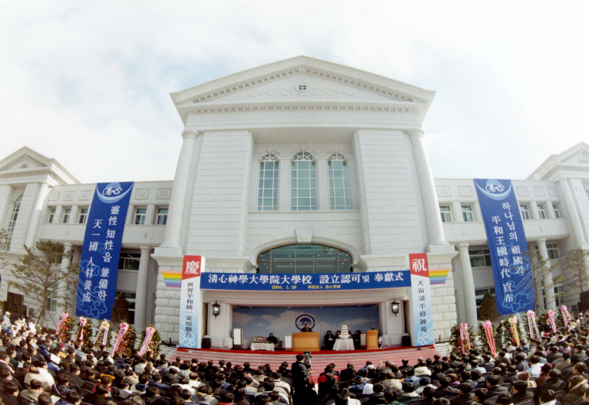
CGST : For Substantial CIG

Slide 20
Philosophy of Education/Research
God, TP, CIG
(Center)
CJG Hoon Dok Hoe
CGST Hoon Dok Hoe
Chapel, Elder’s Lectures
CIG Life
(Practice)
言
True
Love
成
CIG Words
(Research)
Subject, Thesis
Colloquium
Research Project
Presentation/Discussion
Academic Cultural Fest
DMN Guidance
H&E Training Center
Witnessing Activities
Pilgrimage
Shimjung Workshop
誠
CIG Leader
(H, E, I, W, Health)
DP Lecture/Sermon Pract.
Presentation Skills
Korean Language/Culture
Dormitory Life

Slide 21
Areas of Study and Research
▣ True Parents Studies
 Oneness w/ TP in Heart
(Inheritance of TP’s Heart)
 Theology of God/TP/CIG
(In Views of 8 textbooks)
 Value, Character/Life, Words,
Providential works
* Attending CJG HDH
▣ CIG Spirituality Studies
 Spiritual World, Cosmic life
 Prov. of Cheongpyeong Works
 Spirituality Develop. Program
 Spirituality of Other Religions
* Connecting with CPHE Training Center
▣ Church Management St.
 UP Persp. Church Management
 CIG Leadership
CIG Organizations
* Case study on prov. organizations
CGST
Cheon Il Gook
True Parents
Sp.
World
Ph.
World
CIG Spirituality St.
God
Church Management St.
True Love, Word
True Parent Studies

Slide 22
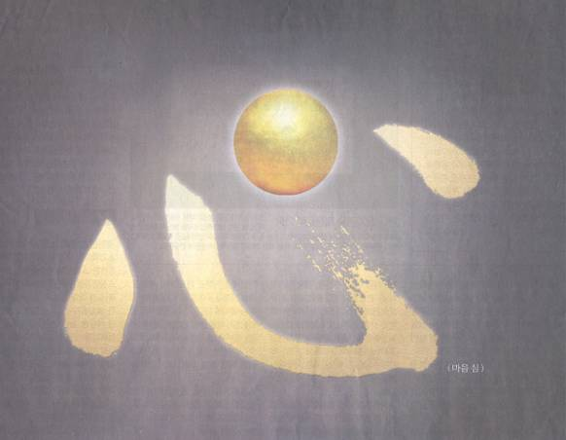
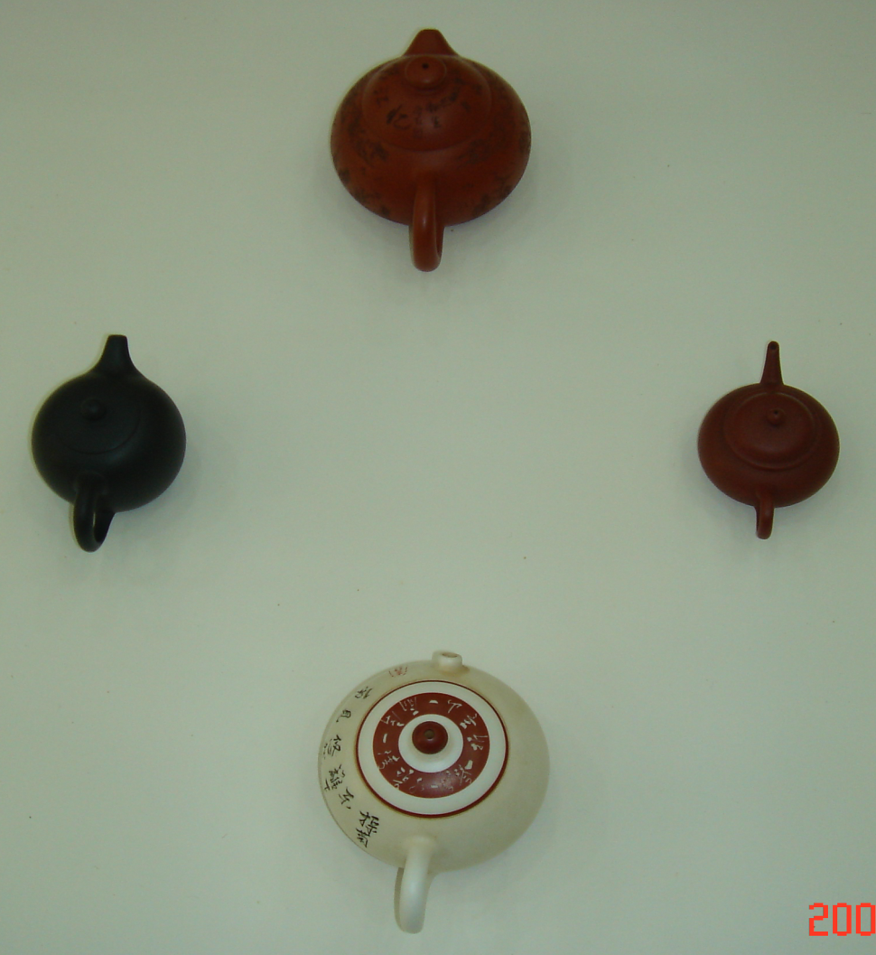
Life
Vert. / Hor.
Alignment
Mind
Mind
(S.Self)
Horizontal
Alignment
Heart
(T. Love)
Vert./Hor.
Alignment
Heart(T. Love)
H
Cheon Il Gook
Emo.
(Bty)
Int.
(Tru)
E
I
True Parent
S.W
God
P.W
W
Emotion(Beauty)
Intellect(Truth)
True Love, Word
1st
GB
3rd
GB
Will
(Goodness)
2nd
GB
Vertical
Alignment
Will(Goodness)

Slide 23
Special Program for Substantial CIG
○ Background
 Strengthen core competencies of Substantial CIG
(Need for specialization and academic degree)
 Alignment centering on True Parents (Faith, Character, Leadership)
 Inheritance of True Parents Language and Korean Culture (Fatherland of God)
○ Goal
 Inheriting the views of TP and World President (Providence, Ministry, Leadership)
 Strengthening specialties for Substantial CIG
(Integrated ability by True Parents, CIG Spirituality, and Church Management studies)
Cultivating ability-solving problems of the field
(Special lectures, Church management strategy, Case studies)
Qualifying Korean language (above 2-3 grades)
Earning a degree in short time (MA, Ph.D, D.Min)

Slide 24
Program for Substantial CIG
Educational Curriculum
 Regular course : 2 years (MA, D. Min) * 3 years (Ph.D)
 Special programs : Summer Vacation (Master thesis substitution course)
* If you want to write a thesis, you can work on it.
 Korean course : 1 year (First/Second semester each 20 weeks)
* 100% church members, Theology classes held at same time
○ Specialization course : 4 Tracks
 Track 1 : Church leader course (future, present)
 Track 2 : Providential organization leader course
 Track 3 : Researcher course
 Track 4 : Lifelong education course

Slide 25
Program for Substantial CIG
○ Track 1: Future church leader
* Moon Hyung Jin World president’s special request (2010.1.19) :
Faith vs Theology, Testifying TPs, Practical faith,
True love theology, True Parents age, s trong discipline
 HDH : Reading Whole Cheonseonggyeong (Reading/Discussing/Practicing of the word)
 Divine Principle (with own language) : Qualifying system (Red, Blue)
 Witnessing : Pass/Non Pass (Bring 6 people to DP workshop, witnessing 1 person)
 CIG Life habit : above 7th grade (Every month ractice/diagnosis/analysis/consultation)
 Wonhwado : 1st level black belt (Mind and body practice, self-confidence)
 Dorm life : Strengthening personal abilities (increasing effectiveness)

Slide 26
Program for Substantial CIG
○ Intensive program (during summer vacation of 2nd year, 4 weeks)
● Purpose : Master thesis substitution, Field study, Internship for field
● Contents
- Leader’s lecture (Continental president, National leader, Senior),
- Headquarter staff lecture (church leader, director),
- Providential field case study (student presentation, source book),
- Holy Ground Pilgrimage
- Visiting Providential organization, Experiencing Korean culture
Cost for Two years (Track 1) * For package
★ Co-investment of CSGST / Continent
 CSGST invest : €7,000 (￦10,800,000) (scholarship: 75% for degree, 50% for Korean study)  Headquarter/Personnel Invest : €6,400 (￦ 9,800,000) * D.Min : €8,800 (￦ 13,500,000)
A. Headquarter(continental, nation) invest :
Headquarter/Association support full scholarship, Candidate recruitment/Managing
(Strong rule on entrance and graduation)
B. Headquarter(continental, nation) + personnel invest :
headquarter support some part of tuition (responsibility achieving educational goal)
C. personal invest :
personal invest full tuition (Headquarter will evaluate compensation)

Slide 27
Annual schedule (MA, D.Min)
Year |  | Semester | Theology | Korean | Note
 |  |  | Graduation |  | Middle of Feb.
2 year | Winter vacation |  | Graduation 40-day workshop (training center) |  | Jan-Feb
 | 4th semester |  | Theological study (3 subjects)
 | Summer vacation |  | Special Program (4 weeks)
 | 3rd semester |  | Theological study 3 subjects)
1 year | Winter Vacation |  | Pre-requisite course (1 subject) | Intermediate, Culture festival | TLI completion ceremony
 | 2nd semester |  | Theological study (2 subjects) | Intermediate, culture trip
 | Summer Vacation |  | Pre-requisite course (1 subject) | Beginning, Culture festival
 | 1st semester |  | Theological study (2 subjects) | Beginning, culture trip
Entrance Procedure |  |  | Visa (Dec), Entering Korea, Entrance ceremony (Mar. 1st week)

Slide 28
Student status (2004-2011)
Continent | MA | D.Min/Ph. D | Sum | Nationality
Korea | 73 | 17 | 90
Japan | 47 | 8 | 55
Asia | 16 | 1 | 17 | Thailand, Nepal, Chinese Taipei, Philippine, Malaysia
Europe | 5 | 2 | 7 | France, Norway, Cheq, Belorussia, Lithuania
North America | 3 | 5 | 8 | America, Canada
South America | 2 | 0 | 2 | Brazil, Peru
Africa | 5 | 0 | 5 | South Africa, Congo
Total | 151 | 33 | 184
Yve Moreau(Fr), Aistis/Kristina (Lithu)
Sharapov (Belo), 이카(Cheq), Fumi (Norway)
○ Student career course status (2004-2011)
Track | Career course | Graduate | Enrolled | Sum | Note
Track1 | Public worker, Missionary, Museum | 59 | 20 | 79 | CIG Leadership course
Track2 | CheongShim organization, Cheonbokgoong, Unification foundation | 20 | 12 | 32 | Organization company leader’s course
Track3 | Doctoral course, Research | 12 | 10 | 22 | Researcher course
Track4 | Life-long education course | 0 | 3 | 3 | Life-long education course
Other | Teachers, Housewives etc. | 40 | 8 | 48
Total |  | 131 | 53 | 184

Slide 29
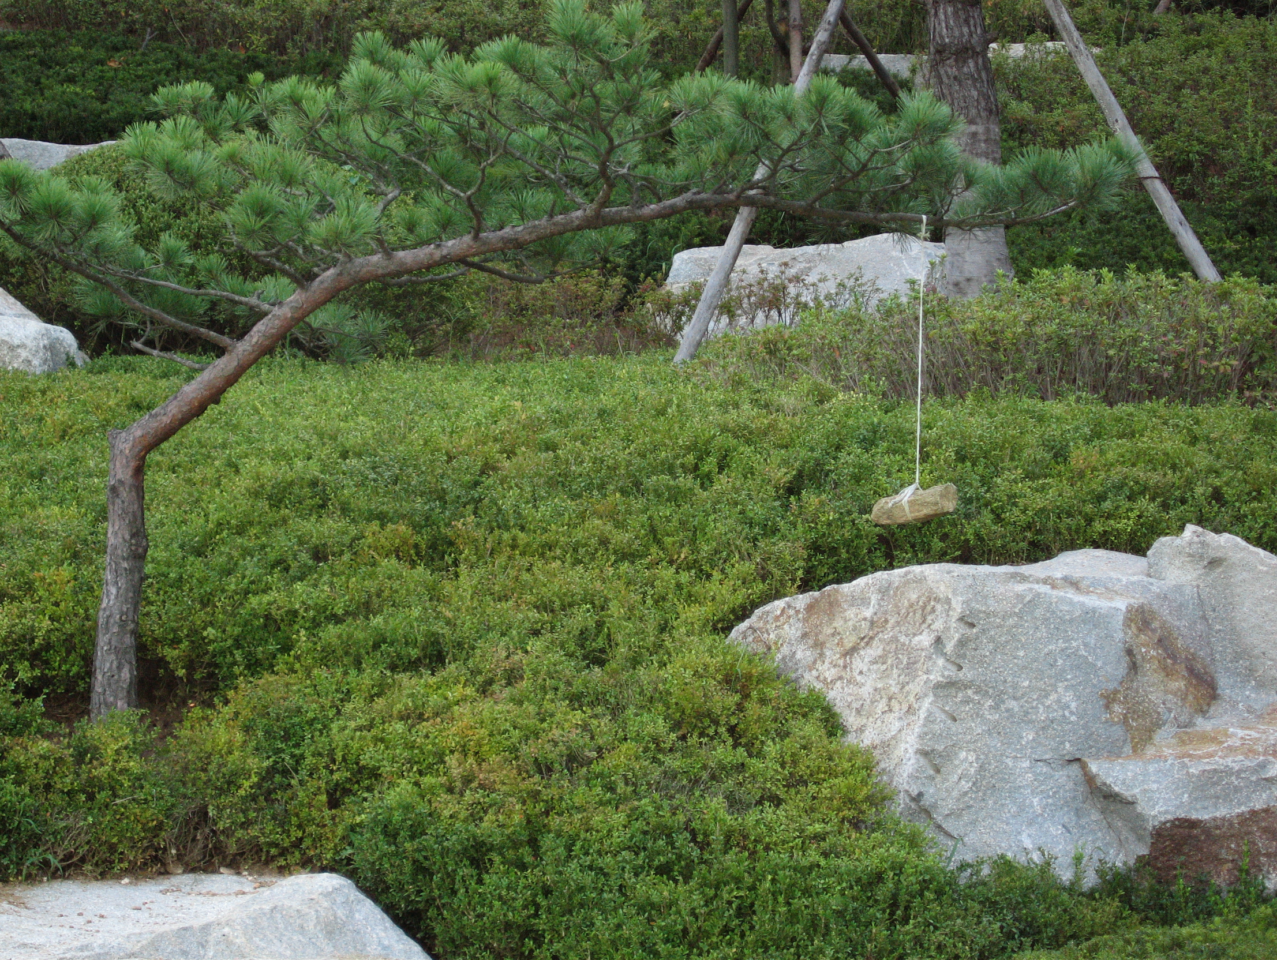
자신을 다듬고/가꾸는 학교생활
Character/Habit/Life
of Student
Sincerity
Practice/Training
Nurturing
Faculty
Staff
God, True Parents, CIG,
True Love, Words, 3GBs, Cosmic Family
After Foundation Day
Cultivating Myself,
Raising Leaders
for Substantial CIG

Slide 30
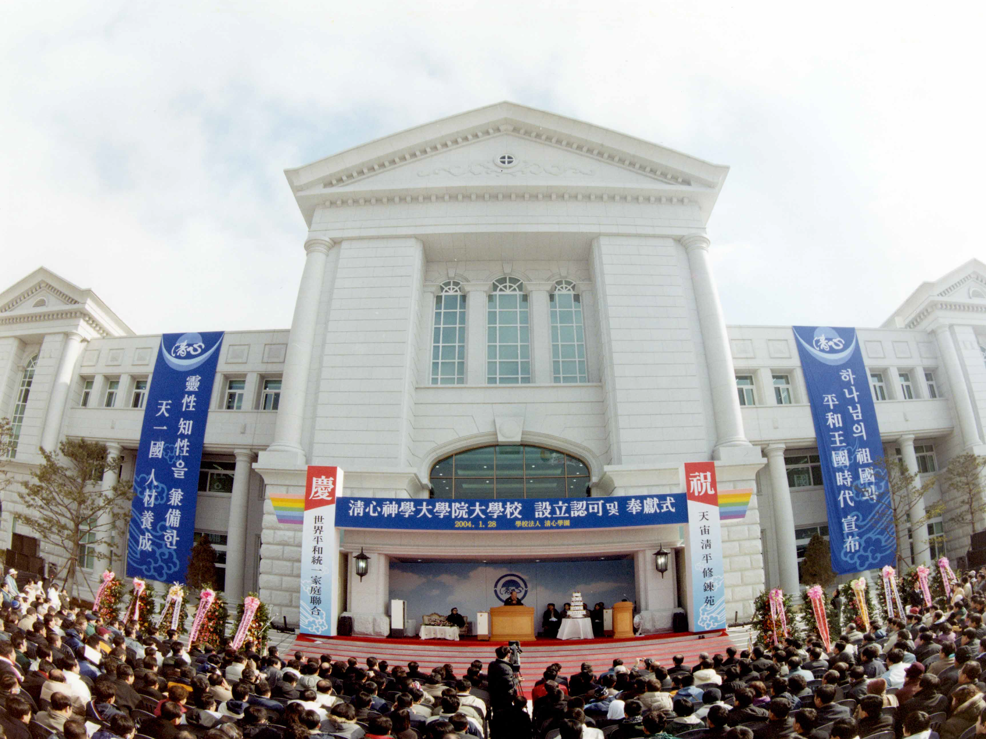
Thank You
for Your Attention.
European Members ! We Warmly Welcome You to our Cheongshim Graduate School of Theology

