Slide 1
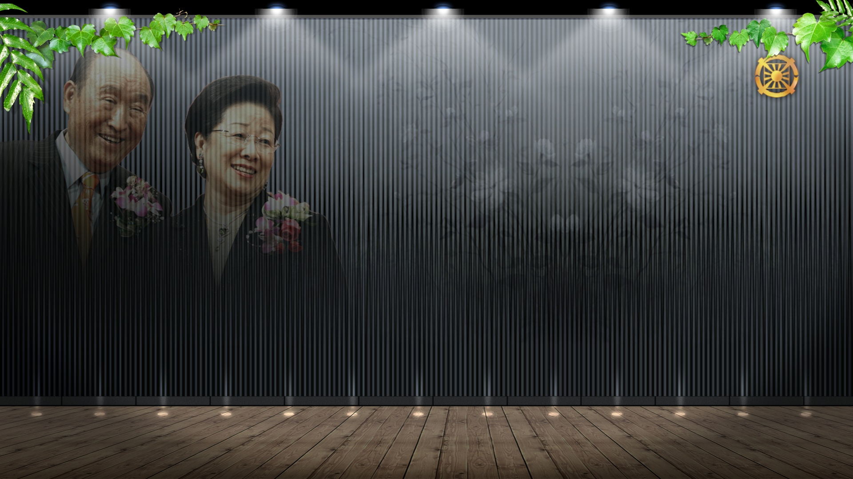
Lecture 1
Era of God of Night and Day
Cheon Gi Year 3 HC 7/6 (Solar Aug.3)

Slide 2
I. Purpose of Creation and True Parents
A. Purpose of Creation and Adam and Eve (2011.4.3)
Completion of Adam and Eve’s portion of responsibility (3 Great Blessings and the commandment)
Through completion of the four realms of the heart and attending the Divine Entity, God
Through becoming substantial being of Absolute Sex resembling the divine entity of Absolute Sex
Achieve God’s substantial holy temple and oneness of God and human being

Slide 3
B. God’s purpose of creation (2011.4.3)
1.God embodies Adam and Eve
Vertical owner of sexual organ: God
Horizontal owner of sexual organ: Spouse
2. God marries and manifests as substantial God
3. First love of Adam and Eve is God’s first love

Slide 4
C. Fall of Adam and Eve (2011.4.3)
Because God could not marry
God’s True Sperm’s long journey could not settle
Manifest as substantial being and settle through True Parents (2010)
God’s purpose of creation was the settlement of God’s True Sperm
God’s purpose of creation is the completion of TP

Slide 5
II. Second Advent: Sending or Calling?
A. If became Messiah through calling (chosen)?
Born with original sin
Born with traces of the Fall
Born as one of the many candidates for Messiah
Childhood becomes life of human being after the Fall
There needs to be ceremony to cleanse the original sin (before 33 years old)
Birth of 2nd, 3rd Messiah is possible.

Slide 6
B. If became Messiah through sending?
Born without original sin
Born without traces of the Fall (2009.6.4)
Messiah from birth
Messiah is born as one person from the beginning
Childhood is life of human being before the Fall
2nd, 3rd Messiah cannot be born.

Slide 7
C. How does True Father see it?
I was born without any trace of the Fall. (2009.7.7)
I was born unrelated to the fallen blood lineage.(2009.7.7)
I was born without original sin.(2010.7.7)
I was born as the direct son of God. (2010.4.13)
I received God’s Heavenly seal from birth. (2011.3.5)

Slide 8
D. Is it sending or calling?
Messiah is through sending, not calling.
TF was sent as the Second Advent from the beginning.
TF was sent as one person from the beginning.
This is not domain of faith but domain of truth.
Proclaimed because the time is right.
Let us newly understand TF from now!

Slide 9
III. Principle and Standard of TM’s Completion
A. Principle of TM’s completion
Absolute subject partner creates an absolute object partner.
God creates Adam.
Adam creates Eve.
AF, AL, AO (1997.1.2) Absolute Faith, Love and Obedience

Slide 10
B. Standard of TM’s completion
Restoration through indemnity of 1st, 2nd, 3rd mistakes of Eve (1997.1.2)
Should achieve oneness with TF (2003.2.6)
And become God’s substantial being .(2006.6.13)
Proclamation of Ultimate Unity of TP(2010.6.26)

Slide 11
C. Process of TM’s completion
Life Course | Process of completion | Change in position | Date | Comment
King of Kings | God | God’s wife | 2013.1.13 | Trinity
 | God | Substantial God | 2006.6.13 | No gyeongbae to God
True Parents | Queen | Oneness | 2003.2.6 | No gyeongbae to TF
 | Grandmother | Equal authority | 2000.6.1 | 40 cities tour
 | Mother | Equal position | 1999.6.14 | 80 cities tour
 | Wife | Side | 1991.7.1 | Start of speaking tour
Messiah | Younger sister | Behind | 1977.2.23 | Complete freedom
 | Daughter | Behind | 1960.4.11 | No financial ability

Slide 12
D. Result of TM’s completion
Victorious TM stands in the “completed position” (2008.5.14)
Completion of Trinity: Holy Father, Holy Son, Holy Daughter (1996.8.1; 2013.1.13)
Coronation Ceremony for the Realm of Liberation of God, King of All Kings (2009.1.15&1.31)
TF: Messiah → TP → King of All Kings

Slide 13
III. Result of Cosmic Assembly for the Proclamation of the Substantial Word and the Settlement of True Parents of Heaven, Earth, and Humankind
God’s lightning of joy and thunder of ecstasy!
(New Year Benediction)
If someone had come forward, I am certain that God would have appeared in his dreams, carried the sun and moon to him, and showered him with lightning of joy and thunder of ecstasy from the heavens.”
(Pyeong Hwa Shin Gyeong p.21)

Slide 14
B. Core Meaning of Cosmic Assembly
Chase away Satan from the cosmos (2011.4.24)
2. “Now, the world is revolving centering on True Parents.”

Slide 15
C. Clearing the past and the start of new history (Cheon Gi Year 2 New year benediction)
Clear up all history since the Fall
New History of Creation has started.
Era when God of Night and Day directly manages the providence

Slide 16
D. Origin-Division-Union Action and Four position Foundation
a. ODU Action
God
Origin
A
E
Division
United Being
Union

Slide 17
b. Four Position Foundation
God
Origin
A
E
Division
Union
Union

Slide 18
E. Core of Cosmic Assembly is the completion of ODU Action
1 | Origin | Division | Union
2 | God of Mind | God of Body | God of Mind and Body
3 | God of Night | God of Day | God of N and D
4 | Parents of Heaven | Parents of Earth | TP of HEH
5 | Divine Self of Divinity | Substantial Self of Divinity | Divine Entity
6 | Divine Word | Substantial Word | God’s Words

Slide 19
F. Purpose of Creation seen through ODU Action
Completion of TP: Union of ODU Action
Completion of Ideal Family: Multiplication as result of ODU Action, Four position foundation
Completion of Ideal Kingdom of Heaven: CIG in the expanded form of ideal family
Core of completion of the purpose of creation: Completion of TP

Slide 20
G. ODU Action and Trinity
Trinity is completed through ODU Action (1998.5.3)
Origin (One Mind): Vertical oneness of God and Adam, God and Eve
Division (One Body): Horizontal oneness of Adam and Eve
Union (One Essence): United Being of God, Adam, and Eve

Slide 21
H. Completion of substantial Trinity is through “Core Thoughts”
When Adam’s sperm and Eve’s egg become one inside Eve’s womb, God comes down vertically and Trinity is completed. (2009.1.15)
Trinity is completed as “Holy Father, Holy Son, Holy Daughter” (1996.8.1)
Trinity is completed through “Core Thoughts”
Trinity has been completed substantially.(CGY1 HC 5/8)

Slide 22
I. Rebirth, Resurrection, Eternal Life Blessing by the Trinity
TP’s Holy Wedding: Formation, growth, completion stage
Human beings after the Fall are reborn by the God of Night and Day
Rebirth Blessing (individual), Resurrection Blessing (family and nation), Eternal Life Blessing (world)
From Seunghwa Ceremony to Sunghwa Ceremony (2011.10.14)

Slide 23
IV. Conclusion
A. Era of God of Night and Day
Purpose of God’s creation is completion of Trinity
God’s Providence of Salvation is “chobudeuksam” (The third time must be brought to completion” EDP, 405)
Era of God of Night and Day through the completion of Trinity
Era of God of Night and Day is the Era of God’s direct dominion

Slide 24
B. Era of God of Night and Day’s Direct dominion
Harmony and unification of SW (Spir. world) and PW (Phys. world) (2009.10.8)
Harmony and unification of harmony and unification (2009.10.9)
When God makes determination, nothing is impossible.
With limitless gratitude, glory, and praise for TP
Let’s become “True I” and “True We”!!! (2001.10.29)

Slide 25
THE END

