Slide 1
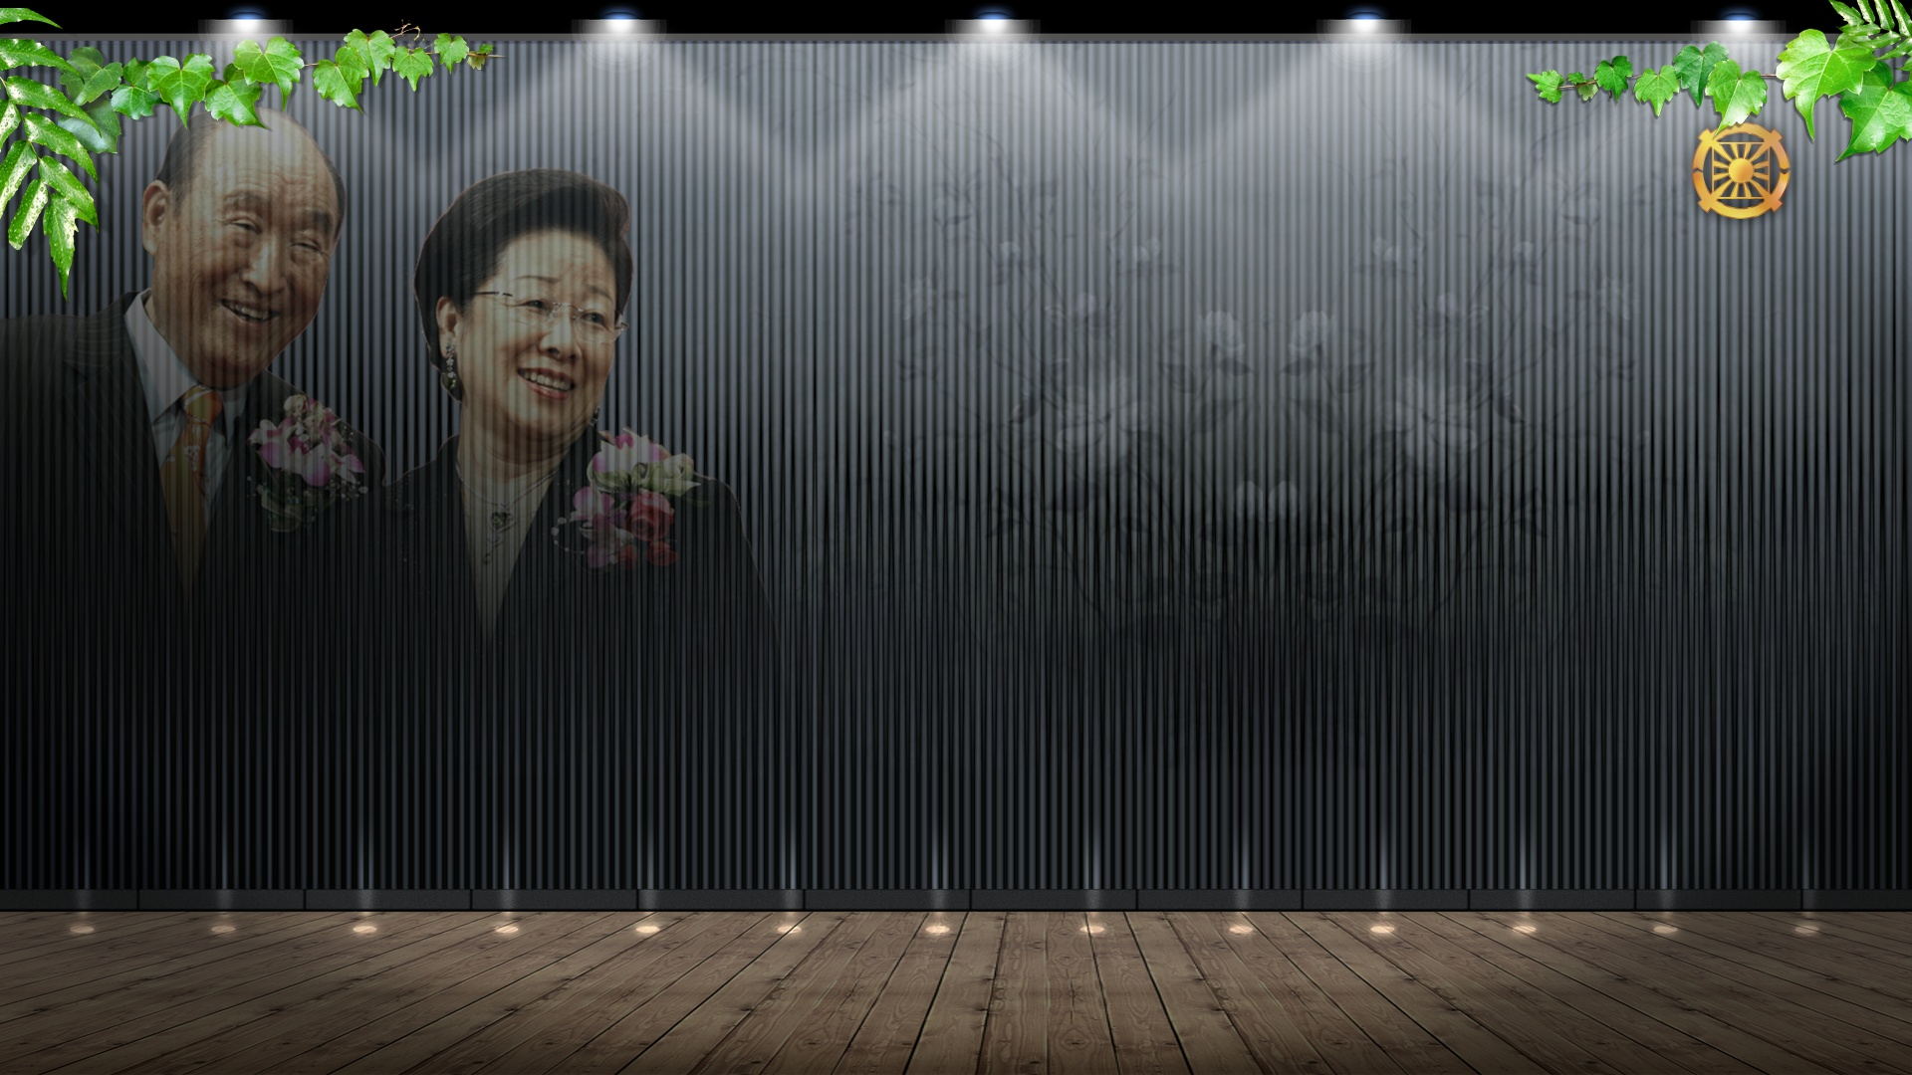
Lecture 3
CIG Foundation Day and
4 Dimensional Registration
Cheon Gi Year 3 HC 7/6 (Solar Aug.23)

Slide 2
I. Introduction
Foundation Day and God’s Holy Wedding (2012.1.13)
God’s Holy Wedding (2012.1.12)
Re-blessing of blessed families: God’s marriage registration
Birth registration as God’s direct children in the Cain realm
Marriage registration through God’s blessing at perfection level of perfection stage
God’s coronation ceremony: Era of God’s Direct Dominion

Slide 3
B. Foundation Day and Free Ideal World
Holy Wedding of God of Night and Day: Trinity as the united being of ODU Action
Coronation Ceremony of God of Night and Day: Coronation Ceremony of TP of HEH
God’s Abel-type Heavenly family: Four position foundation, 4D Registration
God’s Cain-type Heavenly family: Four position foundation, 4D Registration
Substantial CIG centered on God and TP starts.

Slide 4
II. God’s Holy Wedding: Holy Wedding of TP of HEH
A. Stages of God’s Holy Wedding
1st Formation Stage Holy Wedding: Holy Wedding of TP (1960.3.16)
2nd Formation Stage Holy Wedding: Holy Wedding of Parents of Heaven and Earth (2003.1.6)
3rd Completion Stage Holy Wedding: Holy Wedding of TP of HEH(2012.1.13)

Slide 5
B. Holy Wedding of TP: 1st Formation Stage Holy Wedding (1960)
TF: Substantial being of God as God’s divine representative (Lunar 1960.3.1)
TM: Recreation of TF, the substantial being of God
TF and TM: Vertical relationship, Gyeongbae (O)
Core of vertical relationship: AF, AL, AO
Way of TM: Way of achieving oneness with TF

Slide 6
C. Holy Wedding of Parents of Heaven and Earth: 2nd Growth Stage Holy Wedding (2003)
TF: Substantial being of God as God’s divine representative
Course of TM: Side(1991), equal position(1999), same position (2000)
TF and TM: Oneness of TF and TM, Gyeongbae (X)
Relationship with God: AF, AO, AL
Way of TM: Way of becoming substantial being of God

Slide 7
D. Holy Wedding of TP of HEH:
3rd Completion Stage Holy Wedding (2013)
TF: As God’s divine rep., God’s substantial being
TM: As God’s divine rep., God’s substantial being
TF and TM: Independent character that represents God’s one character (2012.3.4)
God, TF, TM: United being of ODU, substantial Trinity
God of Night (Origin) + God of Day (Division) = God of Night and Day (Union)

Slide 8
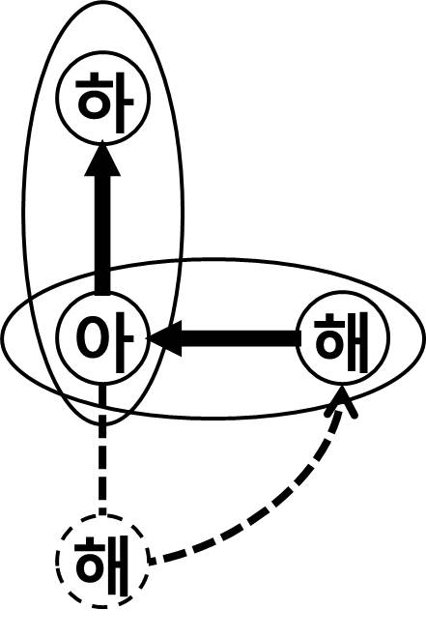
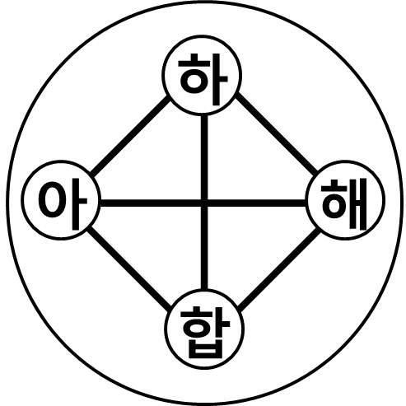
E. Diagram of God’s Holy Wedding (ODU Action)
TP Holy Wedding 1960 Formation stage
Holy Wedding of Parents of
Heaven and Earth
2003 Growth stage
Holy Wedding of TP of HEH Heaven & Earth and Humankind 2013 Completion stage

Slide 9
III. God’s Holy Wedding and Heavenly Family
A. Completion of Abel-type Heavenly family
(Four position foundation)
TP’s direct children (1960)
TP of HE’s direct children (2003)
TP of HEH’s direct children (2013)
Through God’s blessing, born as God’s Abel-type direct children.
The place of God’s blessing is blessing is at perfection level of perfection stage.

Slide 10
B. Completion of Cain-type Heavenly family
(Four position foundation)
TP’s children(19060-2003): Church-level, national-level blessing
TP of HE’s children(2003-2013.1.3): World-level, cosmic-level blessing
TP of HEH’s children(2013.1.13-): Re-blessing (God’s blessing)
Through God’s blessing, born as Cain-type direct children.
Place of God’s blessing is at perfection level of perfection stage.

Slide 11
C. Stages of blessing and registration of Cain-type Heavenly family
Blessing of BF 1st gen. (From 1960): Church-level registration
Restoration Blessing (From 2000.9.26): National-level registration, mission field assignment
Revolution of True Heart and True Liberation and True Complete Freedom CIG Registration Blessing (2003-2004): World-level registration(PW)
TP 1014 Cosmic Blessing (2009-2013): Cosmic-level registration (SW)
Foundation Day Re-blessing (2013): Register as God’s Abel-type direct children through God’s blessing

Slide 12
D. CIG and Pal Jeong Shik
CIG: Nation where two people became one
Who are the two people
Individual level-family level-tribal level-peoples level
National level-world level-cosmic level- God

Slide 13
What is Pal Jeong Sik
Vertical 8 stages: Servant of servant, servant, adopted son, step son, real son, mother, father, God
Horizontal 8 stages: Individual, family, clan, people, nation, world, cosmos, God
God’s Holy Wedding: God completed on the 8 vertical stages and 8 horizontal stages

Slide 14
E. Holy Wedding of God and Pal Jeong Sik
Church-level blessing: Individual, family, tribe, people level registration blessing (1-4 stages)
National-level blessing: National level registration blessing (5 stages)
World-level blessing: World-level registration blessing (6 stages)
Cosmic blessing: Cosmic-level registration blessing (7 stages)
God’s blessing: Blessing registering as God’s Cain-type direct children (8 stages)

Slide 15
IV. God’s Holy Wedding and Proclamation of 4D Registration
A. Meaning of 4D Registration (HC 2012.4.16)
1D Registration: Age of All Things, which is OT Age
2D Registration: Age of Children, which is NT Age
3D Registration: Age of Parents, which is CT Age
4D Registration: Age of God, which is the Age of the Ream of the 4th Adam
4D Registration: Registration as Heavenly family centered on God

Slide 16
B. History of the Providence toward God’s Holy Wedding
Proclamation of perfected being who has achieved completion, unification, and oneness (HC 2010.5.15)
Proclamation of Completion of Restoration and Sunghwa ceremony (HC 2011.10.14)
Proclamation of Completion of Oneness between True God and TP (2011.11.17.-18)
Adam and Eve achieved completion, unification, and oneness. (HC 2012.3.15)
SMM and HHJ who are the TP, have returned to the place of completion of restoration. (HC 2012.3.22)

Slide 17
C. Proclamation of 4D Registration (HC 2012.4.16)
All of TP’s responsibilities are finished.
TP and TP of HEH have completely settled.
Our family saw completion and perfection. (95% + 5% = 100%)
Gookjin-Hyungjin two sons, Cain-Abel became one.
Bless families achieve completion through TP’s 96% responsibility and 4% own responsibility.

Slide 18
D. Understanding of the Proclamation of 4D Registration using diagram
Heavenly family and TP of HEH (2003.10.25)
G
G
O
G
O
+
=
A
E
A
E
A
E
D
D
U
U
U
C
M
C

Slide 19
2. Blessed families and Parents of HEH (2003.10.25)
G
95%
TP
96%
A
E
M
W
5%
4%
C
100%
C
100%
Heavenly Family
Blessed family

Slide 20
V. Free Ideal World and God’s Holy Wedding
A. God’s purpose of creation
God embodies Adam and Eve
God meets and marries substantial wife, Eve
God multiplies direct children and completes Heavenly family.
Heavenly nation is created through expansion of Heavenly family.

Slide 21
B. God’s Holy Wedding and Era of CIG Association
Age of the Association to connect the SW and PW and Family Pledge 5 (2009.10.8)
Age of Association to unite God and human beings in True Love and Family Pledge 8 (2009.10.9)
Era of the Association of Parents of Heaven and Earth and CIG Era (2009.10.9)
God’s Holy Wedding and place of God’s blessing

Slide 22
C. Heavenly nation in the “Creation Ceremony of Heavenly nation (HC 2012.1.2)
Heavenly nation is created centering on Heavenly family.
Heavenly family: Heavenly couple, Heavenly parents, Heavenly children
Heavenly nation: Heavenly family and blessed family are Cain and Abel.
Heavenly nation: Free Ideal World centered on Heavenly family

Slide 23
VI. CIG Citizens’ Right and Duty
A. Clearing the past and new start
God’s homeland: On foundation of 3 great revolutions (431:274, 2004.1.19 evening)
Clearing the past: Revolution of indemnity, Total/All Life Offering, God=Human(TP and children)+all things
New start: Revolution of Conscience, ODP education, inheriting 8 GTTM
After blessing: Revolution of heart, 4 position foundation, 3 great kingships, realm of royal family, Offering and Conversion Ceremony
Daily life motto: One tradition, one blood lineage, one resemblance

Slide 24
B. Portion of Responsibility for the completion of family
Blessed families complete their 4% responsibility.
Live centering on Absolute Sex , True Love, Awareness for Others, Absolute Value
Live centered on prerequisite
Live doing HDH and write Heavenly Family Daily Report (2001.1.31)

Slide 25
C. Portion of responsibility for Free Ideal World (Kingdom of the Peaceful, Ideal World)
Completion of ideal family: Go the way of completing the 4 great realms of heart and 3 great kingships
New tribal Messiah: Go the way of completing the realm of royal family
Tribal messiah activity in PW
Tribal messiah activity in SW
Establish CIG through new tribal messiah Association
Strong Korea: Re-create Korea as Adam nation
Free Ideal World: Connects to UN Providence

Slide 26
VI. Conclusion
Foundation Day and God’s Holy Wedding
I am God’s direct child.
I am God’s blessed family.
I and God’s holy temple.
God is in me.
When God commands, I act.

Slide 27
B. Way that blessed families should go (1997.9.14)
“Believe in True Parents,
Know True Parents,
Live together with True Parents,
Become one with True Family centering on love (oneness in True Love), and
Start life in “Kingdom of Heaven on Earth”

Slide 28
C. “Let’s live together!” attending God
(HC 2012.3.4)
Let’s live together in the Garden of Eden of the original creation!
Let’s live together in the place of “awareness for others”!
Let’s live together where we only hear “God’s sound”
Let’s live together centering on “one tradition, one blood lineage, one resemblance”!
“태평성대” is where God is. (56377, 2007.5.11)

Slide 29
THE END

