Slide 1
Session 1
Notes:
Hello, and welcome to Discovering the Divine Principle.
The Divine Principle is a revelation from God that was received by the Reverend Sun Myung Moon.
Session 1.

Slide 2
2
Notes:
To start our series, let’s take a look at two important points. First, everyone wants to live an ideal life. The ideal does exist; it is not just imaginary.

Slide 3
3
Notes:
Second, you can achieve it by applying the Divine Principle. You can have amazing results that can change your life, as it did mine.
My goal is to empower you to believe in this ideal. Let me start by asking you a few questions.

Slide 4
4
Notes:
Do you believe that you, or anyone, can achieve true happiness?

Slide 5
5
Notes:
Do you believe that there can be authentic families free from divorce and abuse; where husband and wife, parents and children truly love each other?

Slide 6
6
Notes:
Do you believe that we can have a society free of prejudice and conflict? Realistically, the more you think about it, the more skeptical you become. Your head may say, “No way! It’s not possible!”

Slide 7
7
Notes:
You may be someone who believes that to live is to struggle. There has always been war, evil always seeks to destroy that which is good, and maybe suffering is just a part of life. If you believe all that, you might think that since we've never achieved this ideal, then we never will.
But even though your head says this, I think that your heart sees it differently.

Slide 8
8
Notes:
I have confidence that most people trust, in their heart, that the ideal is possible. Think about it. We all get up in the morning hoping for a good day.

Slide 9
9
Notes:
We all seek for love, and yearn for relationships that are stronger, deeper and more fulfilling. Stated simply, we are all striving to be truly happy.
Now, would we do this if we didn't believe it were possible?

Slide 10
10
Notes:
Nevertheless, where’s the evidence that true happiness can be achieved? To find it let's go back and look at human history.

Slide 11
11
Notes:
In the early stages of history, people lived a primitive existence.

Slide 12
12
Notes:
Later people begin to develop a conscience that pushed them to seek for higher ideals.

Slide 13
13
Notes:
Today most people believe in basic human rights and freedom for all.

Slide 14
14
Notes:
Take for example the issue of slavery and racism. When the founders of America formed the Constitution, they couldn't deal with this problem. But over time, things changed.

Slide 15
15
Notes:
We think of Abraham Lincoln,

Slide 16
16
Notes:
Rosa Parks and

Slide 17
17
Notes:
Nelson Mandela among countless heroes in this struggle.

Slide 18
18
Notes:
Twenty years ago, no one would have believed that an African-American would be president of the United States.

Slide 19
19
Notes:
In the past, people thought interracial marriage was scandalous. But today we’ve progressed to look at it as beautiful, and we encourage marriage beyond boundaries to bring our world together. So clearly things can change.

Slide 20
20
Notes:
We’re not living in an ideal world. However, we are getting closer, and if we continue in the right direction we can make the ideal a reality.
I’m not just talking about the human experience. If we look around us, we can see that progress toward an ideal is evident in every part of the universe.

Slide 21
21
Notes:
In what we call the big bang, the universe appeared out of nothingness. Simple entities came together to form more complex entities

Slide 22
22
Notes:
atoms and molecules, galaxies and planets. Eventually there came DNA, a molecule that makes life possible, from single-celled organisms to people like you and me.

Slide 23
23
Notes:
You and I are striving every day for an ideal. So the entire creation is a testimony to the fact that this ideal, what I call “the ideal of creation,” is not a theory, but an attainable reality.

Slide 24
24
Notes:
Let’s look at the everyday phenomenon of growth.

Slide 25
25
Notes:
Here are some bean seeds. Given the right conditions they’ll germinate and grow. If obstacles come, they will try to overcome them.

Slide 26
26
Notes:
Let's say some kids decide this tiny bean sprout is going to be first base in their baseball game. By the end of the game, it is going to be all but destroyed.
However, if there is still life in it, and rain comes, it will sprout again. It will feel the sunlight, put forth new leaves and fulfill its role in the ideal of creation. It’s a scientific inevitability.
So what role could this tiny bean sprout play in the ideal of creation?

Slide 27
27
Notes:
This bean sprout will grow and create beautiful flowers for us to enjoy. Its leaves will produce oxygen to purify the air we breathe. Then finally the beans it creates become a delicious treat for us to savor.
All the fruits of the earth have the same kind of purpose, to bring health and happiness.
Therefore, everything in the ideal of creation exists to bring joy, to you, to me, and all humankind.

Slide 28
28
Notes:
I propose that this universal concept applies to us as well. We push through the obstacles of life to reach an ideal of creation that brings the promise of beauty, life, and joy.

Slide 29
29
Notes:
However, our problem is, we don't fully understand how to get there.
That’s why the Divine Principle is so significant. It explains what the ideal is, and it outlines how we can work together to achieve it.

Slide 30
30
Notes:
We achieve this ideal the same way that we achieve anything in life, whether baking a cupcake, driving a car, or performing eye surgery.

Slide 31
31
Notes:
To achieve anything, we need to learn the underlying principles.
If we want to bake a cupcake, we apply the principles of baking.

Slide 32
32

Slide 33
33
Notes:
If we want to drive a car, we have to take driving lessons and pass a test

Slide 34
34

Slide 35
35
Notes:
If we go to school for years and understand the principles of optics, nerves and tissues, we can perform eye surgery.

Slide 36
36

Slide 37
37
Notes:
What are the principles we have to learn to achieve true happiness, or the ideal of creation?
Let’s look at this from two different perspectives.

Slide 38
38
Notes:
First, there’s the external perspective.

Slide 39
39
Notes:
We’d agree that a good home, good health, and a good job would make us happy. But living the life of a movie star, or winning the lottery doesn’t really make anyone permanently happy.
Logically then we must look to the internal perspective.

Slide 40
40
Notes:
Internal qualities of empathy and sympathy, of living for the sake of others brings us much deeper, long-lasting fulfillment.
So, where can we find those internal principles?

Slide 41
41
Notes:
We find the answers we’re looking for, and so much more, from the source that we traditionally call

Slide 42
42
Notes:
God. God is the designer of these principles and we can apply them to achieve our ideal.

Slide 43
43
Notes:
As the designer of the universe, He infused them in all of us. By looking to the source we can further understand these principles.

Slide 44
44
Notes:
About 4,000 years ago, Abraham came forward with the radical understanding that there was one origin for all of creation; a personal God.

Slide 45
45
Notes:
Later, Moses met this same God and revealed moral principles, the Ten Commandments.

Slide 46
46
Notes:
Through Jesus, God was able to reveal even more. Jesus forgave sinners whom, according to the Law, deserved death.
Jesus showed us that the principles of love and forgiveness bring life, renewal, and joy.

Slide 47
47
Notes:
In our own times, Mother Teresa and countless other believers who embody Jesus’ teachings, bring those same principles to the lives of millions.

Slide 48
48
Notes:
Even so, the ultimate truth eludes us. The Bible is, at times, unclear. Today people still argue over its hidden meanings. However, Jesus also shared that, in the future, God would reveal the truth clearly. (John 16:25)

Slide 49
49
Notes:
I believe that that time is today.
At this point, I want to introduce you to the Reverend Sun Myung Moon.

Slide 50
50
Notes:
His teachings are the basis for this series.
He grew up on a farm in Korea, and at that time, the Japanese military occupied his country, and oppressed his people.

Slide 51
51
Notes:
He often went to the mountains to pray, and asked God why He would allow such suffering and pain. On Easter morning of 1935, while deep in prayer, he had an experience with Jesus that would change his life forever.

Slide 52
52
Notes:
Jesus challenged him to discover the truth about God’s Principles, so that all of humanity would be able to realize the ideal of creation.
Reverend Moon dedicated his life to this discovery and he never wavered from that mission.

Slide 53
53
Notes:
In 1960, after founding a movement for the unification of Christianity, he married Hak Ja Han.

Slide 54
54
Notes:
Since then they have led this international ministry as partners. In September, 2012 Rev. Moon ascended to God, but his ministry continues through his wife and countless churches around the world.

Slide 55
55
Notes:
You may ask, why would God speak to someone like a 15-year-old Korean boy?
I can only share my understanding. When Rev. Moon was young he thought a lot about the conflicts going on in the world. He thought deeply about how any parent would feel if one child were to kill another, and through this he came to realize how intensely God suffers. With this understanding, he prayed and asked what he could do to alleviate God’s suffering.

Slide 56
56
Notes:
I think such a prayer would move me, and I believe that God was moved by his sincerity.
Early in his ministry, Rev. Moon put together what he understood from nature, from the Bible, from Jesus and from direct experience with God. He presented this in the form of principles that enable us to achieve the ideal of creation.
One of these was the principle of human responsibility.

Slide 57
57
Notes:
I’d like to tell you a story. There was a faithful young man, walking along a beach, who heard God’s voice tell him he could have one wish.

Slide 58
58
Notes:
The man thought for a moment, then asked God to build him a bridge to Hawaii so that he could drive his car there.
There was a moment of silence. Then God said that he was asking too much. All of the resources necessary to do that would affect the ecology and it would be so dangerous, and he’d run out of gas on the way, and so forth.
So God asked him to choose something different.

Slide 59
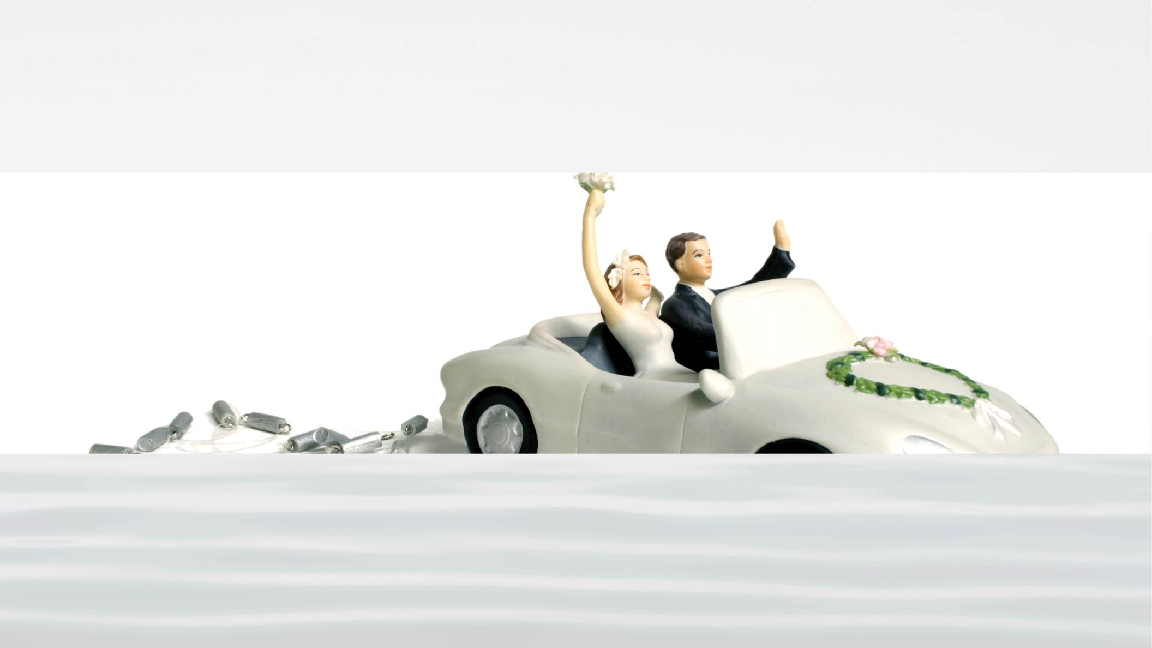
59
Notes:
The man said, “Okay, I want a marriage in which I will always be happy. I want a love relationship that will be problem free.”
There was another long moment of silence, and then God said, “How many lanes did you want on that highway?”
The point here is that when it comes to our relationships, God does not control everything. God gives us a part of the responsibility.

Slide 60
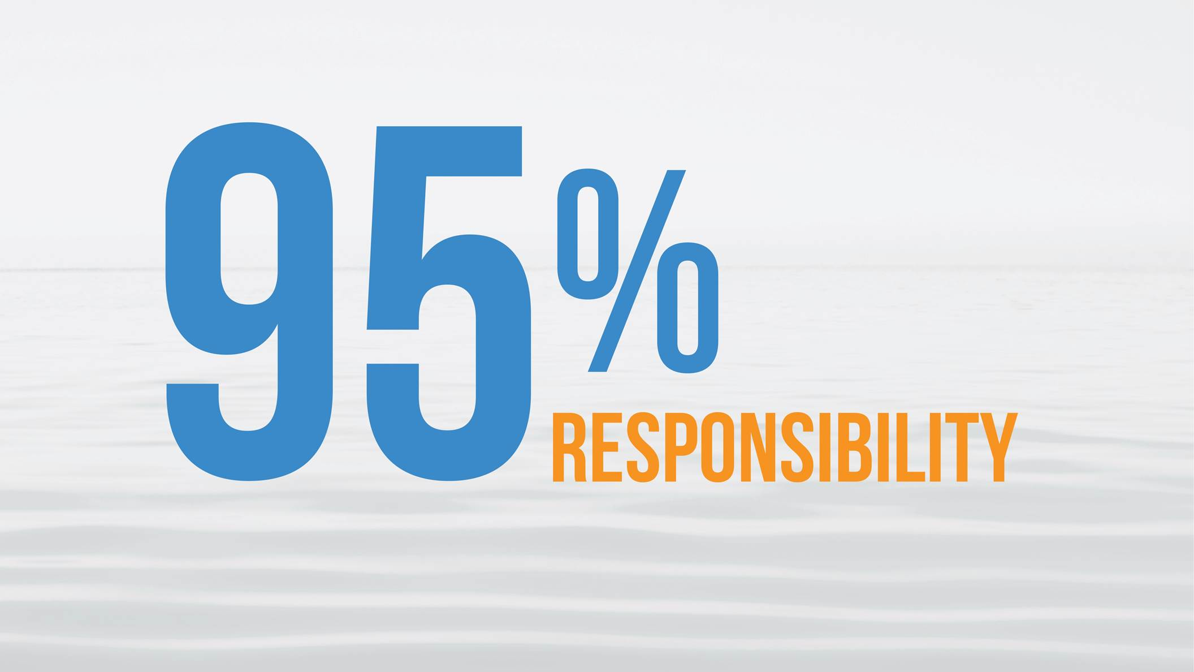
60
Notes:
The ideal of creation involves two parties. One is God. God does 95% of the work. God made the universe, brought forth life, created us, gave us a spirit, the desire to love, and the drive to pursue the ideal.

Slide 61
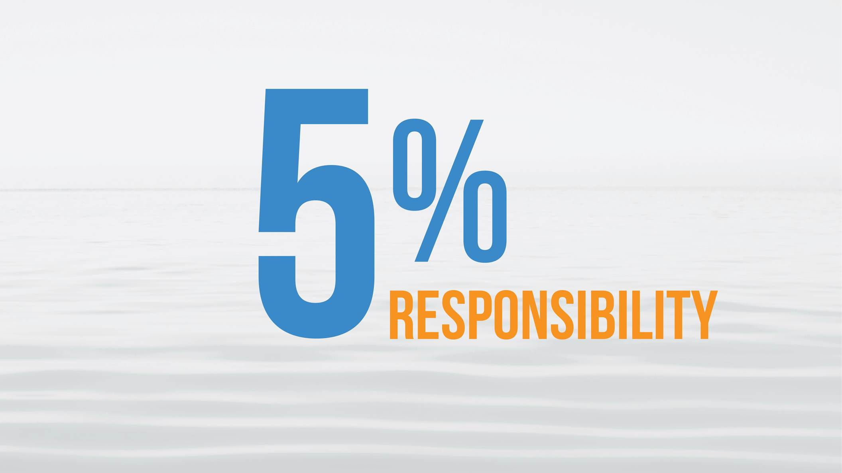
61
Notes:
The remaining 5% is in our hands. The fact that God trusts us is a great honor. The downside is, if we don't fulfill our responsibility, the ideal cannot be realized.
Obviously, we messed up. Everything else is perfect. The creation works like a finely-tuned machine, beautiful, abundant and overflowing with life, until it gets to our part; starvation, injustice, pollution, lies, abuse…

Slide 62
62
Notes:
The question is: why would God give us this kind of responsibility?
The ideal of creation is all about love.

Slide 63
63
Notes:
It's about realizing true love between man and woman,

Slide 64
64
Notes:
between parent and child,

Slide 65
65
Notes:
between brothers and sisters. It ideally begins with the personal relationship of love we develop with God.
Even God can’t make us love each other. No one can pretend love. Real love comes from free will —freedom to give and take. With freedom comes responsibility and God wants us to love authentically.

Slide 66
66
Notes:
I am sure that at times you might have felt that God is far away. God doesn't appear on command when we want Him to. If you were to say, “Hey God, I want to talk to you!” will you hear a voice, “Here I am. It’s Me.” It's usually not that easy.

Slide 67
67
Notes:
Do you think the biblical figures that we mentioned earlier had an easy time finding God?
They made immense effort in their relationship to God. Moses had to fast 40 days, two times, before he was finally able to receive the Ten Commandments.

Slide 68
68
Notes:
We have to make effort. God loves us and He is doing all He can. The problem is not with God; it’s with us, because we have neglected to fulfill our portion of responsibility.

Slide 69
69
Notes:
So the million-dollar question is: What exactly is it that God wants us to do?

Slide 70
70
Notes:
That’s what Discovering the Divine Principle is all about.

Slide 71
71
Notes:
Now I want to give you an overall map of the Divine Principle. It has three basic areas. The first is the ideal, which I have already mentioned, but we will go into greater depth on it in the next two segments. The series covers three basic areas.

Slide 72
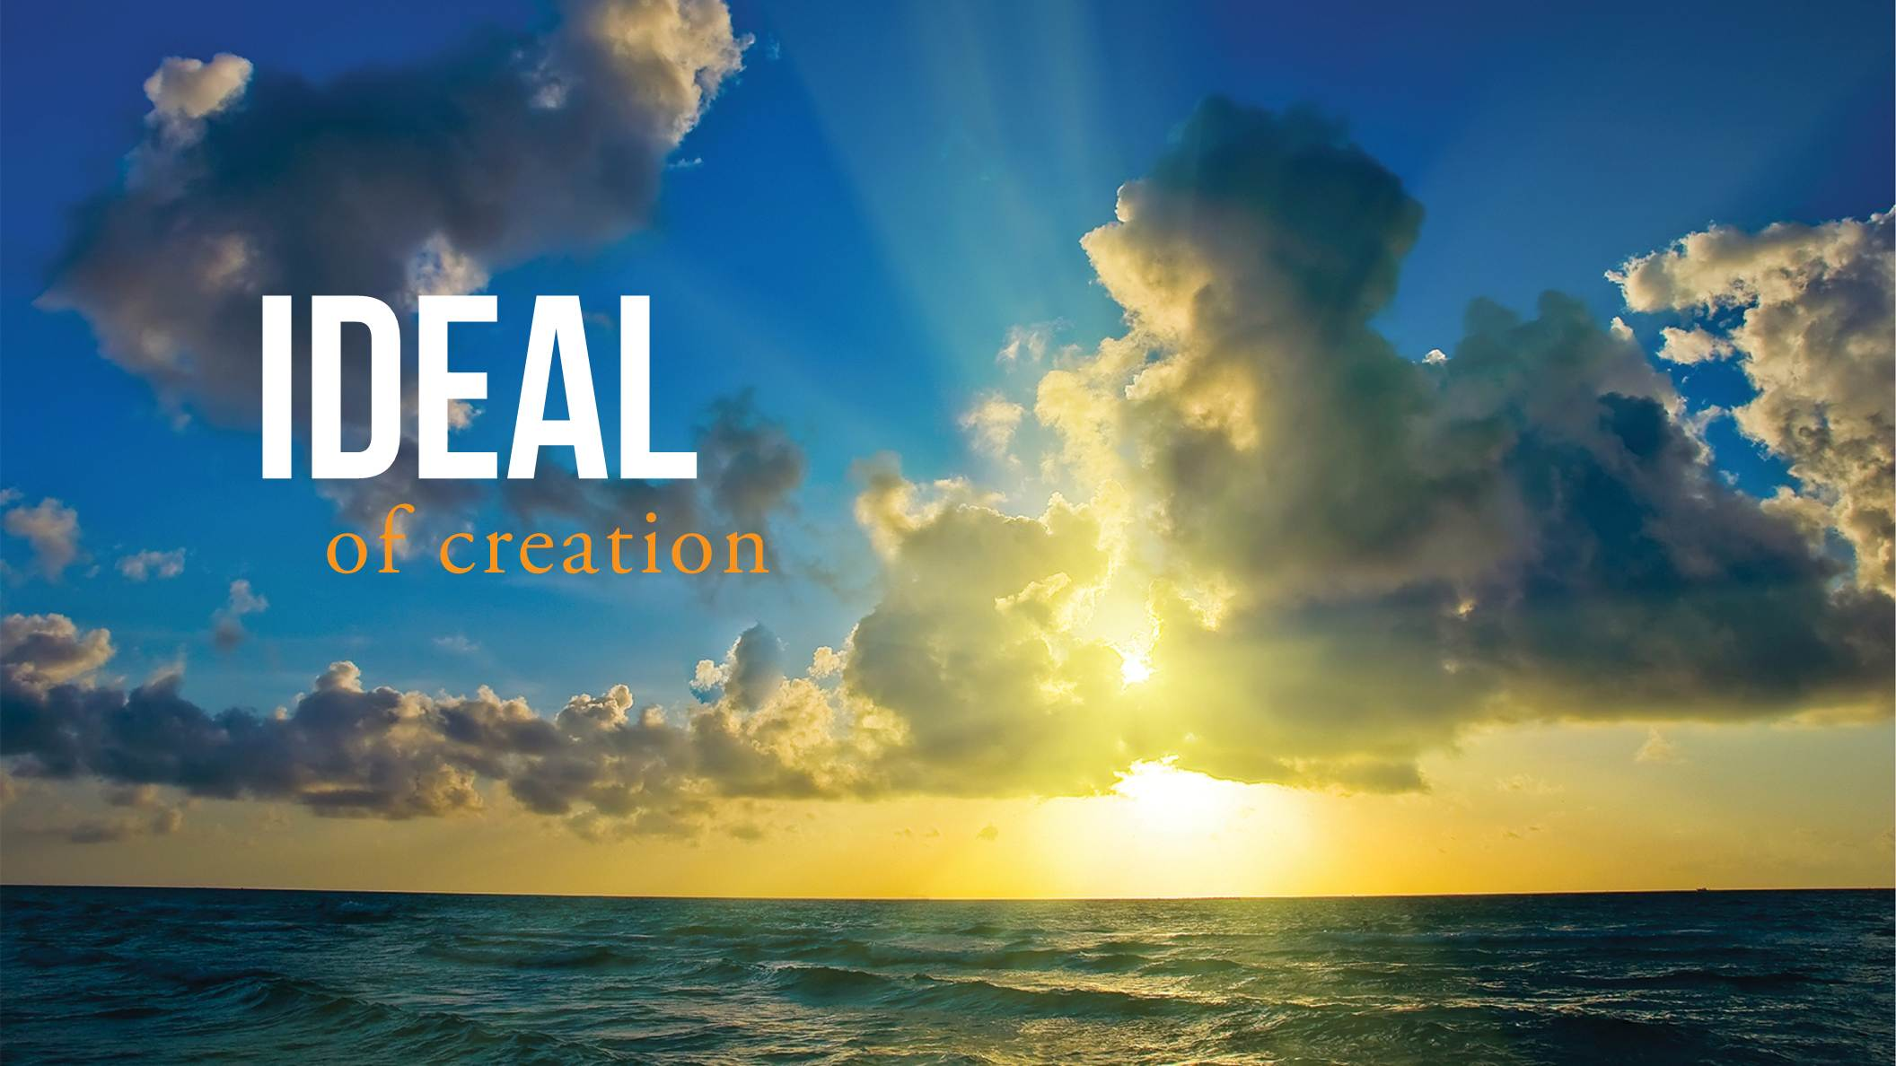
72
Notes:
The first is the ideal of creation.

Slide 73
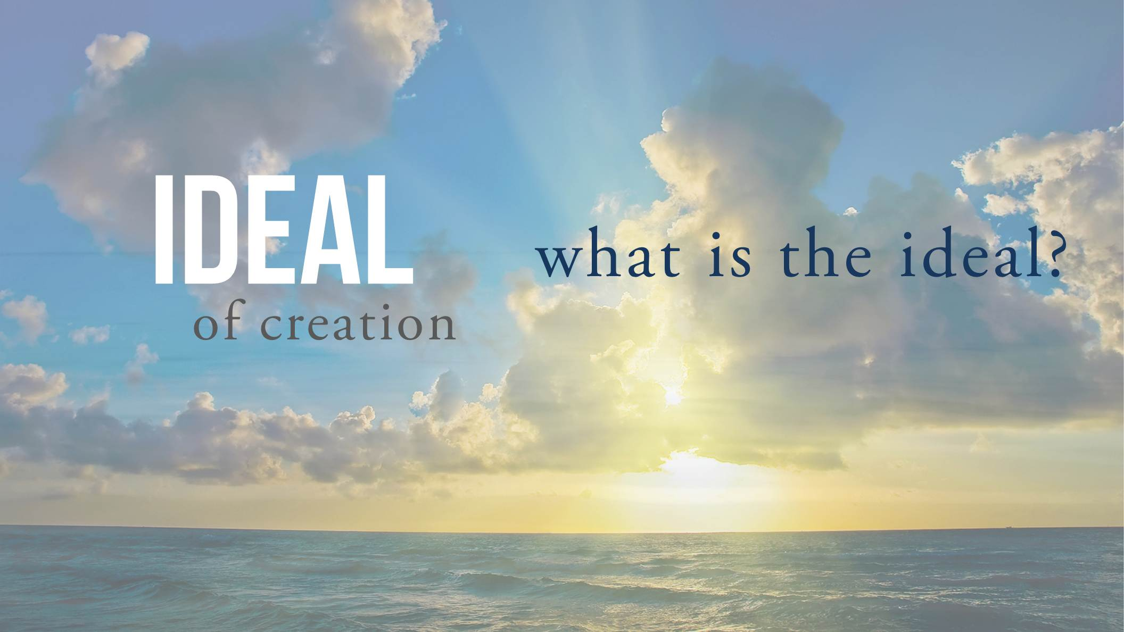
73
Notes:
What is the ideal?

Slide 74
74
Notes:
Who is God?

Slide 75
75
Notes:
What is my purpose?

Slide 76
76
Notes:
Is there life after death?

Slide 77
77
Notes:
Is history just random or is there some plan?

Slide 78
78
Notes:
What is true love? What is the role of marriage?

Slide 79
79
Notes:
The second part is on the Fall, which is about the turning away from God. What exactly went wrong? How did it happen? If we can understand clearly how we left God, then we’ll be able to understand clearly how to get back.

Slide 80
80
Notes:
The third part is about moving forward and fulfilling the original ideal. We call it the Principle of Restoration. It is the process of returning to our original position, the place where the ideal deep within our hearts can be realized.

Slide 81
Notes:
Clearly we have a lot to cover in the next session, and I know you are going to really enjoy it.
As for now, I thank you for joining me in Discovering the Divine Principle.

