Slide 1
Session 10
Notes:
Welcome to Session 10 of Discovering the Divine Principle. In this session we are going to look at the history of God’s providence up to the Second Advent of the Messiah.
As a student, I for one did not enjoy

Slide 2
2
Notes:
history. It seemed like a lot of memorization of one event after another, but in our study, we will discover that history has a goal. Behind history God is working toward an ideal.

Slide 3
3
Notes:
Therefore, just as surely as one season follows another, you can be sure that at some point, God is going to send

Slide 4
4
Notes:
the Messiah and the ideal of creation will be a reality.

Slide 5
5
Notes:
In an earlier session we learned about indemnity. What we are going to discover is that God claims periods in history as conditions of indemnity for the Messiah’s coming.
That sounds complicated, so let me give an analogy. Let’s say when I was young I said

Slide 6
6
Notes:
four very bad words at school. To teach me a lesson, my mom made me bite down on a bar of

Slide 7
7
Notes:
soap for four minutes, one minute for each bad word. In a similar fashion, God uses time periods.
The number four is important, because it represents the original purpose of creation:

Slide 8
8
Notes:
God, man, woman and child. This is why the numbers four, forty or 400 appear constantly in the Bible.
For example, at the time of Noah, the flood judgment was

Slide 9
9
Notes:
40 days. The Israelites were slaves in Egypt for

Slide 10
10
Notes:
400 years. When Moses went up on the mountain,

Slide 11
11
Notes:
he fasted for 40 days. When that failed, he fasted another

Slide 12
12
Notes:
40 days. Jesus also fasted for

Slide 13
13
Notes:
40 days. What’s happening here is that God is using

Slide 14
14
Notes:
4 to claim the ideal of creation. If a person fails to fulfill their responsibility, God will try again.

Slide 15
15
Notes:
It’s like the cycle of seasons. We know that flowers bloom every spring.

Slide 16
16
Notes:
If a frost stops that, we have to wait for the cycle to come around; another three seasons have to precede it. With this understanding of God working through time periods, and then repeating them when things don’t work out, let’s take a look at the path of human history.
In this session we’re going to look at

Slide 17
17
Notes:
cycles in history that reveal remarkable parallels.
We have covered how God prepared the foundation for the Messiah on the level of the family, through

Slide 18
18
Notes:
Adam, Noah, and Abraham’s family.

Slide 19
19
Notes:
God then determined to expand this family foundation to a nation. For this reason, we are going to examine the history of the Israelites, the descendants of Abraham, Isaac, and Jacob.
That history begins with a 400-year period of slavery in Egypt. At the end of this 400-year period, God sent

Slide 20
20
Notes:
Moses to bring the people of Israel out of Egypt and into the land of Canaan. In Canaan they were to establish a kingdom centered on God. In Canaan they passed through another 400-year period, called

Slide 21
21
Notes:
the period of the judges, the last of whom was Samuel. At the end of this 400-year period

Slide 22
22
Notes:
Samuel anointed Saul as king of Israel. This brings us to the period of

Slide 23
23
Notes:
a United Kingdom.

Slide 24
24
Notes:
God’s desire was for the kings, Saul, David and Solomon, to build a Temple in which God’s Word would be kept and in which God’s Spirit would dwell.

Slide 25
25
Notes:
The Temple represented the coming Messiah. By uniting around the temple, the people would make a condition for God to send the Messiah.
Unfortunately, the kings failed and Israel was divided into north and south. The next time period is that of

Slide 26
26
Notes:
a Divided Kingdom. God’s plan was to remove corruption by sending prophets. The mission of the prophets, one of whom was

Slide 27
27
Notes:
Elijah, was to bring the people back to the Word and the Temple. But the people did not listen and, after 400 years, this period also ended in failure.
As a result, Israel was invaded by outside forces.

Slide 28
28
Notes:
The temple was destroyed and the people were taken into exile. This brings us to the period of

Slide 29
29
Notes:
Exile and Return, a period of 210 years. During the first 70 years the Israelites lived in

Slide 30
30
Notes:
Babylon where they repented and gradually they could return to Canaan and rebuild the Temple. Their unity with God’s Word over the next 400 years finally established a

Slide 31
31
Notes:
foundation for the Messiah. God spoke through the prophet Malachi, the last prophet of the Hebrew Scriptures, who proclaimed that the Lord is coming.

Slide 32
32
Notes:
Then, 400 years later Jesus was born.
And what happened? The people God had prepared did not recognize that Jesus was the Messiah.

Slide 33
33
Notes:
They rejected him.
On the foundation of the cross and resurrection, God had to build a foundation for the Messiah to come again.
In the story of the vineyard, Jesus explains that if the people kill God’s son, God will give the vineyard to another people. (Matthew 21:33-43) Who are the “other people”? It is

Slide 34
34
Notes:
those who unite in heart with Jesus. They are the ones to pay the indemnity for the Messiah to come again, this time on a

Slide 35
35
Notes:
worldwide foundation. The Christian faith is beyond national boundaries, prepared to receive and protect the Messiah. With this in mind, let’s look at Christian history. We will see cycles that parallel the previous course.
For example, the first

Slide 36
36
Notes:
400 years of Christianity, a period of suffering under the Roman Empire, parallels the 400-year period of suffering under Egyptian rule.
For the next 400 years, whereas judges guided the Israelites,

Slide 37
37
Notes:
patriarchs guided the Christian churches.
Following this period, in the year 800, the Bishop of Rome anointed

Slide 38
38
Notes:
Charlemagne emperor of the Holy Roman Empire. This parallels Samuel anointing Saul king of Israel.
In another parallel of history, the Holy Roman Empire failed to exalt the Word which began a period of a

Slide 39
39
Notes:
divided Christian empire, just like the period of division in Israel between the northern and southern kingdoms.
And just as God sent prophets to Israel, God sent saints to try to reform the church. But despite saints such as

Slide 40
40
Notes:
St. Francis of Assisi, those in power resisted reform. This brings us to the period of

Slide 41
41
Notes:
exile and return. As the people of Israel were taken into exile in Babylon, the Papacy was exiled to

Slide 42
42
Notes:
Avignon, France. Just as the Israelites were in exile for 70 years before they began their return, the papacy was in exile in France for 70 years. This was also followed by a period of return and in 1377,

Slide 43
43
Notes:
Pope Gregory the Eleventh (XI) r eturned to Rome.
This was a time of great confusion. Kings organized councils to reform the church, but they did not succeed. Finally, just as the Jewish reform occurred at the time of Malachi,

Slide 44
44
Notes:
Luther’s reform took place in the Christian faith. One important result of the Reformation was that

Slide 45
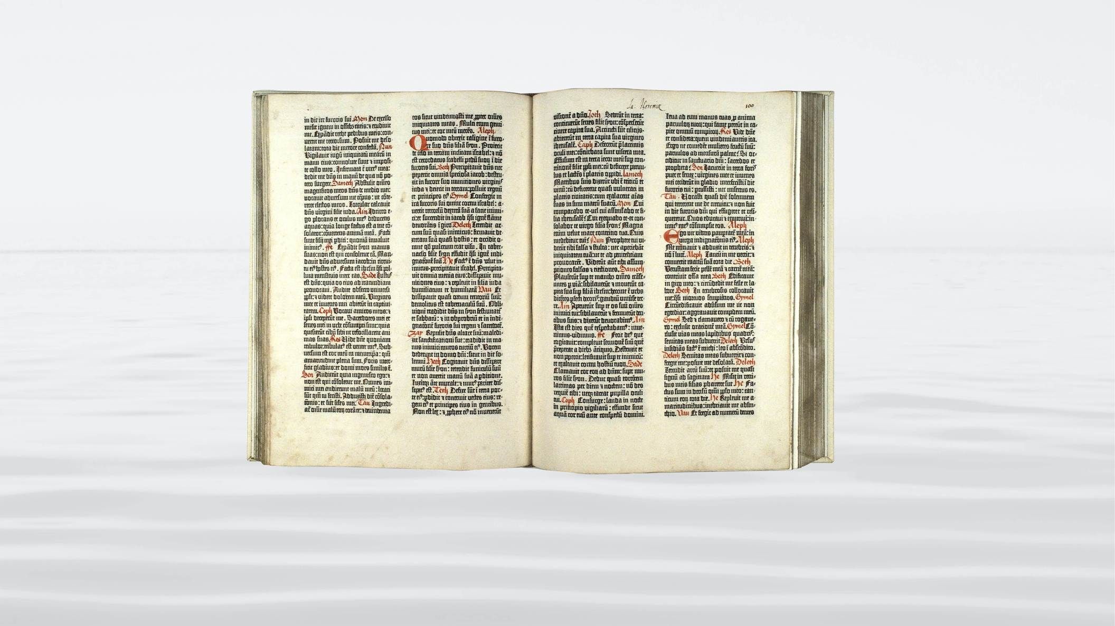
45
Notes:
the Bible was published in the language of the people. The new churches encouraged the people to read the Word of God. This parallels the Jewish scribes disseminating the Hebrew Scriptures. In both cases, the believers could prepare the foundation for the Messiah.
This brings us to the period leading to the birth of

Slide 46
46
Notes:
the Messiah. Malachi and Luther stand in parallel positions. If the pattern holds true, then

Slide 47
47
Notes:
400 years after Luther, the second coming of the Messiah should take place. It would actually bring us to the year 1917.
Let’s review these parallels. God prepared Israel for the coming of Jesus. And likewise, God prepared Christianity for the second coming. These parallels clearly demonstrate God’s hand in history, centering on the Messiah. We see parallels, from Adam to Abraham, which, in biblical years, was about

Slide 48
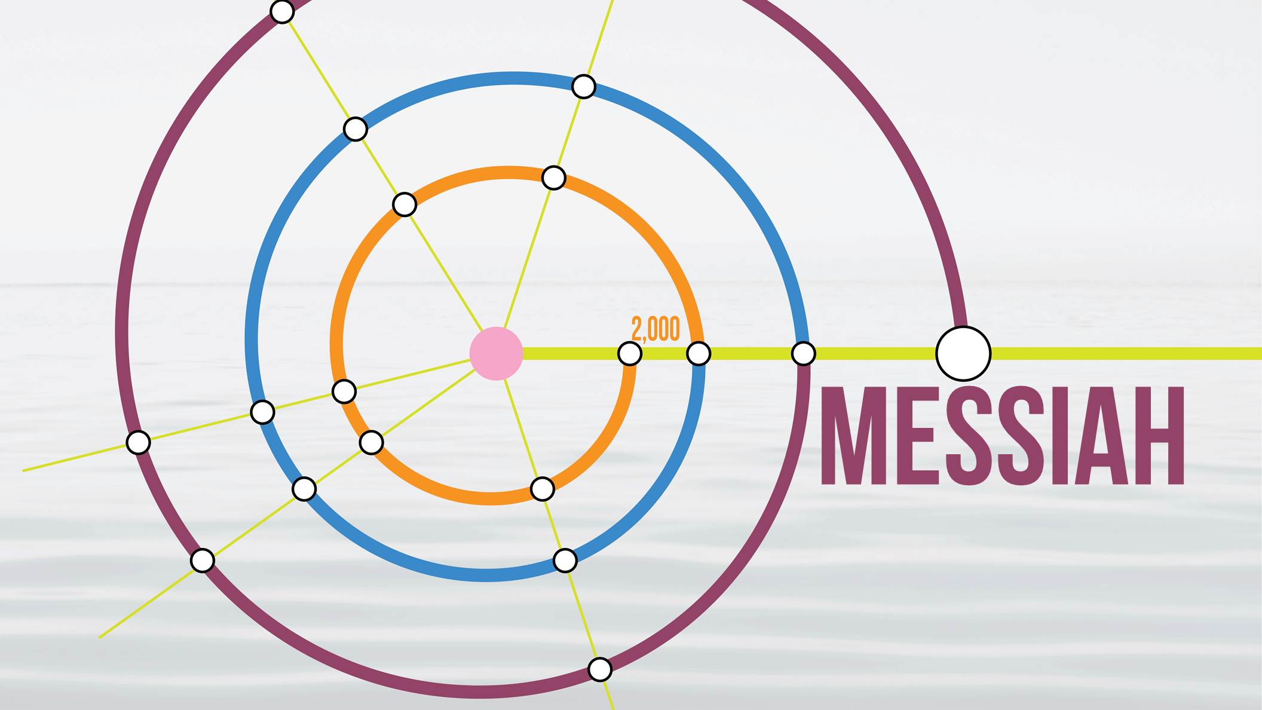
48
Notes:
2,000 years. Next we have the history from Abraham’s family to the birth of Jesus, another period of

Slide 49
49
Notes:
2,000 years. And finally we have a

Slide 50
50
Notes:
2,000-year period from Jesus to 1917. The time for the Messiah to appear has come.

Slide 51
Notes:
I am sure you have many questions and are wondering what to think. I urge you to ask for God’s guidance. Be sure to attend the next session, in which we are going to examine how the Messiah comes and how we will recognize him.

