Slide 1
Session 11
Notes:
Welcome to Discovering the Divine Principle, based on the revelation from God to the Rev. Sun Myung Moon.
For 2,000 years, Christians have wondered about the Second Coming of the Messiah.

Slide 2
2
Notes:
How will he come? When will he come? Will we recognize him?
In this session we will discuss these questions.

Slide 3
3
Notes:
Let’s begin with the question, how will the Messiah come again? There has been disagreement about this.

Slide 4
4
Notes:
This is partly due to confusion between literal and symbolic meanings in biblical prophecy.
This confusion is not new. For example, before Jesus’ birth, Daniel 7:13

Slide 5
5
Notes:
predicted that the Son of Man would come down from heaven. We know, of course, that Jesus was

Slide 6
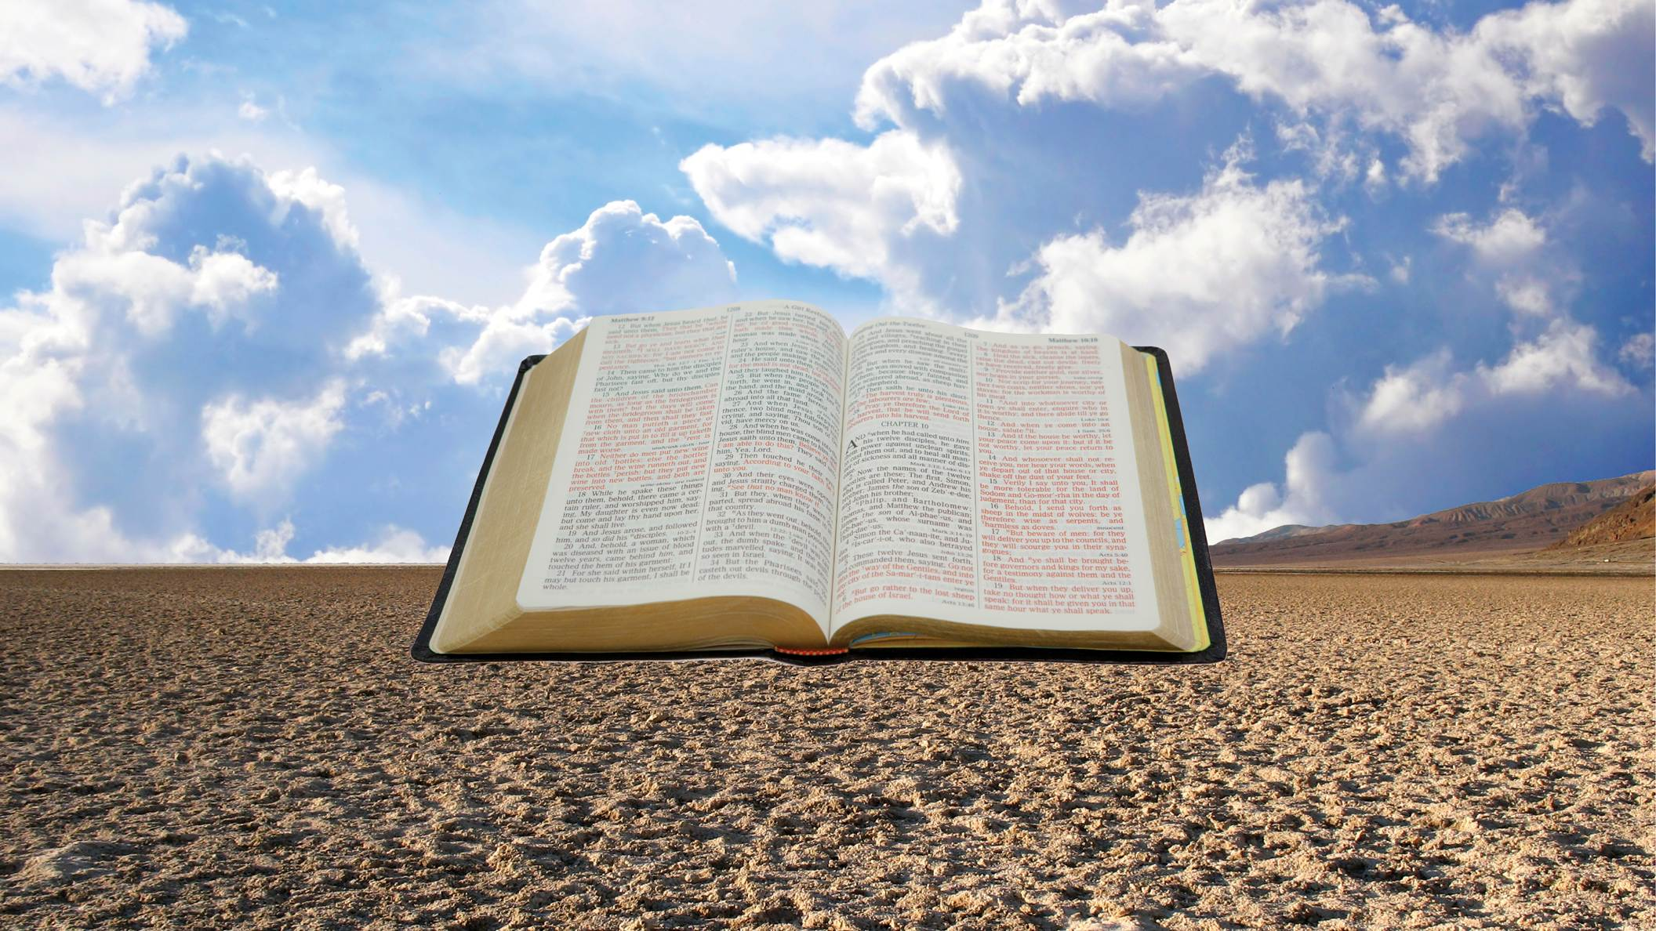
6
Notes:
born as a baby on the earth. Coming down from heaven is symbolic, in that the heavens, the skies above, symbolize God, purity and goodness. Therefore the prophecy of the Messiah coming from heaven does not mean from the literal sky, but that his origin is of God.
Sadly, at the time of Jesus, some took the prophecy of the Messiah floating down from above literally and therefore refused to believe that

Slide 7
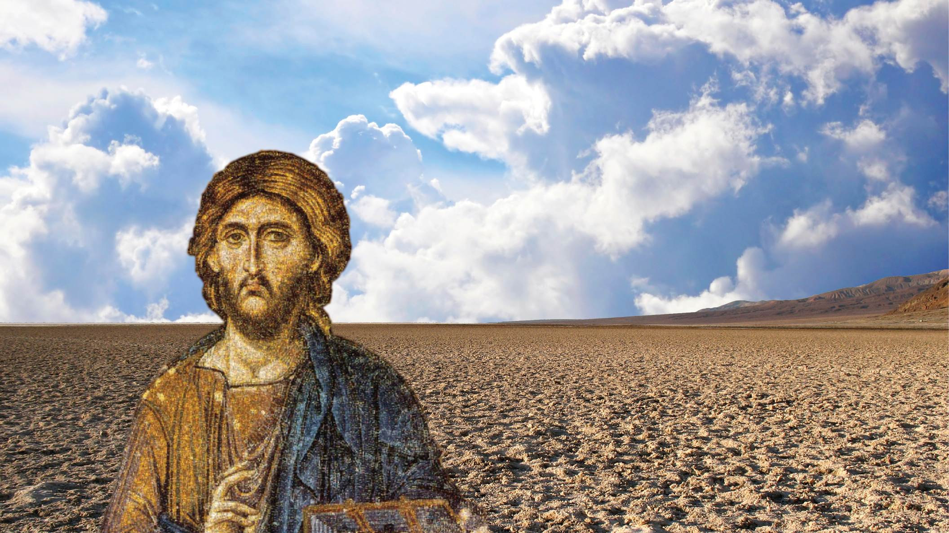
7
Notes:
Jesus was the Messiah, because they knew he was born on earth. (John 6:41-42)
We should be careful not to make that same mistake, because we too have the prophecy of the Messiah coming on the clouds of heaven. (Matthew 24:30)

Slide 8
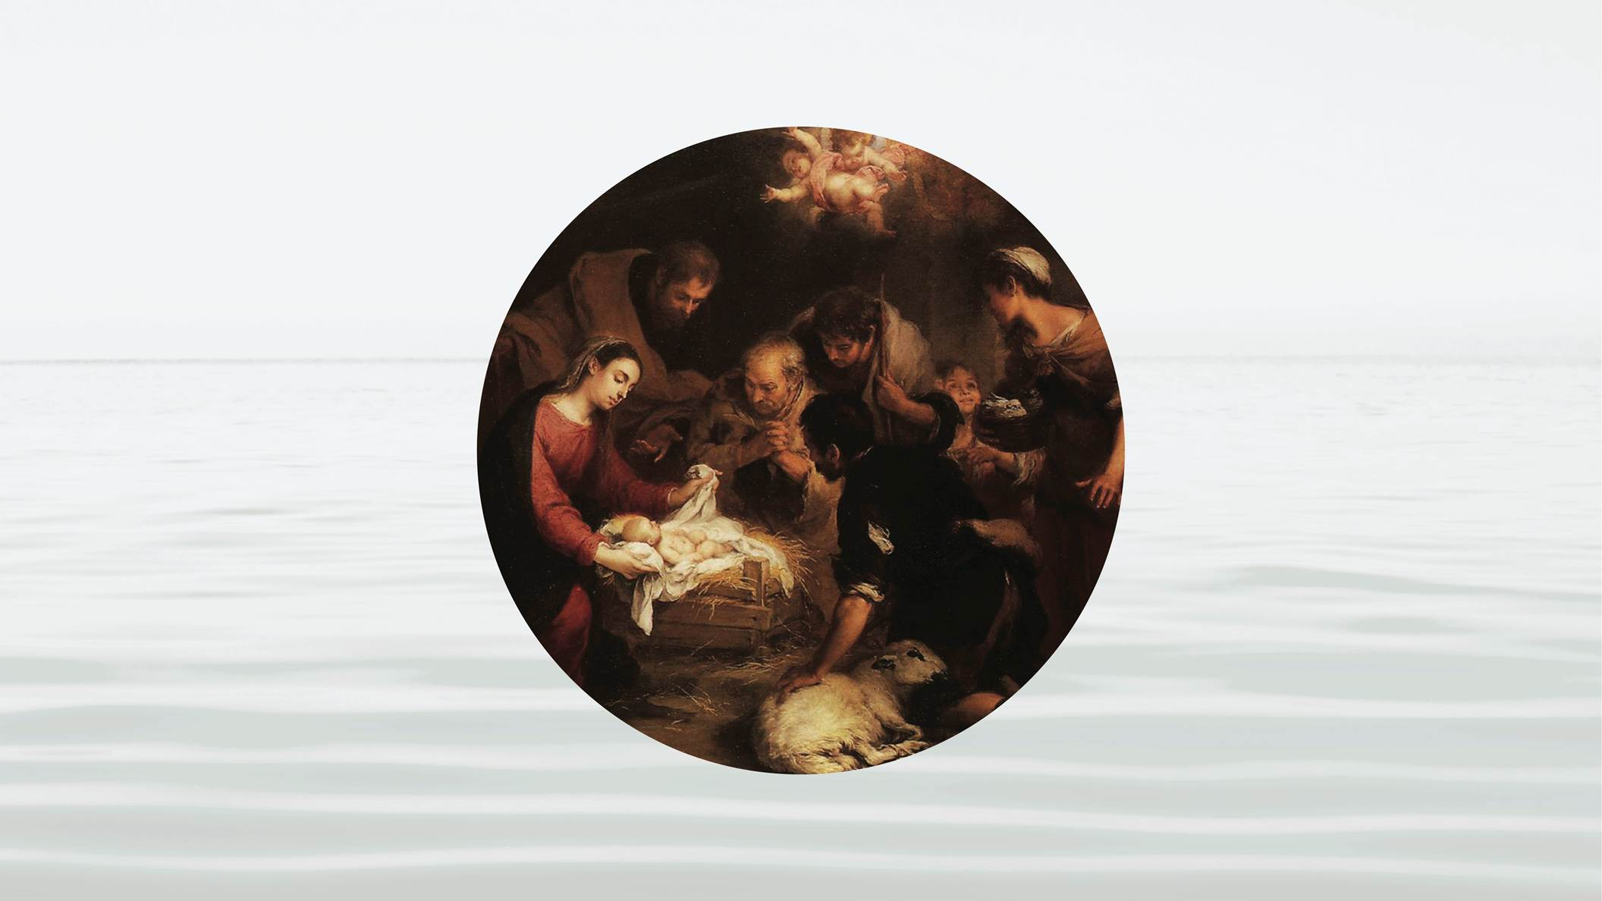
8
Notes:
Focusing on that causes us to ignore Revelation 12:5, which says he will be born of a woman.
The real problem here is that we assume that Jesus himself will be the one to come again. Most Christians can’t imagine that another person could be born as the Messiah.

Slide 9
9
Notes:
Part of this confusion comes from the fact that there are two kinds of Second Comings. One has to do with Jesus himself. This second coming has happened many times.

Slide 10
10
Notes:
Jesus appeared to Mary Magdalene outside the tomb, and he appeared to

Slide 11
11
Notes:
the disciples for 40 days. He appeared to

Slide 12
12
Notes:
Stephen, the first Christian martyr. He appeared to

Slide 13
13
Notes:
St. Paul. It has happened countless times. According to Jesus, in Matthew 18:20, he returns every time people gather together in his name. This kind of Second Coming

Slide 14
14
Notes:
strengthens our faith and guides our lives,

Slide 15
15
Notes:
but it does not fix the fall. It does not restore God’s ideal of creation. Even though Jesus has returned many times, the world continues to suffer. St Paul spoke in Romans 8:32 of a future in which our bodies we will be redeemed. This is the other kind of

Slide 16
16
Notes:
Second Coming. This is the Second Coming that Revelation 19:7 describes as a bridegroom who is to be married. This is the Messiah who fixes the mistake of Adam and Eve, who creates a

Slide 17
17
Notes:
family rooted in God’s love. This Second Coming will be born on the earth and Jesus will return as a different person.
It may be difficult to accept that a person could return through someone else,

Slide 18
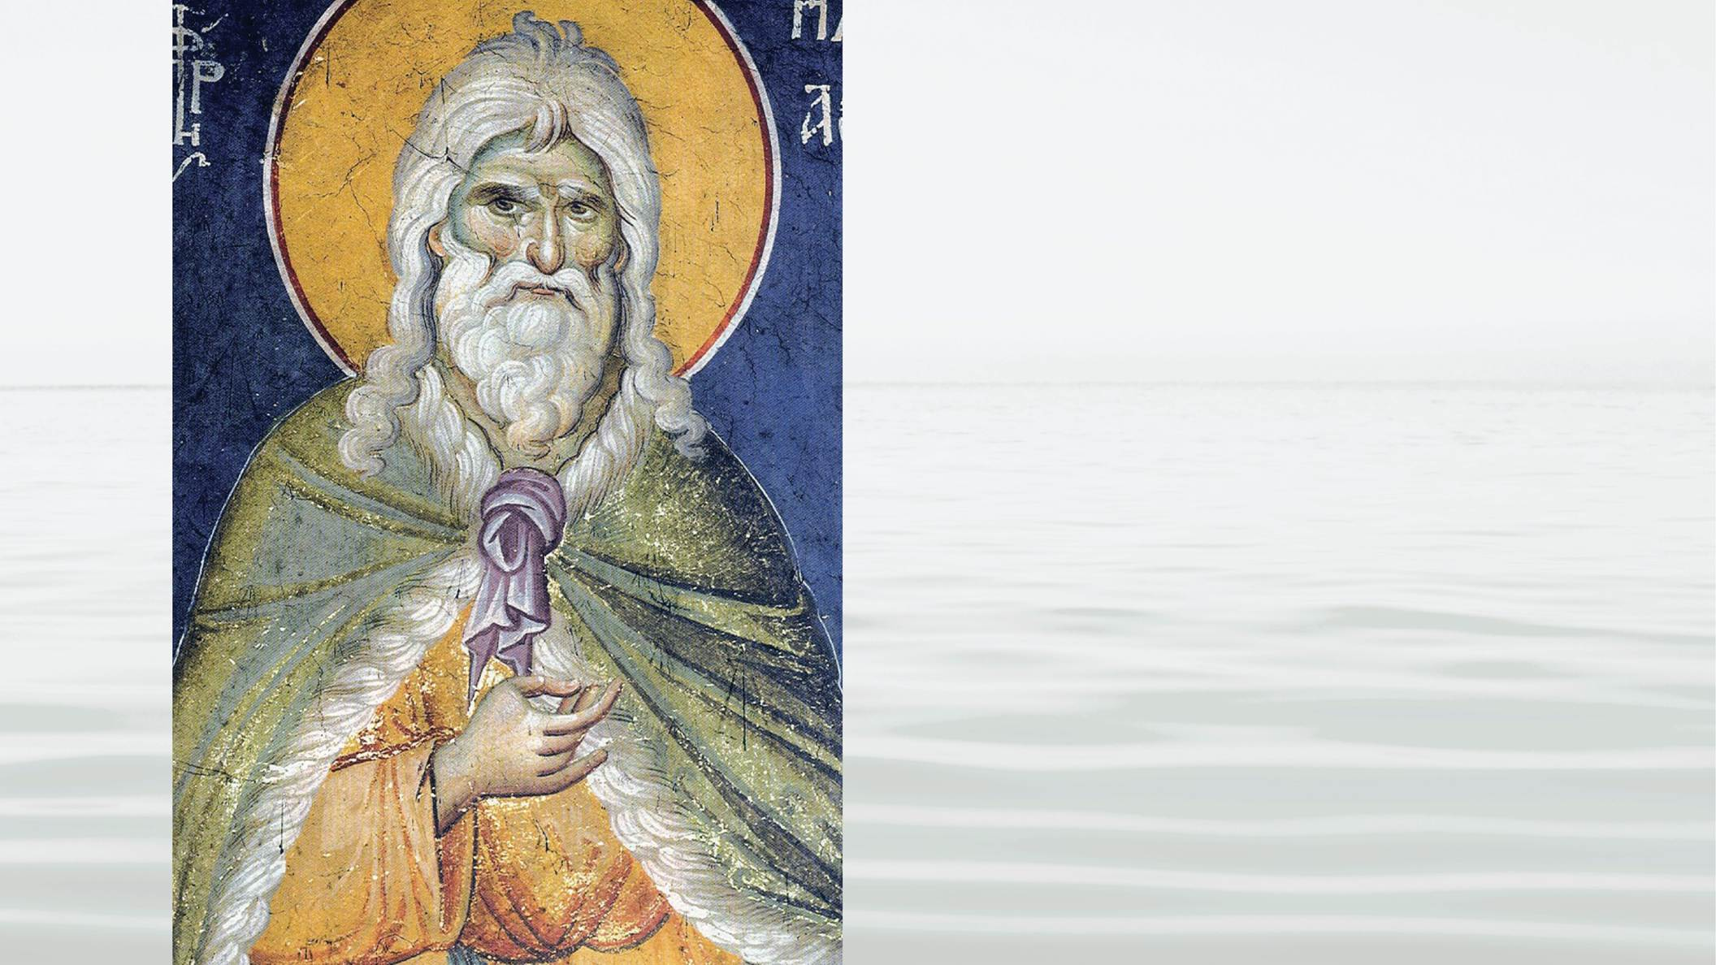
18
Notes:
but this is something Jesus himself taught. He said that Elijah had returned through another person.

Slide 19
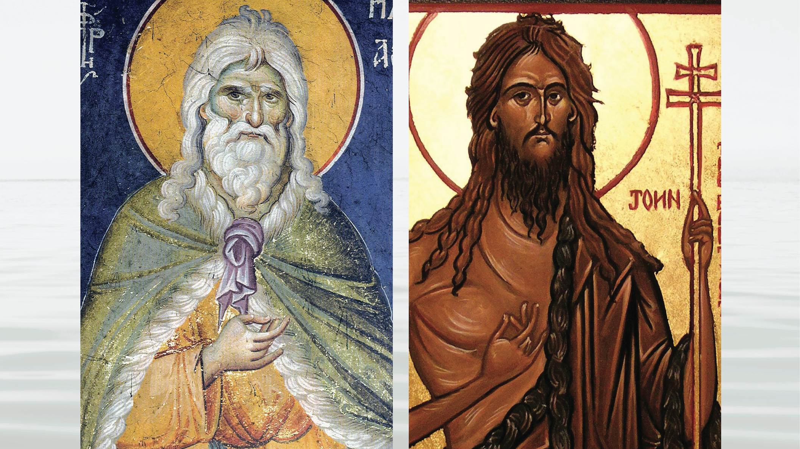
19
Notes:
John the Baptist had come in the spirit and power of Elijah – but was not Elijah himself.

Slide 20
20
Notes:
The next question is when? When will the Messiah be born into this world?

Slide 21
21
Notes:
We have looked at the three 2,000-year periods, from Adam to Abraham, from Abraham to Jesus, and from Jesus to the present. We pointed out several parallels, ending with the parallel between Malachi and Martin Luther. 400 years after Malachi, Jesus was born. If our parallels are correct, this would indicate that the Messiah would be born 400 years after Luther,

Slide 22
22
Notes:
which would be around 1917.
After a century of relative stability, massive wars and revolutions occurred around that time. The first was

Slide 23
23
Notes:
World War I. Then came

Slide 24
24
Notes:
World War II, and then the expansion of

Slide 25
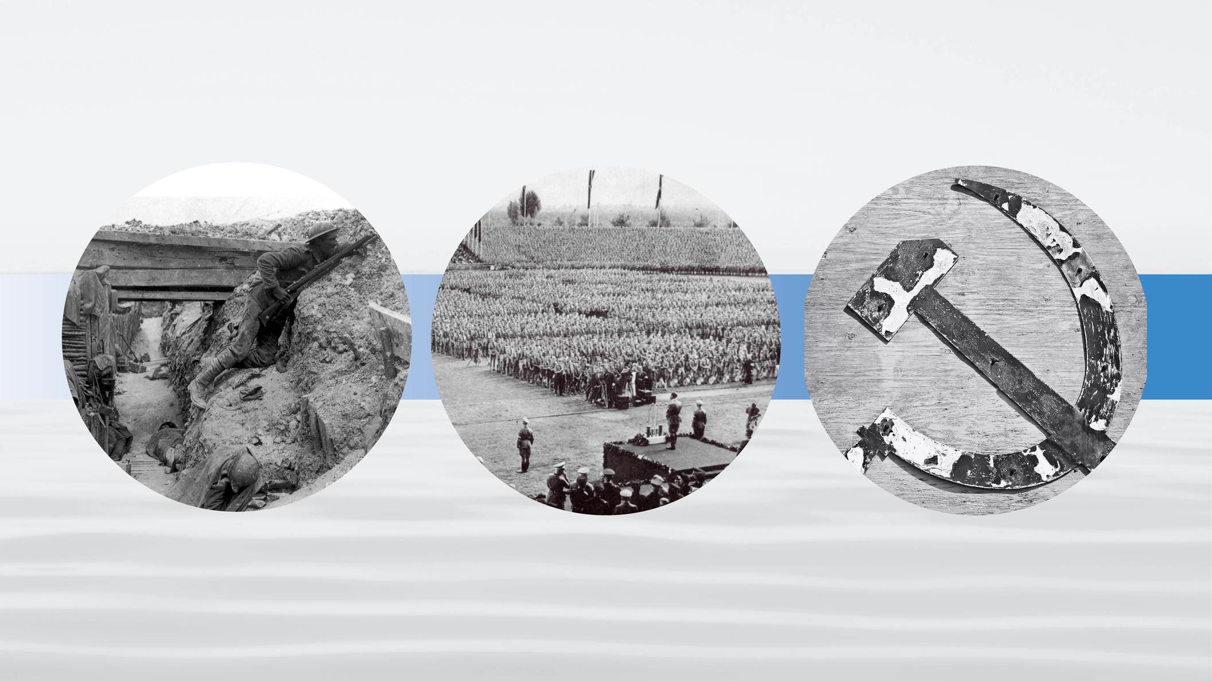
25
Notes:
communism, which crushed faith, freedom and life itself. In each of these there was the side of Cain,

Slide 26
26
Notes:
more distant from God’s will, and of Abel,

Slide 27
27
Notes:
closer to God’s will. In Adam’s family Cain killed Abel, destroying the foundation for the Messiah.

Slide 28
28
Notes:
On the global level, God could send the Messiah if the Abel side could prevail. In World War I, Germany, Austria-Hungary, and Turkey were imperial regimes oppressing freedom. The United States, England and France were free Christian democracies, and they prevailed.

Slide 29
29
Notes:
Because of this worldwide condition, the Messiah could be born. But the forces oppressing faith and freedom would try to suppress him.

Slide 30
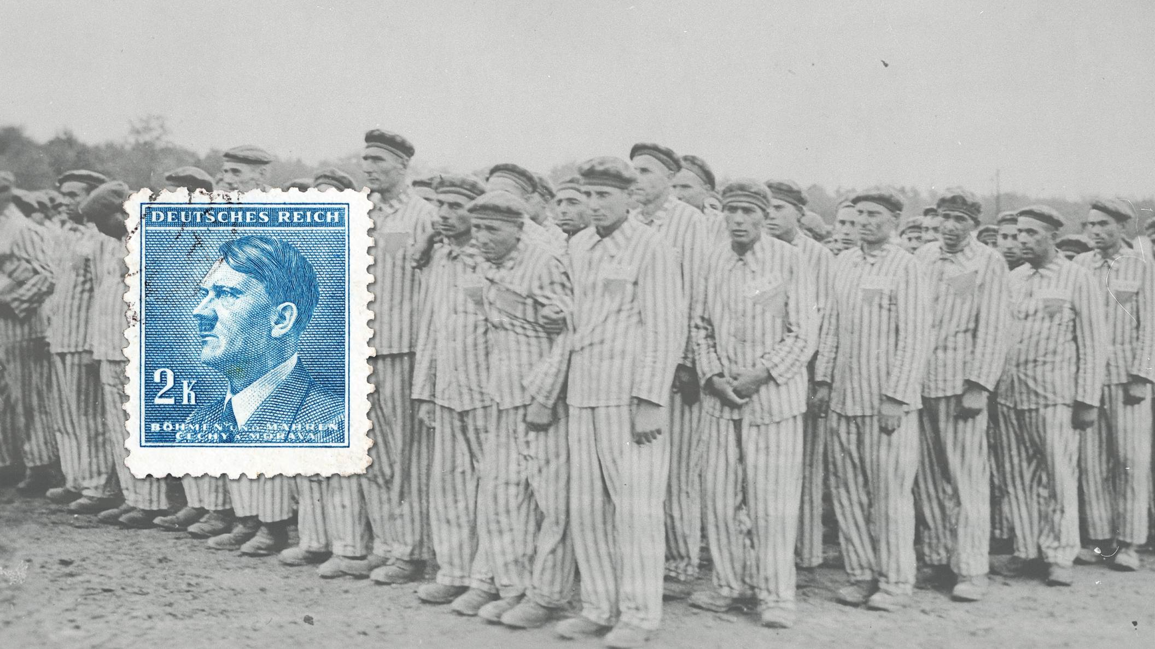
30
Notes:
Germany, Italy and Japan united to conquer the world, but the free world again prevailed in 1945. This was the condition for the Messiah to begin his ministry. From that time, Communism expanded its totalitarian oppression.

Slide 31
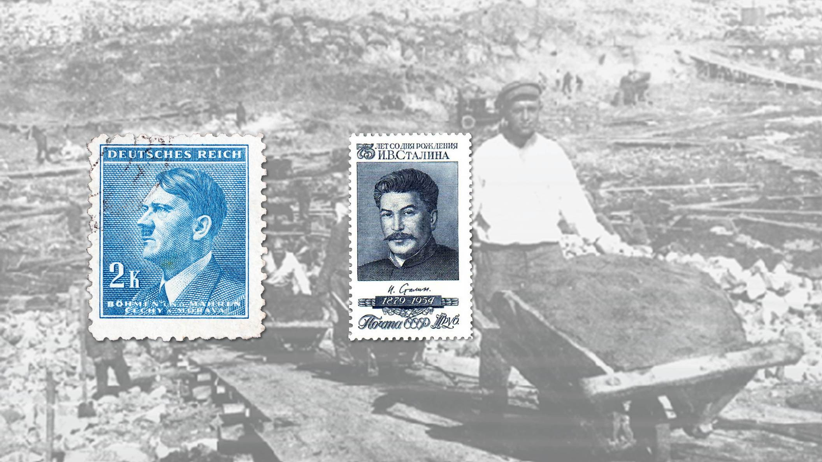
31
Notes:
Under Stalin, millions died. The Communist States all but destroyed religion. In China,

Slide 32
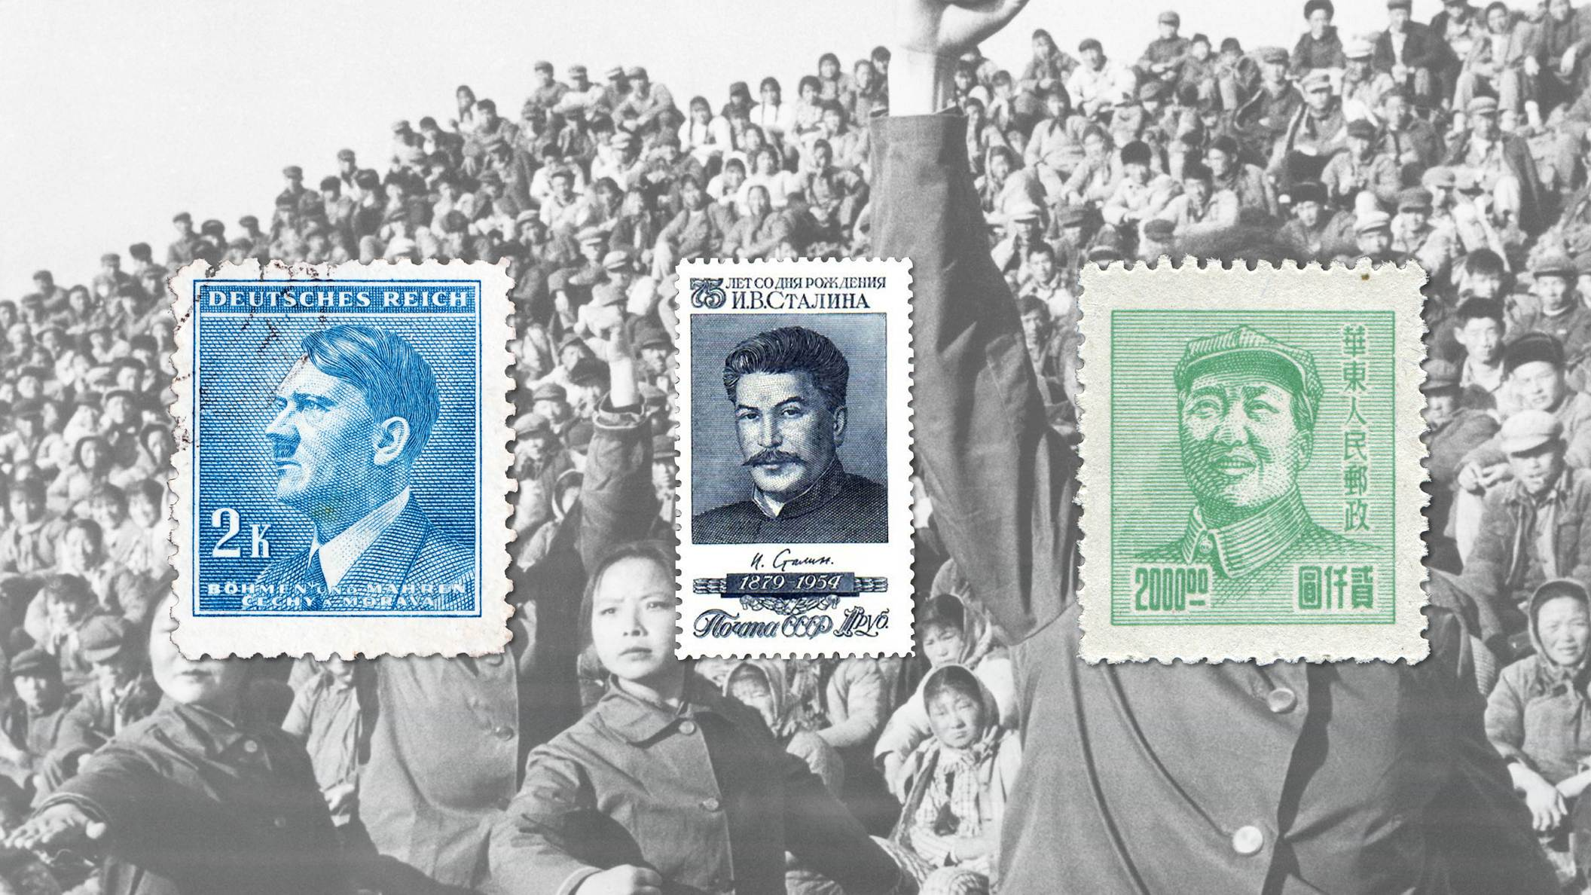
32
Notes:
Mao replaced God with Communist heads of state. It was at this time that God called the Messiah to uplift and empower Christianity, to reject communism decisively, and to lead the faithful of all religions to fulfill

Slide 33
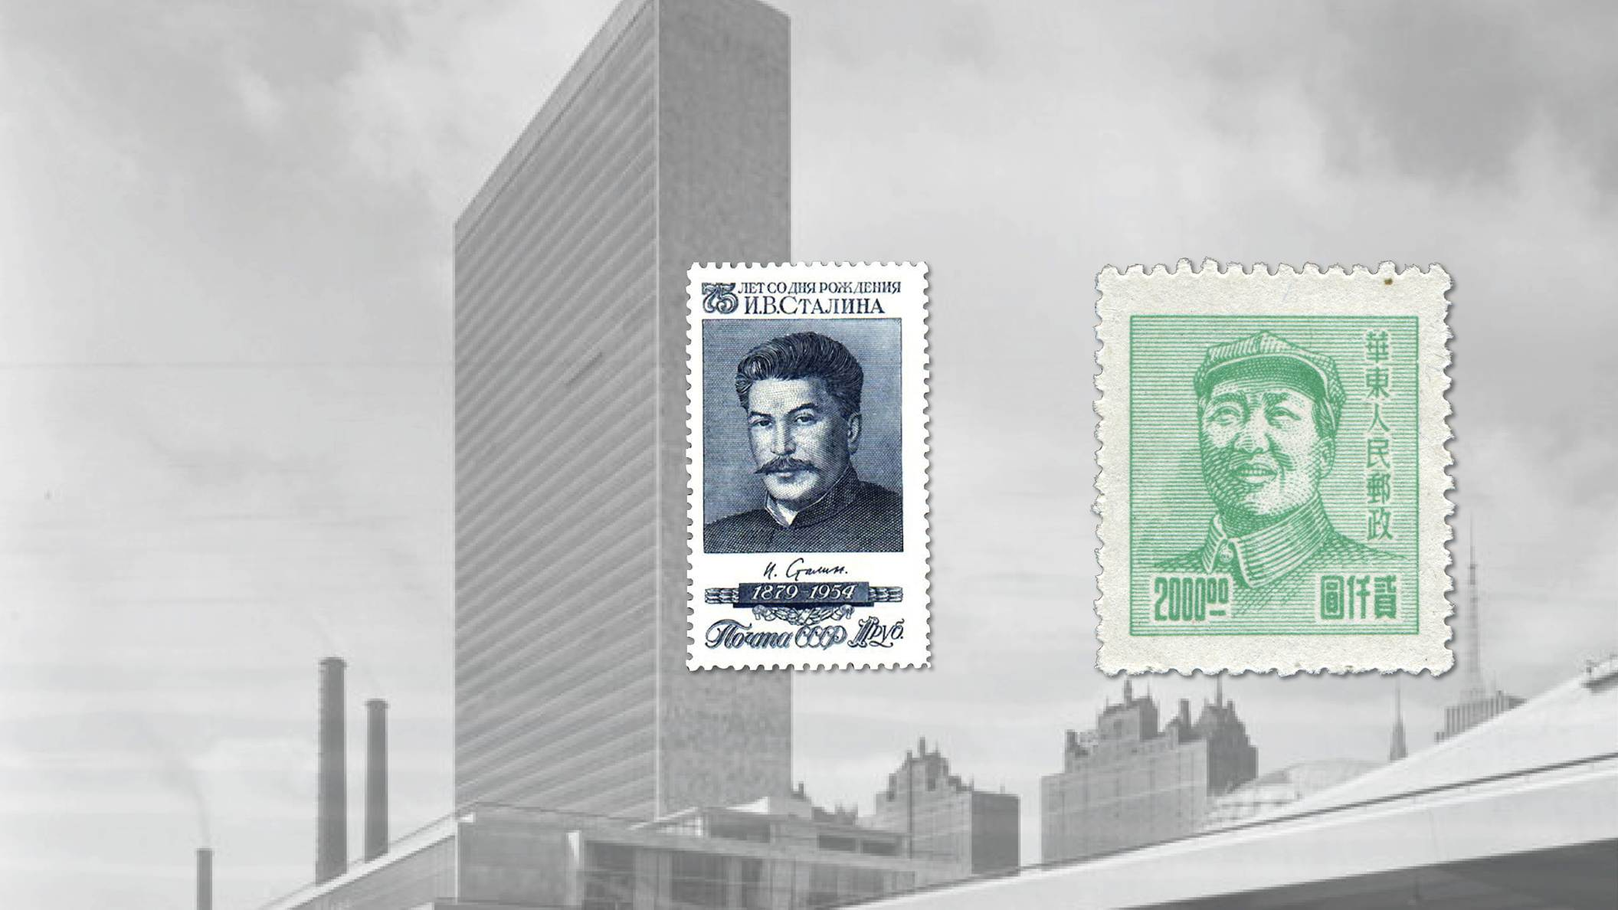
33
Notes:
the ideal of creation. By the 1950s Communism should have fallen and a new culture based on freedom, the love of God, and mutual cooperation was to have emerged out of a revitalized Christianity and was to have led the United Nations.
However, the Messiah did not appear.

Slide 34
34
Notes:
Why?

Slide 35
35
Notes:
Why, in the 40 years until 1985, did Communism expand?

Slide 36
36
Notes:
Why did Christian nations decline, while seeing the rise of drug use, free sex, consumerism and the breakdown of the family?

Slide 37
37
Notes:
It is because the person God chose to be the Messiah was not received. What happened to Jesus 2,000 years ago happened again. This person was condemned to die

Slide 38
38
Notes:
in a communist concentration camp. This time, however, the Messiah did not die. He continued his ministry. Gradually, over time, he gathered

Slide 39
39
Notes:
A small number of disciples. By 1960, he and his bride

Slide 40
40
Notes:
were blessed in marriage and were able to establish God’s family. On that foundation they have given the blessing of God to tens of thousands of families, of every nation, race, and culture.
The Messiah and his bride, the True Parents, are building God’s ideal on this earth. Now your question must be,

Slide 41
41
Notes:
who is this person and who is his bride? In Matthew 7:16, Jesus urged us to be careful, not to follow false prophets. He told us that we would know them by their fruits.

Slide 42
42
Notes:
A good tree will always produce good fruits and an evil tree will produce evil fruits.
To conclude our session today, let’s consider

Slide 43
43
Notes:
the qualities should we look for in this person.

Slide 44
44
Notes:
This person must be able to reveal the true heart of God and His sorrow as the Parent of all humanity.

Slide 45
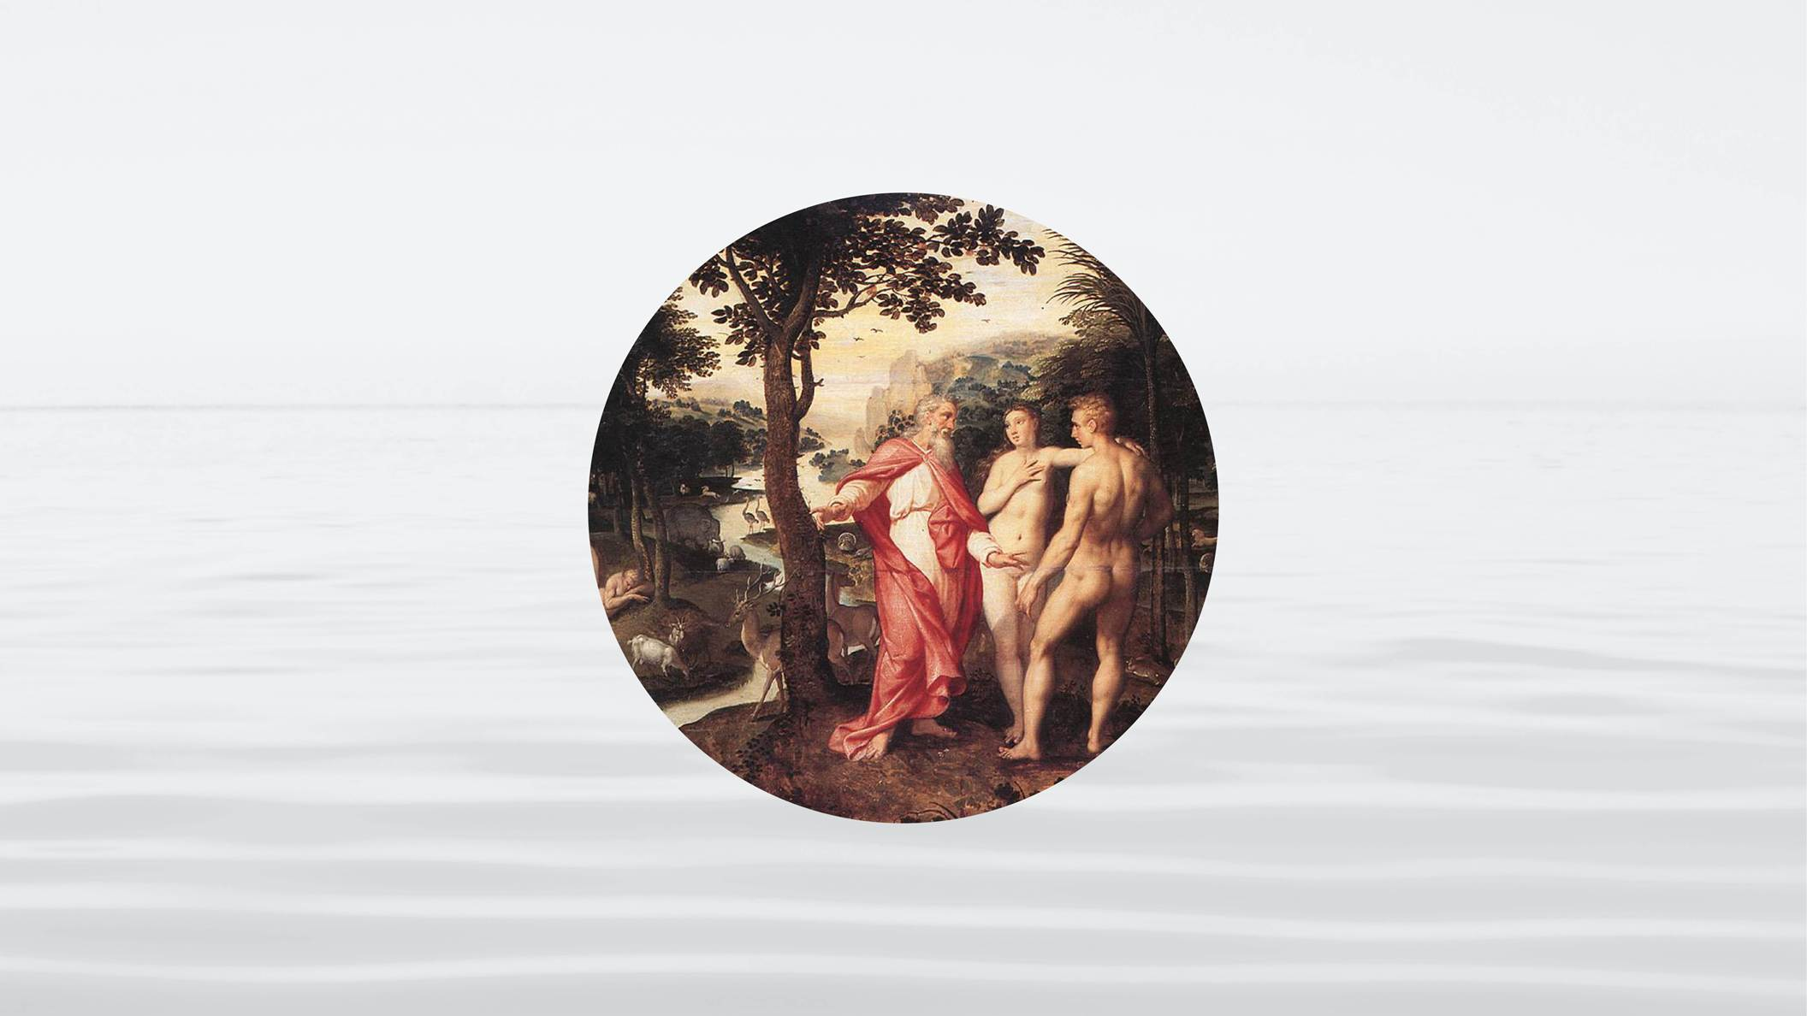
45
Notes:
He must reveal the purpose for which God created us.

Slide 46
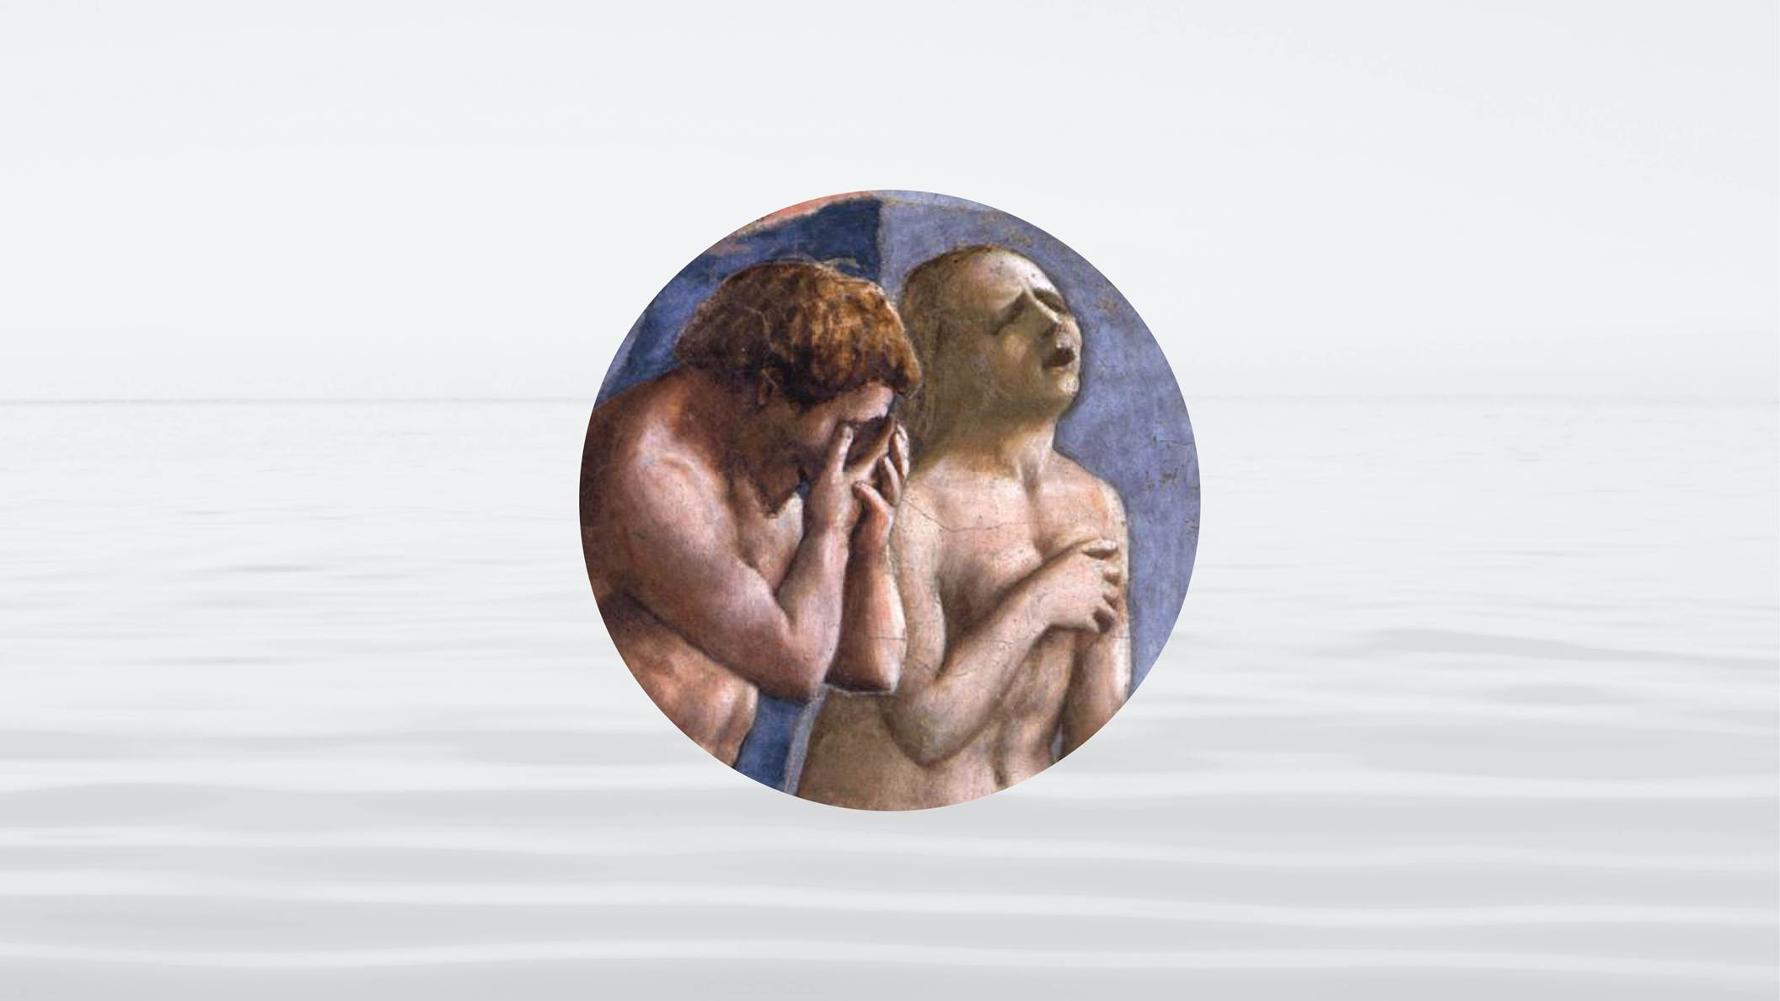
46
Notes:
He must reveal the original sin. He must expose that crime that separated all generations from God’s love.

Slide 47
47
Notes:
This person must reveal the mission and heart of Jesus.

Slide 48
48
Notes:
He must show us how God has been working in history to bring salvation.

Slide 49
49
Notes:
This person must establish a family through which God’s love can flow to all people.

Slide 50
50
Notes:
And this person and his bride must love with God’s sacrificial love, as parents to all, and give God’s blessing to all families, enabling all people to form one family under God. If you find this person, this couple, you’ve found the one God and Jesus have sent.

Slide 51
Notes:
Thank you for studying with us. I pray that you will receive God’s abundant blessings.

