Slide 2
Family Federation for
World Peace and Unification

Slide 3
presents

Slide 4
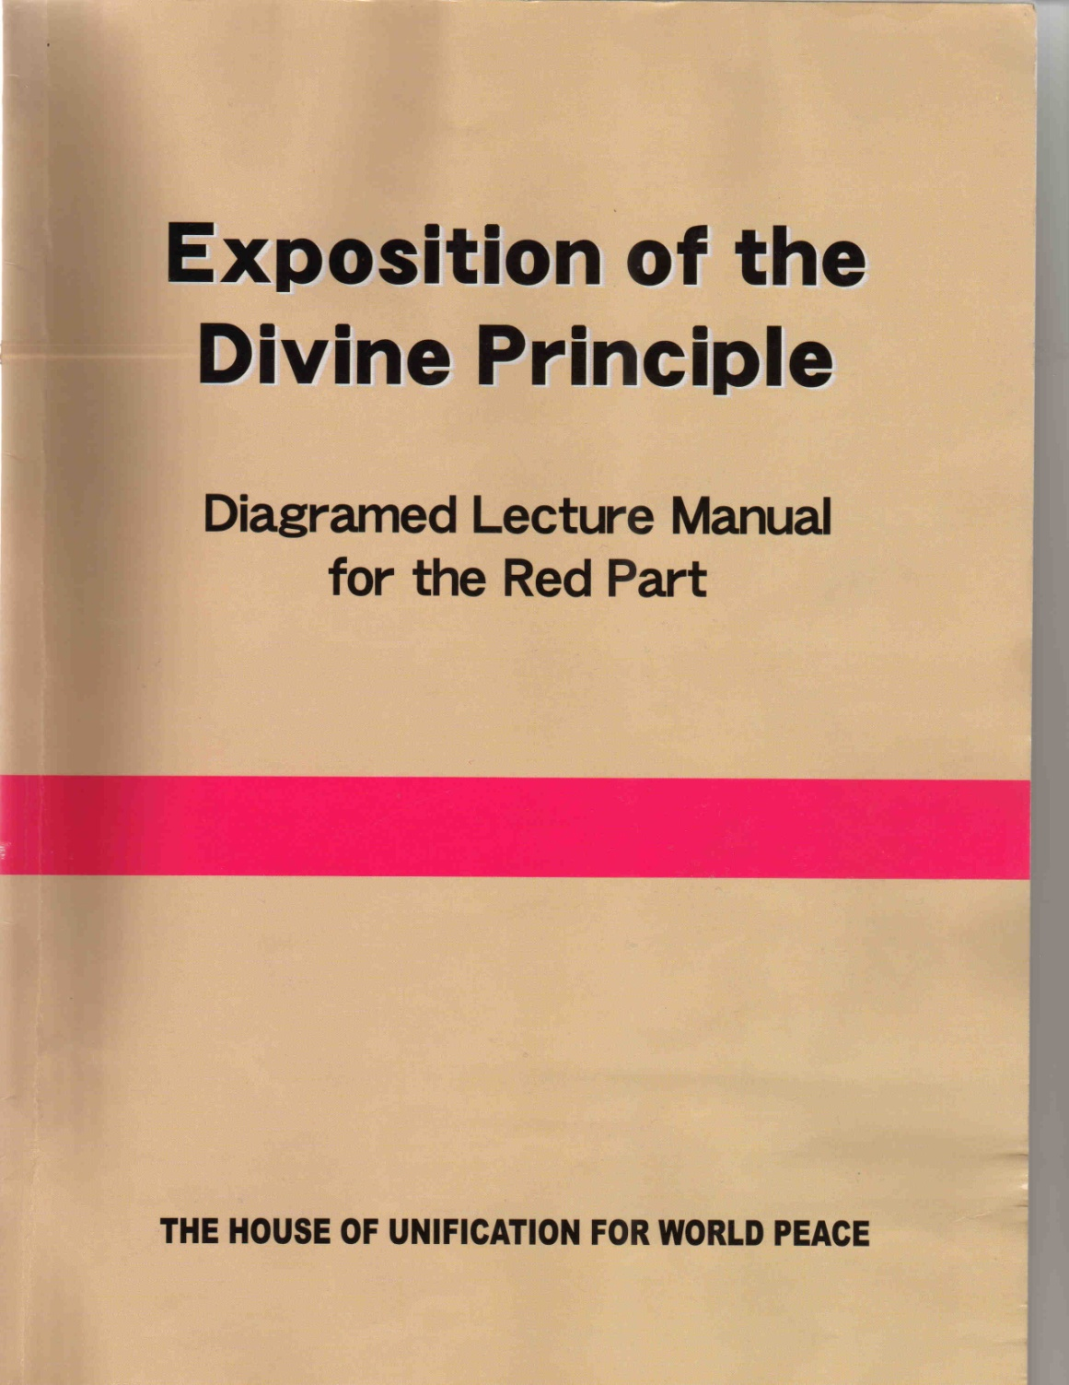
A Slide Show Presentation
of the Divine Principle
- Red Part -

Slide 5
Introduction

Slide 6
(1)
Human striving
Happiness
Misfortune

Everyone is struggling to attain happiness and avoid misfortune (p. 1).

People feel joy when their desires are fulfilled.

Slide 7
(2)
Human contradiction and the fall
Original
Mind
Evil
Mind
Happi-
ness
Good-
ness
Wicked-
ness
Mis-
fortune

Within the self-same individual are two opposing inclinations: the original mind that desires goodness and the evil mind that desires wickedness (p. 2).

Slide 8
(2)
Human contradiction and the fall
Original
Mind
Evil
Mind
Happi-
ness
Good-
ness
Wicked-
ness
Mis-
fortune
contradiction

They are engaged in a fierce battle, striving to accomplish two conflicting purposes. Any being possessing such a contradiction within itself is doomed to perish.

Slide 9
(2)
Human contradiction and the fall
Original
Mind
Evil
Mind
Happi-
ness
Good-
ness
Wicked-
ness
Mis-
fortune
contradiction
state of destruction
...…
the Fall

Christianity sees this state of destruction as the result of the human Fall.

Slide 10
(3)
Human Ignorance
Intellect
Ignor-
ance

Considered from the viewpoint of the intellect, the human Fall represents humanity’s descent into ignorance.

Slide 11
(3)
Human Ignorance
mind
Internal
Intellect
:
Ignor-
ance
body
External
Intellect
:

People are composed of two aspects: internal and external, or mind and body; likewise, the intellect consists of two aspects: internal and external.

Slide 12
(3)
Human Ignorance
mind
Internal
Intellect
Internal
Ignorance
}
:
Ignor-
ance
body
External
Intellect
External
Ignorance
:

In the same way, there are two types of ignorance:
Internal ignorance and external ignorance.

Slide 13
(4)
Human search for truth
Internal
Ignorance
Search for
internal truth
Religion
External
Ignorance

Humanity through religion has followed the path of searching for internal truth.

Slide 14
(4)
Human search for truth
Internal
Ignorance
Search for
internal truth
Religion
Science
External
Ignorance
Search for
external truth

and through science has followed the path of seeking external truth (p. 3).

Slide 15
(4)
Human search for truth
Internal
Ignorance
Search for
internal truth
Religion
Science
External
Ignorance
Search for
external truth

They have seemed in the course of their development to take positions that were contradictory and irreconcilable.

Slide 16
(5)
Need for the new truth
Internal
Ignorance
Internal
Knowledge
Religion
Religion
Realize
Good-
ness
New Truth
Science
Science
External
Ignorance
External
Knowledge

For humankind to completely overcome the two aspects of ignorance and fully realize the goodness which the original mind desires, at some point in history there must emerge a new truth which can reconcile religion and science and resolve their problems in an integrated undertaking (p. 6).

Slide 17
(6)
Mission of the new truth
Humanity
New World
New Truth

New Truth should bring humanity into a new world (p. 7-8).

Slide 18
(6)
Mission of the new truth
Humanity
New World
Religions
Ideologies
Philosophies
Unity
New Truth

New Truth should be able to embrace all historical religions, ideologies, and philosophies and bring complete unity among them.

Slide 19
(6)
Mission of the new truth
Humanity
New World
Religions
Ideologies
Philosophies
Unity
Fallen
people
Original
State

New Truth should guide fallen people to return to their original state.

Slide 20
Reverend
Sun Myung
Moon

God has sent one person to this earth to resolve the fundamental problems of human life and the universe. His name is Rev. Sun Myung Moon (p. 12).

Slide 21
For more information visit our website
http://www.unificationstudy.com

