Slide 2
Chapter 1
The Principle of Creation

Slide 3
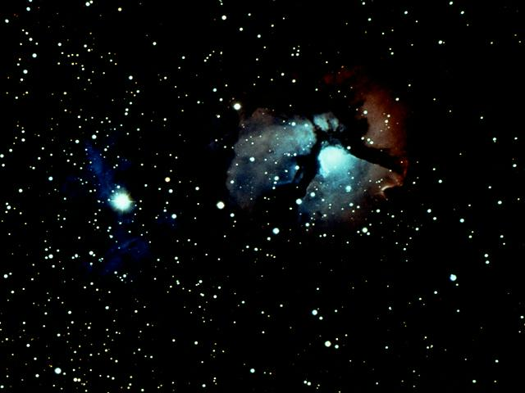
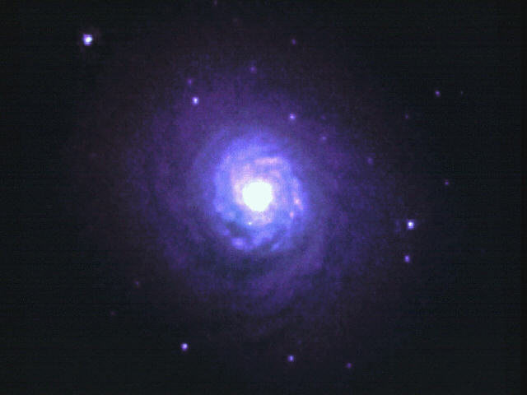
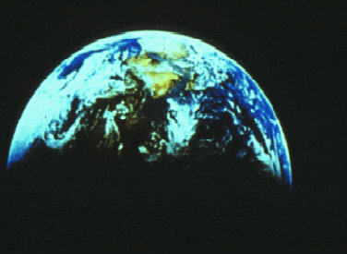

Throughout history, people have anguished over the fundamental questions of human life and the universe (p. 15).

Slide 4
Principle
Humanity
and
Universe
Result

This is because no one has understood the root principle
by which humanity and the universe were originally created.

Slide 5
Principle
Humanity
and
Universe
Result

The fundamental question is that of the causal reality.

Slide 6
Causal
reality
Principle
Humanity
and
Universe
Result

The fundamental question is that of the causal reality.

Slide 7
Causal
reality
Principle
Humanity
and
Universe
Result

Problems concerning human life and the universe cannot be solved without first understanding the nature of God.

Slide 8
Causal
reality
God
Principle
Humanity
and
Universe
Result

Problems concerning human life and the universe cannot be solved without first understanding the nature of God.

Slide 9
Section 1
The Dual Characteristics of God
and the Created Universe
1.1 The Dual Characteristics of God

Slide 10
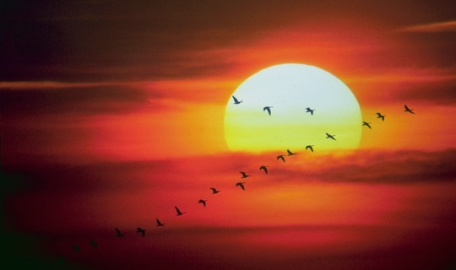
(1) How can we know
the divine nature of the invisible God ?

One way to fathom God’s deity is by observing the universe which He created.

Slide 11
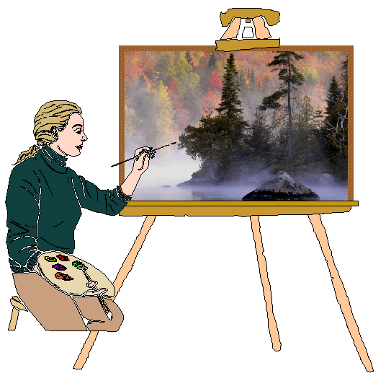
(1) How can we know
the divine nature of the invisible God ?
Character of
an artist
Nature of
God
Invisible:
Ever since the creation of the world his invisible nature, namely, his eternal power and deity, has been clearly perceived in the things that have been made. So they are without excuse.
Rom.
1:20
Works of Art
Creation
Visible:
Romans 1:20

Just as we can come to know the character of an artist through his works, so we can understand the nature of God
by observing the diverse things of creation (Rom. 1:20) (p. 16).

Slide 12
(2)
Common elements in the natural world
Common elements

Let us point out the common elements which are found universally throughout the natural world.

Slide 13
(2)
Common elements in the natural world
Entity
Yang
Dual
Characteristics
A
]
Yin
A
Every entity, both within the entity and between it and other entities, possesses dual characteristics of yang and yin.

Slide 14
(2)
Common elements in the natural world
Entity
Yang
Dual
Characteristics
A
]
Yin
(inner quality)
Entity
B
(outer form)
B
More fundamentally, every entity possesses both an outer form and inner quality. The visible outer form resembles the invisible inner quality.

Slide 15
(2)
Common elements in the natural world
Entity
Yang
Dual
Characteristics
A
]
Yin
(inner quality)
Internal nature
Entity
B
(outer form)
External form
The inner quality is called internal nature, and the outer form or shape is called external form (p. 17).

Slide 16
(2)
(2)
Common elements in the natural world
Entity
Yang
Dual
Characteristics
A
]
Yin
(inner quality)
Internal nature
Entity
B
(outer form)
External form

Since internal nature and external form refer to corresponding inner and outer aspects of the entity, the external form may also be understood as a second internal nature.

Slide 17
(2)
Common elements in the natural world
Entity
Yang
Dual
Characteristics
A
]
Yin
(inner quality)
Internal nature
Entity
]
Dual
Characteristics
B
(outer form)
External form
Therefore, the internal nature and external form together constitute dual characteristics.

Slide 18
God
(Original) Yang
Dual
Characteristics
First
Cause
]
(Original) Yin

It is only natural to surmise that God, the First Cause of all things, also exists based on the reciprocal relationship between His dual characteristics of yang and yin (p. 18).

Slide 19
God
(Original) Yang
Dual
Characteristics
First
Cause
]
(Original) Yin
internal nature
God
Dual
Characteristics
First
Cause
]
external form

As the First Cause, God must also possess the dual characteristics of internal nature and external form, which stand in the position of subject partner to the internal natures and external forms of all beings.

Slide 20
God
(Original) Yang
Dual
Characteristics
First
Cause
]
(Original) Yin
internal nature
Original
God
Dual
Characteristics
First
Cause
]
external form
Original
We call God’s internal nature and external form the original internal nature and original external form.

Slide 21
(3)
Relationship between God’s original internal nature
and external form,
and God’s original Yang and Yin
Original
Yang
Original
internal
nature
Original
Yin
Original
Yang
Original
external
form
Original
Yin

God’s original internal nature and original external form each contain the mutual relationship of original yang and original yin.

Slide 22
(3)
Relationship between God’s original internal nature
and external form,
and God’s original Yang and Yin
Original
Yang
Original
internal
nature
Original
Yin
Original
Yang
Original
external
form
Original
Yin
Therefore, original yang and original yin are attributes of original internal nature and original external form (p. 19).

Slide 23
(4)
God is:

Harmonious union of
original internal nature
and
original external form

God is the Subject and harmonious union of
original internal nature and original external form.

Slide 24
(4)
God is:

Harmonious union of
original internal nature
and
original external form

Harmonious union of masculinity and femininity

God is the harmonious union of masculinity and femininity, which manifest the qualities of original internal nature and original external form, respectively.

Slide 25
(4)
God is:

Harmonious union of
original internal nature
and
original external form

Harmonious union of masculinity and femininity

Subject partner
of internal nature
and masculinity towards the universe

God is the subject partner having qualities of internal nature and masculinity towards the universe.

Slide 26
1.2
The Relationship between God and the Universe
Universe
God
Internal
nature
+
+
-
Human
beings
Original
internal
nature
-
External
form
+
-
Internal
nature
+
Original
external
form
+
-
All
things
-
External
form
+
-

The relationship between God and the universe can be summarized thus:

Slide 27
1.2
The Relationship between God and the Universe
Universe
God
Internal
nature
+
+
-
Human
beings
Original
internal
nature
-
External
form
+
-
Internal
nature
+
Original
external
form
+
-
All
things
-
External
form
+
Invisible
subject
partner
-
Substantial object partner

God is the invisible subject partner, and the universe as a whole is a substantial object partner to God.

Slide 28
1.2
The Relationship between God and the Universe
Universe
God
Internal
nature
+
+
-
Human
beings
Original
internal
nature
Image
-
Principle
of
Creation
+
External
form
-
Internal
nature
+
Original
external
form
+
-
Symbol
All
things
-
External
form
+
Invisible
subject
partner
-
Substantial object partner
In accordance with the Principle of Creation, God’s dual characteristics manifest itself symbolically or in image as individual embodiments of truth, which constitute the universe (p. 20).

Slide 29
Section 2
Universal Prime Energy,
Give and Take Action,
and the Four Position
Foundation

Slide 30
2.1 Universal Prime Energy

Creator

Absolute reality
God

Eternal

Self-existent
Transcendent


God, the Creator of all things, is the absolute reality, eternal, self-existent and transcendent of time and space (p. 21).

Slide 31
2.1 Universal Prime Energy

Creator
Fundamental
energy

Absolute reality
God

Eternal
Eternal

Self-existent
Self-existent
Transcendent
Absolute


The fundamental energy of God’s being is also eternal, self-existent and absolute.

Slide 32
2.1 Universal Prime Energy

Creator
Fundamental
energy

Absolute reality
God

Eternal
Eternal

Self-existent
Self-
existent
Transcendent

Created
beings
Absolute
Exist
Origin of
all energy

It is the origin of all energies and forces that allow created beings to exist.

Slide 33
2.1 Universal Prime Energy

Creator
Fundamental
energy

Absolute reality
God

Eternal
Eternal

Self-existent
Universal
Prime
Energy
Self-
existent
Transcendent

Created
beings
Absolute
Exist
Origin of
all energy

We call this fundamental energy universal prime energy.

Slide 34
2.2 Give and Take Action
Universal Prime Energy
God
(U.P.E.)
Common base
Subject
element
Object
element
Interaction

Through the agency of universal prime energy, the subject and object elements of every entity form a common base and enter into interaction.

Slide 35
2.2 Give and Take Action
Universal Prime Energy
God
(U.P.E.)
Common base
Subject
element
Object
element
Interaction
}
Exist
Forces
Forces for the entity
Multiply
Act
This interaction, in turn, generates all the forces the entity needs for existence, multiplication and action (p. 22).

Slide 36
2.2 Give and Take Action
Universal Prime Energy
God
(U.P.E.)
Common base
Subject
element
Object
element
Interaction
}
Exist
Forces
Forces for the entity
Forces
Multiply
Act

The interaction generating these forces through this process is called give and take action.

Slide 37
2.3 The Four Position Foundation
Which Realizes the Three Object Purpose
through Origin-Division-Union Action
2.3.1
Origin-Division-Union-Action
_ _ _ _ _ _ _ _ _
Origin
God
Subject
partner
Object
partner
_ _ _
Division
Union
_ _ _ _ _ _ _ _ _
Union

The process in which out of God, the Origin, two entities are separately manifested and reunited in oneness is called origin – division – union action (p. 24).

Slide 38
2.3.2
Three Object Purpose
(Origin)
Subject
Partner
Object
Partner
God
Union
Subject
Partner
Object
Partner
Union
God
God
Union
Object
Partner
Subject
Partner
Union
Object
Partner
Subject
Partner
God
Communion of three object partners

Any of the four positions resulting from the origin-division-union action, namely, the origin, subject partner and object partner, and their union, may assume the position of subject partner and engage the other three as its object partners, forming a communion of three object partners (p. 25).

Slide 39
God
Subject
partner
Object
partner
Union

When each of the four then acts as the subject partner and enters into give and take with the other three, they fulfill the three object purpose.

Slide 40
God
God
Subject
partner
Object
partner
Union

When each of the four then acts as the subject partner and enters into give and take with the other three, they fulfill the three object purpose.

Slide 41
God
God
Subject
partner
Object
partner
Union
S. P.

When each of the four then acts as the subject partner and enters into give and take with the other three, they fulfill the three object purpose.

Slide 42
God
God
O. P.
Subject
partner
Object
partner
Union
S. P.

When each of the four then acts as the subject partner and enters into give and take with the other three, they fulfill the three object purpose.

Slide 43
God
God
O. P.
Subject
partner
Object
partner
Union
S. P.
Fulfillment of the three object purpose
Union

When each of the four then acts as the subject partner and enters into give and take with the other three, they fulfill the three object purpose.

Slide 44
God
God
O. P.
Subject
partner
Object
partner
Union
S. P.
Fulfillment of the three object purpose
Union

When each of the four then acts as the subject partner and enters into give and take with the other three, they fulfill the three object purpose.

Slide 45
2.3.3
The Four Position Foundation
Origin
_ _ _ _ _
God
Divi-
sion
_ _
Subject
partner
Object
partner
Union
_ _ _ _ _
Union

When the origin, the subject partner and object partner and their union all fulfill the three object purpose, the four position foundation is established.

Slide 46
2.3.3
The Four Position Foundation
_ _ _ _ _
1
Root of the principle of
three stages
Origin
God
Divi-
sion
_ _
Subject
partner
Object
partner
Union
_ _ _ _ _
Union

This foundation is:
1
Root of the principle of three stages because it involves three stages of God, husband and wife, and children.

Slide 47
2.3.3
The Four Position Foundation
_ _ _ _ _
1
Root of the principle of
three stages
Origin
God
2
Root of the number twelve
Divi-
sion
_ _
Subject
partner
Object
partner
Union
_ _ _ _ _
Union

This foundation is:
2
Root of the number twelve because as each of the four takes on three object partners, twelve object partners are created.

Slide 48
2.3.3
The Four Position Foundation
_ _ _ _ _
1
Root of the principle of
three stages
Origin
God
2
Root of the number twelve
Divi-
sion
_ _
3
Fundamental foundation of
goodness
Subject
partner
Object
partner
Union
_ _ _ _ _
Union

This foundation is:
3
Fundamental foundation of goodness and realization of God’s purpose of creation.

Slide 49
2.3.3
The Four Position Foundation
_ _ _ _ _
1
Root of the principle of
three stages
Origin
God
2
Root of the number twelve
Divi-
sion
_ _
3
Fundamental foundation of
goodness
Subject
partner
Object
partner
4
Fundamental foundation
for life
Union
_ _ _ _ _
Union

This foundation is:
4
Fundamental foundation for the life of all beings, providing all the forces necessary for their existence.

Slide 50
2.3.3
The Four Position Foundation
_ _ _ _ _
1
Root of the principle of
three stages
Origin
God
Root of the number twelve
2
Root of the number twelve
Divi-
sion
_ _
3
Fundamental foundation of
goodness
Subject
partner
Object
partner
Fundamental foundation of
goodness
4
Fundamental foundation
for life
Fundamental foundation
for life
Union
_ _ _ _ _
Union

Eternal purpose of creation

The four position foundation is God’s eternal purpose of creation.

Slide 51
Section 3
The Purpose of Creation

Slide 52

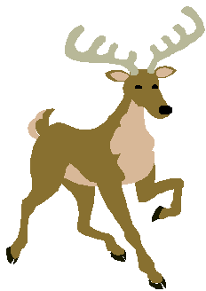
3.1 The Purpose of the Creation of the Universe
Gen. 1:4-31

After God completed each day of creation, He saw that it was good (Gen. 1:4-31)(p. 32).

Slide 53
3.1 The Purpose of the Creation of the Universe
Gen. 1:4-31
God
Delight
Creations
Object partners
of goodness

God wanted His creations to be object partners embodying goodness that He might take delight in them.

Slide 54
3.1 The Purpose of the Creation of the Universe
Gen. 1:4-31
God
Delight
Creations
Object partners
of goodness

Therefore, the ultimate purpose of the universe, with human beings at its center, is to return joy to God (p. 33).

Slide 55

3.2 Good Object Partners for the Joy of God
Subject Partner

Joy is not produced by an individual alone.

Slide 56

3.2 Good Object Partners for the Joy of God
Subject Partner
Subject Partner
Object Partner
(Intangible • substantial)

Joy arises when we have an object partner, whether intangible or substantial, in which our internal nature and external form are reflected and developed. Our object partner stimulates us and helps us to feel our own internal nature and external form.

Slide 57
3.2 Good Object Partners for the Joy of God
Subject Partner
Internal nature
External form
Object Partner
(Intangible • substantial)

Joy arises when we have an object partner, whether intangible or substantial, in which our internal nature and external form are reflected and developed. Our object partner stimulates us and helps us to feel our own internal nature and external form.

Slide 58




3.2 Good Object Partners for the Joy of God
Subject Partner
God
Internal nature
Original internal nature
External form
Original external form
Object Partner
(Intangible • substantial)

God feels the fullness of joy when He is stimulated by His substantial object partners to feel His original internal nature and original external form through them.

Slide 59
3.2 Good Object Partners for the Joy of God
Subject Partner
God
Internal nature
Original internal nature
External form
Original external form
Object Partner
Kingdom of Heaven :
(Intangible • substantial)
Good Object Partner

When the Kingdom of Heaven is realized – through the fulfillment of the three great blessings and the establishment of the four position foundation – it becomes the good object partner that gives joy to God.

Slide 60

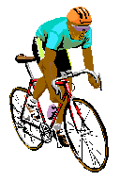


God’s three blessings
God
Mind
Body
Mind
Body
One
Indi-
vidual
Individual
Four Position Foundation

The key to God’s first blessing is the perfection of individual character; for this, one should form a God-centered individual four position foundation whereby his mind and body become one.

Slide 61
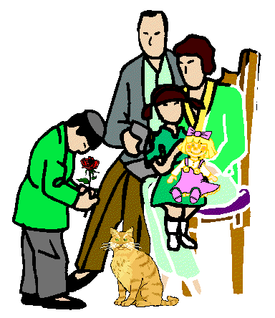
God’s three blessings
God
God
Hus-
band
Wife
Hus-
band
Mind
Body
Wife
Indi-
vidual
Children
Children
Individual
Four Position Foundation
Family
Four Position Foundation

In fulfilling God’s second blessing, individually perfected Adam and Eve should construct a God-centered family four position foundation by joining in loving oneness as husband and wife and raising children (p. 34).

Slide 62
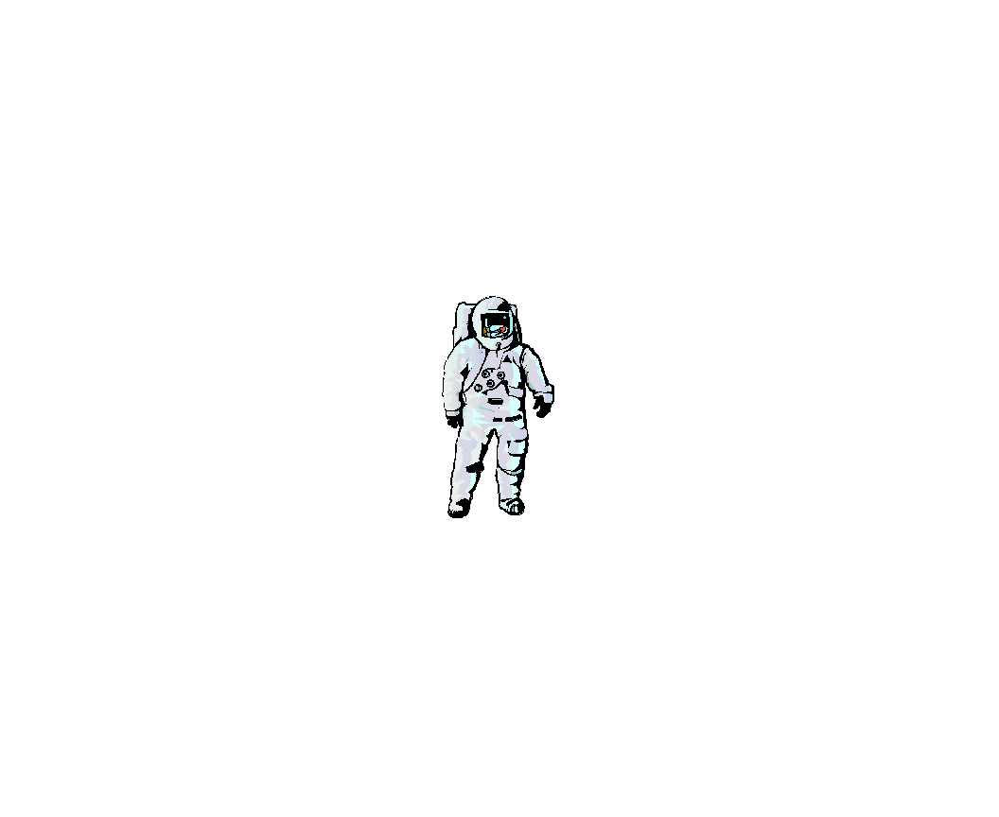

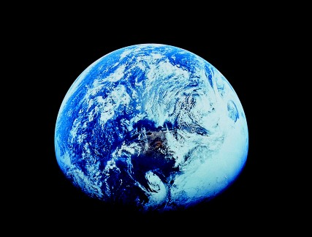
God’s three blessings
God
Human
Beings
Natural
World
Human
beings
Natural
world
One
Creation
Four Position Foundation of
Dominion

God’s third blessing means the perfection of a human being’s dominion over the natural world; for this, a God-centered four position foundation of dominion must be established through human beings and the natural world’s becoming completely one (p. 35).

Slide 63
God’s three blessings
God
God
God
Hus-
band
Human
beings
Natural
world
Mind
Body
Wife
Indi-
vidual
Children
Creation
Individual
Four Position Foundation
Family
Four Position Foundation
Four Position Foundation of
Dominion

Slide 64
Section 4
Original Value

Slide 65
4.1
The Process and Standard
for the Determination of Original Value
God
Person
Object
Partner
Subject
Partner
Object
Partner
Union

The original value of an entity is determined when it participates as an object partner in a God-centered four position foundation by relating with a person as its subject partner (p. 36).

Slide 66
4.1
The Process and Standard
for the Determination of Original Value
God
Absolute Being
----------
Person
Object
Partner
Subject
Partner
Object
Partner
----------
Union
Original Value
Absolute

Since the center of this four position foundation is God, it is God who sets the standard for its value. Since God is absolute, the original value of an object partner determined in relation to this standard must also be absolute.

Slide 67
Section 5
The Process of the Creation
of the Universe
and Its Growing Period

Slide 68
5.1
The Process of the Creation of the Universe
God
Time
Universe

The universe did not suddenly spring forth complete. In fact,
its origin and development took an enormous length of time (p. 40).

Slide 69
5.1
The Process of the Creation of the Universe
God
Time
Six days
Six ordered periods
in the creation process
----
(Gen. 1)
Universe

The biblical period of six days for the completion of the universe is not to be reckoned by the number of literal sunrises and sunsets. It symbolizes six ordered periods of time in the creation process.

Slide 70
5.2
The Growing Period for the Creation
Perfection
_________________
Morning
Growing
period
“One day”
------------
(Gen. 1:5)
Evening
_________________
Creation

When the first day of creation was completed, the Bible states, “There was evening and there was morning, one day.” (Gen. 1:5) This is because all creation are designed to reach perfection only after passing through a set growing period (p. 41).

Slide 71
5.2.1
The Three Ordered Stages of the Growing Period
Perfection
________________________________________________________
Completion
-----------------------------------------------------------------------------------
Growing
period
Growth
-----------------------------------------------------------------------------------
Formation
________________________________________________________
Creation
Creation

All creation reach perfection by passing through three ordered stages of growth: the formation stage, the growth stage and the completion stage.

Slide 72
5.2.1
The Three Ordered Stages of the Growing Period
Perfection
Individual
Perfection
Purpose of
Creation
________________________________________________________
Completion
3-stage
resto-
ration
-----------------------------------------------------------------------------------
Growing
period
Growth
Fall
-----------------------------------------------------------------------------------
Formation
________________________________________________________
Creation
Creation
Human
Beings
Fallen
People

Human beings fell without completing the three stages of the growing period. Hence, in realizing the purpose of creation, they must pass through these three stages for the restoration (p. 42).

Slide 73
5.2.1
The Three Ordered Stages of the Growing Period
Perfection
Individual
Perfection
Purpose of
Creation
________________________________________________________
Completion
3-stage
resto-
ration
-----------------------------------------------------------------------------------
Growing
period
Growth
Fall
-----------------------------------------------------------------------------------
Formation
________________________________________________________
Creation
Human
Beings
Fallen
People

The first human ancestors fell at the top of the growth stage.

Slide 74
5.2.2
The Realm of Indirect Dominion
Perfection
________________________________________
--------------------------------------------------------------------
Growing
period
------------------------------------------------
--------------------
________________________________________
Creation

When created beings are in the growing period, God has regard only for the fruits of their growth which are based on the Principle. In this way, He governs all things indirectly.

Slide 75
5.2.2
The Realm of Indirect Dominion
Perfection
________________________________________
~
Indirect
Dominion
--------------------------------------------------------------------
Growing
period
------------------------------------------------
--------------------
Dominion by
Principle
Accomplish-
ments
~
________________________________________
Creation
We call this growing period the realm of God’s indirect dominion or the realm of dominion based on accomplishments through the Principle (p. 43).

Slide 76
5.2.2
The Realm of Indirect Dominion
Perfection
Perfection
________________________________________
~
Indirect
Dominion
--------------------------------------------------------------------
Growing
period
Principle
------------------------------------------------
--------------------
Dominion by
Principle
Accomplish-
ments
~
________________________________________
Creation
All things

All things reach perfection after passing through the growing period by virtue of the autonomy and governance given by God’s Principle.

Slide 77
5.2.2
The Realm of Indirect Dominion
Perfection
Individual
Perfection
________________________________________
Principle
Indirect
Dominion
~
--------------------------------------------------------------------
+
Growing
period
Principle
------------------------------------------------
Human
responsibility
Dominion by
Principle
Accomplish-
ments
--------------------
~
________________________________________
Creation
Human
Beings
All things

Human beings, however, pass through the growing period and reach perfection by fulfilling their own portion of responsibility, in addition to the guidance provided by the Principle.

Slide 78
5.2.3 The Realm of Direct Dominion
God
Direct dominion:
Subject
Partner
Object
Partner
Union

Human beings abide in the realm of direct dominion when as subject partner and object partner, they unite in the love of God to form a four position foundation and become one in heart with God.

Slide 79
5.2.3 The Realm of Direct Dominion
God
Direct dominion:
Purpose of
goodness realized
Subject
Partner
Object
Partner
Union
In this realm, they freely and fully share love and beauty according to the will of the subject partner, thus realizing
the purpose of goodness (p. 46).

Slide 80
5.2.3 The Realm of Direct Dominion
God
Direct dominion:
Purpose of
goodness realized
Subject
Partner
Object
Partner
Realm of perfection
Union

Hence, the realm of direct dominion is the realm of perfection.

Slide 81
Section 6
The Incorporeal World
and the Corporeal World
Whose Center is Human Beings

Slide 82
6.1 The Incorporeal World and the Corporeal World
as Substantial Realities
God
Universe

The universe was created after the pattern of a human being, who is in the image of God’s dual characteristics (p. 45).

Slide 83
6.1 The Incorporeal World and the Corporeal World
as Substantial Realities
In-
corporeal
world
God
Mind
~
Universe
Cos-
mos
Corporeal
world
Body
~

Corresponding to the human mind and body, the universe consists of the incorporeal world and the corporeal world both of which are real and substantial. The two worlds together form the cosmos.

Slide 84
6.1 The Incorporeal World and the Corporeal World
as Substantial Realities
In-
corporeal
world
Subject
Partner
God
Mind
~
Universe
Cos-
mos
Corporeal
world
Body
~
Object
Partner

The incorporeal world is in the position of subject partner, and the corporeal world in the position of object partner. The latter is like a shadow of the former (p. 46).

Slide 85
6.1 The Incorporeal World and the Corporeal World
as Substantial Realities
In-
corporeal
world
Subject
Partner
God
Mind
~
Universe
Cos-
mos
Corporeal
world
Body
~
Object
Partner

When we shed our physical bodies, we enter the incorporeal world as spirits and live there for eternity.

Slide 86
6.2 The Position of Human Beings in the Cosmos
Spiritual world
(Incorporeal world)
1
Ruler
Spirit
2
Mediator and center of harmony
Human
beings
Body
3
Substantial
encapsulation
Physical world
(Corporeal world)
1
God created human beings to be rulers of the universe,
2
Mediator and center of harmony of the cosmos, and an
3
Encapsulation, in a substantial form, of the essence of everything in the cosmos (microcosm) (p. 47).

Slide 87
6.3 The Reciprocal Relationship between
the Physical Self and the Spirit Self
6.3.1 The Structure and Functions of the Physical Self
Spirit self
_____________
Physical
mind
Physical self
Physical self
Physical
body

The physical self consists of the dual characteristics of the physical mind and the physical body.

Slide 88
6.3 The Reciprocal Relationship between
the Physical Self and the Spirit Self
6.3.1 The Structure and Functions of the Physical Self
Becomes good
Spirit self
Spirit self
Becomes evil
_____________
Physical
mind
Good conduct
Physical self
Physical self
Physical
body
Evil conduct

Good or evil in the conduct of the physical self is the main determinant of whether the spirit self becomes good or evil.

Slide 89
6.3.2 The Structure and Functions of the Spirit Self
Spirit
self
Spirit body
Spirit
mind
_____________
Physical
mind
Physical
self
Physical
body

Our spirit self consists of the dual characteristics of spirit mind and spirit body (p. 48).

Slide 90
6.3.2 The Structure and Functions of the Spirit Self

Grows and reaches perfection
Spirit
self
Spirit body
Spirit
mind
_____________
Physical
mind
Physical
self
Physical
self
Physical
body

The spirit can grow and reach perfection only while it abides in the body.

Slide 91
6.3.2 The Structure and Functions of the Spirit Self

Grows and reaches perfection
Spirit
self
Spirit body

Becomes good
Spirit
mind
_____________
Physical
mind
Physical
self
Physical
body

The spirit becomes good only through the redemption of sins granted during earthly life (p. 49).

Slide 92
6.3.2 The Structure and Functions of the Spirit Self

Grows and reaches perfection
Spirit
self
Spirit body

Becomes good
Spirit
mind

Decides own heaven and hell
_____________
Physical
mind
Physical
self
Physical
body

It is not God who decides whether a person’s spirit enters heaven or hell upon his death; it is decided by the spirit himself (p. 50).

Slide 93
For more information visit our website
http://www.unificationstudy.com

