Slide 2
Chapter 3
Eschatology
and Human History

Slide 3
Human history

We dwell in ignorance of history, uncertain about its origin, the direction in which it is heading, and its final destination (p. 79).

Slide 4
Human history
Last Days
?
Eschatology

Hence, we are ignorant about the Last Days of the human history.

Slide 5
Human history
Last Days
?
Purpose of Creation
Meaning of human fall
Goal of restoration
Eschatology

To address this issue, we should first understand such fundamental matters as the purpose of God’s creation, the meaning of the human Fall, and the goal of the providence of restoration.

Slide 6
Section 1
The Completion of God's
Purpose of Creation and
the Human Fall

Slide 7
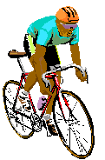



1.1 The Completion of God’s Purpose of Creation
God
God
Mind
Body
Mind
Body
Individual
Indi-
vidual
Individual
Perfection

A person who has emotional sensitivity to the Heart of God, intuition and reason to comprehend His Will, and the requisite abilities to practice it has perfected his individual character (p. 80).

Slide 8
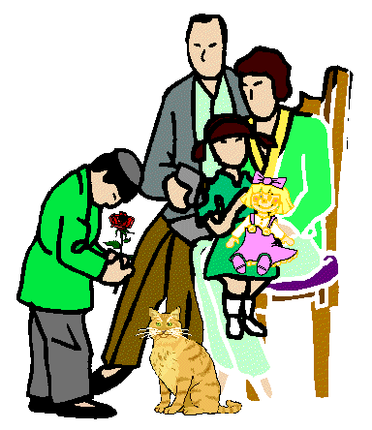
1.1 The Completion of God’s Purpose of Creation
God
God
Adam
Eve
Mind
Body
Adam
Eve
Indi-
vidual
Children
Children
Individual
Perfection
Family
Perfection

Had Adam and Eve reached perfection, they would have borne good children and founded a sinless family and society in complete concordance with God’s blessings. They would have founded one great family with the same parents (p. 81).

Slide 9
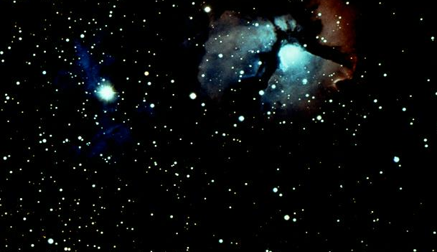


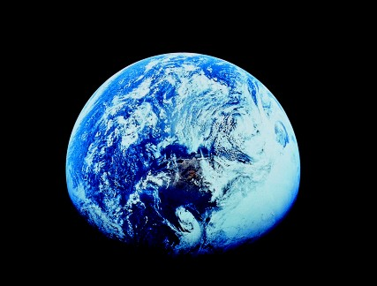
1.1 The Completion of God’s Purpose of Creation
God
All
Humans
All
Things
Humans
Things
Creation
Creation
Perfection
of Dominion

People of perfected character should advance science and create an extremely pleasant social and living environment.

Slide 10
1.1 The Completion of God’s Purpose of Creation
God
God
God
All
Things
Mind
Body
Adam
Eve
Humans
Indi-
vidual
Children
Creation
Individual
Perfection
Family
Perfection
Perfection
of Dominion
Kingdom of heaven on earth

Kingdom of Heaven on earth is where such an ideal is realized. God’s purpose of creation is to build the Kingdom of Heaven first on earth.

Slide 11
1.2
Consequences of the Human Fall
Satan
Satan
Mind
Body
Mind
Body
Indi-
vidual
Individual
Evil Nature

Due to the Fall, human beings united with Satan and became his dwelling places, acquiring an evil nature (p. 82).

Slide 12
1.2
Consequences of the Human Fall
Satan
Satan
Adam
Eve
Adam
Eve
Children
Children
Evil family

People with evil nature have propagated evil through their children, constituting evil families, evil societies and an evil world.

Slide 13
1.2
Consequences of the Human Fall
Satan
Satan
Humans
All
Humans
All
Things
Things
Creation
Creation
Satanic Dominion
Hell on earth

This is the hell on earth in which we have been living. We have established the sovereignty of Satan.

Slide 14
1.2
Consequences of the Human Fall
Satan
Satan
Satan
Mind
Body
Adam
Eve
Humans
All
Things
Indi-
vidual
Children
Creation
Evil
Nature
Evil family
Satanic Dominion
Hell on earth

Slide 15
Section 2
God's Work of Salvation

Slide 16
2.1
God’s Work of Salvation is
the Providence of Restoration
God
Joy
Sorrow
Creation
Fall
World
of goodness
World of sin

God intended to create a world of goodness and experience from it the utmost joy; yet due to the human Fall, the world came to be filled with sin and sorrow.

Slide 17
2.1
God’s Work of Salvation is
the Providence of Restoration
God
God
Joy
Sorrow
Creation
Fall
World
of goodness
World of sin
Salvation

If this sinful world were to continue forever in its present state, then God would be an impotent and ineffectual God who failed in His creation. Therefore, God will save this sinful world, by all means.

Slide 18
2.1
God’s Work of Salvation is
the Providence of Restoration
God
God
Joy
Sorrow
Creation
Fall
World
of goodness
World of sin
Salvation

To save a person suffering under the yoke of sin means to restore him to his original, sinless state (p. 82).

Slide 19
2.1
God’s Work of Salvation is
the Providence of Restoration
God
God
Joy
Sorrow
Creation
Fall
World
of goodness
World of sin
Salvation

God’s work of salvation is the providence of restoration.

Slide 20
2.2
The Goal of the Providence of Restoration
Purpose of creation
Establishment of heavenly kingdom

The goal of the providence of restoration is the establishment of the Kingdom of Heaven, which is God’s good object partner and the fulfillment of His purpose of creation.

Slide 21
2.3
Human History is the History
of the Providence of Restoration
Human History
History of providence of restoration

Human history can be seen as the history of the providence through which God has been trying to save fallen people and work through them to restore the original, good world (p.84).

Slide 22
Section 3
The Last Days

Slide 23
3.1 The Meaning of the Last Days
Messiah
Satanic
sovereignty

Last Days
God’s
sovereignty

The Last Days is this time, when with the advent of the Messiah as the turning point, the evil world under satanic sovereignty is transformed into the ideal world under God’s sovereignty (p. 89).

Slide 24
3.1 The Meaning of the Last Days
Messiah
Heavenly
Hell
on
earth
Satanic
sovereignty
Kingdom
on earth

Last Days
God’s
sovereignty

Hell on earth will be transformed into the Kingdom of Heaven on earth.

Slide 25
Section 4
The Last Days
and the Present Days

Slide 26
T o d a y
=
Last Days

We can deduce that today is in fact the Last Days by examining the various circumstances of the present age.

Slide 27
Restoration of three great blessings
T o d a y
=
Last Days
We can recognize in these circumstances the restoration of the three great blessings, which God has purposed in His providence of restoration (p. 96).

Slide 28
4.1 Signs of the Restoration of the First Blessing
God
Mind
Body
Indi-
vidual
Individual Perfection

The first blessing is perfection of individual character.

Slide 29
4.1 Signs of the Restoration of the First Blessing
God
1
Restoration of spirituality
Mind
Body
Indi-
vidual
Individual Perfection
We see signs of the restoration of the first blessing in that:
1
Spirituality of fallen people is being restored.

Slide 30
4.1 Signs of the Restoration of the First Blessing
God
1
Restoration of spirituality
2
Freedom of original mind
Mind
Body
Indi-
vidual
Individual Perfection
2
History moves toward the recovery of the freedom of the original mind (p. 97).

Slide 31
4.1 Signs of the Restoration of the First Blessing
God
1
Restoration of spirituality
2
Freedom of original mind
Mind
Body
3
True human value
4
Original love
Indi-
vidual
Individual Perfection
3
True human value is being restored.
4
Original, true love in fallen people is being restored.

Slide 32
4.1 Signs of the Restoration of the First Blessing
God
1
Restoration of spirituality
2
Freedom of original mind
Mind
Body
3
True human value
4
Original love
Indi-
vidual
Individual Perfection

From this we can see that the present time is the eve of the Last Days, when we can reach perfection of individual character (p. 98).

Slide 33
4.2 Signs of the Restoration of the Second Blessing
God
Adam
Eve
Children
Family Perfection

God’s second blessing is forming a family, society and world where goodness reigns.

Slide 34
4.2 Signs of the Restoration of the Second Blessing
1
Brothers
and sisters
in Jesus Christ
God
Adam
Eve
Children
Family Perfection
1
In the present age, all races and peoples are increasingly coming to stand side by side as brothers and sisters in Jesus Christ, thereby restoring the second blessing of God.

Slide 35
4.2 Signs of the Restoration of the Second Blessing
1
Brothers
and sisters
in Jesus Christ
God
Adam
Eve
2
Confrontation
between democratic
and communist
worlds
Children
Family Perfection
2
At present, our world is divided into two:
the democratic world, which seeks to create societies on God’s side, and the communist world, which has been establishing regimes on Satan’s side.

Slide 36
4.2 Signs of the Restoration of the Second Blessing
1
Brothers
and sisters
in Jesus Christ
God
Adam
Eve
2
Confrontation
between democratic
and communist
worlds
Children
Family Perfection
These opposing forces are at the point of intersection (p. 100).

Slide 37
4.2 Signs of the Restoration of the Second Blessing
1
Brothers
and sisters
in Jesus Christ
God
Adam
Eve
2
Confrontation
between democratic
and communist
worlds
Children
Family Perfection

Hence, the present age is the Last Days because the second blessing is being restored.

Slide 38
4.3 Signs of the Restoration of the Third Blessing
God
Human
beings
All
Things
Creation
Perfection of Dominion

The third blessing means gaining dominion over the natural world (p. 101).

Slide 39
4.3 Signs of the Restoration of the Third Blessing
God
1
Elevation of spirituality
towards God
Human
beings
All
Things
Creation
Perfection of Dominion
1
God’s providence of restoration through religion, philosophy, ethics and so forth, has gradually elevated the spirituality of fallen people toward God.

Slide 40
4.3 Signs of the Restoration of the Third Blessing
God
1
Elevation of spirituality
towards God
Human
beings
All
Things
Creation
Perfection of Dominion
In the modern world, there is evidence that people are regaining the worthiness to govern the creation through heart (p. 102).

Slide 41
4.3 Signs of the Restoration of the Third Blessing
God
1
Elevation of spirituality
towards God
Human
beings
All
Things
2
Pleasant living
environment
Creation
Perfection of Dominion
2
Modern people have built an extremely comfortable
and pleasant living environment through the economic progress that has accompanied scientific development.

Slide 42
4.3 Signs of the Restoration of the Third Blessing
God
1
Elevation of spirituality
towards God
Human
beings
All
Things
2
Pleasant living
environment
Creation
Perfection of Dominion

Observing signs of re-establishment of God’s third blessing, we are assured that the present era is the Last Days.

Slide 43
Section 5
The Last Days,
the New Truth
and Our Attitude

Slide 44
5.1
The Last Days and the New Truth
God
Spirit
Truth
Spirituality
Intellect
Fallen
people

Fallen people have been overcoming their internal ignorance by enlightening their spirituality and intellect with “spirit and truth” through religion (p. 103).

Slide 45
Truth
Internal truth
Religion
Intellect

“Truth” may be divided into two types: internal truth as taught by religion, which helps people overcome internal ignorance, and external truth as obtained through science, which helps people overcome external ignorance.

Slide 46
Truth
Internal truth
External truth
Religion
Science
Internal
ignorance
Intellect

“Truth” may be divided into two types: internal truth as taught by religion, which helps people overcome internal ignorance, and external truth as obtained through science, which helps people overcome external ignorance.

Slide 47
Truth
Internal truth
External truth
Religion
Science
Internal
ignorance
External
ignorance
Intellect

“Truth” may be divided into two types: internal truth as taught by religion, which helps people overcome internal ignorance, and external truth as obtained through science, which helps people overcome external ignorance.

Slide 48
Spirit
God
Truth
_______________________________________
Scope
Development of spirituality
---------------
Expression
and intellect
--------------
--------
Fallen
people
Ignorance

Spirit and truth are unique, eternal and unchanging.
However, the degree and scope of their teaching and the means of their expression will vary from one age to another
as they restore humankind from a state of utter ignorance (p.104).

Slide 49
Spirit
God
Truth
_______________________________________
New truth
Scope
Development of spirituality
---------------
Expression
and intellect
--------------
--------
Fallen
people
Ignorance
Present age
(Last Days)

For modern, intellectual people to be enlightened in the truth, there must appear another textbook of higher and richer content, with a more specific method of expression. We call this the new truth.

Slide 50
5.2
Our Attitude in the Last Days
----------
-
-
Last Days
Internal:
anxiety,
fear,
and confusion
External:
strife
and battles

Those who live in this period suffer internally from anxiety, fear and confusion due to the absence of a guiding ideology or philosophy. They suffer externally from strife and battles fought with fearsome weapons (p. 106).

Slide 51
5.2
Our Attitude in the Last Days
New age
Old age
----------
-
-
Last Days
(Conflict)
Internal:
anxiety,
fear,
and confusion
External:
strife
and battles

The new age sprouts and grows amidst the final phases
of the old age and comes into conflict with that age (p. 107).

Slide 52
5.2
Our Attitude in the Last Days
New age
Old age
----------
-
-
Last Days
(Conflict)
Internal:
anxiety,
fear,
and confusion
External:
strife
and battles

Jesus came in such a way as to bewilder the faithful adherents of the Mosaic Law. He was ostracized by the Jewish people and eventually crucified.

Slide 53
People in the Last Days
Mind
Spirit
Prayer

We are living in the Last Days. We should cultivate
a humble heart (mind) and make the utmost effort
to receive inspiration of spirit through prayer (p. 108).

Slide 54
People in the Last Days
Mind
Spirit
Prayer
God
Receptive
to the spirit
Body
New
Truth

We should not be strongly attached to conventional concepts, but rather should direct ourselves (body) to be receptive to the spirit, in order that we may find the new truth which can guide us to the providence of the new age.

Slide 55
For more information visit our website
http://www.unificationstudy.com

