Slide 2
Chapter 4
The Messiah:
His Advent and the Purpose
of His Second Coming

Slide 3
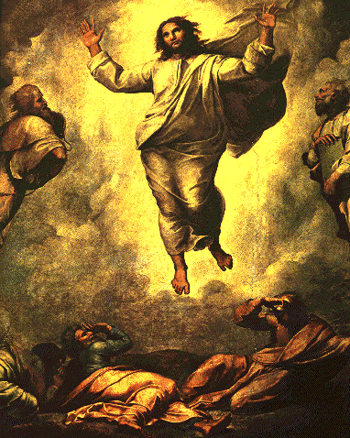
Messiah
…….
King

The word “Messiah” in Hebrew means the “anointed one,” signifying a king (p. 111).

Slide 4
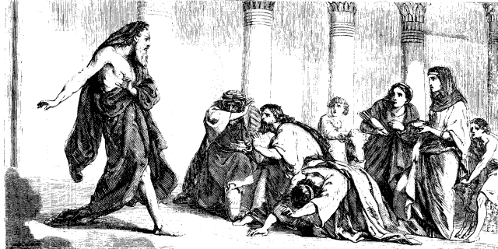
Messiah
…….
King
-----
Messianic
expectation
…….
Savior
(King)

The chosen people of Israel believed in the Word of God as revealed through the prophets, which promised that God would send them a king and savior. Such was their messianic expectation.

Slide 5
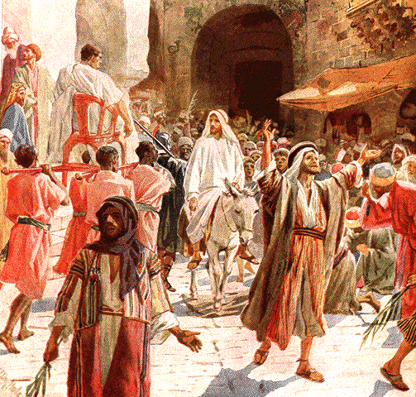
Messiah
…….
King
-----
Messianic
expectation
…….
Savior
(King)
Jesus Christ
…….
Messiah

God sent this Messiah in the person of Jesus Christ. “Christ” is the Greek word for Messiah.

Slide 6
Messiah
…….
King
-----
Messianic
expectation
…….
Savior
(King)
Jesus Christ
…….
Messiah

The Messiah comes to fulfill the purpose of God’s work of salvation.

Slide 7
Section 1
Salvation
through the Cross

Slide 8
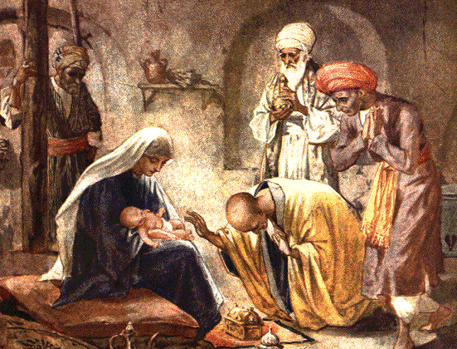
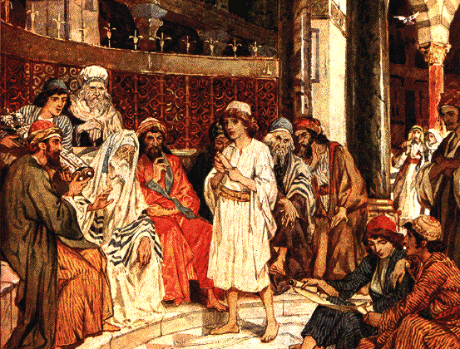
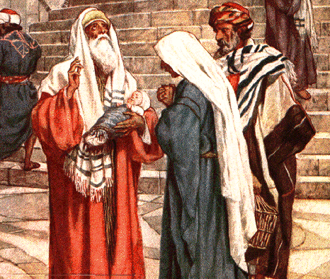
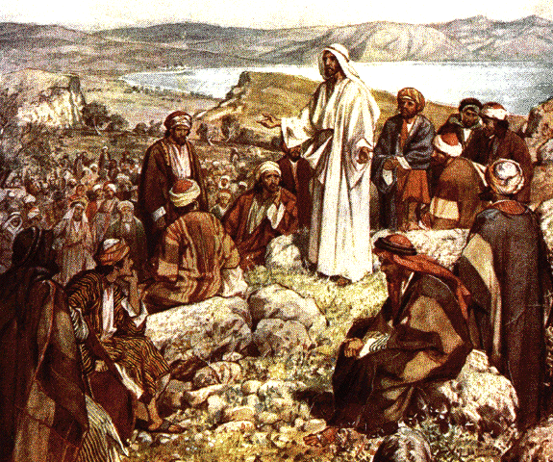
1.1
The Purpose of Jesus’ Coming as the Messiah
Complete
salvation
Jesus
Goal of the providence
of restoration
:
Fallen
humanity

Jesus came as the Messiah for nothing less than the complete salvation of humanity; he was to fulfill the goal of the providence of restoration (p. 112).

Slide 9
1.1
The Purpose of Jesus’ Coming as the Messiah
Complete
salvation
Establishing
the Kingdom of Heaven
:
ll
Jesus
Goal of the providence
of restoration
:
Fallen
humanity

Jesus was supposed to establish the Kingdom of Heaven, first on the earth.

Slide 10
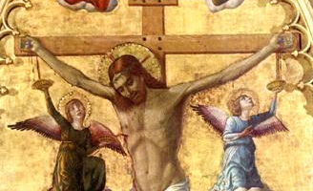
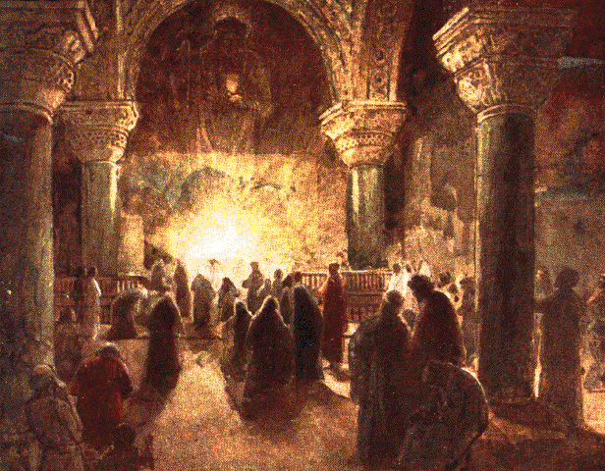
1.2 Was Salvation Completed through the Cross?
Perfect
person
Kingdom of Heaven
::::::
Believers
Jesus
Fallen
person

Did Jesus’ crucifixion fulfill the purpose of the providence of restoration? If so, faithful believers in Jesus would have restored their original nature and built the Kingdom of Heaven on earth (p. 113).

Slide 11
1.2 Was Salvation Completed through the Cross?
Perfect
person
Kingdom of Heaven
::::::
Believers
Believers
Jesus
1
No oneness with God
Fallen
person
1
Yet in the entire history of Christianity, there has been no one, no matter how devout, who lived his life in inseparable oneness with God.

Slide 12
1.2 Was Salvation Completed through the Cross?
Perfect
person
Kingdom of Heaven
::::::
Believers
Believers
Jesus
1
No oneness with God
2
Need redemption,
Fallen
person
prayer,
and devotion
2
There has never been a believer who had no need of redemption or a life of ardent prayer and devotion.

Slide 13
1.2 Was Salvation Completed through the Cross?
Perfect
person
Kingdom of Heaven
::::::
Believers
Believers
Jesus
1
No oneness with God
2
Need redemption,
Fallen
person
prayer,
and devotion
3
Transmit original sin
3
No matter how devout, Christian parents continue to transmit the original sin to their children.

Slide 14
1.2 Was Salvation Completed through the Cross?
Perfect
person
Kingdom of Heaven
::::::
Believers
Believers
Jesus
1
No oneness with God
2
Need redemption,
Fallen
person
prayer,
and devotion
3
Transmit original sin
Original nature not perfectly restored

It teaches us that the grace of redemption by the cross has neither fully uprooted our original sin nor perfectly restored our original nature.

Slide 15
1.3 Jesus’ Death on the Cross
Disciples
1
None of the rulers of this age understood this; for if they had, they would not have crucified the Lord of glory.
Not
2
God
God’s
Will
1 Cor. 2:8
Jesus
3

Considering
1
the words and deeds of the disciples,
2
God’s providence, and
3
words and deeds of
Jesus himself (Matt. 26:39), Jesus’ death on the cross was not the most desired Will of God (1 Cor. 2:8) (p. 113-115).

Slide 16
1.3 Jesus’ Death on the Cross
Disciples
1
And going a little farther he fell on his face and prayed, “My Father, if it be possible, let this cup pass from me; nevertheless, not as I will, but as thou wilt.”
Not
2
God
God’s
Will
Matt. 26:39
Jesus
3

Considering
1
the words and deeds of the disciples,
2
God’s providence, and
3
words and deeds of
Jesus himself (Matt. 26:39), Jesus’ death on the cross was not the most desired Will of God (1 Cor. 2:8) (p. 113-115).

Slide 17
1.3 Jesus’ Death on the Cross
Disciples
1
Suffering
of the
Israelites
Not
2
God
God’s
Will
Jesus
3

Ever since Jesus died on the cross, the people of Israel became scattered over the face of the earth, suffering oppression and persecution (p. 117).

Slide 18
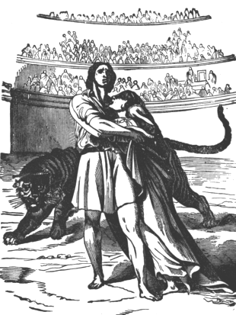
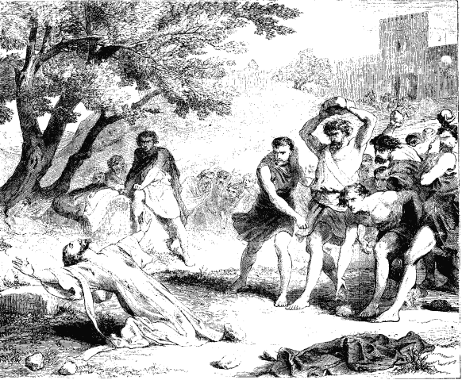
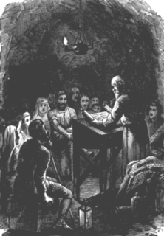
1.3 Jesus’ Death on the Cross
Disciples
1
Suffering
of the
Israelites
Not
2
God
God’s
Will
Cross
of the
Christians
Jesus
3

Also many faithful Christians have shouldered the cross as their portion for the collective sin of having killed Jesus.

Slide 19
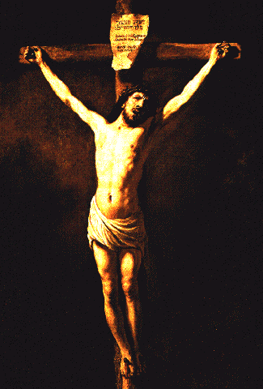
1.4
The Limit of Salvation through Redemption by the Cross and the Purpose
of Jesus’ Second Advent
Spiritual salvation
Jesus
Physical salvation

If Jesus had not been crucified, he would have accomplished both the spiritual and physical aspects of salvation (p. 118).

Slide 20
1.4
The Limit of Salvation through Redemption by the Cross and the Purpose
of Jesus’ Second Advent
Heavenly
Kingdom
on
earth
Spiritual salvation
Jesus
Physical salvation

He surely would have established the everlasting and indestructible Kingdom of Heaven on earth.

Slide 21
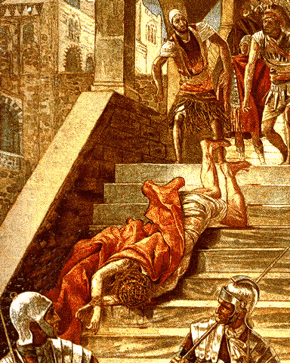
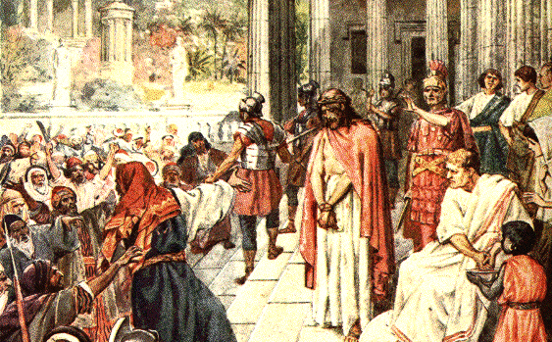
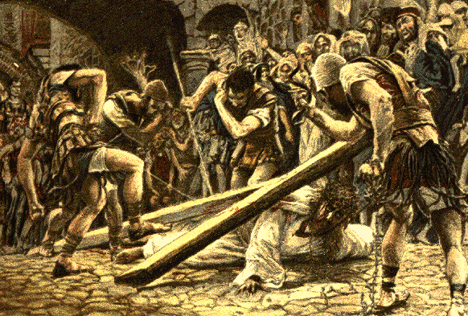
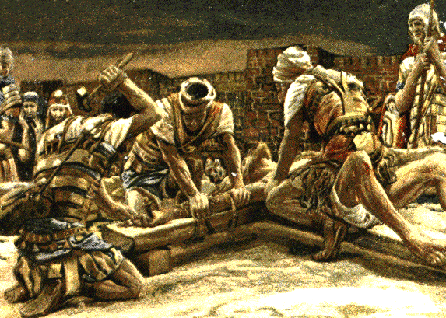
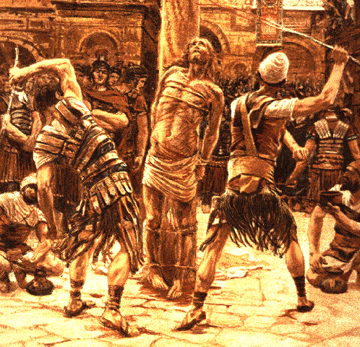
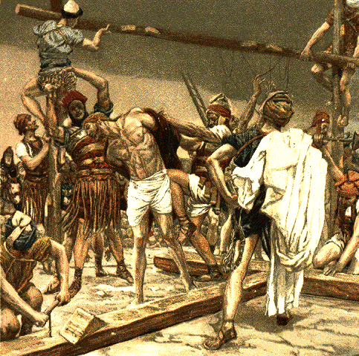
Body :
Satan’s
assault
No
Physical
salvation

The people led him to the cross. Jesus’ body was exposed to Satan’s assault, and he was killed. Consequently, Christians cannot attain physical salvation.

Slide 22
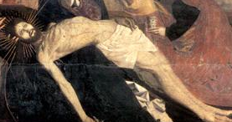
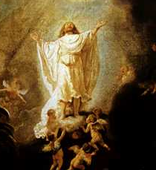
Spirit: basis
for
salvation
>
Body :
Satan’s
assault
No
Physical
salvation

However, Jesus laid the basis for spiritual salvation by securing the victorious foundation for his resurrection through the redemption by his blood on the cross.

Slide 23
Spirit: basis
for
salvation
Spiritual
salvation
Believers
>
Body :
Satan’s
assault
No
Physical
salvation
As a result, all believers since his resurrection have received the benefit of spiritual salvation, but not physical salvation
(p. 119).

Slide 24
Spirit: basis
for
salvation
Spiritual
salvation
Believers
>
Body :
Satan’s
assault
No
Physical
salvation
Coming
Second
:
Spiritual and
physical salvation

To complete the work of spiritual and physical salvation, Jesus must come again on earth.

Slide 25
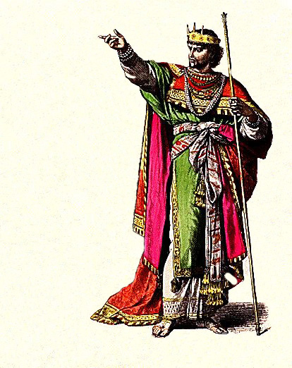
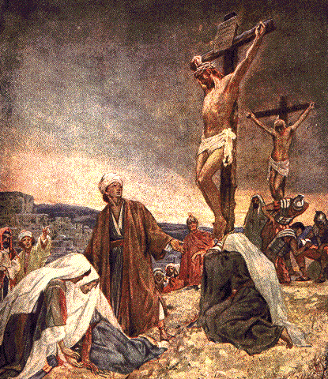
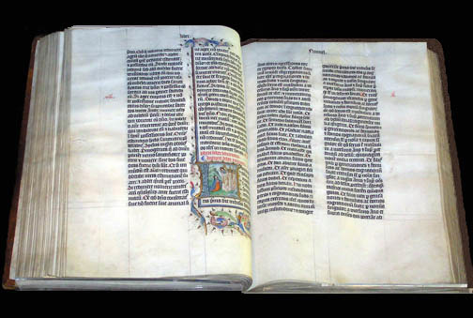
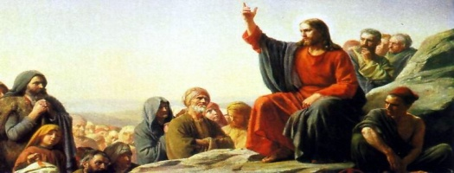
1.5 Two Kinds of Prophecies Concerning the Cross
King - Kingdom
C r o s s
(Isa. 9, 11, 60)
Jesus
(Isa. 53)

It was prophesied in Isaiah 53 that Jesus would suffer on the cross; in Isaiah 9, 11, 60, however, it was foretold that Jesus would become the king of the Jews in his lifetime and establish an everlasting kingdom on earth.
Notes:
Jewish King in ancient Judah – 19th Cent_PD

Slide 26
1.5 Two Kinds of Prophecies Concerning the Cross
King - Kingdom
C r o s s
(Isa. 9, 11, 60)
Jesus
(Isa. 53)
Let us investigate why God gave two contrasting kinds of prophecies concerning Jesus (p. 120).

Slide 27
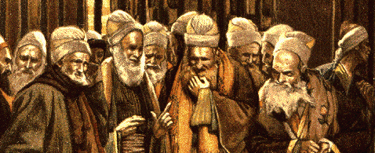
1.5 Two Kinds of Prophecies Concerning the Cross
God's
Will
Accomplishment
Failure
Jews:
……
Faith
responsibility
Disbelief
……
King - Kingdom
C r o s s
(Isa. 9, 11, 60)
Jesus
(Isa. 53)

The nature of the fruits human beings bear depends upon whether or not they fulfill their portion of responsibility. For this reason, God gave two kinds of prophecies concerning the accomplishment of His Will.

Slide 28
1.6
Gospel Passages in which Jesus Spoke
of His Crucifixion as if it were Necessary
Jesus

Several times Jesus spoke of his suffering on the cross as if it were necessary for salvation.

Slide 29
1.6
Gospel Passages in which Jesus Spoke
of His Crucifixion as if it were Necessary
Matt. 16:23
Jesus
……
“Get behind me, Satan.”
Dissuade
Predict crucifixion
Peter
For example, when Peter heard Jesus’ prediction of his imminent crucifixion and tried to dissuade him, Jesus rebuked him, saying, “Get behind me, Satan!” (Matt. 16:23) (p. 121).

Slide 30
1.6
Gospel Passages in which Jesus Spoke
of His Crucifixion as if it were Necessary
Matt. 16:23
Jesus
……
“Get behind me, Satan.”
Dissuade
Predict crucifixion
Peter
Hindrance to spiritual
salvation through the cross

Peter’s dissuasion could have hindered Jesus from paving the way for spiritual salvation through the cross. For this reason, Jesus rebuked him.

Slide 31
John 19:30
Jesus
……
“It is finished.”

Jesus said, on the cross, “It is finished.” (John 19:30)

Slide 32
John 19:30
Jesus
……
“It is finished.”

Jesus did not utter these words to mean that through the crucifixion he had completely accomplished the providence of salvation.

Slide 33
John 19:30
Jesus
……
“It is finished.”
Finished laying the foundation for spiritual salvation
through the cross

Jesus meant that he had finished laying the foundation for spiritual salvation. By this time, it had become the alternative goal of the providence.

Slide 34
Section 2
The Second Coming
of Elijah
and John the Baptist

Slide 35
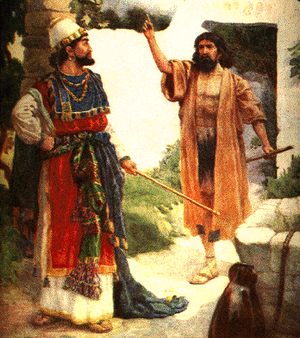
Elijah
Malachi
”Behold, I will send you Elijah before the great and terrible day of the Lord comes”
Come
again
(Mal. 4:5)
Mal. 4:5

The prophet Malachi foretold that Elijah would come again before the Messiah (p. 122).

Slide 36
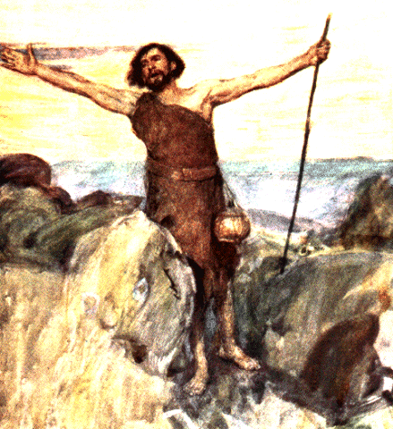
Elijah
Malachi
“…and if you are willing to accept it, he is Elijah who is to come. …”
Come
again
Jesus
(Mal. 4:5)
(
)
Matt. 11:14
Matt. 17:13
Matt. 11:14
John
the Baptist
Returning
Elijah
___________
___________

Jesus testified that the prophesied coming of Elijah was realized in none other than John the Baptist.

Slide 37
Elijah
…”Elijah does come, and he is to restore all things; …” Then the disciples understood that he was speaking to them of John the Baptist.
Malachi
Come
again
Jesus
(Mal. 4:5)
(
)
Matt. 11:14
Matt. 17:13
John
the Baptist
Returning
Elijah
Matt. 17:13
___________
___________

Jesus testified that the prophesied coming of Elijah was realized in none other than John the Baptist.

Slide 38
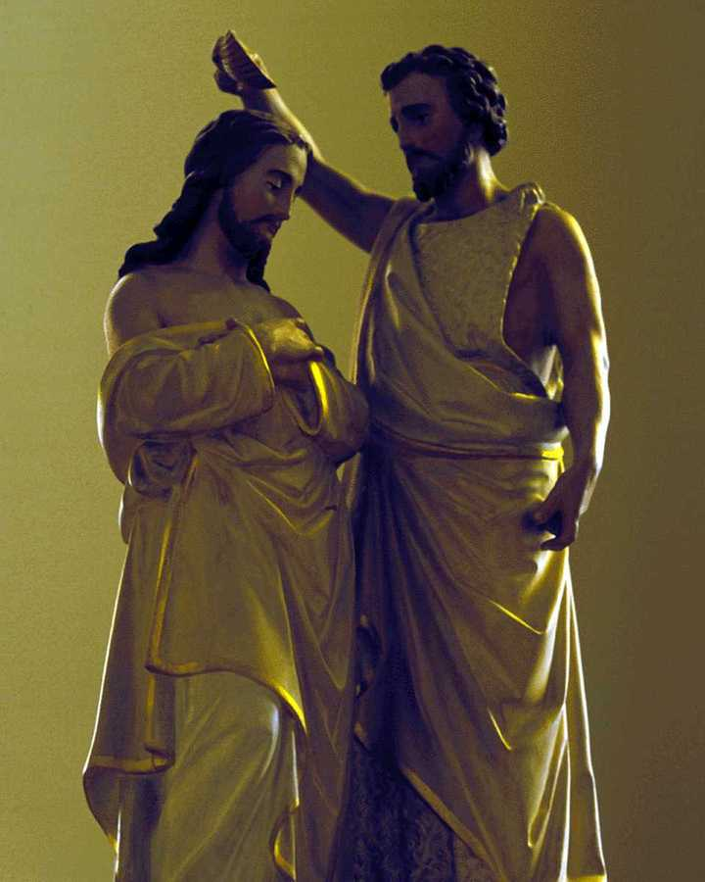
2.1
The Jewish Belief in the Return of Elijah
Testify
Jesus
John
the Baptist

Since the disciples already believed that Jesus was the Messiah, they willingly accepted his testimony that John the Baptist was Elijah (p. 124).

Slide 39
2.1
The Jewish Belief in the Return of Elijah
Testify
Jesus
John
the Baptist
?
Jews

Yet how could the other Jews who did not know Jesus accept this controversial claim?

Slide 40
2.2 The Direction the Jewish People Would Choose
Testify
Jesus
John
the Baptist
Elijah
“…and if you are willing to accept it, he is Elijah who is to come. …”
?
Jews
Matt. 11:14

Jesus testified that John the Baptist was the very Elijah (Matt. 11:14).

Slide 41
2.2 The Direction the Jewish People Would Choose
Testify
And this is the testimony of John, when the Jews sent priests and Levites from Jerusalem to ask him, “Who are you?”
He confessed, he did not deny, but confessed, “I am not the Christ.”
And they asked him, “What then?
Are you Elijah?” He said, ”I am not.”
Jesus
Jesus
John
the Baptist
Deny
?
Jews
John 1:19-20

On the contrary, John the Baptist himself flatly denied this claim.

Slide 42
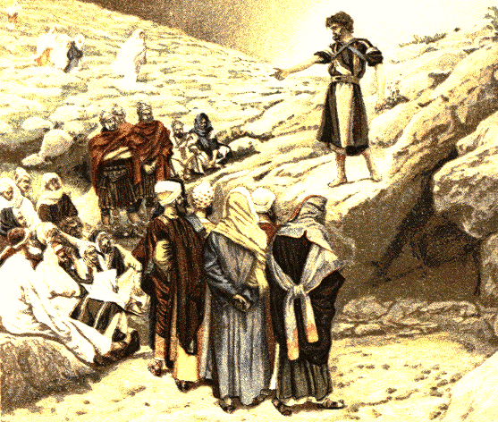
2.2 The Direction the Jewish People Would Choose
Testify
Jesus
Jesus
John
the Baptist
John
the Baptist
Deny
?
Believe
Jewish
people
Jews

At that time, the Jewish people believed John the Baptist more than Jesus (p. 126).

Slide 43
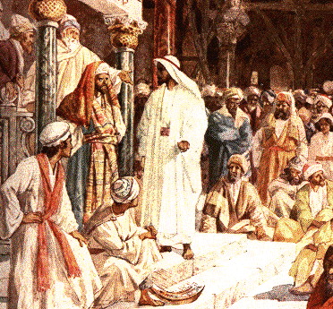
2.2 The Direction the Jewish People Would Choose
Testify
Jesus
John
the Baptist
John
the Baptist
Deny
?
Believe
Reject
Jewish
people

Thus, they rejected Jesus’ words as a fabrication concocted to support his dubious claim to be the Messiah.

Slide 44
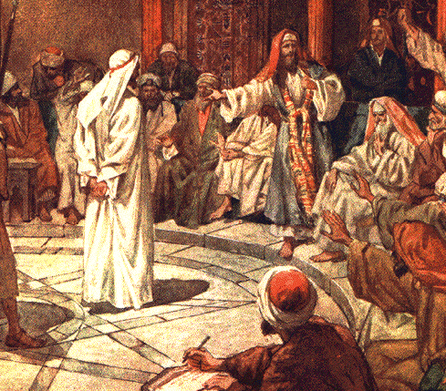
2.2 The Direction the Jewish People Would Choose
Testify
Jesus
John
the Baptist
John
the Baptist
Deny
Reject
Believe
Jewish
people
Impostor

Consequently, Jesus was condemned as an impostor.

Slide 45
2.3
The Faithlessness of John the Baptist
John
the Baptist
Jewish
people

Many among the Jewish leadership and people of Jesus’ day had the highest respect for John the Baptist; some even thought of him as the Messiah.

Slide 46
2.3
The Faithlessness of John the Baptist
Jesus
Elijah
John
the Baptist
Announce
Jewish
people

Had John the Baptist announced that he was Elijah, as Jesus had testified, all the Jewish people would have readily believed John’s testimony and flocked to Jesus.

Slide 47
2.3
The Faithlessness of John the Baptist
Jesus
Elijah
Elijah
John
the Baptist
Announce
Deny
Jewish
people

Instead, John’s ignorance of God’s providence, which led him to insist that he was not Elijah, became the principal reason why the Jewish people did not come to Jesus.

Slide 48
2.3
The Faithlessness of John the Baptist
Jesus
Elijah
Elijah
John
the Baptist
Announce
Deny
Jewish
people

Here we have come to understand that the main reason why Jesus had to die on the cross was the failure of John the Baptist (p. 130).

Slide 49
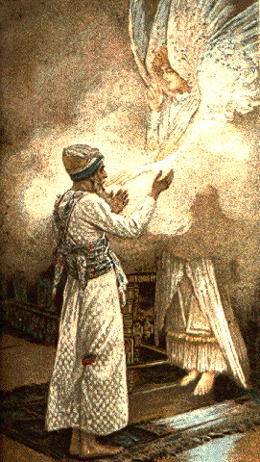
2.4 The Sense in Which John the Baptist Was Elijah
Inherit the mission
“….and he will go before him in the spirit and power of Elijah, ……. to make ready for the Lord a people prepared.”
(Luke 1:17)
John
the
Baptist
Elijah
Luke. 1:17

As recorded in the Bible, John the Baptist was to inherit and complete the mission which Elijah had left unfinished on earth (Luke 1:17).

Slide 50
2.4 The Sense in Which John the Baptist Was Elijah
Inherit the mission
(Luke 1:17)
John
the
Baptist
Elijah
(
Second
)
Coming

Hence, in terms of his mission, John was the
second coming of Elijah.

Slide 51
2.5
Our Attitude toward the Bible

Until today, no one has ever uncovered this heavenly secret.

Slide 52
2.5
Our Attitude toward the Bible
Conventional
view
of the Bible
John the Baptist:
great prophet

This is because we have been reading the Bible based on the unquestioned belief that John the Baptist was a great prophet.

Slide 53
2.5
Our Attitude toward the Bible
Conventional
view
of the Bible
John the Baptist:
great prophet
Dispense with the conservative
attitude of faith !

We should dispense with the conservative attitude of faith which makes us afraid to question conventional beliefs and traditional doctrines (p. 131).

Slide 54
For more information visit
http://www.unificationstudy.com

