Slide 2

Family Federation for
World Peace and Unification

Slide 3
presents

Slide 4
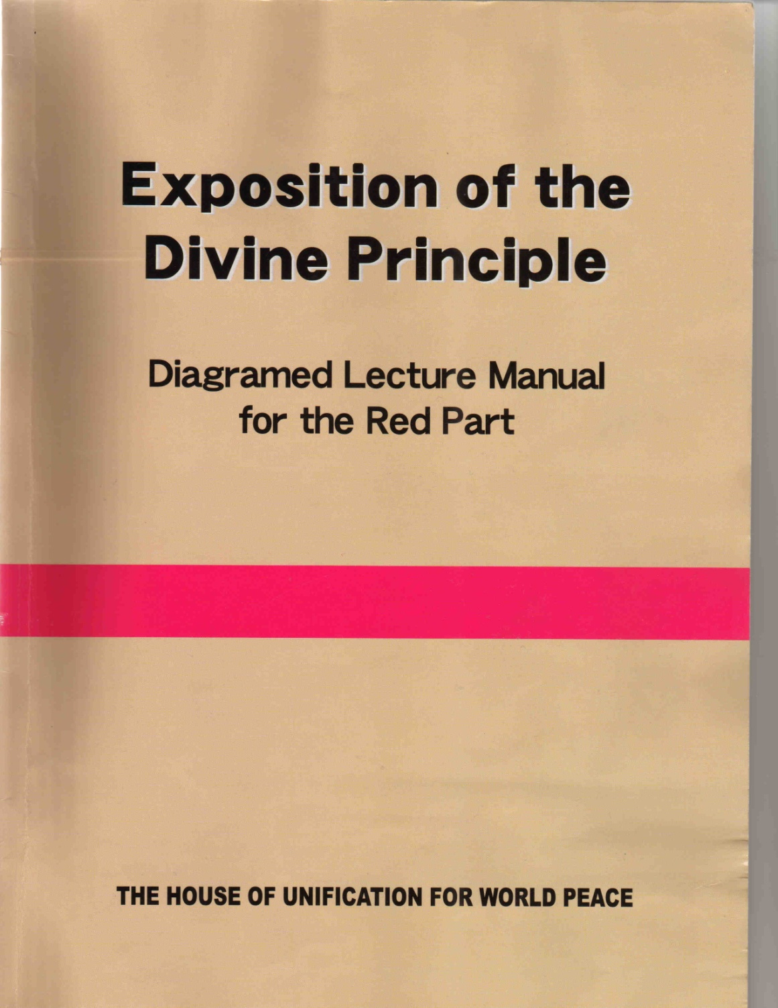
A Slide Show Presentation
of the Divine Principle
Part Two

Slide 5
Introduction
to
Restoration

Slide 6


Providence of restoration
God
Work
Human
beings
Original state
Restore

The providence of restoration refers to God’s work to restore human beings to our original, unfallen state so that we may fulfill the purpose of creation (p. 175).

Slide 7
God
A
E
______________________
....
....
______________________
______________________
______________________
A
E

Human beings fell from the top of the growth stage and have been held under Satan’s dominion.

Slide 8
God
A
E
______________________
....
....
______________________
______________________
______________________
A
E

To restore human beings, God works to cut off Satan’s influence. For this, we must have the original sin removed.

Slide 9
God
A
E
______________________
....
....
______________________
.
}
______________________
1
Course to separate Satan
______________________
A
E
Fallen
people
Fallen
people

Hence, we, fallen people,
1
First need to go through a course to separate Satan from ourselves. We do this in order to restore ourselves in form to the spiritual level which Adam and Eve had reached before the Fall – the top of the growth stage.

Slide 10
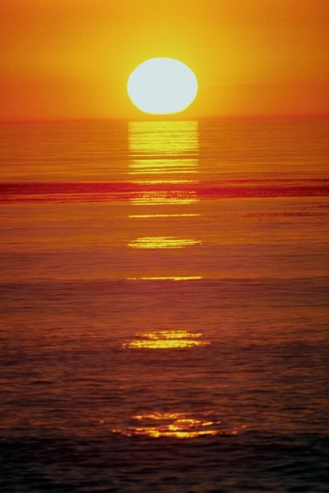
God
A
E
______________________
…
....
....
______________________
.
2
Receive the Messiah
and be reborn
}
______________________
1
Course to separate Satan
______________________
A
E
Fallen
people
Fallen
people
2
On this foundation, we are to receive the Messiah and be reborn, and thereby be fully restored to the original state of human beings before the Fall.

Slide 11
}
God
God
4
Fulfill the purpose of
creation
A
E
Humans
______________________
}
3
Continue our growth
…
…
…
…
....
....
_
______________________
.
2
Receive the Messiah
and be reborn
}
______________________
1
Course to separate Satan
______________________
A
E
Fallen
people
Fallen
people
3
Finally, by following the Messiah, we should continue our growth to maturity
4
where we can fulfill the purpose of creation.

Slide 12
Providence of Restoration
-
-
Re-creation
In accordance with God’s Principle

Since the providence of restoration is God’s work of re-creation, which has as its goal the fulfillment of the purpose of creation, God works this providence in accordance with His Principle.

Slide 13
Providence of Restoration
-
-
Re-creation
In accordance with God’s Principle
Principle of Restoration
In the course of the providence of restoration, this principle is called the Principle of Restoration.

Slide 14
1. The Principle of Restoration
through Indemnity

Slide 15
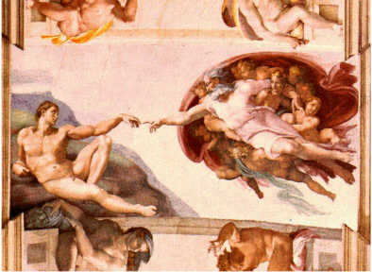
1.1 Restoration through Indemnity
(1) Position of fallen people
Before the fall
God
One
in heart
Humans
Relate only with God

If the first human ancestors had reached perfection, they would have lived relating only with God (p. 176).

Slide 16

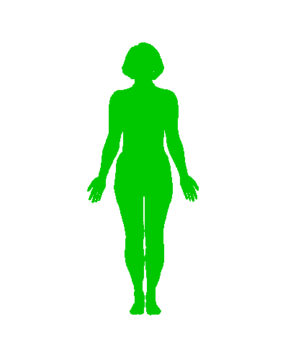

1.1 Restoration through Indemnity
(1) Position of fallen people
Before the fall
After the fall
God
Satan
One
in heart
Kinship
of blood
Humans
Humans
Relate only with God

However, due to their Fall, they joined in a kinship of blood with Satan.

Slide 17
1.1 Restoration through Indemnity
(1) Position of fallen people
Before the fall
After the fall
God
God
Satan
One
in heart
Creator
Kinship
of blood
Humans
Humans
Relate only with God
Midway position
Hence, immediately after the Fall, they found themselves in the midway position – a position between God and Satan where they were relating with both.

Slide 18
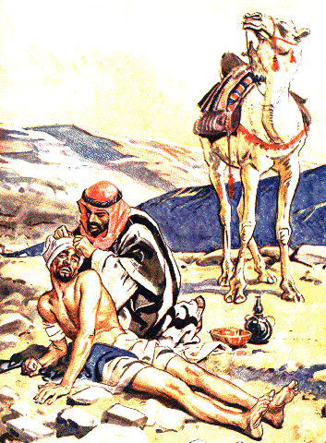
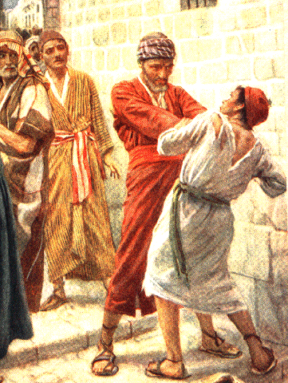
(2) Separating Satan from fallen people
God
Satan
Good conditions
Evil conditions
Fallen People
Midway position

How does God separate Satan from fallen people? A fallen person will go to God’s side if he makes good conditions and to Satan’s side if he makes evil conditions.

Slide 19
(3) Restoration through Indemnity

What then is the meaning of restoration through indemnity?

Slide 20
(3) Restoration through Indemnity
Original
state
Lost
Restored
Fall

When someone has lost his original position or state, he must make some condition to be restored to it.

Slide 21
(3) Restoration through Indemnity
Making
conditions
Indemnity
Original
state
_
_
Lost
Restored
Fall

The making of such conditions of restitution is called indemnity.

Slide 22
(3) Restoration through Indemnity
Making
conditions
Indemnity
Original
state
_
_
Process
of restoring
Restoration
through Indemnity
_
_
Lost
Restored
Fall

We call this process of restoring the original position and state through making conditions restoration through indemnity.

Slide 23
(3) Restoration through Indemnity
Making
conditions
Indemnity
Original
state
_
_
Process
of restoring
Restoration
through Indemnity
_
_
Lost
Restored
Conditions
made
Condition
Of Indemnity
_
_
Fall

And we call the conditions made a condition of indemnity.

Slide 24
(3) Restoration through Indemnity
Making
conditions
Indemnity
Original
state
_
_
Process
of restoring
Restoration
through Indemnity
_
_
Lost
Restored
_
_
Conditions
made
Condition
Of Indemnity
_
_
Fall
Providence
of Restoration
through Indemnity
God’s work
to restore
_
_

God’s work to restore people to their true, unfallen state by having them fulfill indemnity conditions is called the providence of restoration through indemnity.

Slide 25
(4) Comparison of conditions of Indemnity

How does a condition of indemnity compare with the value of what was lost ? (p. 177)

Slide 26
(4) Comparison of conditions of Indemnity
Original state
Restore
Equal Indemnity

First, in the case of a condition of equal indemnity, restoration to the original state is achieved by making a condition of indemnity at a price equal to the value of what was lost (restitution or compensation).

Slide 27
(4) Comparison of conditions of Indemnity
Original state
Restore
_
Equal Indemnity
Lesser Indemnity

Second, in the case of a condition of lesser indemnity, restoration is achieved by making a condition of indemnity at a price less than the value of what was lost.

Slide 28
(4) Comparison of conditions of Indemnity
Original state
Restore
_
Equal Indemnity
Lesser Indemnity
Greater Indemnity

Third, in the case of a condition of greater indemnity, when a person has failed to meet a condition of lesser indemnity, he must make another indemnity condition to return to the original state, this time at a price greater than the first.

Slide 29
(5)
Indemnity condition:
method?
Original
state
Reversing the course
_
Lost
Restored
Fall

Let us study the method of fulfilling indemnity conditions. For anyone to be restored to the original position or state from which he fell, he must make an indemnity condition by reversing the course of his mistake (p. 178).

Slide 30
(5)
Indemnity condition:
method?
who?
Original
state
Reversing the course
_
Lost
Restored
_
_
We ourselves
_
Fall

Who should make indemnity conditions? We ourselves must fulfill the necessary indemnity conditions as our portion of responsibility.

Slide 31
1.2 The Foundation for the Messiah

For fallen people to be restored to their original state, we must receive the Messiah and remove the original sin. Before we can receive the Messiah, however, we must first establish the foundation for the Messiah (p. 179).

Slide 32
1.2 The Foundation for the Messiah
Realize the purpose of creation

For Adam to realize the purpose of creation, he was supposed to fulfill two conditions:

Slide 33
1.2 The Foundation for the Messiah
Realize the purpose of creation
Adam (person)
Foundation of
Faith
_
God’s commandment (condition)
_
_
_
Growing period (period)
_

First, Adam should have established the foundation of faith by keeping strictly God’s commandment and passing through a set growing period.

Slide 34
1.2 The Foundation for the Messiah
Realize the purpose of creation
Perfect incarnation of the Word
Foundation of Substance
_
One with God
_
_
_
Upon foundation of faith
_
Adam (person)
Foundation of
Faith
_
God’s commandment (condition)
_
_
_
Growing period (period)
_

Second, Adam was supposed to establish the foundation of substance. After he established an unshakable foundation of faith, he was then to become one with God, thereby becoming the perfect incarnation of the Word with perfect character.

Slide 35
God
God
A
A
___________________
....
_
_
_
.
___________________
___________________
___________________
A
Fallen
people
Foundation of Faith

To restore the basis upon which they can complete the purpose of creation, fallen people must first restore through indemnity the foundation of faith which the first human ancestors failed to establish (p. 180).

Slide 36
God
God
A
A
___________________
Receive the Messiah
....
_
_
_
.
___________________
Foundation for the Messiah
___________________
___________________
Foundation of Substance
A
Fallen
people
Foundation of Faith

On this foundation, we need to establish the foundation of substance and thereby the foundation for the Messiah, through which we can receive the Messiah and be cleansed of the original sin.

Slide 37
God
God
A
A
___________________
Receive the Messiah
....
_
_
_
.
___________________
Foundation for the Messiah
___________________
___________________
Foundation of Substance
A
Fallen
people
Foundation of Faith
This is required in order for us to become perfect incarnations of the Word (p. 181).

Slide 38
Foundation for the Messiah
Foundation of Substance
Foundation of Faith

The foundation for the Messiah is laid when we establish the foundation of substance on the basis of the foundation of faith (p. 181).

Slide 39
Foundation for the Messiah
Foundation of Substance
Central figure
_
Foundation of Faith
Object for the condition
_
_
_
Numerical period of indemnity
_

In order to restore the foundation of faith, first there must be a central figure. Second, an object for the condition must be offered. Third, a numerical period of indemnity must be completed (p. 180).

Slide 40
Foundation for the Messiah
Foundation of Substance
Indemnity condition
to remove fallen nature
_
_
Central figure
_
Foundation of Faith
Object for the condition
_
_
_
Numerical period of indemnity
_

In order to lay the foundation of substance, a fallen person must make the indemnity condition to remove the fallen nature (p. 181).

Slide 41
2. The Course of the Providence
of Restoration

Slide 42
2.1 The Ages in the Course of the Providence of Restoration
God
A
____________________________________________________
....
____________________________________________________
____________________________________________________
____________________________________________________
A
Adam

Let us now present an overview of the entire course of history since the time of Adam, as reckoned in the Bible, and survey the providential ages that comprise it.

Slide 43
2.1 The Ages in the Course of the Providence of Restoration
God
A
____________________________________________________
....
____________________________________________________
____________________________________________________
Abraham
____________________________________________________
.
A
2000 years
Adam
-

The two-thousand-year period from Adam to Abraham was for the purpose of finding one father of faith who could lay the foundation to begin the providence of restoration (p. 182).

Slide 44
2.1 The Ages in the Course of the Providence of Restoration
God
A
____________________________________________________
....
____________________________________________________
Jesus
____________________________________________________
.
2000 years
-
Abraham
____________________________________________________
.
A
2000 years
Adam
-

However, due to Abraham’s mistake in making the symbolic offering, these two thousand years were lost to Satan. The period to restore those lost years through indemnity to God’s side is the two thousand years from Abraham to Jesus.

Slide 45
2.1 The Ages in the Course of the Providence of Restoration
God
God
A
A
____________________________________________________
....
_
_
Christ at the Second Advent
_
____________________________________________________
.
2000 years
-
Jesus
____________________________________________________
.
2000 years
-
Abraham
____________________________________________________
.
A
2000 years
Adam
-

However, the Jewish people sent Jesus to the cross. Thus, these two thousand years were lost yet again to Satan. The period to restore those lost years through indemnity to God’s side is the two thousand years from Jesus’ time until today (p. 183).

Slide 46

3. The History of the Providence of Restoration and I
Each one of us
(Product of history)
(Product of history)

As an individual each one of us is a product of the history of the providence of restoration (187).

Slide 47
3. The History of the Providence of Restoration and I
Each one of us
(Product of history)
(Product of history)

I must take up the cross of history and accept responsibility to fulfill its calling.

Slide 48
3. The History of the Providence of Restoration and I
History
of the providence of restoration
Each one of us
(Product of history)
(Product of history)
Indemnity conditions
To this end, I must fulfill in my lifetime (horizontally), through my efforts, the indemnity conditions which have accumulated through the long course of the providence of restoration (vertically).

Slide 49
3. The History of the Providence of Restoration and I
History
of the providence of restoration
Each one of us
(Product of history)
(Product of history)
Indemnity conditions
Fruit of history

Only by doing this can I stand proudly as the fruit of history, the one whom God has eagerly sought throughout His providence.

Slide 50

To become a historical victor
1
God’s Heart,
purpose,
and mission

To become such a historical victor, I must understand clearly the Heart of God when He worked with past prophets and saints, the original purpose for which God called them, and the details of the providential missions which He entrusted to them.

Slide 51

To become a historical victor
Returning
Christ
We
1
God’s Heart,
purpose,
and mission
2
Through Christ at the Second Advent

We must understand all these things through Christ at the Second Advent, who comes to fulfill the providence of restoration.

Slide 52

To become a historical victor
Returning
Christ
We
1
God’s Heart,
purpose,
and mission
2
Through Christ at the Second Advent
3
Believe,
become one with,
and attend him
Moreover, when we believe in him, become one with him, and attend him in his work, we can stand in the position of having fulfilled horizontally with him the vertical indemnity conditions in the history of the providence of restoration.

Slide 53
For more information visit our website
http://www.unificationstudy.com

