Slide 2
Chapter 1
The Providence
to Lay the Foundation for
Restoration

Slide 3
Section 1
The Providence
of Restoration
in Adam's Family

Slide 4
Providence of restoration in Adam’s Family
Foundation of Substance
Foundation of Faith

For the providence of restoration to be accomplished in Adam’s family, the members of his family had to make certain conditions of indemnity to restore the foundation of faith and the foundation of substance.

Slide 5
Providence of restoration in Adam’s Family
Foundation for the Messiah
Foundation of Substance
Foundation of Faith
On these two foundations, the foundation for the Messiah was to have been established, and the Messiah could have come to Adam’s family (p. 189).

Slide 6
1.1 The Foundation of Faith
Object for condition
Sacrificial offering
…….....
Adam

To restore through indemnity the foundation of faith, fallen people must set up an object for the condition substituting for God’s Word. For Adam’s family, this object was a sacrificial offering (p. 190).

Slide 7
1.1 The Foundation of Faith
Object for condition
Sacrificial offering
}
…….....
Central figure
Adam
Abel
Cain

To restore the foundation of faith, there must also be a central figure. Yet nowhere in the biblical record do we find Adam offering a sacrifice. Instead, his sons Cain and Abel offered them.

Slide 8
1.1 The Foundation of Faith
Object for condition
Sacrificial offering
}
…….....
Central figure
Adam
Abel
Cain
Representing goodness
Representing evil

What was the reason for this? God symbolically divided Adam, who embodied both good and evil, by giving him two sons, representing good and evil.

Slide 9
1.1 The Foundation of Faith
Object for condition
Sacrificial offering
}
…….....
Central figure
God
Satan
Adam
Abel
Cain
Representing goodness
Representing evil
God set them in positions where each dealt with only one master, God or Satan, and had them offer sacrifices separately.

Slide 10
1.1 The Foundation of Faith
Object for condition
Sacrificial offering
}
…….....
Central figure
God
Satan
Adam
……
Abel
Cain
Representing goodness
Representing evil

Cain was chosen to represent evil. Therefore, he was in a position to relate with Satan. Abel was chosen to represent goodness. Therefore, he was in a position to relate with God (p. 191).

Slide 11
1.1 The Foundation of Faith
Object for condition
Sacrificial offering
}
…….....
Central figure
Abel
……...........
God
Satan
Foundationof
Faith
Adam
Offering
……
Abel
Cain
Representing goodness
Representing evil

Abel made the offering in a manner acceptable to God. In this way, he successfully laid the foundation of faith (p. 192).

Slide 12
1.2 The Foundation of Substance
God
Adam
Foundation of Substance
Abel
Cain
Indemnity condition to remove the fallen nature

Had Cain fulfilled the indemnity condition to remove the fallen nature, God would have gladly accepted his sacrifice. The foundation of substance would then have been laid in Adam’s family.

Slide 13
1.2 The Foundation of Substance
God
Adam
Foundation of Substance
Abel
Cain
Indemnity condition to remove the fallen nature
….
Reverse course

To remove the fallen nature, a person must make an indemnity condition by taking a course which reverses the process through which human beings initially acquired the fallen nature.

Slide 14
Causes of the primary characteristics of the fallen nature
God
Fall
Adam
Archangel
1
The Archangel fell because he did not love Adam; rather, he envied Adam, who was receiving more love from God than he.

Slide 15
Causes of the primary characteristics of the fallen nature
God
Fall
Adam
Archangel
Primary characteristics of fallen nature
1
Failing to take God’s standpoint
This was the cause of the first primary characteristic of the fallen nature: failing to take God’s standpoint (p. 193).

Slide 16
Causes of the primary characteristics of the fallen nature
God
Fall
Adam
Archangel
Primary characteristics of fallen nature
1
Failing to take God’s standpoint
2
The Archangel fell because he did not respect Adam as God’s mediator and did not receive God’s love through him; rather, he attempted to seize Adam’s position.

Slide 17
Causes of the primary characteristics of the fallen nature
God
Fall
Adam
Archangel
Primary characteristics of fallen nature
1
Failing to take God’s standpoint
2
Leaving one’s proper position
This was the cause of the second primary characteristic of the fallen nature: leaving one’s proper position.

Slide 18
Causes of the primary characteristics of the fallen nature
God
Fall
Adam
Archangel
Primary characteristics of fallen nature
1
Failing to take God’s standpoint
2
Leaving one’s proper position
3
Reversing dominion
3
The Archangel claimed dominion over Eve and Adam, who were his rightful lords. This was the cause of the third primary characteristic of the fallen nature: reversing dominion.

Slide 19
Causes of the primary characteristics of the fallen nature
God
Fall
Adam
Archangel
Primary characteristics of fallen nature
1
Failing to take God’s standpoint
2
Leaving one’s proper position
3
Reversing dominion
4
Multiplying evil
4
The Archangel conveyed to Adam and Eve his evil will. This was the cause of the fourth primary characteristic of the fallen nature: multiplying evil.

Slide 20
Indemnity conditions to remove the fallen nature
Indemnity conditions

To remove these characteristics of the fallen nature:

Slide 21
Indemnity conditions to remove the fallen nature
God
Restore
Abel
Cain
(In Adam’s position)
(In Archangel’s position)
Indemnity conditions
1
Love Abel

First, Cain who stood in the Archangel’s position, should have taken God’s standpoint by loving Abel, who stood in Adam’s position.

Slide 22
Indemnity conditions to remove the fallen nature
God
Restore
Abel
Cain
(In Adam’s position)
(In Archangel’s position)
Indemnity conditions
1
Love Abel
2
Respect Abel as mediator

Second, Cain should have received God’s love through Abel, respecting him as God’s mediator.

Slide 23
Indemnity conditions to remove the fallen nature
God
Restore
Abel
Cain
(In Adam’s position)
(In Archangel’s position)
Indemnity conditions
1
Love Abel
2
Respect Abel as mediator
3
Submit to Abel

Third, Cain should have obediently submitted to Abel, accepting Abel’s dominion.

Slide 24
Indemnity conditions to remove the fallen nature
God
Restore
Abel
Cain
(In Adam’s position)
(In Archangel’s position)
Indemnity conditions
1
Love Abel
2
Respect Abel as mediator
3
Submit to Abel
4
Learn God’s Will from Abel

Last, Cain should have learned God’s Will from Abel, multiplying goodness.

Slide 25
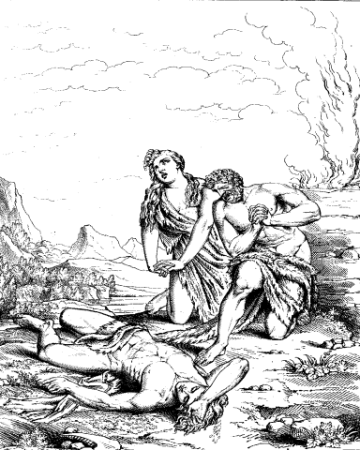
Failure of the foundation of substance
God
Restore
Abel
Cain
(In Adam’s position)
(In Archangel’s position)
Cain killed Abel

Cain killed Abel. In murdering Abel, Cain repeated the sin of the Archangel. That is, he re-enacted the very process which had given rise to the primary characteristics of the fallen nature.


Slide 26
Failure of the foundation of substance
God
Abel
Cain
(In Adam’s position)
(In Archangel’s position)
Cain killed Abel
Foundation of Substance
:
Adam’s family thus failed to lay the foundation of restoration (p. 194).


Slide 27
Failure of the foundation of substance
God
Restoration failed
Abel
Cain
(In Adam’s position)
(In Archangel’s position)
Cain killed Abel
Foundation of Substance
:

Consequently, God’s providence of restoration through Adam’s family could not be fulfilled.


Slide 28
1.3 The Foundation for the Messiah in Adam’s Family
Foundation for the Messiah
F. S.
(substantial offering)
F. F.
(symbolic offering)

The foundation of faith is restored by making an acceptable symbolic offering, and the foundation of substance is established by making an acceptable substantial offering (p. 195).

Slide 29
1.3 The Foundation for the Messiah in Adam’s Family
Foundation for the Messiah
F. S.
(substantial offering)
_
2
Indemnity condition to symbolically restore humans
F. F.
(symbolic offering)
_
_
1
Indemnity condition to restore the natural world
_

The purpose for making the symbolic offering of all things is first
to fulfill an indemnity condition for the restoration of the natural world, ___ and second to fulfill an indemnity condition for the symbolic restoration of human beings.
1
2

Slide 30
1.3 The Foundation for the Messiah in Adam’s Family
Foundation for the Messiah
F. S.
(substantial offering)
_
2
Indemnity condition to symbolically restore humans
F. F.
(symbolic offering)
_
_
1
Indemnity condition to restore the natural world
_

The substantial offering means fulfilling the indemnity condition for the actual restoration of human beings.

Slide 31
1.3 The Foundation for the Messiah in Adam’s Family
Foundation for the Messiah
F. S.
(substantial offering)
_
3
Indemnity condition
to restore children
_
2
Indemnity condition to symbolically restore humans
F. F.
(symbolic offering)
_
_
1
Indemnity condition to restore the natural world
_

When Cain honors Abel and sets him above himself as an offering, they fulfill the indemnity condition to be restored as good children.
3

Slide 32
1.3 The Foundation for the Messiah in Adam’s Family
Foundation for the Messiah
4
Indemnity condition
to restore parents
_
F. S.
(substantial offering)
_
_
3
Indemnity condition
to restore children
_
_
2
Indemnity condition to symbolically restore humans
F. F.
(symbolic offering)
_
_
1
Indemnity condition to restore the natural world
_

This is also reckoned as the indemnity condition for the restoration of their parents (p. 196).
4

Slide 33
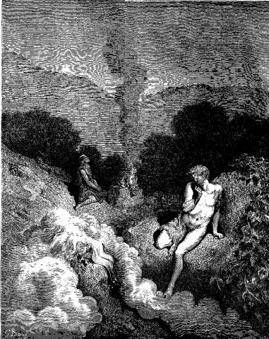
Foundation of Faith

When Abel made his sacrifice in a manner acceptable to God, he fulfilled the indemnity condition to restore the foundation of faith and firmly secured his position as the central figure of the substantial offering (p. 197).

Slide 34
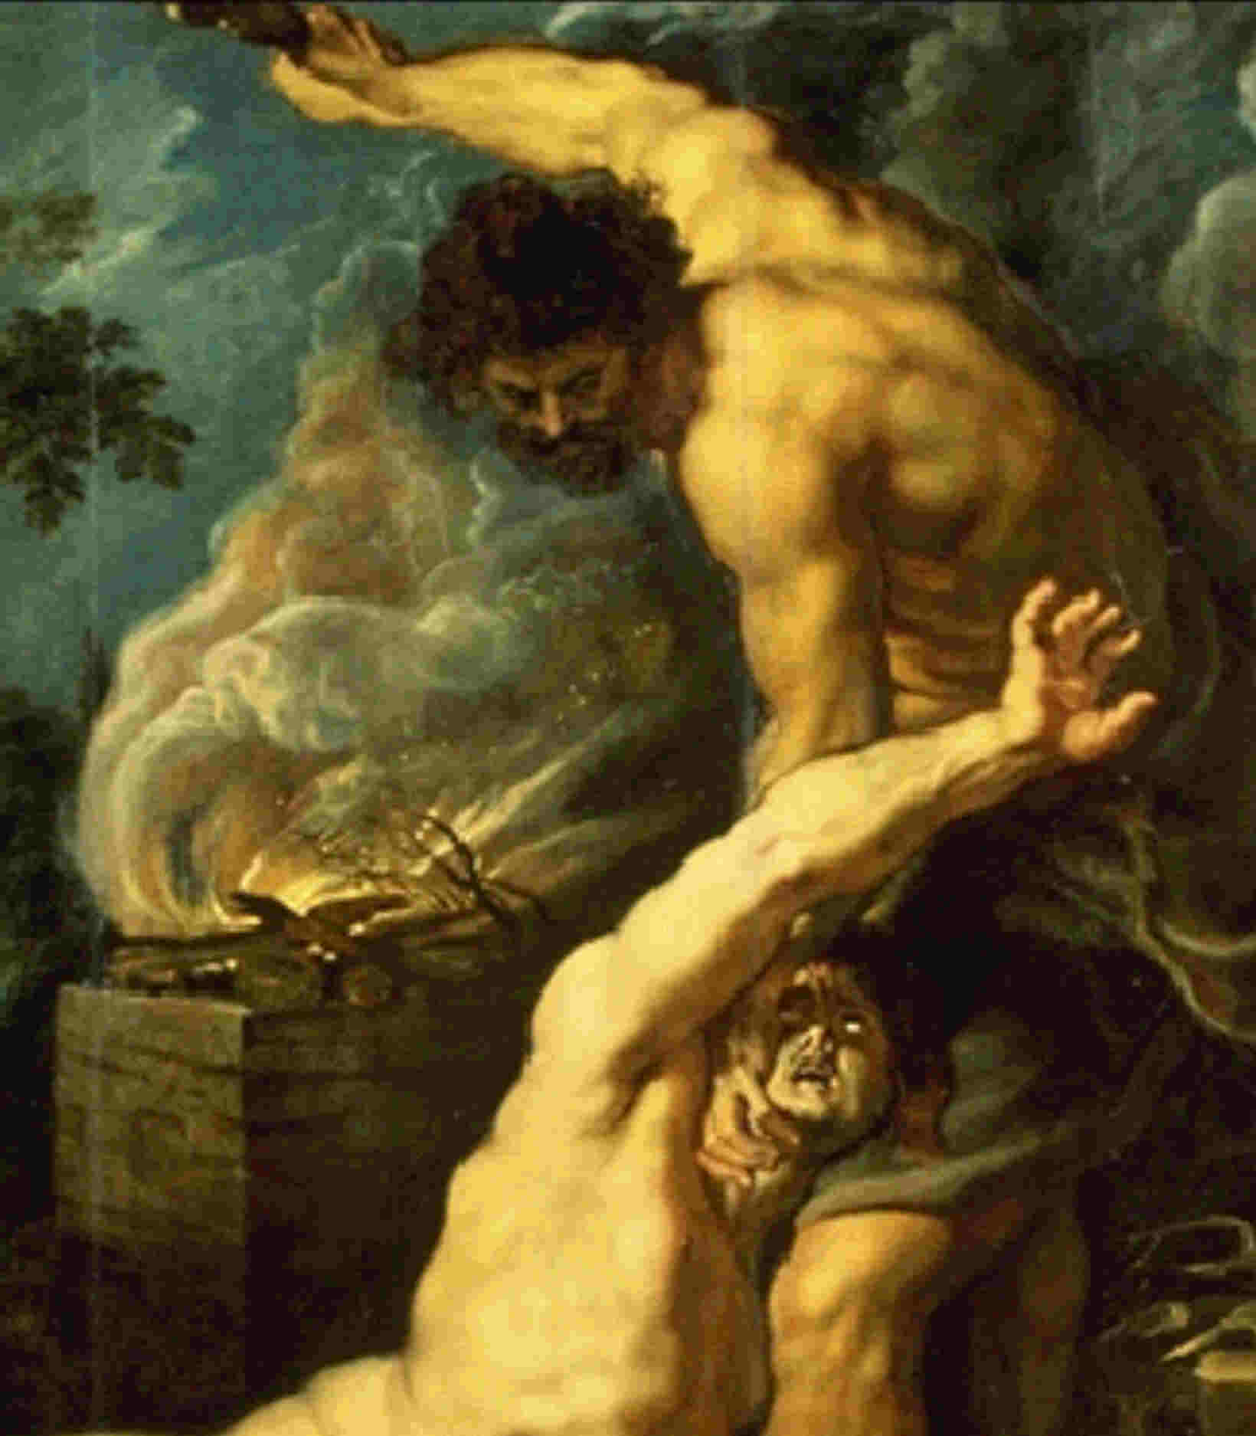
Foundation for the Messiah
Foundation of Substance
Foundation of Faith

However, when Cain murdered Abel, they failed to make the substantial offering. Hence, neither the foundation of substance nor the foundation for the Messiah could be established.

Slide 35
Providence of restoration in Adam’s Family
:
Foundation for the Messiah
Foundation of Substance
Foundation of Faith

God’s providence of restoration in Adam’s family came to naught.

Slide 36
1.4 Some Lessons from Adam’s Family
……………
_
Accomplishment
of God’s Will
Conditional
predestination
1
_
….……
Human responsibility
Respect
_
1
The failure of God’s providence of restoration in Adam’s family teaches us something about God’s conditional predestination of the accomplishment of His Will and His absolute respect for the human portion of responsibility.

Slide 37
1.4 Some Lessons from Adam’s Family
……………
_
Accomplishment
of God’s Will
Conditional
predestination
1
_
….……
Human responsibility
Respect
_
2
Second, even after Cain killed Abel, God began a new chapter of His providence by raising Seth in Abel’s place.

Slide 38
1.4 Some Lessons from Adam’s Family
……………
_
Accomplishment
of God’s Will
Conditional
predestination
1
_
….……
Human responsibility
Respect
_
God’s Will
..….……………
_
Absolute
predestination
2
_
...……………
Human being
_
Conditional
predestination
This shows us that God has absolutely predestined that His Will shall one day be fulfilled, even though His predestination concerning individual human beings is conditional.

Slide 39
1.4 Some Lessons from Adam’s Family
……………
_
Accomplishment
of God’s Will
Conditional
predestination
1
_
….……
Human responsibility
Respect
_
God’s Will
..….……………
_
Absolute
predestination
2
_
...……………
Human being
_
Conditional
predestination
Fallen people
.....……………
3
Abel-type
person
3
Third, through the offerings of Cain and Abel, God teaches us that fallen people must constantly seek for an Abel-type person.

Slide 40
1.4 Some Lessons from Adam’s Family
……………
_
Accomplishment
of God’s Will
Conditional
predestination
1
_
….……
Human responsibility
Respect
_
God’s Will
..….……………
_
Absolute
predestination
2
_
...……………
Human being
_
Conditional
predestination
Fallen people
.....……………
3
Abel-type
person
By honoring, obeying and following him, we can accomplish God’s Will even without understanding every aspect of it (p. 198).

Slide 41
Section 2
The Providence
of Restoration
in Noah's Family

Slide 42

God has predestined absolutely the fulfillment of the purpose of creation, and His Will remains unchangeable.


Slide 43
God
Foundation
of Faith
Abel
Cain
Foundation of Substance
Seth
Noah’s family

God, upon the foundation of the loyal heart which Abel demonstrated toward Heaven, chose Seth in his place. From among Seth’s descendants, God chose Noah’s family and commenced a new chapter in His providence.


Slide 44
God
Foundation
of Faith
Abel
Cain
Foundation of Substance
Seth
Noah’s family

Noah’s family was responsible to fulfill the indemnity condition to restore the foundation of faith, and then the indemnity condition to restore the foundation of substance.


Slide 45
God
Foundation
of Faith
Abel
Cain
Foundation of Substance
Seth
Noah’s family
Restore the foundation
for the Messiah
in Adam’s family
:
They were to restore through indemnity the foundation for the Messiah, which Adam’s family had failed to lay.


Slide 46
2.1 The Foundation of Faith
2.1.1 The Central Figure for the Foundation of Faith
Noah

In the providence of restoration through Noah’s family, Noah was the central figure to restore the foundation of faith (p. 199).

Slide 47
2.1 The Foundation of Faith
2.1.1 The Central Figure for the Foundation of Faith
1
Adam-Noah: 1O generations, 1,6OO years
Noah
1
God called Noah ten generations or sixteen hundred biblical years after Adam.

Slide 48
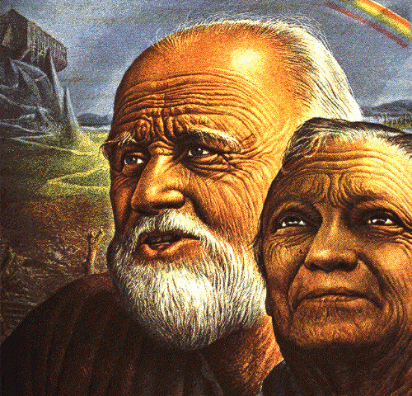
2.1 The Foundation of Faith
2.1.1 The Central Figure for the Foundation of Faith
1
Adam-Noah: 1O generations, 1,6OO years
2
Second ancestor of humanity
Noah
2
Noah was the second ancestor of humanity.

Slide 49
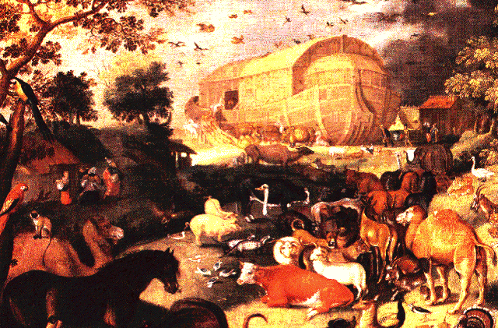
2.1 The Foundation of Faith
2.1.1 The Central Figure for the Foundation of Faith
1
Adam-Noah: 1O generations, 1,6OO years
2
Second ancestor of humanity
3
Absolute obedience to God
Noah
3
Noah worked for 120 years on a mountain to build the ark in absolute obedience to God’s instructions.

Slide 50
2.1 The Foundation of Faith
2.1.1 The Central Figure for the Foundation of Faith
1
Adam-Noah: 1O generations, 1,6OO years
2
Second ancestor of humanity
3
Absolute obedience to God
Noah
4
Foundation of Abel’s heart
4
He was called by God upon the foundation of Abel’s loyal and faithful heart.

Slide 51
2.1 The Foundation of Faith
2.1.1 The Central Figure for the Foundation of Faith
1
Adam-Noah: 1O generations, 1,6OO years
2
Second ancestor of humanity
3
Absolute obedience to God
Noah
4
Foundation of Abel’s heart
5
Descendant of Seth to replace Abel
5
Noah was a descendant of Seth, chosen to replace Abel.

Slide 52
2.1 The Foundation of Faith
2.1.1 The Central Figure for the Foundation of Faith
1
Adam-Noah: 1O generations, 1,6OO years
_
2
Second ancestor of humanity
_
_
3
Absolute obedience to God
Noah
_
_
_
4
Foundation of Abel’s heart
_
5
Descendant of Seth to replace Abel
_
_
_
6
Righteous man
_
6
Noah was a righteous man in the sight of God. For these reasons, he was qualified to make the symbolic offering to God.

Slide 53
2.1.2 The Object for the Condition
in Restoring the Foundation of Faith
God
Central figure: Noah
_
Foundation of Faith
Object: ark
(new cosmos)
_
Noah

The object for the condition by which Noah was to restore the foundation of faith was the ark. It was the indemnity condition for the restoration of the cosmos, which had been lost to Satan due to Adams’s fall, and signified the new cosmos.

Slide 54
2.1.2 The Object for the Condition
in Restoring the Foundation of Faith
God
Central figure: Noah
_
Foundation of Faith
_
Object: ark
(new cosmos)
_
_
_
Noah
Indemnity period:
40 days
_
of flood judgment

After the ark was completed, God judged the world with the flood for forty days. Its purpose was to eliminate sinful humanity in order to raise up a family who would relate only with Him (p. 200).

Slide 55
2.1.2 The Object for the Condition
in Restoring the Foundation of Faith
God
Central figure: Noah
_
Foundation of Faith
_
Object: ark
(new cosmos)
_
_
_
Noah
Indemnity period:
40 days
_
of flood judgment
Foundation of Faith
:
restored

Through the forty-day judgment, Noah’s family offered the ark in the manner acceptable to God and restored through indemnity the foundation of faith.

Slide 56
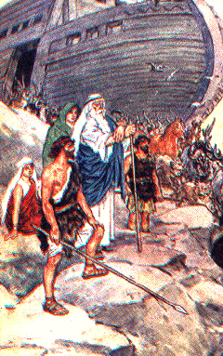
2.2 The Foundation of Substance
Ham
Shem
(Abel)
(Cain)

Noah’s sons, Shem and Ham, were to have stood in the position of Cain and Abel, respectively.

Slide 57
2.2 The Foundation of Substance
Ham
Shem
Indemnity condition
to remove
fallen nature
(Abel)
(Cain)
Had they then succeeded in the substantial offering by fulfilling the indemnity condition to remove the fallen nature, they would have laid the foundation of substance (p. 203).

Slide 58
2.2 The Foundation of Substance
Ham
Shem
Indemnity condition
to remove
fallen nature
(Abel)
(Cain)

For Noah’s family to make an acceptable substantial offering, Ham, Noah’s second son and the central figure of the substantial offering, was to restore the position of Abel.

Slide 59
2.2 The Foundation of Substance
Noah
One in heart
Ham
Shem
Indemnity condition
to remove
fallen nature
(Abel)
(Cain)

For Ham to stand in the position of Abel, he had to become inseparably one in heart with his father, Noah, who had made the symbolic offering.

Slide 60
Providence surrounding Noah’s nakedness

Let us examine how God worked to help Ham become one in heart with Noah.

Slide 61
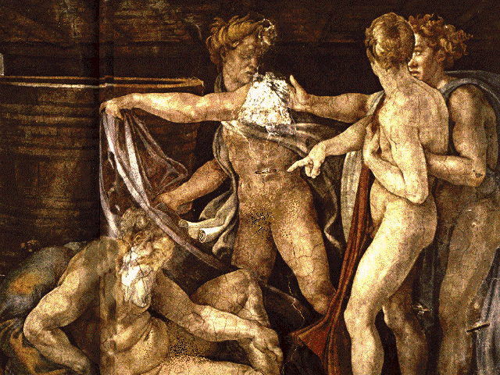
Providence surrounding Noah’s nakedness
(Gen. 9:2O-25)

The Bible reports that when Ham saw his father lying naked in his tent, he felt ashamed of Noah and stirred up the same feelings in his brothers, Shem and Japheth.

Slide 62
Providence surrounding Noah’s nakedness
(Gen. 9:2O-25)
Noah
Naked
God
Felt ashamed,
covered
lower parts
Felt
ashamed
Adam Eve
Nakedness
Ham
Condition for Satan’s entry

When Ham felt ashamed of his father’s nakedness, an act that resembled Adam and Eve’s covering their lower parts and hiding, he made a condition for Satan to enter; hence his feeling and act constituted a sin (p. 205).

Slide 63
Providence surrounding Noah’s nakedness
(Gen. 9:2O-25)
Noah
Naked
God
Felt ashamed,
covered
lower parts
Felt
ashamed
Adam Eve
Nakedness
Ham
Condition for Satan’s entry
Ham
:
failed to restore Abel’s position

Consequently, Ham could not restore through indemnity the position of Abel from which to make the substantial offering.

Slide 64
Providence of restoration in Noah’s family
:
Providence of restoration in Noah’s Family
Foundation for the Messiah
Foundation of Substance
Foundation of Faith

Since Ham failed to restore through indemnity the position of Abel from which to make the substantial offering and thus to establish the foundation of substance, the providence of restoration in Noah’s family ended in failure.

Slide 65
Section 3
The Providence
of Restoration
in Abraham's Family

Slide 66
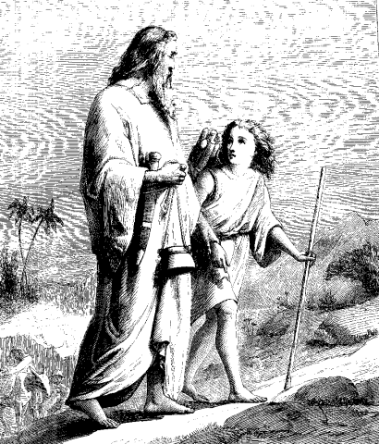
3.1 The Foundation of Faith
3.1.1 The Central Figure for the Foundation of Faith
Abraham

In the providence of restoration in Abraham’s family, the central figure to restore the foundation of faith was Abraham (p. 206).

Slide 67
3.1 The Foundation of Faith
3.1.1 The Central Figure for the Foundation of Faith
1
Restore the conditions
of Noah’s family
Abraham

Abraham was to restore through indemnity all the conditions which had been given to Noah to fulfill, but which were lost to Satan due to Ham’s sin.

Slide 68
3.1 The Foundation of Faith
3.1.1 The Central Figure for the Foundation of Faith
1
Restore the conditions
of Noah’s family
Abraham
2
Restored Adam

Abraham was to inherit the mission of Noah and thus the mission of Adam. In this capacity, he represented restored Adam.

Slide 69
3.1 The Foundation of Faith
3.1.1 The Central Figure for the Foundation of Faith
“And I will make of you a great nation, and I will bless you, and make your name great, so that you will be a blessing.”
1
Restore the conditions
_
of Noah’s family
_
Abraham
_
_
_
2
Restored Adam
_
Genesis 12:2-3
(source of blessing)
As God had blessed Adam and Noah, God also blessed Abraham to make a great nation and be the source of blessing (Gen. 12:2-3) (p. 207).

Slide 70
3.1.2 The Objects for the Condition Offered
for the Foundation of Faith
3.1.2.1 Abraham’s Symbolic Offering
Three
God
Abraham
offerings
(Gen. 15:9)
Dove, ram, and heifer
Offered on one altar

God commanded Abraham to offer a dove, a ram, and a heifer. These were the objects for the condition which he offered to restore the foundation of faith (p. 208).

Slide 71

Significance of Abraham’s symbolic offering
Three
offerings
Dove, ram, and heifer

What was the significance of Abraham’s symbolic offering (p. 209) ?

Slide 72
Significance of Abraham’s symbolic offering
Adam's
Object for the condition to restore Adam’s family’s task
1
family
Three
offerings
Abel
Cain
Dove, ram, and heifer
1
It was an object for the condition to restore all that Adam’s family was supposed to accomplish through Cain and Abel’s sacrifices,

Slide 73
Significance of Abraham’s symbolic offering
Adam's
Object for the condition to restore Adam’s family’s task
1
family
Noah's
Object for the condition to restore Noah’s family’s task
2
family
2
and object for the condition to restore all that Noah’s family was trying to accomplish through the dispensation of the ark.

Slide 74
Three sacrifices: cosmos completed through three stages
Completion
___________
___________
___________
___________
____
___________
___________
___________
___________
___
___________
___________
___________
___________
___
___________
___________
___________
___________
___
Cosmos
Three
Three
sacrifices
stages

These three sacrifices symbolized the cosmos, which is completed through the three stages of the growing period (p. 210).

Slide 75

Three sacrifices: cosmos completed through three stages
Completion
___________
___________
___________
___________
____
Heifer
Completion
___________
---------
---------
___________
___________
___________
___
Ram
Growth
___________
----------
----------
___________
___________
___________
___
Dove
Formation
___________
___________
___________
___________
___
Cosmos
Three
Three
sacrifices
stages

The dove represented the formation stage, the ram the growth stage, and the heifer the completion stage.

Slide 76
Three sacrifices: cosmos completed through three stages
Completion
___________
___________
___________
___________
____
Heifer
Completion
___________
---------
---------
___________
___________
___________
___
Ram
Growth
___________
----------
----------
___________
___________
___________
___
Dove
Formation
___________
___________
___________
___________
___
Cosmos
Three
Three
sacrifices
stages

Why did Abraham place the three sacrifices on one altar?

Slide 77
Three sacrifices: cosmos completed through three stages
Completion
___________
___________
___________
___________
____
Heifer
Completion
}
Res-
tore
at
once
Abraham
___________
---------
---------
___________
___________
___________
___
-------
Ram
Growth
Noah
___________
----------
----------
___________
___________
___________
___
-------
Dove
Formation
Adam
___________
___________
___________
___________
___
Cosmos
Three
Three
Three
sacrifices
stages
generations
Abraham, now in the position of Adam, was supposed to restore, all at once, the long providence which God had conducted through the three providential generations of
Adam (formation), Noah (growth) and Abraham (completion).

Slide 78

How Abraham made the symbolic offering
Birds of prey
Divide = separate good and evil

Because Abraham did not cut the dove in two as he should have, birds of prey came down and defiled the sacrifices (p. 211).

Slide 79
How Abraham made the symbolic offering
Birds of prey
Divide = separate good and evil
(Satan)
(Satan’s possession)

His mistake had the effect of acknowledging Satan’s claim of possession over the sacrifices (p. 212)

Slide 80
How Abraham made the symbolic offering
Birds of prey
Divide = separate good and evil
(Satan)
(Satan’s possession)
Failure of symbolic offering

Through this failure in the symbolic offering, all the conditions God intended to restore through it were lost.

Slide 81
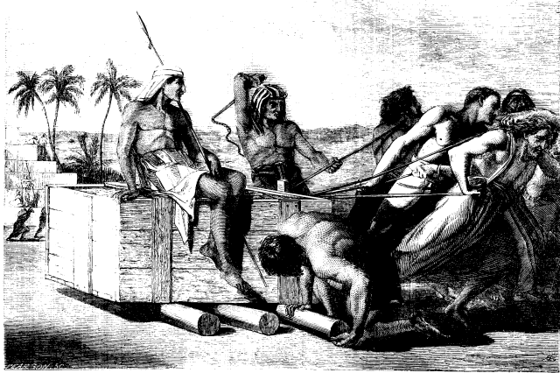
How Abraham made the symbolic offering
Birds of prey
Divide = separate good and evil
(Satan)
(Satan’s possession)
Failure of symbolic offering

Abraham’s descendants:
four hundred years of slavery

Providence:
prolonged through three generations

As a consequence, Abraham’s descendants had to suffer oppression and slavery for four hundred years in the land of Egypt, and the providence centered on him was prolonged through the three generations of Abraham, Isaac and Jacob (p. 212-3).

Slide 82
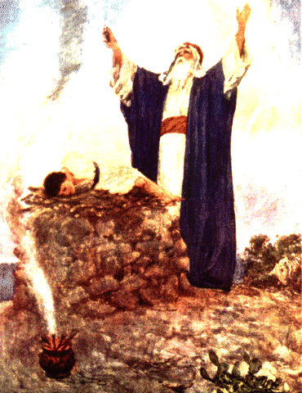

3.1.2.2 Abraham’s Offering of Isaac
God
God
Symbolic offering
Isaac
(burnt offering)
Abraham
Abraham

After Abraham failed in the symbolic offering, God commanded him to sacrifice his only son Isaac as a burnt offering.

Slide 83
3.1.2.2 Abraham’s Offering of Isaac
God
God
Restore
through indemnity
Three
sacrifices
Isaac
Symbolic offering
(undivided)
(burnt offering)
Abraham
Abraham

In this way, God began a new dispensation for the purpose of restoring through indemnity Abraham’s failure.

Slide 84
Why God worked with Abraham again

Why did God work with Abraham again when he had him offer Isaac?

Slide 85
Why God worked with Abraham again
1
Abraham’s family :
third dispensation
Requirement of God’s principle
1
First, the number three represents completion. Since the providence to lay the foundation for the Messiah in Abraham’s family was the third dispensation, God’s Principle required that it conclude this time.

Slide 86
Why God worked with Abraham again
1
Abraham’s family :
third dispensation
Requirement of God’s principle
2
over two generations
attack
Satan :
2
Second, Satan had attacked both Adam and his son Cain, defiling the family over the course of two generations.

Slide 87
Why God worked with Abraham again
1
Abraham’s family :
third dispensation
Requirement of God’s principle
2
over two generations
attack
Satan :
Take back
over two generations
Hence, according to the principle of restoration through indemnity, God could work to take back Abraham and his son Isaac over the course of two generations (p. 214).

Slide 88
Why God worked with Abraham again
1
Abraham’s family :
third dispensation
Requirement of God’s principle
2
over two generations
attack
Satan :
Take back
over two generations
3
Merit
of faithful hearts
3
Third, even though Abraham failed, God could raise him up and give him another chance to make an offering based on the accumulated merit of Abel’s and Noah’s faithful hearts.

Slide 89

How Abraham offered Isaac
Slay
Abraham
Isaac
Mt. Moriah

Abraham put forth his hand, and took the knife to slay Isaac.

Slide 90
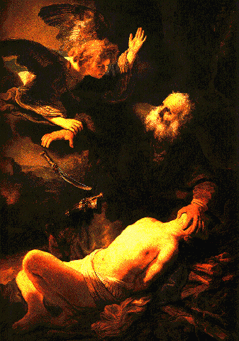
How Abraham offered Isaac
God
Do not lay your hand
Slay
Abraham
Isaac
Mt. Moriah

But the angel of the Lord called to him from heaven, and said, “Do not lay your hand on the lad or do anything to him; for now I know that you fear God.” (Gen. 22:9-12)

Slide 91
Consequence of offering of Isaac
Abraham’s zeal and actions
Position of having killed Isaac
(separated Satan)

Abraham’s zeal to do God’s Will and his resolute actions, carried out with absolute faith, obedience and loyalty, lifted him up to the position of already having killed Isaac. Therefore, he completely separated Satan from Isaac (p. 215).

Slide 92
Consequence of offering of Isaac
Abraham’s zeal and actions
Position of having killed Isaac
(separated Satan)
Success of offering of Isaac
Providence of restoration in Abraham’s family
:
by Isaac

Because Abraham succeeded in his offering of Isaac, the providence of restoration in Abraham’s family could be carried on by Isaac.

Slide 93
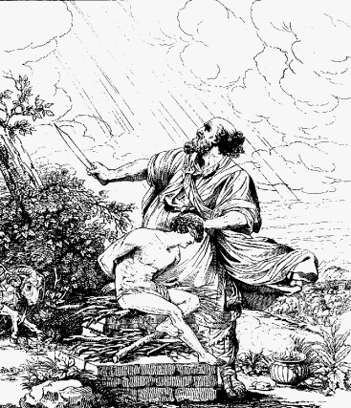
3.1.2.3
Isaac’s Position and His Symbolic Offering in the Sight of God
God
Abraham
Inseparable
oneness
Isaac

Through the success of Isaac’s offering, Abraham and Isaac attained inseparable oneness in their fidelity to God’s Will (p. 216).

Slide 94
3.1.2.3
Isaac’s Position and His Symbolic Offering in the Sight of God
Ram
Abraham
God
Inseparable
oneness
Isaac

After the divine mission had passed from Abraham to Isaac, Abraham offered the ram provided by God as the substitute for Isaac. In fact, this was the symbolic offering by which Isaac restored the foundation of faith (p. 217).

Slide 95
3.1.2.3
Isaac’s Position and His Symbolic Offering in the Sight of God
Ram
Abraham
God
Inseparable
oneness
Isaac
Restoration of foundation of faith

In this way, Isaac, having inherited Abraham’s mission, made the symbolic offering and restored through indemnity the foundation of faith.

Slide 96
3.2 The Foundation of Substance
God
Foundation
of Faith
Abraham
Isaac
Jacob
Esau
(Abel)
(Cain)

To establish the foundation for the Messiah in Isaac’s family, the foundation of substance had to be laid next. For this purpose, Isaac’s sons, Esau and Jacob, had to be placed in the divided positions of Cain and Abel respectively.

Slide 97
3.2 The Foundation of Substance
God
Foundation
of Faith
Abraham
Isaac
Jacob
Esau
Foundation
of Substance
(Abel)
(Cain)
...
Indemnity condition to remove the fallen nature
By making the substantial offering, they were responsible to fulfill the indemnity condition to remove the fallen nature and lay the foundation of substance.

Slide 98
Jacob’s restoration of Abel’s position through indemnity

Before Esau and Jacob could make the substantial offering, Jacob first had to fulfill the indemnity condition to restore the position of Abel (p. 218)

Slide 99

Jacob’s restoration of Abel’s position through indemnity
1
Restoration of birthright on Individual level
(bread and pottage)
1
In the fight to restore the birthright of the eldest son on the individual level, Jacob cleverly obtained it from Esau in exchange for some bread and a pottage of lentils.

Slide 100
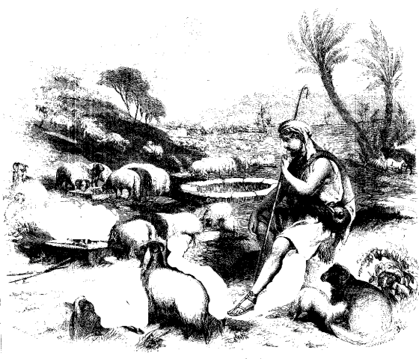
Jacob’s restoration of Abel’s position through indemnity
1
Restoration of birthright on Individual level
(bread and pottage)
2
Restoration of birthright with family and wealth
(21 years in Haran)
2
Second, Jacob went to Haran, which represented the satanic world. After suffering through twenty-one years of drudgery, he restored the birthright by gaining family and wealth as his due inheritance (p. 219).

Slide 101
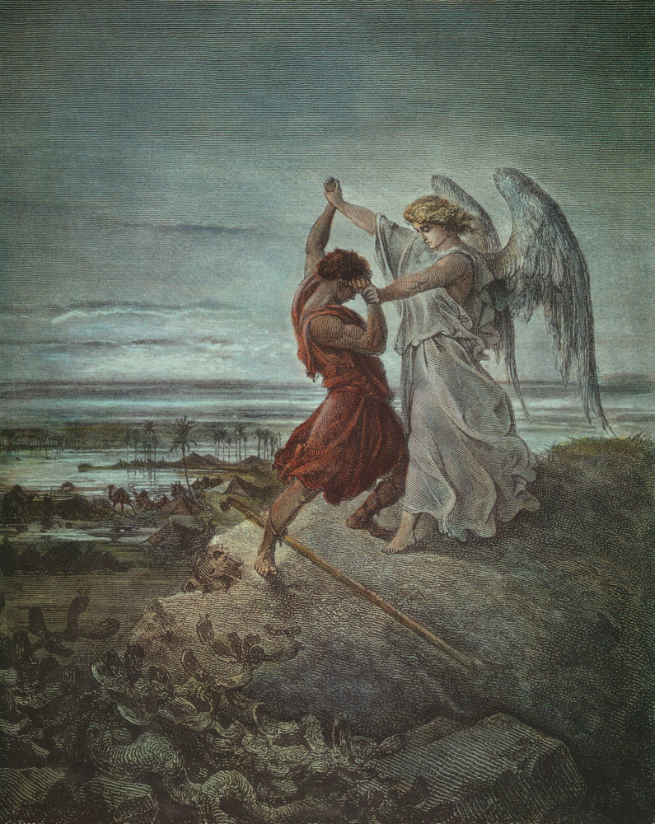
Jacob’s restoration of Abel’s position through indemnity
1
Restoration of birthright on Individual level
(bread and pottage)
2
Restoration of birthright with family and wealth
(21 years in Haran)
3
Restoration of dominion over angels
(wrestling with angels)
3
Third, Jacob triumphed in wrestling with an angel at the ford of Jabbok, thereby restoring dominion over the angel in a substantial struggle.

Slide 102
Jacob’s restoration of Abel’s position through indemnity
1
Restoration of birthright on Individual level
(bread and pottage)
2
Restoration of birthright with family and wealth
(21 years in Haran)
3
Restoration of dominion over angels
(wrestling with angels)
Jacob
:
Restoration of Abel’s position

This way, Jacob restored through indemnity the position of Abel.

Slide 103
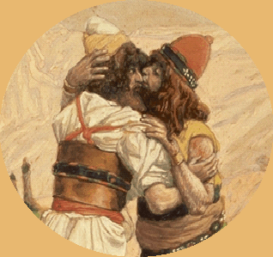
Establishment of Foundation of Substance
Indemnity condition
to remove the fallen nature
Affectionately welcomed
Jacob
Esau

When Esau opened his arms and affectionately welcomed Jacob as he returned to Canaan, they fulfilled the indemnity condition to remove the fallen nature.

Slide 104
Establishment of Foundation of Substance
Restoration of foundation of substance
God
Indemnity condition
to remove the fallen nature
Abraham
Isaac
Affectionately welcomed
Jacob
Esau

Their victory restored through indemnity, horizontally in one family, the long vertical course of history in which God had been working to restore the foundation of substance.

Slide 105
3.3 The Foundation for the Messiah
Isaac's
Family foundation
for the Messiah
:
established
family

At last, the foundation for the Messiah was established in Isaac’s family.

Slide 106
3.3 The Foundation for the Messiah
Isaac's
Family foundation
for the Messiah
:
established
family
Messiah unable to come

However, by Abraham’s time, fallen people had already built up satanic nations which could easily overpower Abraham’s family. Hence, the Messiah could not have safely come on that foundation.

Slide 107
3.3 The Foundation for the Messiah
Isaac's
Family foundation
for the Messiah
:
established
family
Messiah unable to come
A foundation of a sovereign state was needed to cope with the nations of the satanic world.

Slide 108
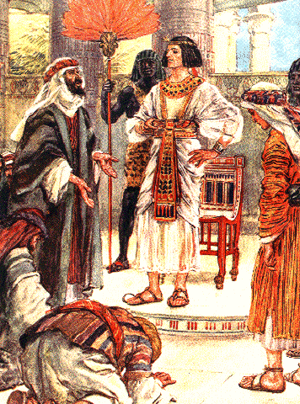
3.3 The Foundation for the Messiah
Isaac's
Family foundation
for the Messiah
:
established
family
Messiah unable to come
Jacob's
National foundation
for the Messiah
:
started
family

Hence, Jacob’s family entered Egypt centering on Joseph
and went through the four hundred years of indemnity course, trying to build the national foundation for the Messiah.

Slide 109
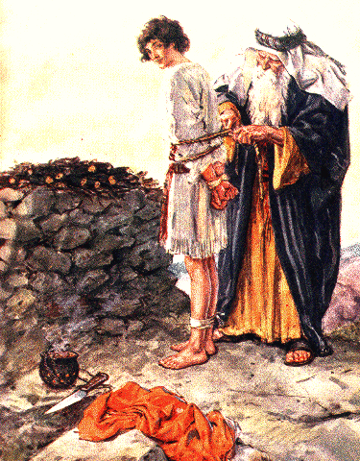
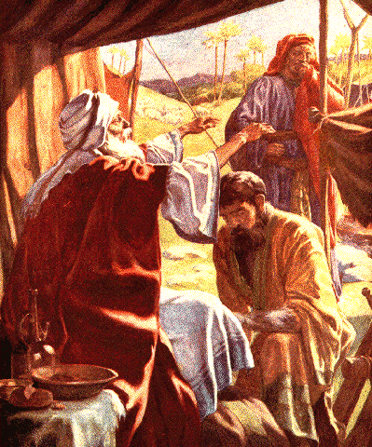
Isaac
Jacob

This way, the providence centering on Isaac was prolonged into the providence centering on Jacob.

Slide 110


Abraham
Isaac
Jacob

Jacob, as the central figure who laid the foundation for the Messiah in Isaac’s family, was responsible to shoulder Abraham’s sin.

Slide 111
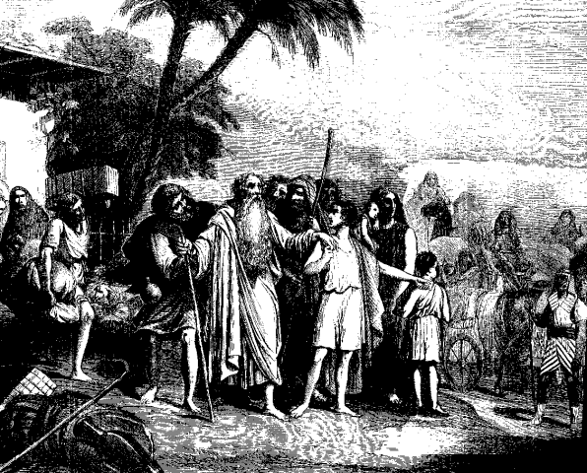
Abraham
Isaac
Jacob
He was also responsible to embark upon an indemnity course to realize on the national level the Will which had been entrusted to Isaac.

Slide 112
Abraham
_
_
Different Individuals
_
Isaac
_
_
_
Same person in God’s Will
_
Jacob
_
_
:
Three generations
one generation in God’s Will
Therefore, as was the case with Abraham and Isaac, God regarded Abraham, Isaac and Jacob as the same person with respect to His Will, even though they were three different individuals (p. 221).

Slide 113
Jacob’s course
:
model course to subjugate Satan
Won the birthright as an individual
1

Jacob triumphed as an individual in his struggle with Esau to win the birthright (p. 222).

Slide 114
Jacob’s course
:
model course to subjugate Satan
Won the birthright as an individual
1
Won the birthright as a family
2

He entered Haran and, as a family, triumphed in a twenty-one-year struggle to win the birthright.

Slide 115
Jacob’s course
:
model course to subjugate Satan
Won the birthright as an individual
1
Won the birthright as a family
2
Restored dominion over angel
3

Jacob was victorious in the fight with the angel and fulfilled the indemnity condition to restore the dominion over the angel.

Slide 116
Jacob’s course
:
model course to subjugate Satan
Won the birthright as an individual
1
Won the birthright as a family
2
Restored dominion over angel
3
Chosen people (Israel)
Thereupon, he received the name “Israel,” laying the groundwork upon which the chosen people would be established.

Slide 117
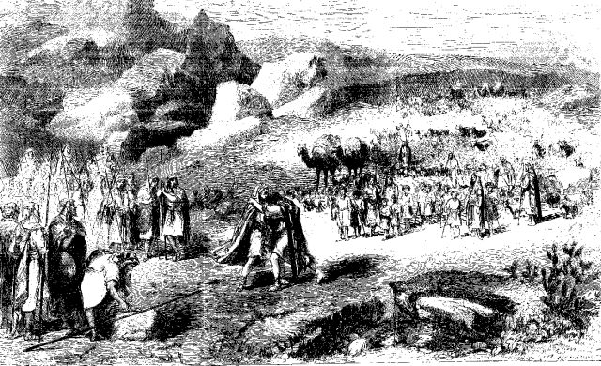
Jacob’s course
:
model course to subjugate Satan
Won the birthright as an individual
1
Won the birthright as a family
2
Restored dominion over angel
3
Chosen people (Israel)
4
Fulfilled the indemnity condition to remove the fallen nature

After returning to Canaan with these victories, Jacob fulfilled the indemnity condition to remove the fallen nature.

Slide 118
Jacob’s course
:
model course to subjugate Satan
Won the birthright as an individual
1
Won the birthright as a family
2
Restored dominion over angel
3
Chosen people (Israel)
4
Fulfilled the indemnity condition to remove the fallen nature
Jacob thus victoriously completed the model course to bring Satan to submission

Slide 119
For more information visit our website
http://www.unificationstudy.com

