Slide 2
Chapter 2
Moses and Jesus
in the Providence
of Restoration

Slide 3
….Secrets of God’s work of salvation
(Amos 3:7)
“Surely the Lord God does nothing, without revealing his secret to his servants the prophets.”
Amos 3:7

The Bible contains many secrets concerning God’s work of salvation. It is written, “Surely the Lord God does nothing, without revealing his secret to his servants the prophets.” (Amos 3:7) (p. 225).

Slide 4
….Secrets of God’s work of salvation
(Amos 3:7)
Principle behind God’s providence
“Surely the Lord God does nothing, without revealing his secret to his servants the prophets.”
Unable to discern the mysteries
Amos 3:7

However, without knowing the principle behind God’s providence, people have been unable to discern the mysteries concealed in the Bible.

Slide 5
….Secrets of God’s work of salvation
(Amos 3:7)
Principle behind God’s providence
Unable to discern the mysteries
Providential courses of Jacob and Moses
Jesus’ course

God set up the providential courses of Jacob and Moses as models for Jesus’ course to save humankind.

Slide 6
Section 1
The Model Courses
for Bringing Satan
to Submission

Slide 7
Model course for subjugating Satan
Jacob
Moses
:
Jesus
substantial course

Jacob’s entire course to bring Satan to submission became the model course for Moses and Jesus. Jesus came to bring Satan to submission in substantial terms.

Slide 8
Model course for subjugating Satan
:
Jacob
symbolic course
:
Moses
image course
:
Jesus
substantial course
Moses walked a course that was the image of Jesus’ course. Still earlier, God had Jacob walk a course that was a symbolic representation of Jesus’ course.

Slide 9
Model course for subjugating Satan
:
Jacob
symbolic course
:
Moses
image course
:
Jesus
substantial course
Model course for
Israelites and humanity

These model courses showed the way the Israelites and all humanity must walk to bring Satan to submission (p. 226).

Slide 10
1.1 Why Jacob’s Course and Moses’ Course
Were Set Up as the Models for Jesus’ Course
Goal of the providence of restoration
Voluntary submission of Satan

The goal of the providence of restoration is attained when human beings bring Satan to voluntary submission and become his master.

Slide 11
1.1 Why Jacob’s Course and Moses’ Course
Were Set Up as the Models for Jesus’ Course
Goal of the providence of restoration
Voluntary submission of Satan
They must do this by fulfilling their given portion of responsibility.

Slide 12
1.1 Why Jacob’s Course and Moses’ Course
Were Set Up as the Models for Jesus’ Course
Goal of the providence of restoration
Voluntary submission of Satan
People of faith
-------
Jesus
Humanity
______________
Satan

Jesus, as the Messiah and the true human ancestor, pioneered the course to bring Satan to complete submission and has since guided people of faith to follow his example.

Slide 13
1.1 Why Jacob’s Course and Moses’ Course
Were Set Up as the Models for Jesus’ Course
Goal of the providence of restoration
Voluntary submission of Satan
God
People of faith
-------
Jesus
Humanity
______________
Satan

Satan, who does not meekly surrender even before God, would by no means readily surrender to Jesus.

Slide 14
1.1 Why Jacob’s Course and Moses’ Course
Were Set Up as the Models for Jesus’ Course
Goal of the providence of restoration
Voluntary submission of Satan
God
People of faith
__________
___________
-------
Jacob
Moses
Jesus
Humanity
……..
………..
.........
......................
______________
Symbol
Satan
Image
Therefore, God called upon Jacob and Moses and worked through them to show the course for bringing Satan to submission.

Slide 15
Section 2
The Providence
of Restoration
under the Leadership
of Moses

Slide 16
2.1 Overview of the Providence Led by Moses
2.1.1 The Foundation of Faith

Central figure
:
Moses
Moses

Moses was the central figure to restore the foundation of faith.

Slide 17
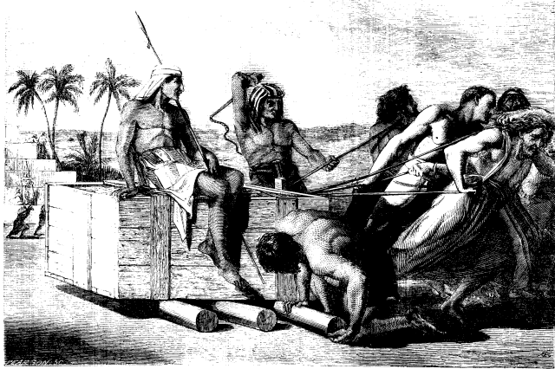
2.1 Overview of the Providence Led by Moses
2.1.1 The Foundation of Faith

Central figure
:
Moses
Moses
A foundation of faith had to be laid anew to begin the course to return to the promised land of Canaan upon the conclusion of the four hundred years of slavery (p. 230)

Slide 18
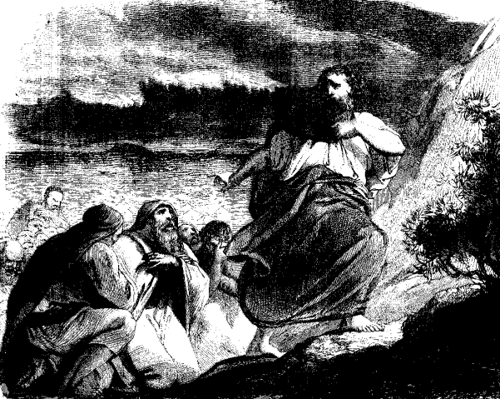
2.1 Overview of the Providence Led by Moses
2.1.1 The Foundation of Faith
God

Central figure
:
Moses
Moses
1
Represent God

Moses was different from all the previous central figures who were called to lay the foundation of faith in that first, Moses was put in the position representing God, acting in His stead,

Slide 19
2.1 Overview of the Providence Led by Moses
2.1.1 The Foundation of Faith
God

Central figure
:
Moses
Moses
1
Represent God
2
Prefigure Jesus
and second, God set up Moses to prefigure Jesus.

Slide 20
2.1 Overview of the Providence Led by Moses
2.1.1 The Foundation of Faith
God

Central figure
:
Moses
Moses
1
Represent God
2
Prefigure Jesus

Unlike Abel, Noah and Abraham, Moses did not need to make a symbolic offering.

Slide 21
2.1 Overview of the Providence Led by Moses
2.1.1 The Foundation of Faith
God

Central figure
:
Moses
Foundationof
Faith
:
God’s Word

Object for condition
Indemnity period

:
dispensation
Moses
of forty
1
Represent God
2
Prefigure Jesus
Rather, he could restore the foundation of faith merely by obedience to God’s Word while fulfilling a dispensation of forty for the separation of Satan (p. 232).

Slide 22
2.1.2 The Foundation of Substance
Age of the Foundation
for Restoration
God
Isaac
Jacob
Esau
Family foundation
of substance

In the Age of the Providence to Lay the Foundation for Restoration, God worked to lay the family foundation of substance.

Slide 23
2.1.2 The Foundation of Substance
Age of the Foundation
for Restoration
Age of the Providence
for Restoration
God
Isaac
Jacob
Esau
Family foundation
of substance
National foundation
of substance
Upon entering the Age of the Providence of Restoration,
God worked to lay the national foundation of substance (p. 233).

Slide 24
2.1.2 The Foundation of Substance
Age of the Foundation
for Restoration
Age of the Providence
for Restoration
God
God
Isaac
Jacob
Esau
Moses
Israelites
Family foundation
of substance
National foundation
of substance

Once Moses had secured the position of Abel, the Israelites, standing
in the position of Cain, were supposed to fulfill the national indemnity condition to remove the fallen nature through their obedience to Moses.

Slide 25
2.1.2 The Foundation of Substance
Age of the Foundation
for Restoration
Age of the Providence
for Restoration
God
God
Isaac
Jacob
Esau
Moses
Israelites
Family foundation
of substance
National foundation
of substance
By doing so, they would establish the national foundation of substance.

Slide 26
2.1.3 The Foundation for the Messiah
God
National
foundation
of faith
National foundation of faith
Moses

Moses was to restore through indemnity the national foundation of faith,

Slide 27
2.1.3 The Foundation for the Messiah
National foundation for the Messiah
God
National foundation of substance
National
foundation
of faith
National foundation of faith
Moses
Israelites
National foundation
of substance
and the Israelites under Moses’ leadership were to restore through indemnity the national foundation of substance. This would have constituted the national foundation for the Messiah.

Slide 28
2.2 The National Courses to Restore Canaan under
the Leadership of Moses
Moses’ course
Egypt
Israelites
Miracles and signs
Red Sea
Wilderness
Canaan

Moses brought the Israelites out of Egypt, the satanic world, with
miracles and signs, led them across the Red Sea, and had them wander through the wilderness before entering the promised land of Canaan (p. 234).

Slide 29
2.2 The National Courses to Restore Canaan under
the Leadership of Moses
Moses’ course
Jesus’ course
Egypt
Israelites
Christians
Miracles and signs
Red Sea
…….................................
Wilderness
Canaan

This foreshadowed the course of which Jesus would one day lead Christians, the Second Israel.

Slide 30
2.2 The National Courses to Restore Canaan under
the Leadership of Moses
Moses’ course
Jesus’ course
Egypt
Lives of sin
Israelites
Christians
Miracles and signs
Miracles and signs
Red Sea
…….................................
Sea of evil
Wilderness
Canaan
With miracles and signs, Jesus would bring Christians out of lives of sin and lead them safely across the troubled sea of evil.

Slide 31
2.2 The National Courses to Restore Canaan under
the Leadership of Moses
Moses’ course
Jesus’ course
Egypt
Lives of sin
Israelites
Christians
Miracles and signs
Miracles and signs
Red Sea
…….................................
Sea of evil
Wilderness
Desert
Canaan
Eden
He would take them through a desert devoid of life-giving water before guiding them into the Garden of Eden of God’s promise.

Slide 32
2.2 The National Courses to Restore Canaan under
the Leadership of Moses
Moses’ course
Jesus’ course
Egypt
Lives of sin
Israelites
Christians
Miracles and signs
Miracles and signs
Red Sea
…….................................
Sea of evil
Wilderness
Desert
Canaan
Eden
Prolonged three times
Prolonged three times

Both courses were prolonged three times because of the Israelites’ faithlessness.

Slide 33
2.2.1 The First National Course to Restore Canaan
2.2.1.1 The Foundation of Faith

Central figure
:
Moses
:

Object for condition
God’s Word

Indemnity period

In order for Moses to become the central figure to restore the foundation of faith and be qualified to lead the Israelites out of Egypt, he as an individual had to inherit the four-hundred-year national indemnity period and complete a dispensation of forty for the separation of Satan.

Slide 34
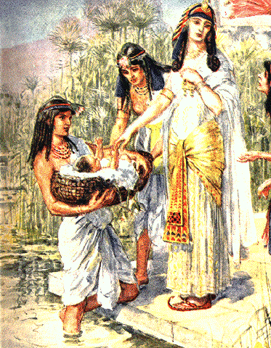
2.2.1 The First National Course to Restore Canaan
2.2.1.1 The Foundation of Faith

Central figure
:
Moses
:

Object for condition
God’s Word

Indemnity period
:
Forty years
in Pharaoh’s palace
Moses
Dispensation of forty for separation of Satan

To achieve this purpose, Moses was brought into the Pharaoh’s palace, the center of the satanic world, and he spent forty years there, completing the dispensation of forty for the separation of Satan.

Slide 35
2.2.1 The First National Course to Restore Canaan
2.2.1.1 The Foundation of Faith
God

Central figure
:
Moses
:

Object for condition
God’s Word
Foundation
of faith

Indemnity period
:
Forty years
in Pharaoh’s palace
Moses
Dispensation of forty for separation of Satan

During the forty years of his life in the Pharaoh’s palace, Moses restored the foundation of faith (p. 235).

Slide 36
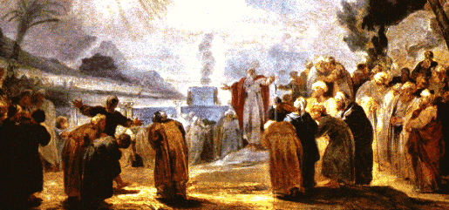
2.2.1.2 The Foundation of Substance
Abel
Cain
Moses
Israelites

The Israelites, who were in the position of Cain, were supposed to follow and obey in faith Moses, who had secured the position of Abel.

Slide 37
2.2.1.2 The Foundation of Substance
God
Abel
Cain
Moses
Israelites
National indemnity condition to remove fallen nature
By inheriting God’s Will from Moses and multiplying goodness, they would lay the national foundation of substance.

Slide 38
2.2.1.2 The Foundation of Substance
God
Abel
Foundation
of substance
Cain
Moses
Israelites
National indemnity condition to remove fallen nature

The Israelites were to lay the foundation of substance by following Moses from the time they left Egypt until they entered the blessed land of Canaan.

Slide 39
2.2.1.2 The Foundation of Substance
God
Abel
Foundation
of substance
Cain
Moses
Israelites
National indemnity condition to remove fallen nature
Dispensation to start

God commenced the dispensation to start the course with Moses’ act of killing an Egyptian.

Slide 40


2.2.1.3 The Failure of the First National Course to Restore Canaan
Moses killed Egyptian

Seeing one of his brethren being mistreated by an Egyptian taskmaster, Moses was incited by his burning love for his people; he struck and killed the man.

Slide 41
2.2.1.3 The Failure of the First National Course to Restore Canaan
Moses killed Egyptian
Israelites misunderstood and spoke ill of him
Pharaoh sought to kill Moses

When the Israelites saw Moses strike and kill the Egyptian, they misunderstood him and spoke ill of him. When Pharaoh heard of it, he sought to kill Moses.

Slide 42
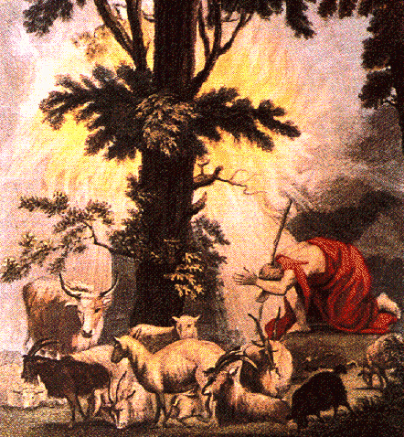
2.2.1.3 The Failure of the First National Course to Restore Canaan
Moses killed Egyptian
Israelites misunderstood and spoke ill of him
Pharaoh sought to kill Moses
Reluctantly forsaking the Israelites, he fled into the wilderness of Midian (p. 236).

Slide 43
2.2.1.3 The Failure of the First National Course to Restore Canaan
God
Moses killed Egyptian
Israelites misunderstood and spoke ill of him
Pharaoh sought to kill Moses
Foundation
of substance
Moses
Israelites
Failure of dispensation to start

The foundation of substance was shattered, and the first national course to restore Canaan failed.

Slide 44
2.2.2 The Second National Course to Restore Canaan
2.2.2.1 The Foundation of Faith

When the first national course to restore Canaan ended in failure, Satan claimed the forty years of Moses’ life in Pharaoh’s palace.

Slide 45
2.2.2 The Second National Course to Restore Canaan
2.2.2.1 The Foundation of Faith

Central figure
:
Moses
:

Object for condition
God’s Word

Indemnity period

Hence, for Moses to begin the second national course to restore Canaan, he had to lay anew the foundation of faith by completing another period of forty years to restore through indemnity his lost forty years in the palace (p. 237).

Slide 46
2.2.2 The Second National Course to Restore Canaan
2.2.2.1 The Foundation of Faith

Central figure
:
Moses
:

Object for condition
God’s Word

Indemnity period
:
Forty years in Midian
Moses
Dispensation of forty for separation of Satan

Moses went through a second dispensation of forty for the separation of Satan during the forty years he spent in the wilderness of Midian.

Slide 47
2.2.2 The Second National Course to Restore Canaan
2.2.2.1 The Foundation of Faith
God

Central figure
:
Moses
:
Foundation
of faith

Object for condition
God’s Word

Indemnity period
:
Forty years in Midian
Moses
Dispensation of forty for separation of Satan

There he restored the foundation of faith needed to embark upon the second national course to restore Canaan.

Slide 48
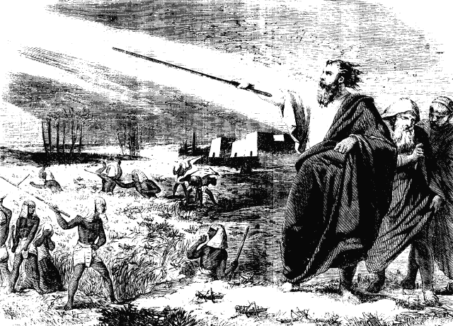
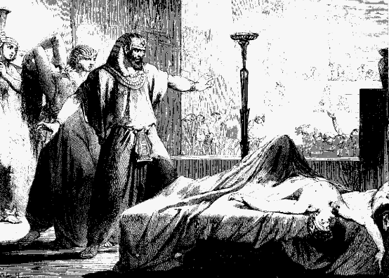
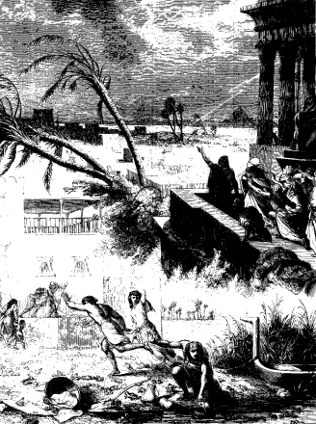
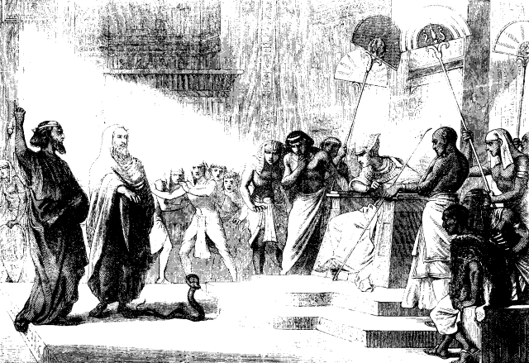
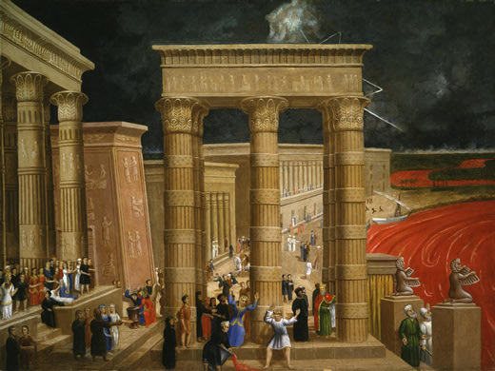
2.2.2 The Second National Course to Restore Canaan
2.2.2.2 The Foundation of Substance
Success of dispensation to start
Three signs and ten plagues

To work the dispensation to start the second national course to restore Canaan, God granted Moses three signs and ten plagues with which to prevail over the Egyptians (p. 237-8).

Slide 49
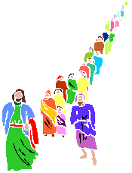
2.2.2 The Second National Course to Restore Canaan
2.2.2.2 The Foundation of Substance
God
Foundation
of substance
Moses
Israelites
Success of dispensation to start
Three signs and ten plagues

The Israelites believed and followed Moses. Hence, they could embark upon the second national course to restore Canaan (p. 241).

Slide 50
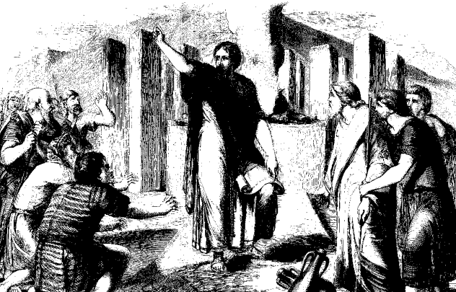

The Israelites had to remain faithful and obedient to Moses for the duration of their journey.

Slide 51
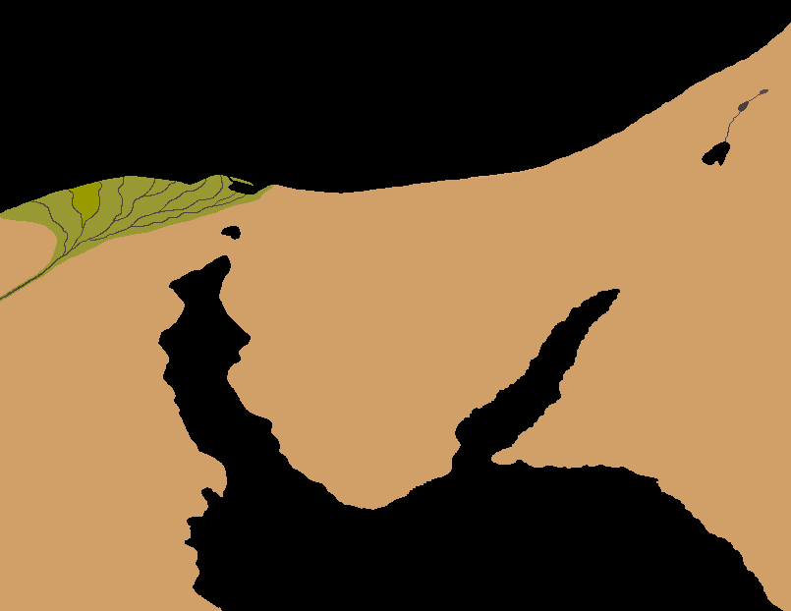
Canaan
Jordan
River
Dead Sea
Wilderness
of
Midian
Egypt
Wilderness of Sin
Wilderness
of
Sinai
Until they had traversed the wilderness with unwavering faith in Moses and entered the land of Canaan, the national foundation of substance would not be established (p. 242).

Slide 52
First
twenty-one-day
course
Canaan
Jordan
River
......
Dead Sea
Rameses
......
......
......
......
......
Wilderness
of
Midian
Egypt
Wilderness of Sin
Wilderness
of
Sinai

In the first course, the Israelites would have entered Canaan in twenty-one days.

Slide 53
First
twenty-one-day
course
Canaan
Jordan
River
......
Dead Sea
Rameses
......
......
......
......
......
Wilderness
of
Midian
Egypt
Wilderness of Sin
Wilderness
of
Sinai
However, in the second course, God was worried that they might again turn faithless and return to Egypt.

Slide 54
Second
twenty-one-month
course
First
twenty-one-day
course
Canaan
Jordan
River
......
Dead Sea
Rameses
......
......
......
......
......
Succoth
Wilderness
of
Midian
Egypt
Wilderness of Sin
Wilderness
of
Sinai
Mt. Horeb
Rephidim
Hence, God led them in a long detour so that they could enter Canaan after twenty-one months.

Slide 55
God
Canaan
Moses
Jordan
River
Dispensation to start
Dead Sea
Wilderness
of
Midian
Egypt
Wilderness
of
Sinai
Mt. Horeb

In order to start the national course, Moses had to have the three-day period in which to separate Satan by deceiving the Pharaoh and liberating his people from bondage.

Slide 56
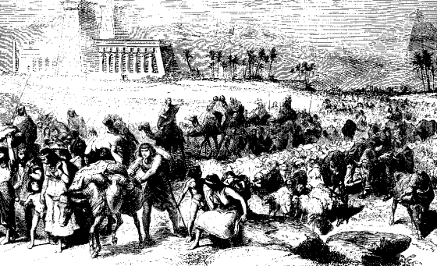
God
Foundation
of substance
Canaan
Moses
Israelites
Jordan
River
Dispensation to start
Dead Sea
Rameses
Rameses
Three-day journey
Wilderness
of
Midian
Egypt
Wilderness
of
Sinai
Mt. Horeb
The Israelites departed from Rameses and upheld God’s Will throughout the three-day journey to Succoth (Exod. 12:6-37)
(p. 243).

Slide 57
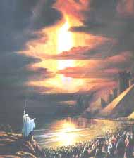
God
Foundation
of substance
Canaan
Moses
Israelites
Jordan
River
And the LORD went before them by day in a pillar of cloud to lead them along the way, and by night in a pillar of fire to give them light, that they might travel by day and by night;
Dispensation to start
Dead Sea
Rameses
Three-day journey
Succoth
Wilderness
of
Midian
Succoth
Pillars of cloud and fire
Egypt
Wilderness
of
Sinai
Exod. 13:21
Mt. Horeb

From Succoth, God granted them the grace of a pillar of cloud by day and a pillar of fire by night to guide their way (Exod. 13:21).

Slide 58

God
Foundation
of substance
Canaan
Moses
Israelites
Jordan
River
Dispensation to start
Dead Sea
Rameses
Three-day journey
Wilderness
of
Midian
Succoth
Pillars of cloud and fire
Egypt
Wilderness
of
Sinai
Red Sea
Mt. Horeb

At the shore of the Red Sea, upon God’s commandment, Moses stretched out his staff and parted the waters; then he led the Israelites across on dry ground.

Slide 59
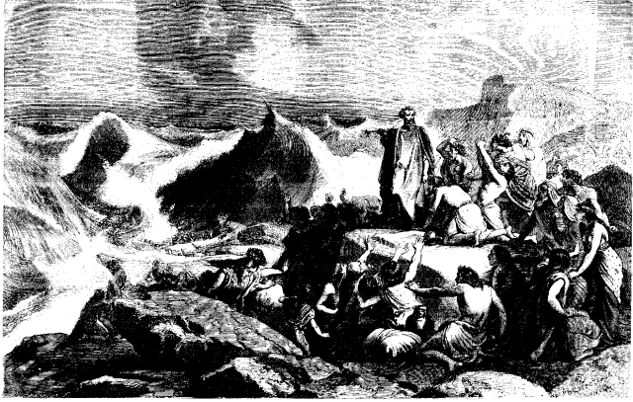
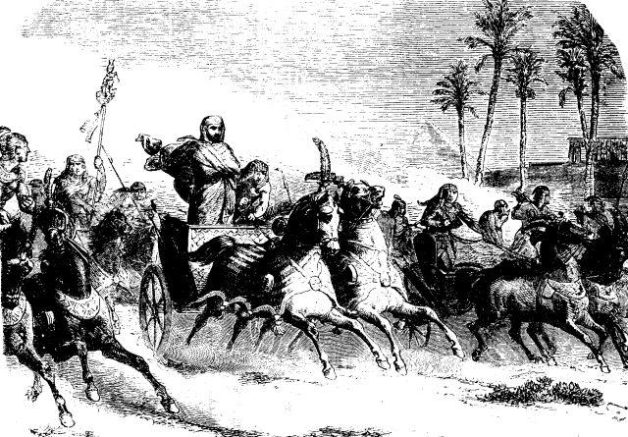
God
Foundation
of substance
Canaan
Moses
Israelites
Jordan
River
Dispensation to start
Dead Sea
Rameses
Three-day journey
Wilderness
of
Midian
Succoth
Pillars of cloud and fire
Egypt
Wilderness
of
Sinai
Red Sea
Mt. Horeb
The Egyptians chasing them in chariots were drowned when the waters closed up and engulfed them.

Slide 60
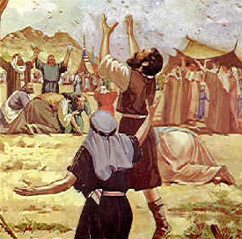
God
Foundation
of substance
Canaan
Moses
Israelites
Jordan
River
Dispensation to start
Dispensation to start
Dead Sea
Rameses
Egypt
Wilderness
of
Midian
W. of Sin
Manna and quail
Wilderness of Sin
Egypt
Wilderness of Sin
Wilderness
of
Sinai
Mt. Horeb

The Israelites arrived at the Wilderness of Sin. From then, God fed them with manna and quail (Exod. 16:13-35)

Slide 61
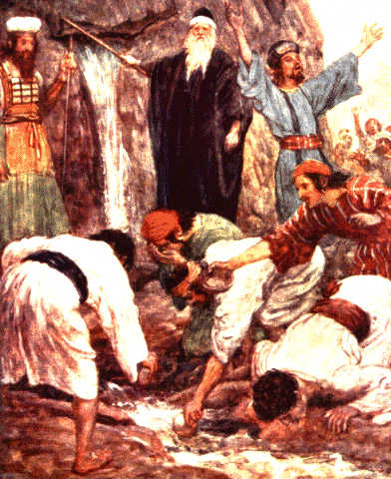
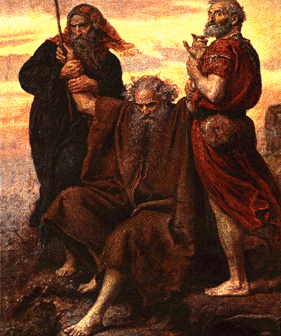
God
Foundation
of substance
Canaan
Moses
Israelites
Jordan
“Behold, I will stand before you there on the rock at Horeb: and you shall strike the rock, and water shall come out of it, that the people may drink.” And Moses did so, in the sight of the elders of Israel.
River
Dispensation to start
Dispensation to start
Dead Sea
Rameses
Egypt
Wilderness
of
Midian
W. of Sin
Manna and quail
Egypt
Wilderness of Sin
Exod. 17:6
Rock
Wilderness
of
Sinai
Rephidim
Defeated Amalekites
Mt. Horeb
Mt. Horeb
Rephidim

When the Israelites camped at Rephidim, God commanded Moses to strike the rock at Horeb that water might spring forth from it. Moses did so and gave the water to the people (Exod. 17:6) (p. 244).

Slide 62
2.2.2.3 The Providence of Restoration and the Tabernacle
First and second foundations for the Tabernacle
Canaan
Jordan
River
Wilderness of Sinai
Dead Sea
Wilderness
of
Midian
Egypt
Wilderness of Sin
Wilderness
of
Sinai
Mt. Horeb

The Israelites arrived in the wilderness of Sinai at the beginning of the third month.

Slide 63
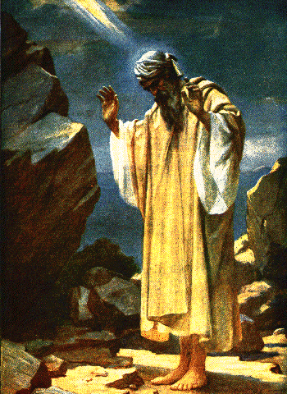
2.2.2.3 The Providence of Restoration and the Tabernacle
First and second foundations for the Tabernacle
Canaan
Jordan
River
Wilderness of Sinai
Dead Sea

Forty-day fast
Wilderness
of
Midian

Instruction concerning Ark and
Tabernacle
Egypt
Wilderness of Sin
Wilderness
of
Sinai

Indemnity period
Mt. Horeb

During his fast on Mt. Sinai, Moses received God’s instructions concerning the Ark of the Covenant and the Tabernacle.

Slide 64
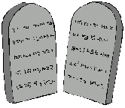
2.2.2.3 The Providence of Restoration and the Tabernacle
First and second foundations for the Tabernacle
Canaan
Jordan
River
Wilderness of Sinai
Dead Sea

Forty-day fast
Wilderness
of
Midian

Instruction concerning Ark and
Tabernacle
Egypt
Wilderness of Sin
Wilderness
of
Sinai

Two tablets of stone
(Ten Commandsments)

Indemnity period
Mt. Horeb
When the forty-day fast was over, he received two tablets of stone, inscribed with the Ten Commandments.

Slide 65
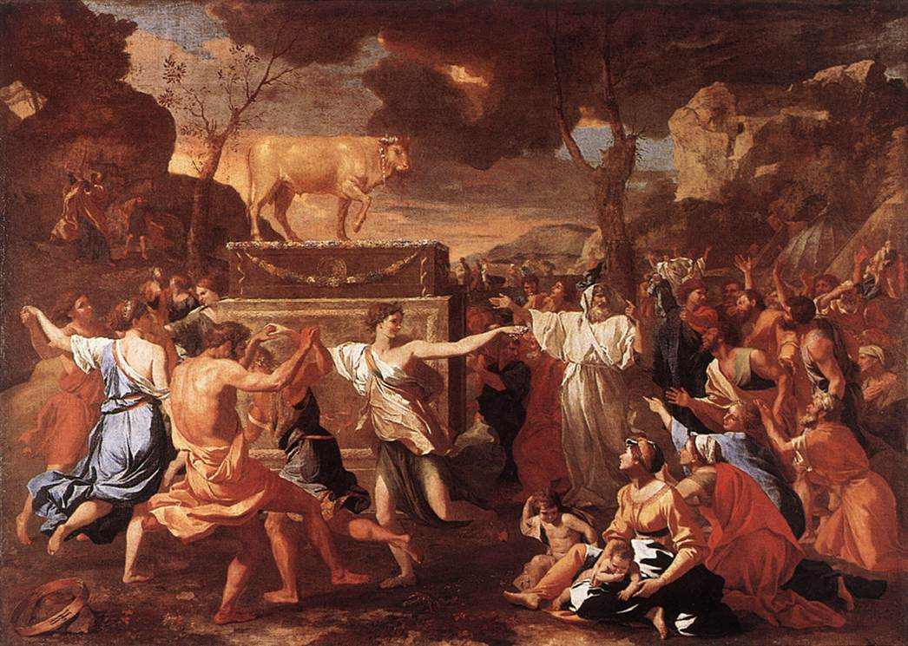
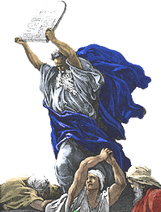
2.2.2.3 The Providence of Restoration and the Tabernacle
First and second foundations for the Tabernacle
Canaan
Jordan
River
Wilderness of Sinai
Dead Sea

Forty-day fast
Wilderness
of
Midian

Instruction concerning Ark and
Tabernacle
Egypt
Wilderness of Sin
Wilderness
of
Sinai

Two tablets of stone
(Ten Commandsments)

Indemnity period
Mt. Horeb

However, when Moses saw the faithlessness of the people his anger burned hot, and he broke the tablets of stone (first failure). (p. 244).

Slide 66
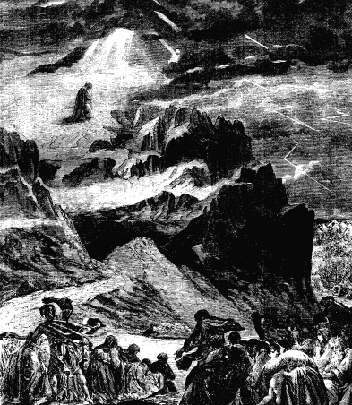
2.2.2.3 The Providence of Restoration and the Tabernacle
First and second foundations for the Tabernacle
Canaan
Jordan
River
Wilderness of Sinai
Dead Sea

Forty-day fast
(twice)
Wilderness
of
Midian

Instruction concerning Ark and
Tabernacle
Egypt
Wilderness of Sin
Wilderness
of
Sinai

Two tablets of stone
(Ten Commandsments)

Indemnity period
Mt. Horeb
Then, after Moses fasted for forty days a second time, God dictated the Ten Commandments to Moses, and Moses wrote them on the tablets (p. 245).

Slide 67
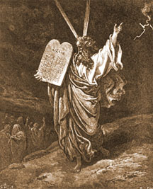
2.2.2.3 The Providence of Restoration and the Tabernacle
First and second foundations for the Tabernacle
Canaan
Jordan
River
Wilderness of Sinai
Dead Sea

Forty-day fast
(twice)
Wilderness
of
Midian
Instruction concerning Ark and
Tabernacle

Tabernacle
Egypt
Wilderness of Sin
Wilderness
of
Sinai

Two tablets of stone
(Ten Commandsments)

Indemnity period
Mt. Horeb

Moses took these tablets and went before the Israelites again. This time they honored Moses. In Obedience to his directions, they built the Ark of the Covenant and constructed the Tabernacle.

Slide 68
2.2.2.3.1 The Significance and Purpose of the Tablets of Stone,
Tabernacle and Ark of the Covenant
Significance
Tablets
Adam
●
Eve
Jesus
●
Holy Spirit

The two tablets inscribed with the Word symbolized restored Adam and Eve, and also symbolized Jesus and his would-be Bride (Holy Spirit).

Slide 69
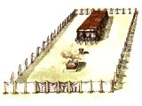
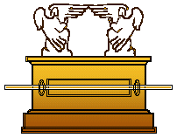
2.2.2.3.1 The Significance and Purpose of the Tablets of Stone,
Tabernacle and Ark of the Covenant
Significance
Tabernacle
Tablets
Ark
Representation
of Jesus in symbol
Adam
●
Eve
Jesus
●
Holy Spirit
Representation
of cosmos and Tabernacle

The Tabernacle was a representation of Jesus in symbol. The Ark of the Covenant represented the cosmos and, at the same time, was a smaller representation of the Tabernacle (p. 246).

Slide 70
Purpose

For what purpose did God give the tablets of stone, the Tabernacle, and the Ark of the Covenant (p. 247) ?

Slide 71
Purpose

Faithlessness of Israelites

Even Moses might act faithlessly

The Israelites repeatedly fell into faithlessness during their journey. In the end, there was danger that even Moses might act faithlessly.

Slide 72
Purpose

Faithlessness of Israelites

Even Moses might act faithlessly

Unchanging object of faith

To cope with this situation, God set up an object of faith, one which would remain unchanged even though the people might change.

Slide 73
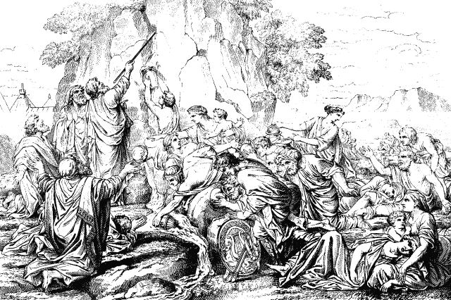
The Third Foundation for the Tabernacle

Because of the faithlessness of the Israelites, the second foundation for the Tabernacle was again defiled by Satan
(p. 251).

Slide 74
The Third Foundation for the Tabernacle
God
Foundation
of substance
Moses
Israelites

However, the Israelites were allowed to attempt yet another dispensation of forty for the separation of Satan and restore through indemnity the foundation for the Tabernacle in their third attempt.

Slide 75
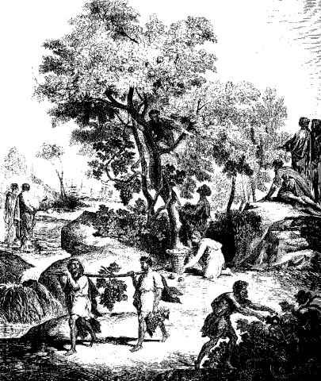
The Third Foundation for the Tabernacle
God
Foundation
of substance
Moses
Israelites

40-day spy mission
The forty-day mission to spy out the land of Canaan was given as the condition to achieve this.

Slide 76
The Third Foundation for the Tabernacle
God
Foundation
of substance
Moses
Israelites

40-day spy mission

Faithless reports

When they returned from the mission, all the spies except Joshua and Caleb presented faithless reports.

Slide 77
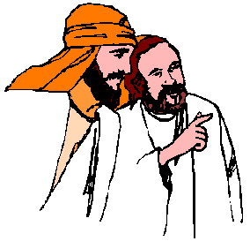
The Third Foundation for the Tabernacle
God
Foundation
of substance
Moses
Israelites

40-day spy mission

Faithless reports

Israelites murmured against Moses

Upon hearing this report, the Israelites again murmured against Moses. As a result of their lack of faith, the third foundation for the Tabernacle ended in failure (p. 251-2).

Slide 78
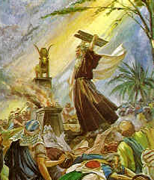
2.2.2.4 Failure of the Second National Course to Restore Canaan
(Numbers 11:1-35)
God
Foundation
of substance
Moses
Israelites
Failure of first, second, and third foundation for the Tabernacle

The foundation for the Tabernacle was invaded by Satan three times. Therefore, the foundation of substance for the second national course to restore Canaan was not laid.

Slide 79
2.2.2.4 Failure of the Second National Course to Restore Canaan
God
Foundation
of substance
Moses
Israelites
Failure of first, second, and third foundation for the Tabernacle
Consequently, the entire second national course to restore Canaan ended in failure.

Slide 80
2.2.2.4 Failure of the Second National Course to Restore Canaan
2.2.2.4 Failure of the Second National Course to Restore Canaan
God
Second
twenty-one-month
course
Canaan
Jordan
Foundation
of substance
River
Dead Sea
.
.
.
Moses
.
Israelites
.
.
Wilderness
of
Midian
Failure of first, second, and third foundation for the Tabernacle
Egypt
Wilderness of Sin
Wilderness
of
Sinai
Failure of 21-month second wilderness course
Failure of 21-month second wilderness course
Mt. Horeb
Prolonged to 4O-year third wilderness course

The twenty-one-month second wilderness course
was prolonged to the forty-year third wilderness course.

Slide 81

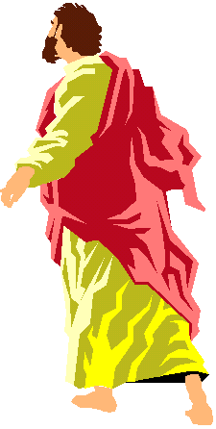
2.2.3 The Third National Course to Restore Canaan
2.2.3.1 The Foundation of Faith
Second
twenty-one-month
course
Canaan
Jordan
River
Dead Sea
Wilderness
of
Midian
Wilderness
of
Midian
Egypt
Wilderness of Sin
Wilderness
of
Sinai
Mt. Horeb

Because the second national course to restore Canaan ended
in failure, the forty years Moses had spent in the wilderness of Midian to restore the foundation of faith were invaded by Satan.

Slide 82
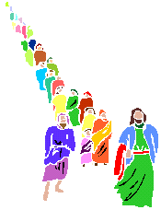
2.2.3 The Third National Course to Restore Canaan
2.2.3.1 The Foundation of Faith
God
Canaan
Kadesh
Jordan
River
:
barnea
Dead Sea

Central figure
Moses
-
:

Object for condition
Tabernacle
Foundation
of faith

Indemnity period
:
Forty years
Wilderness
of
Midian
in wilderness
Egypt
Wilderness of Sin
Wilderness
of
Sinai
Moses
Dispensation of forty for separation of Satan
Mt. Horeb

For Moses the forty-year’s wandering in the wilderness honoring the Tabernacle until the Israelites returned to Kadesh-barnea was to separate Satan, who had invaded the previous foundation of faith, and to restore through indemnity the foundation of faith for the third course (p. 252-3).

Slide 83
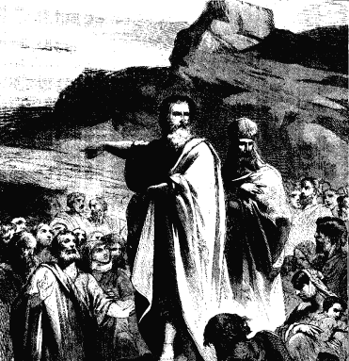
......
First course
Forty-day
spying
in Canaan
Second course
Jericho
Third course
Jordan
River
......
Kadesh
......
Dead Sea
......
.
.
.
......
......
......
......
.
barnea
-
.
.
Wilderness
of
Midian
Wilderness of Sin
Egypt
Wilderness
of
Sinai
Mt. Horeb

During the forty years, Moses completed the foundation of faith for the third national course to restore Canaan. Accordingly, he also secured the position of Abel for the foundation of substance.

Slide 84
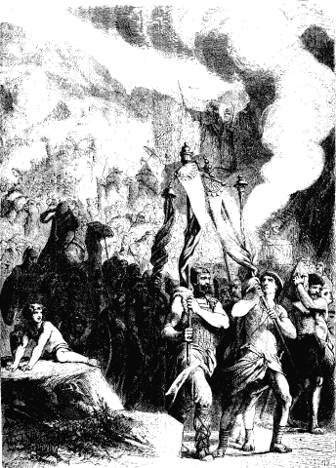
2.2.3.2 The Foundation of Substance
2.2.3.2.1 Foundation of Substance Centered on Moses
Jericho
......
......
.
.
.
.
.
......
.
......
......
......
......
Kadesh
.
barnea
.
-
.
.
.
.
Mt. Horeb

For the Israelites, the goal for the forty years of wandering in the wilderness was to accomplish the dispensation to start the third course.

Slide 85
2.2.3.2 The Foundation of Substance
2.2.3.2.1 Foundation of Substance Centered on Moses
Jericho
......
......
.
.
.
......
......
......
......
......
Kadesh
.
barnea
-
.
Dispensation to start
based on the rock
.
Mt. Horeb

The third national course to restore Canaan was to begin upon completing a dispensation to start based on the rock.

Slide 86
2.2.3.2 The Foundation of Substance
2.2.3.2.1 Foundation of Substance Centered on Moses
God
Jericho
Foundation
of substance
......
......
.
.
.
......
......
......
Moses
......
......
Kadesh
.
barnea
-
Israelites
.
Dispensation to start
based on the rock
.
Enter Canaan
Mt. Horeb
Henceforth, had the Israelites honored the Tabernacle with faith and devotion and followed Moses into Canaan, they would have established the foundation of substance in the third national course (p. 254).

Slide 87
Dispensation to start
God
Foundation
of substance
Jericho
Moses
......
......
Israelites
......
.
.
.
......
......
......
......
Kadesh
.
barnea
-
.
.
(Based on the water of the rock)
Mt. Horeb

In order to conduct the dispensation to start based on the rock, God instructed Moses to strike the rock with his staff that it might yield water and give drink to the people.

Slide 88
Dispensation to start
God
Foundation
of substance
Jericho
Moses
......
......
Israelites
......
.
.
.
......
......
......
......
Kadesh
.
barnea
-
.
.
(Based on the water of the rock)

Israelites
:
murmuring
Moses
:
Mt. Horeb

struck the rock twice

However, when Moses heard the people murmuring against him and complaining that they had no water to drink, he raged in uncontrolled anger and struck the rock twice.

Slide 89
Dispensation to start
God
Foundation
of substance
Jericho
Moses
......
......
Israelites
......
.
.
.
......
......
......
......
Kadesh
.
barnea
-
.
Failure of dispensation to start
.
(Based on the water of the rock)

Israelites
:
murmuring
Moses
:
Mt. Horeb

struck the rock twice

By striking the rock twice, Moses undermined the dispensation to start based on the rock.

Slide 90
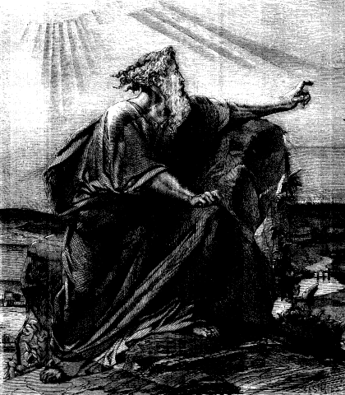
Dispensation to start
God
Foundation
of substance
Jericho
Moses
......
......
Israelites
......
.
.
.
......
......
......
......
Kadesh
.
barnea
-
.
Failure of dispensation to start
.
(Based on the water of the rock)

Israelites
:
murmuring
Moses
:
Mt. Horeb

struck the rock twice

As a consequence, he was not permitted to enter the promised land (p. 254-5).

Slide 91

2.2.3.2.2 The Foundation of Substance Centered on Joshua
God
Foundation of faith
Jericho
Moses
......
......
.
.
.
......
......
......
......
......
Kadesh
.
barnea
-
.
Joshua
.
Mt. Horeb

God elevated Joshua to Moses’ place (p. 259).

Slide 92
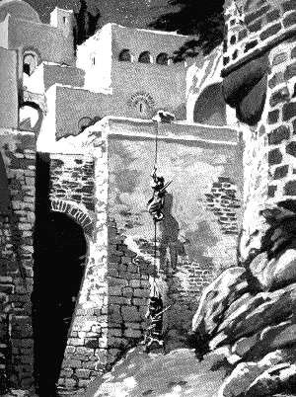
2.2.3.2.2 The Foundation of Substance Centered on Joshua
God
Foundation of faith
Jericho
Moses
......
......
.
.
.
......
......
......
......
......
Kadesh
.
barnea
-
.
Joshua
.
Spying out Jericho
Mt. Horeb

Joshua sent two men to spy out the fortified city of Jericho.

Slide 93
2.2.3.2.2 The Foundation of Substance Centered on Joshua
God
Foundation of faith
Jericho
Moses
......
......
.
.
.
And they said to Joshua, “Truly the LORD has given all the land into our hands; and moreover all the inhabitants of the land are fainthearted because of us.”
......
......
......
......
......
Kadesh
.
barnea
-
.
Joshua
.
:
Spying out Jericho
faithful report
Joshua 22:24
Mt. Horeb
When they returned from Jericho, the two spies made a faithful report: “…all inhabitants of the land are fainthearted because of us.” (p. 260)

Slide 94
2.2.3.2.2 The Foundation of Substance Centered on Joshua
God
Foundation of faith
Jericho
Moses
......
......
.
.
.
And they said to Joshua, “Truly the LORD has given all the land into our hands; and moreover all the inhabitants of the land are fainthearted because of us.”
......
Foundation of substance
......
......
......
......
Kadesh
.
barnea
-
.
Joshua
Younger
Israelites
.
Success of dispensation to start
:
Spying out Jericho
faithful report
Joshua 22:24
Mt. Horeb
Start

The younger generation of Israelites raised in the wilderness all believed the spies’ words and this faith enabled them to start the third course.

Slide 95
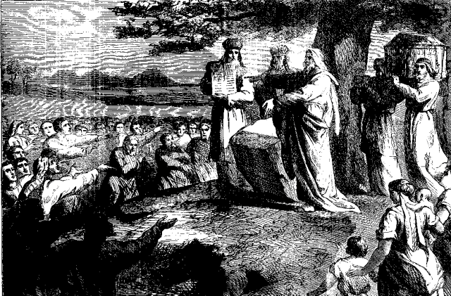
Entering Canaan
God
Foundation
of substance
Jericho
Moses
......
......
Younger
Younger
Joshua
.
.
.
Joshua
......
Israelites
......
......
......
......
Kadesh
Israelites
Success of dispensation to start
.
barnea
-
.
Three-day course
.
Mt. Horeb

The Israelites under Joshua’s leadership passed through a three-day course before they crossed the Jordan River.

Slide 96
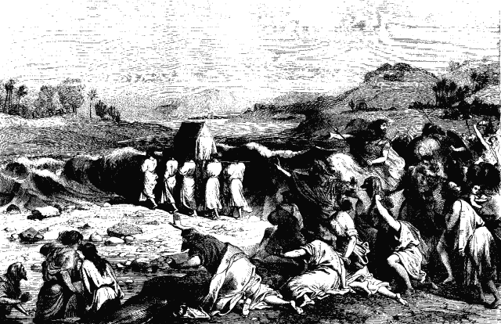
Entering Canaan
God
Foundation
of substance
Jericho
Moses
......
......
Younger
Joshua
......
.
.
.
......
......
......
......
Kadesh
Israelites
Success of dispensation to start
.
barnea
-
.
Three-day course
.
(Ark of Covenant)
(Ark of Covenant)
Mt. Horeb

After this, the Ark, symbolizing Jesus and his would-be Bride, led them to the Jordan River (p. 261).

Slide 97
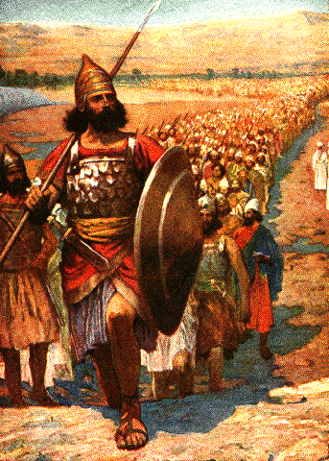
Entering Canaan
God
Foundation
of substance
Jericho
Moses
......
......
Younger
Joshua
......
.
.
.
......
......
......
......
Kadesh
Israelites
Success of dispensation to start
.
barnea
-
.
Three-day course
.
(Ark of Covenant)
Jordan River
Mt. Horeb
When the Ark entered the Jordan River, its waters parted, opening the way for the people to walk on the riverbed.

Slide 98
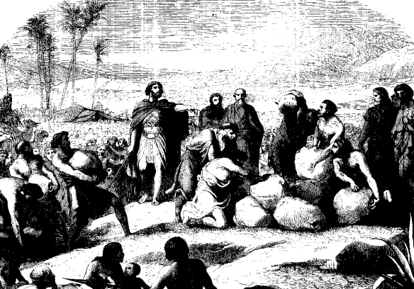
Entering Canaan
God
Foundation
of substance
Jericho
Moses
......
......
Younger
Joshua
......
.
.
.
......
......
......
......
Kadesh
Israelites
Success of dispensation to start
.
barnea
-
.
Three-day course
.
(Ark of Covenant)
Jordan River
Gilgal
(12 Stones)
(12 Stones)
Mt. Horeb

After coming up out of the Jordan, they encamped in Gilgal and set up the twelve stones there which they took out of the Jordan.

Slide 99
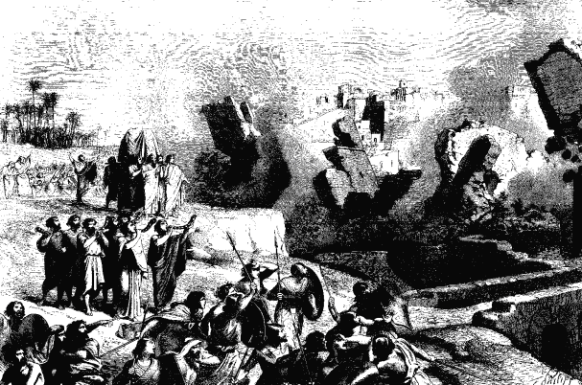
Entering Canaan
God
Foundation
of substance
Jericho
Moses
......
......
Younger
Joshua
......
.
.
.
......
......
......
......
Kadesh
Israelites
Success of dispensation to start
.
barnea
-
.
Three-day course
.
(Ark of Covenant)
Jordan River
Gilgal
(12 Stones)
Jericho
Mt. Horeb

After the feast of Passover, they set out for the city of Jericho. After marching around the city for seven days, they raised a great shout, and the city walls tumbled down (p. 262-3).

Slide 100
Entering Canaan
God
Foundation
of substance
Jericho
Moses
......
......
Younger
Joshua
......
.
.
.
......
......
......
......
Kadesh
Israelites
Success of dispensation to start
.
barnea
-
.
Three-day course
.
(Ark of Covenant)
Jordan River
Gilgal
(12 Stones)
Jericho
Mt. Horeb
(Defeated 31 kings)
Canaan

Joshua defeated thirty-one kings (Canaan) altogether.

Slide 101
2.2.3.3 The Foundation for the Messiah
Jericho
God
......
......
.
.
.
......
......
......
......
......
:
established
Foundation for the Messiah
Kadesh
.
Foundation
of faith
barnea
-
.
(National)
.
Moses
Foundation of substance
Joshua
Younger
Israelites
Mt. Horeb
Entering Canaan

Based on this victory, they laid the foundation of substance in the third national course and established the national foundation for the Messiah (p. 264).

Slide 102
2.2.3.3 The Foundation for the Messiah
(Satanic nations)
Jericho
God
......
......
.
.
.
......
......
......
......
......
:
established
Foundation for the Messiah
Kadesh
.
Foundation
of faith
barnea
-
.
(National)
.
Moses
Egypt
Foundation of substance
Joshua
Younger
Israelites
Mt. Horeb
Entering Canaan

However, fallen people had already founded powerful nations such as Egypt, led by satanic rulers opposing
God’s providence of restoration.

Slide 103
2.2.3.3 The Foundation for the Messiah
-
-
Coming of Messiah
(Satanic nations)
Jericho
God
......
......
.
.
.
......
......
......
......
......
:
established
Foundation for the Messiah
Kadesh
.
Foundation
of faith
barnea
-
.
(National)
.
Moses
Foundation of substance
Joshua
Younger
Israelites
Mt. Horeb
Entering Canaan
Therefore, it would be necessary to build a Heavenly sovereign kingdom before the Messiah could come.

Slide 104
2.2.3.3 The Foundation for the Messiah
-
-
Coming of Messiah
(Satanic nations)
Jericho
God
......
......
.
.
.
......
......
......
......
......
:
established
Foundation for the Messiah
Kadesh
.
Foundation
of faith
barnea
-
.
(National)
.
Moses
Foundation of substance
Joshua
Younger
Israelites
Mt. Horeb
Entering Canaan

However, once the younger generation of Israelites entered Canaan, they also became faithless. Hence God’s providence was prolonged again, and would suffer repeated setbacks until the time of Jesus.

Slide 105
For more information visit
http://www.unificationstudy.com
Pictures from
www.biblepicturegallery.com

