Slide 2
Section 2
The Providence
of Restoration
under the Leadership
of Jesus

Slide 3


Course to subjugate Satan

Jesus came as the second Adam to personally bring Satan to submission and establish the Kingdom of Heaven (p. 266).

Slide 4

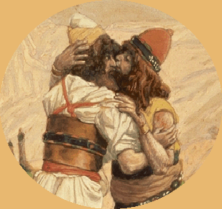
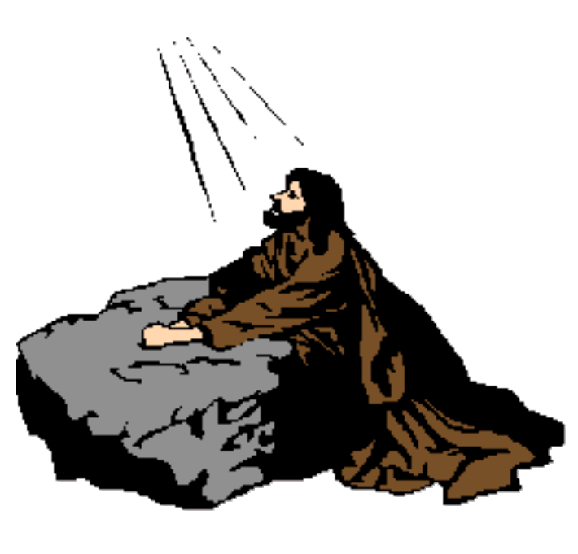
Course to subjugate Satan
God
__________
___________
Jacob
Moses
Jesus
............
...........................
Symbolic
Family
Image
National
Actual

Jacob walked the symbolic course to bring Satan to submission, while Moses walked the image course. Their courses pioneered the way for Jesus to walk the actual course (p. 267).

Slide 5
Course to subjugate Satan
God
__________
___________
Jacob
Moses
Jesus
............
Subjugate
...........................
Symbolic
Family
Image
National
Satan
Actual
Worldwide

In walking the worldwide course to subjugate Satan and restore Canaan, Jesus followed the model demonstrated in the national course to restore Canaan when Moses was working to subjugate Satan.

Slide 6
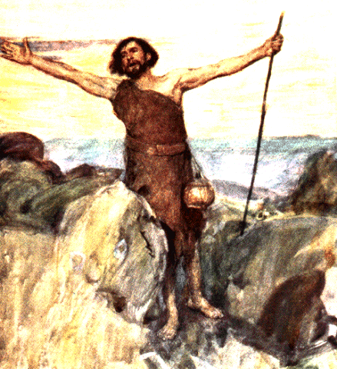
3.1. The First Worldwide Course to Restore Canaan
3.1.1. The Foundation of Faith

Central figure
:
John the Baptist
the Baptist
John

In the first worldwide course to restore Canaan, the central figure entrusted with the mission to restore the foundation of faith was John the Baptist.

Slide 7
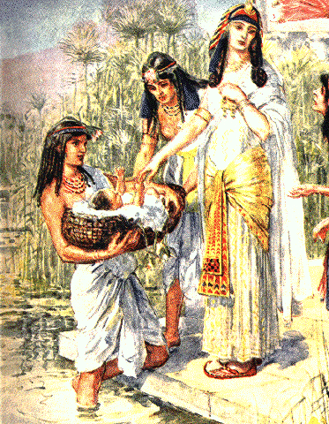
3.1. The First Worldwide Course to Restore Canaan
3.1.1. The Foundation of Faith

Central figure
:
John the Baptist
:

Object for condition
faith and obedience to Heaven

Indemnity period
Life in the wilderness
:
the Baptist
John

Moses had learned to love his brethren and the traditions of his fathers while living in Pharaoh’s palace. Likewise, John the Baptist learned the way of faith and obedience to Heaven while living in the wilderness (p. 268).

Slide 8
3.1. The First Worldwide Course to Restore Canaan
3.1.1. The Foundation of Faith
God

Central figure
:
John the Baptist
:

Object for condition
faith and obedience to Heaven
Foundation
of faith

Indemnity period
Life in the wilderness
:
the Baptist
John
Dispensation of forty for separation of Satan

In this way, John the Baptist successfully established the dispensation of forty for the separation of Satan and was able to lay the foundation of faith for the first worldwide course to restore Canaan.

Slide 9
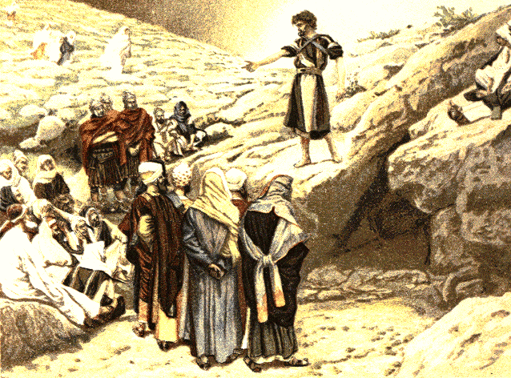
3.1.2. The Foundation of Substance
God
Foundation
of faith
the Baptist
John

Since John the Baptist restored through indemnity the foundation of faith, he secured the position of Abel for the fulfillment of the indemnity condition to remove the fallen nature on the world level.

Slide 10
3.1.2. The Foundation of Substance
God
Foundation
of substance
the Baptist
John
Jewish People
Success of dispensation to start

John the Baptist
miracles
:

God conducted the dispensation to start by encouraging the Jewish people to believe in John through the miracles surrounding his life (p. 269).

Slide 11
3.1.2. The Foundation of Substance
God
Foundation
of substance
the Baptist
John
Jewish People
Success of dispensation to start

John the Baptist
miracles
:

:
Jewish people
believe and follow

Since the Jewish people believed and followed John the Baptist, they could start the worldwide course to restore Canaan.

Slide 12
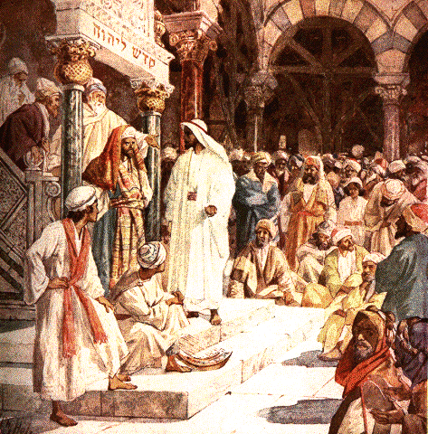
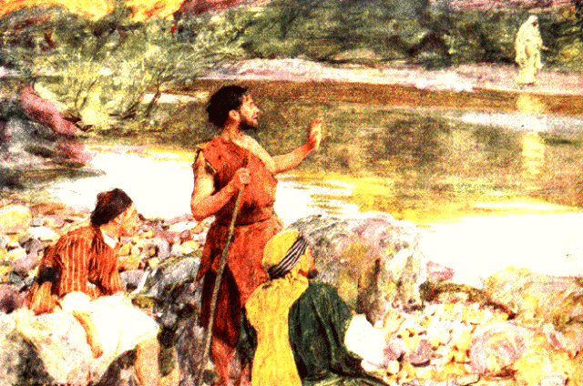
3.1.3. The Failure of the First Worldwide Course to Restore Canaan
God
the Baptist
John
Jewish People
Opposed Jesus
(doubted Jesus,
denied his being Elijah)

John the Baptist harbored doubts toward Jesus, even though he had testified to him, and he denied that he was Elijah even though he in fact came to fulfill Elijah’s mission. This not only blocked the Jewish people’s path to Jesus, it even led them to oppose him (p. 269-270).

Slide 13
3.1.3. The Failure of the First Worldwide Course to Restore Canaan
Foundation for the Messiah
failed
:
God
Foundation
of substance
the Baptist
John
Jewish People
Left Abel’s position
Opposed Jesus
(doubted Jesus,
denied his being Elijah)

In effect, John left the position of Abel and failed to complete the foundation of substance or the foundation for the Messiah. Consequently, the first worldwide course to restore Canaan was aborted.

Slide 14
3.2. The Second Worldwide Course to Restore Canaan
3.2.1. The Foundation of Faith
3.2.1.1. Jesus Takes on the Mission of John the Baptist
God
Foundation
of faith

Indemnity period
the Baptist
John
Jesus
Took on John’s mission

The foundation of faith which John had laid for the first course was invaded by Satan. Jesus himself now had to take on John’s mission and restore through indemnity the foundation of faith in order to set out on the second worldwide course to restore Canaan.

Slide 15
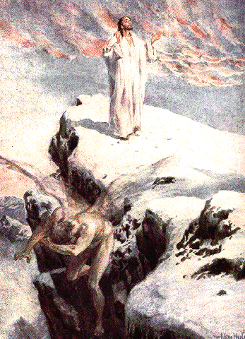
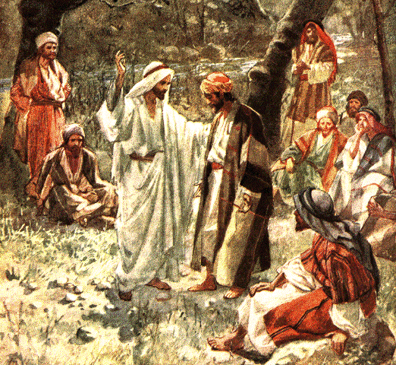
3.2. The Second Worldwide Course to Restore Canaan
3.2.1. The Foundation of Faith
3.2.1.1. Jesus Takes on the Mission of John the Baptist
God

Central figure
:
Jesus
:

Object for condition
forty-day fast,
Foundation
of faith
three temptations

Indemnity period
:
forty-day fast
Jesus
Took on John’s mission

When Jesus fasted for forty days in the wilderness, it was to separate Satan for the very purpose of restoring the foundation of faith. Because he was in such a situation, Jesus enjoined Peter not to reveal to the Jewish people that he was the Messiah (p. 271).

Slide 16
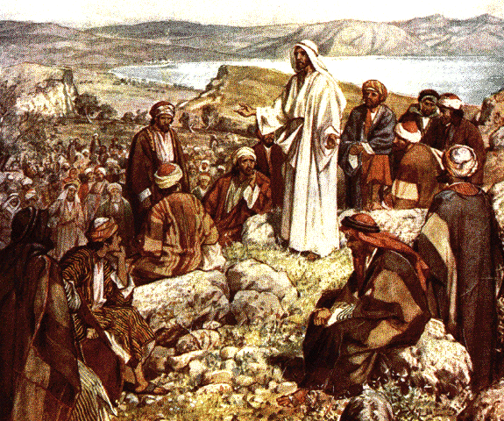
3.2.1.2. The Result of the Forty-Day Fast and Three Temptations
1

First, in the position of John the Baptist, Jesus restored through indemnity the foundation of faith for the second worldwide course to restore Canaan.

Slide 17
3.2.1.2. The Result of the Forty-Day Fast and Three Temptations
Restored through Indemnity
1
-
All that had been offered for the foundation of faith
In so doing, Jesus restored all that had been offered to God over the course of the providence for the purpose of laying the foundation of faith (p. 275).

Slide 18
3.2.1.2. The Result of the Forty-Day Fast and Three Temptations
Restored through Indemnity
1
-
All that had been offered for the foundation of faith
-
All the dispensations of forty for separation of Satan

Furthermore, Jesus restored through indemnity, all at once, all the dispensations of forty for the separation of Satan conducted during the four thousand years since Adam.

Slide 19
3.2.1.2. The Result of the Forty-Day Fast and Three Temptations
Restored through Indemnity
1
-
All that had been offered for the foundation of faith
-
All the dispensations of forty for separation of Satan
2
Fulfillment of three blessings
and restoration of the four position foundation

Second, by rising from John the Baptist’s position to
the position of the Messiah, Jesus paved the way for the fulfillment of God’s three great blessings and the restoration of the four position foundation (p. 276).

Slide 20
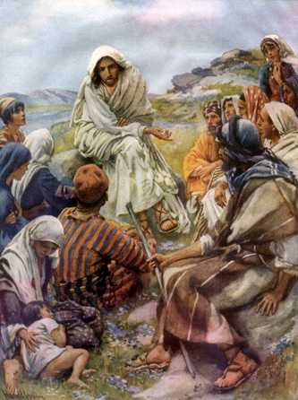
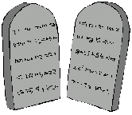

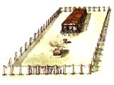
3.2.2. The Foundation of Substance
Dispensation to start

Jesus was the fulfillment of the three manifestations of grace (tablets, Ark, and Tabernacle) and the Ten Commandments. Therefore, God conducted the dispensation to start the second worldwide course to restore Canaan based on Jesus’ own words and miraculous deeds.

Slide 21
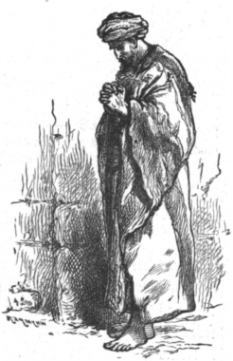
3.2.2. The Foundation of Substance
Foundation for the Messiah
God
Foundation of Substance
Jesus
Jewish People
Dispensation to start

If the Jewish people (Cain) had been moved to believe in and follow Jesus, they would have restored the foundation of substance. The foundation for the Messiah would thus have been laid.

Slide 22
3.2.2. The Foundation of Substance
Jesus:
John the Baptist
Messiah
Foundation for the Messiah
God
Foundation of Substance
Jesus
Jewish People
(John the Baptist)
Dispensation to start

Standing upon this foundation, Jesus would have risen from the position of John the Baptist to the position of the Messiah.

Slide 23
3.2.2. The Foundation of Substance
Kingdom of Heaven on earth
Jesus:
John the Baptist
Messiah
Foundation for the Messiah
God
Foundation of Substance
Jesus
Jewish People
(John the Baptist)
Dispensation to start
Then, by engrafting all people with himself, humankind would have been reborn, cleansed of the original sin, and would have become one with God in heart. They would have restored their original, God-given nature and built the Kingdom of Heaven on earth in Jesus’ day (p. 276-7).

Slide 24
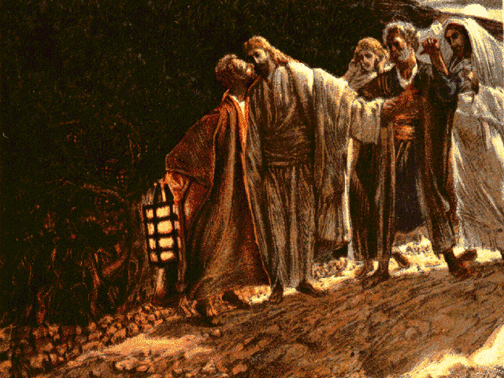
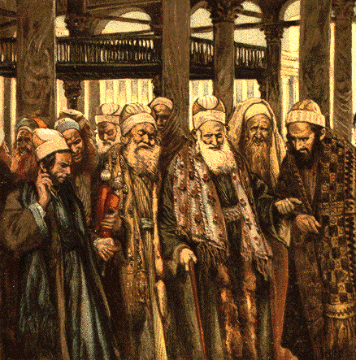
3.2.3. The Failure of the Second Worldwide Course to Restore Canaan
Disbelief
(Judas Iscariot)

Satan confronted Jesus, working primarily through the Jewish leadership, priests, scribes, and in particular Judas Iscariot, who betrayed him.

Slide 25
3.2.3. The Failure of the Second Worldwide Course to Restore Canaan
Foundation for the Messiah
failed
:
God
Foundation of Substance
Jesus
Jewish People
(John the Baptist)
Disbelief
(Judas Iscariot)

Due to the faithlessness of such people, Jesus could lay neither the foundation of substance nor the foundation for the Messiah for the second worldwide course to restore Canaan. The second worldwide course thus ended in tragic failure.

Slide 26
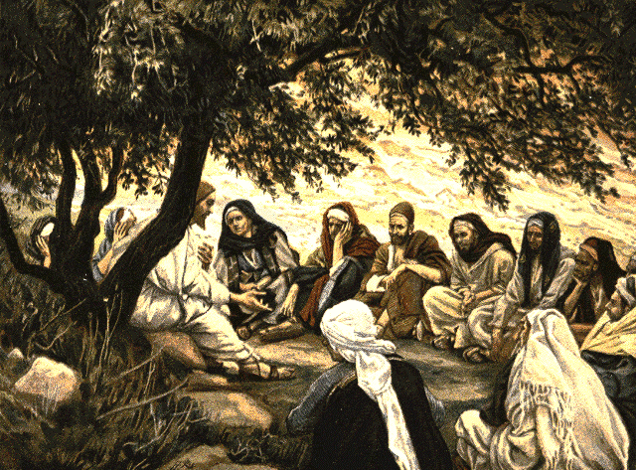
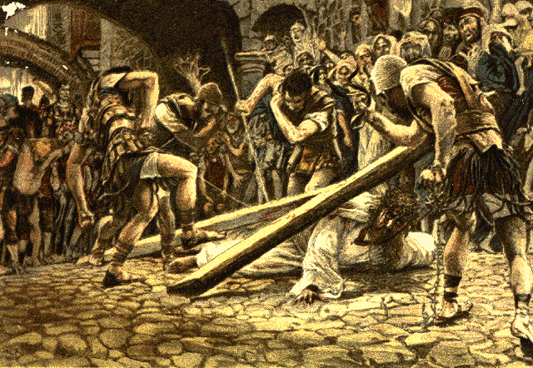
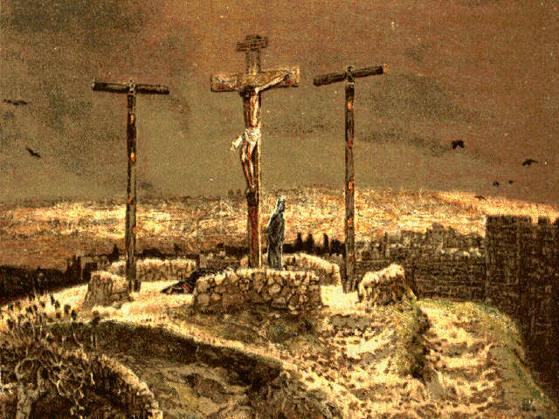
3.3. The Third Worldwide Course to Restore Canaan
3.3.1. The Spiritual Course to Restore Canaan under Jesus’ Leadership
God
Second course
Jesus
Jewish People

Jesus, who was the focus of faith for the Jewish people, had to walk the path of death and be crucified, and the Jewish people lost the one who should have been the spiritual and physical focus of their faith (p. 277-8).

Slide 27
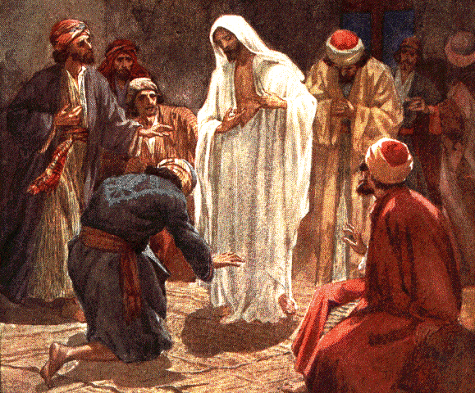
3.3. The Third Worldwide Course to Restore Canaan
3.3.1. The Spiritual Course to Restore Canaan under Jesus’ Leadership
God
Second course
Jesus
Jewish People
Third course
Resurrected
Christians
Jesus
Spiritual

They no longer had a basis upon which to begin the third worldwide course to restore Canaan as a substantial course. Rather, Christians, as the Second Israel, were to begin this course as a spiritual course by exalting the resurrected Jesus as their focus of faith.

Slide 28

3.3. The Third Worldwide Course to Restore Canaan
3.3.1. The Spiritual Course to Restore Canaan under Jesus’ Leadership
God
Second course
Jesus
Jewish People
Third course
Resurrected
Christians
Jesus
Spiritual
Third course
Second
Believers
Advent
Spiritual and physical

Christ at the Second Advent will complete, both spiritually and physically, the third worldwide course to restore Canaan.

Slide 29
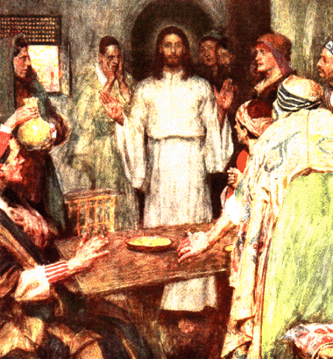
3.3.1.1. The Spiritual Foundation of Faith
God

Central figure
resurrected Jesus
:
:

Object for condition
Work of forty-day resurrection

Indemnity period
:
forty-day resurrection
Resurrected
Spiritual dispensation of forty for the separation of Satan
Jesus
(Spiritual
John the Baptist)

After Jesus gave up his body on the cross, he resumed John the Baptist’s mission spiritually. During the forty-day period from his resurrection to his ascension, Jesus fulfilled the spiritual dispensation of forty for the separation of Satan.

Slide 30
3.3.1.1. The Spiritual Foundation of Faith
God

Central figure
resurrected Jesus
:
:

Object for condition
Work of forty-day resurrection
Foundation
of faith

Indemnity period
:
forty-day resurrection
Resurrected
Spiritual dispensation of forty for the separation of Satan
Jesus
(Spiritual
John the Baptist)

By doing so, Jesus restored the foundation of faith for the spiritual course in the third worldwide course to restore Canaan.

Slide 31
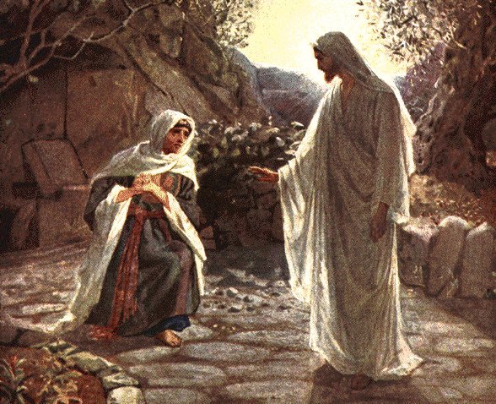
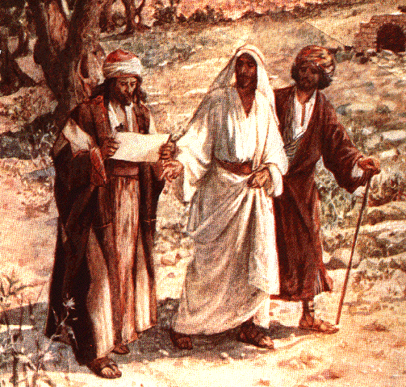
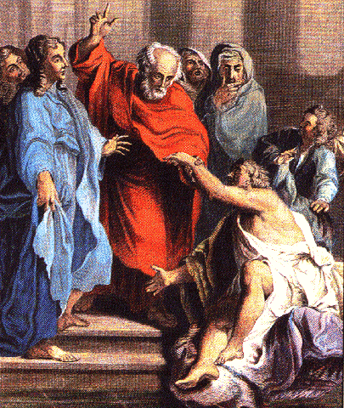
3.3.1.2. The Spiritual Foundation of Substance
God
Resurrected
Jesus
(John the Baptist)
Success of dispensation to start

The resurrected Jesus was the spiritual fulfillment of the tablets, Ark, and Tabernacle. He gathered his scattered disciples and worked the dispensation to start by giving them the power to perform signs and miracles (p. 280).

Slide 32
3.3.1.2. The Spiritual Foundation of Substance
God
Foundation
of substance
Resurrected
Believers
Jesus
(John the Baptist)
Success of dispensation to start
Spiritual foundation of substance
:
restored

The faithful believers stood in the position of Cain. By believing in Jesus and following him devotedly, they fulfilled the indemnity condition to remove the fallen nature and restored the spiritual foundation of substance.

Slide 33
3.3.1.3. The Spiritual Foundation for the Messiah
Foundation for the Messiah
laid
:
Believers

The disciples laid the spiritual foundation of substance and the spiritual foundation for the Messiah.

Slide 34
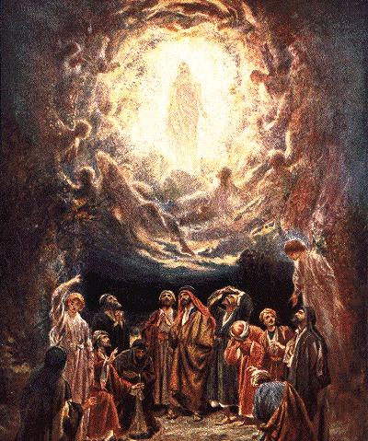
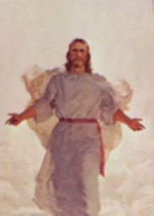


3.3.1.3. The Spiritual Foundation for the Messiah
Foundation for the Messiah
laid
:
Jesus:
position of spiritual Messiah
Spiritual
Holy Spirit
Messiah
Believers

Upon this foundation, Jesus ascended from the position
of the spiritual mission-bearer for John the Baptist to the position of the spiritual Messiah and sent the Holy Spirit.

Slide 35
3.3.1.3. The Spiritual Foundation for the Messiah
Foundation for the Messiah
laid
:
Jesus:
position of spiritual Messiah
Spiritual True Father
Spiritual True Mother
Spiritual
Holy Spirit
Messiah
Believers
Spiritual Rebirth
Thereupon, Jesus and the Holy Spirit became the
spiritual True Parents and began the work of giving rebirth.

Slide 36



3.3.1.4. The Restoration of Spiritual Canaan
Christians
Resurrected Jesus
Spirit
Spiritual salvation
Restoration
of spiritual Canaan

By believing and serving the resurrected Jesus, who stands upon
the spiritual foundation for the Messiah, Christians can accomplish the restoration of spiritual Canaan and enter its realm of grace (p. 281).

Slide 37
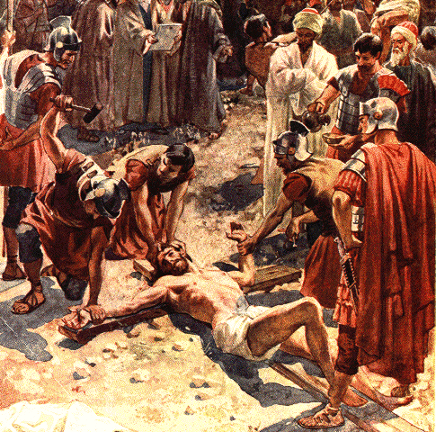
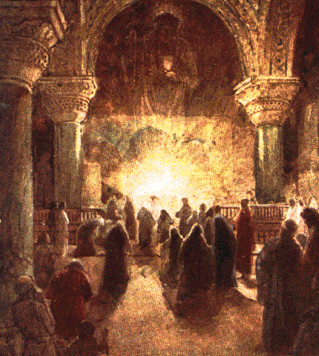
3.3.1.4. The Restoration of Spiritual Canaan
Christians
Resurrected Jesus
Spirit
Body
Spiritual salvation
Assaulted by Satan
Restoration
of spiritual Canaan

On the other hand, the physical bodies of Christians stand in the same position as Jesus’ body, which was assaulted by Satan through the crucifixion.

Slide 38
3.3.1.4. The Restoration of Spiritual Canaan
Christians
Resurrected Jesus
Spirit
Body
Spiritual salvation
Assaulted by Satan
Separation of Satan
to prepare
for the Second Coming
Restoration
of spiritual Canaan
Hence, Christians are still stained with the original sin, and thus they still must walk the course for the separation of Satan to prepare for the Second Coming of Christ.

Slide 39


3.3.2 The Course to Restore Substantial Canaan
under the Leadership of Christ at the Second Advent
Returning Christ
Realize the heavenly kingdom on earth

While Jesus has been restoring Canaan as a worldwide spiritual realm, Christ at the Second Advent is to complete this third worldwide course as a substantial course and build the actual Kingdom of Heaven on earth (p. 282).

Slide 40

3.3.2 The Course to Restore Substantial Canaan
under the Leadership of Christ at the Second Advent
Returning Christ
Born
on earth
Realize the heavenly kingdom on earth

He must be born on earth in the flesh.

Slide 41
3.3.2 The Course to Restore Substantial Canaan
under the Leadership of Christ at the Second Advent
Returning Christ
Born
on earth
Third
attempt
Realize the heavenly kingdom on earth

He will not die without fulfilling the providence of restoration. This is because God’s providence, which began with Adam and was prolonged through Jesus, will be successful on the third attempt, at the time of the Second Advent.

Slide 42
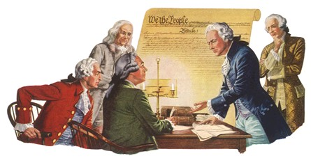
3.3.2 The Course to Restore Substantial Canaan
under the Leadership of Christ at the Second Advent
Returning Christ
Born
on earth
Third
attempt
Democratic
society
Realize the heavenly kingdom on earth

Moreover, God’s spiritual providence of restoration during the two thousand years since Jesus has prepared a democratic society and legal environment which will protect Christ at the Second Advent.

Slide 43
The relation of kinship
between God
and human beings
God
Adam
_
Eve
_
_
_
_
_
_
_
_
_
_
_
Children
_____________________________________________________
direct lineage
_____________________________________________________
_____________________________________________________
_____________________________________________________
Satan
Adam•Eve

The ultimate purpose of God’s providence of restoration is to transform fallen people into children born of God’s direct lineage (p. 284).

Slide 44
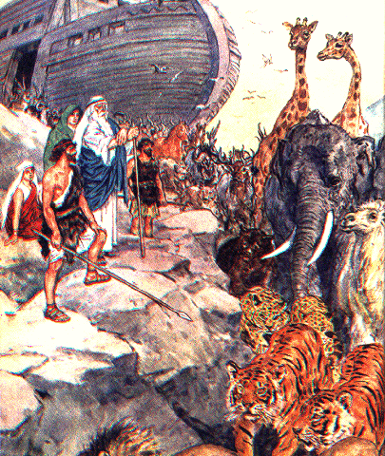
The relation of kinship
between God
and human beings
God
Adam
_
Eve
_
_
_
_
_
_
_
_
_
_
_
Children
_____________________________________________________
direct lineage
_____________________________________________________
_____________________________________________________
_____________________________________________________
Before Old Testament:
servant of servants
Satan
Noah
Adam•Eve
_
(Devotion)
_
_

At Noah’s time, because Noah had demonstrated utmost devotion, his family could stand in an indirect relationship with God, as a servant of servants.

Slide 45
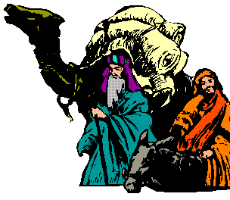
The relation of kinship
between God
and human beings
_____________________________________________________
direct lineage
_____________________________________________________
_____________________________________________________
Old Testament:
servants
Abraham
_____________________________________________________
Before Old Testament:
servant of servants
Satan
(Faith)
_
_
Noah
_
Adam•Eve
_
(Devotion)
_
_

Abraham’s family and their descendants, as God’s chosen people, were elevated to the position of God’s servants.

Slide 46
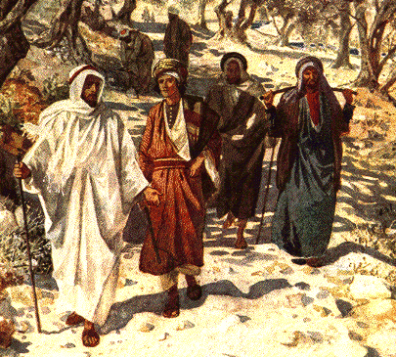
The relation of kinship
between God
and human beings
_____________________________________________________
direct lineage
_____________________________________________________
New Testament:
adopted children
Jesus
_____________________________________________________
Old Testament:
servants
_
_
Abraham
_
_____________________________________________________
Before Old Testament:
servant of servants
Satan
(Faith)
_
_
Noah
_
Adam•Eve
_
(Devotion)
_
_

In the days of Jesus, the disciples were elevated to the position of adopted children.

Slide 47
The relation of kinship
between God
and human beings
God
Adam
_
Eve
_
_
_
_
_
_
_
_
_
_
_
Children
_____________________________________________________
Completed Testament:
_
direct lineage
_
Ret. Christ
_
_____________________________________________________
New Testament:
adopted children
_
_
Jesus
_
_____________________________________________________
Old Testament:
servants
_
_
Abraham
_
_____________________________________________________
Before Old Testament:
servant of servants
Satan
(Faith)
_
_
Noah
_
Adam•Eve
_
(Devotion)
_
_

The Christ will return and restore all humanity to be God’s children of direct lineage (p. 285).

Slide 48
Foundation for the Messiah
:
laid
God
Foundation of Substance
Returning
Christ
(
)
Dispensation to start
Take on mission
of John the Baptist

The returning Christ will conduct the dispensation to start based on the Word and then complete the foundation for the Messiah both spiritually and physically.

Slide 49

Children of direct lineage
Foundation for the Messiah
:
laid
God
Foundation of Substance
Believers
Returning
and
Christ
Dispensation to start
all humanity
(
)
Take on mission
of John the Baptist
Upon that foundation, he will engraft all humanity with himself, cleansing them of the original sin and restoring them to be God’s children, born of his direct lineage.

Slide 50

Children of direct lineage

Family,
clan, society, nation,
world, and cosmos
Foundation for the Messiah
:
laid
God
Foundation of Substance
Believers
Returning
and
Christ
Dispensation to start
all humanity
(
)
Take on mission
of John the Baptist

The returning Christ will begin by laying, both spiritually and physically, the family foundation for the Messiah. He will then expand its scope to the clan, society, nation, world and cosmos.

Slide 51


Children of direct lineage
Heavenly
Kingdom

Family,
clan, society, nation,
world, and cosmos
Foundation for the Messiah
:
laid
God
Foundation of Substance
Believers
Returning
and
Christ
Dispensation to start
all humanity
(
)
Take on mission
of John the Baptist
When this foundation is secure, he will finally be able to build the Kingdom of Heaven (p. 285-6).

Slide 52
For more information visit
http://www.unificationstudy.com
Pictures from
www.biblepicturegallery.com

