Slide 2
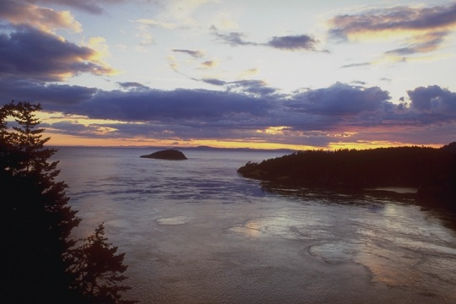
Chapter 3
The Periods
in Providential History
and the Determination
of Their Lengths

Slide 3

Section 1
Parallel Providential Periods

Slide 4
Parallel Providential Periods
)
A
)
A'
Repeat the events
)
A''
of a previous period

When a period of history repeats the events of a previous period, albeit with differences in scope and degree, the
two periods are called parallel providential periods (p. 289).

Slide 5
Parallel Providential Periods
)
A
)
A'
Repeat the events
)
A''
of a previous period

The principal cause behind these parallels lies in God’s providence of restoration through indemnity.

Slide 6


(1) Factors determining the parallel providential periods
Foundation for the Messiah

Parallel providential periods recur because of repeated
dispensations to restore the foundation for the Messiah (p. 290).

Slide 7
(1) Factors determining the parallel providential periods
Foundation for the Messiah

Accordingly, the factors which determine the formation of parallel providential periods are:

Slide 8

(1) Factors determining the parallel providential periods
Foundation for the Messiah
Central figure
_
Foundation of Faith
1
Object for condition
_
_
_
_
Numerical period
_

First, the three conditions necessary for the foundation of faith (central figure, object for the condition, and the numerical period of indemnity).

Slide 9
(1) Factors determining the parallel providential periods
Foundation for the Messiah
Foundation of Substance
2
Indemnity condition
to remove fallen nature
_
Central figure
_
Foundation of Faith
1
Object for condition
_
_
_
_
Numerical period
_

Second, the indemnity condition to remove the fallen nature, which is necessary to restore the foundation of substance.

Slide 10
(2) Two characteristics of parallel providential periods

Two characteristics of parallel providential periods stand out:

Slide 11
(2) Two characteristics of parallel providential periods
Foundation
of Faith
Numerical period
1
Generations
or years
_
_

First, the lengths of the parallel providential periods are
determined based on a fixed number of generations or years of
the indemnity period necessary for restoring the foundation of faith.

Slide 12
(2) Two characteristics of parallel providential periods
Foundation for the Messiah
Foundation
of Substance
Indemnity condition
to remove fallen nature
2
Providential
facts
_
_
_
_
_
Central figure
_
_
_
_
_
Foundation
of Faith
Object for condition
_
_
_
Numerical period
1
Generations
or years
_
_
_

Second, the parallels of history are shaped by providential facts: the central figure and the object for the condition offered for the foundation of faith, and the indemnity condition to remove the fallen nature for the foundation of substance (p. 291).

Slide 13
Section 2
The Number of Generations
or Years in the Periods
of the Age of the Providence
to Lay the Foundation
for Restoration

Slide 14
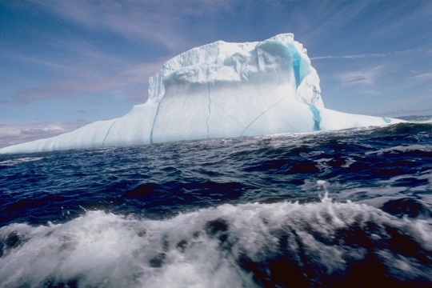
2.1 Why and How the Providence of Restoration Is Prolonged
Why Prolonged?
God's Will
Absolute predestination
……

According to the principle of predestination, since God absolutely predestines His Will, He surely will realize it one day (p. 291-2).

Slide 15



2.1 Why and How the Providence of Restoration Is Prolonged
Why Prolonged?
God's Will
Absolute predestination
……
Fulfillment
of God’s Will
God’s
responsibility
Human
responsibility
-
+
-
Conditional
predestination

However, whether God’s Will is fulfilled through any particular individual is conditional upon the fulfillment of his portion of responsibility, which is in addition to God’s portion of responsibility.

Slide 16
2.1 Why and How the Providence of Restoration Is Prolonged
Why Prolonged?
God's Will
Absolute predestination
……
Fulfillment
of God’s Will
God’s
responsibility
Human
responsibility
-
+
-
Conditional
predestination

Accordingly, when the Will is not fulfilled because the responsible person fails, God will choose another person in a different era to take his place. God will continue His work until its complete fulfillment, prolonging the providence in the process.

Slide 17

How Prolonged?
Being of number three
God
……
[Principle of Creation]
Three-stage process
Creation
(Existence, movement, and growth)
……

According to the Principle of Creation, God is a
being of the number three. All things created in His likeness manifest themselves through a three-stage process with respect to their mode of existence, movement and growth (p. 292).

Slide 18
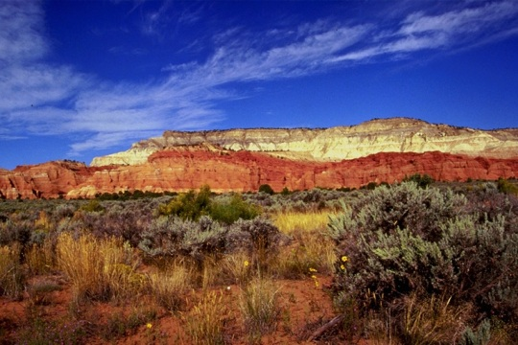
How Prolonged?
Being of number three
God
……
[Principle of Creation]
Three-stage process
Creation
(Existence, movement, and growth)
……
Prolongation to three stages

Therefore, whenever the providence of restoration is prolonged, it may extend to as many as three stages.

Slide 19
2.2 Vertical Indemnity Conditions
and Horizontal Restoration through Indemnity
A
B
C
Central
__________
figure
C'
B'
A'

A central figure responsible for the providence of restoration must fulfill, in a short time, all the indemnity conditions which his predecessors tried to fulfill.

Slide 20
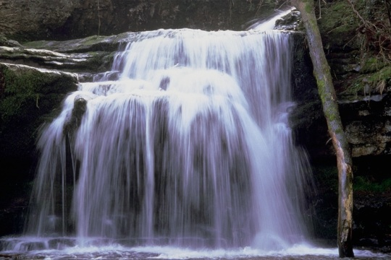

2.2 Vertical Indemnity Conditions
and Horizontal Restoration through Indemnity
A
Vertical
Indemnity
conditions
B
C
Central
__________
figure
C'
B'
A'
Horizontal restoration
through indemnity

The conditions which accumulate in the course of providential history are called vertical indemnity conditions. The task of the central figure to fulfill all these conditions in a short time is called horizontal restoration through indemnity (p. 293).

Slide 21
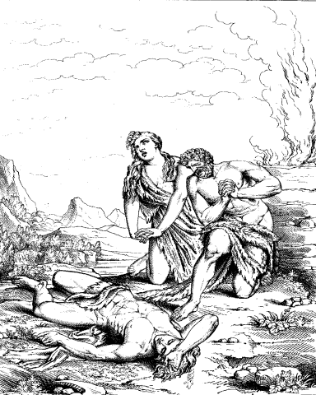
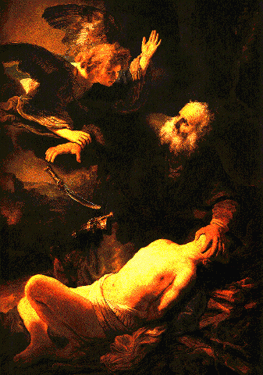
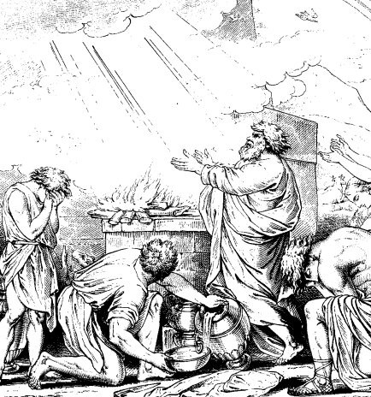
2.3 Horizontal Restoration through Indemnity Carried Out Vertically
Adam
Adam's family
Noah's family
Noah

Since the work of restoration in Abraham’s family was the third attempt in the providence to restore the family foundation for the Messiah, the Principle required that his family accomplish God’s Will without fail (p. 294).
Notes:
The Angel Prevents the Sacrifice of Isaac´ by Rembrandt;
Abel murdered by his brother Cain (Engraving based on a picture by Vanderwerf);
Noah´s sacrifice (Engraving based on a picture by Nicholas Paussin);

Slide 22
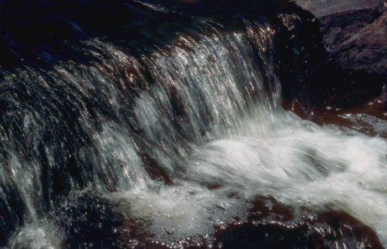
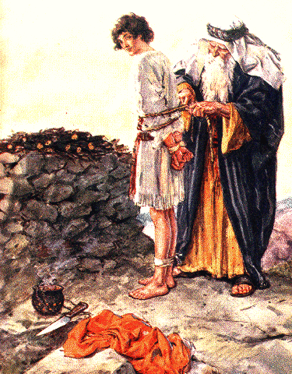
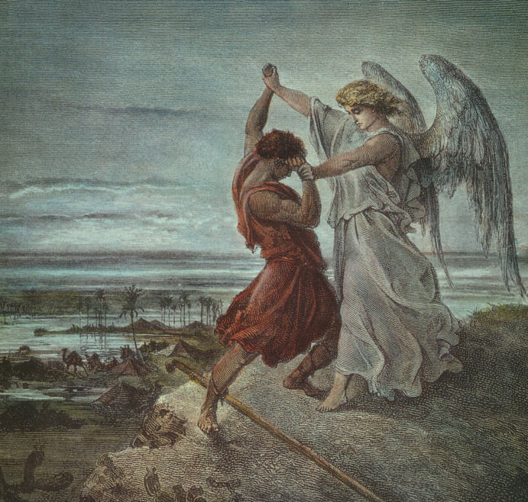


2.3 Horizontal Restoration through Indemnity Carried Out Vertically
Adam
Horizontal
Indemnity
conditions
Noah
Abraham
________________
Isaac
Jacob

Hence, when Abraham failed to complete the horizontal indemnity conditions, he completed them vertically through the generations of Isaac and Jacob, and God could still credit him with having fulfilled them in his own generation.
Notes:
Is Isaac to Die - Genesis 22;
Jacob wrestling the Angel;

Slide 23
2.3 Horizontal Restoration through Indemnity Carried Out Vertically
Adam
Horizontal
Indemnity
conditions
Noah
}
Abraham
________________
Horizontal
restoration
carried out
vertically
Isaac
Jacob
This type of restoration is called horizontal restoration through indemnity carried out vertically.

Slide 24
2.4 Numerical Indemnity Periods for Restoring the Foundation of Faith

A central figure has to fulfill one or more numerical indemnity periods in order to restore the foundation of faith.

Slide 25

2.4 Numerical Indemnity Periods for Restoring the Foundation of Faith
________________________
40
_
Foundation
of
Faith
21
_
4
_
Numerical
growing
period
_
12
_
________________________
Adam
Eve

The first human ancestors were to lay the foundation of faith based on significant numbers, including 12, 4, 21, and 40, which represent the numerical growing period.

Slide 26

2.4 Numerical Indemnity Periods for Restoring the Foundation of Faith
40
God
_
21
_
Perfect
embodiments
4
_
_
Person
12
_
________________________
40
_
Foundation
of
Faith
....
__________________
21
_
4
_
Numerical
growing
period
_
12
_
________________________
Adam
Eve
When they then accomplished the purpose of creation, they would have become the perfect embodiments of the quality of these numbers (p. 295, 299).

Slide 27


2.4 Numerical Indemnity Periods for Restoring the Foundation of Faith
40
God
God
_
21
_
Perfect
embodiments
4
_
_
Person
Person
12
_
________________________
Messiah
40
_
Foundation
of
Faith
....
_
__________________
Foundation
of Substance
21
}
_
_
4
_
Numerical
growing
period
____________
Numerical
growing
period
_
12
_
_
40
________________________
Foundation
of
Faith
21
Adam
_
Eve
_
4
Fallen people
_
_
12

Yet due to their fall, all these numbers were claimed by Satan. Therefore, the central figures in providential history must
fulfill numerical periods of indemnity to restore the numbers 12, 4, 21, and 40.

Slide 28
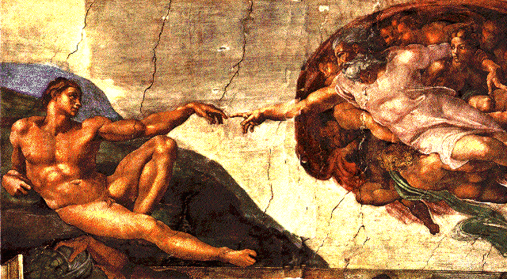
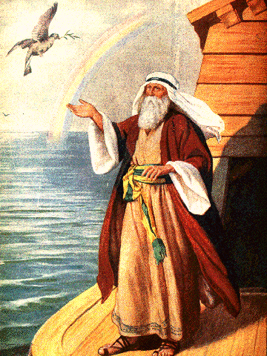
2.5 The Parallel Periods Determined by the Number of Generations
Adam
12
4
21
40
.
.
.
1600
10 generations
Noah
120
.
40
.
21
.
40

God chose Noah to shoulder the providence of ten generations and sixteen hundred years after Adam.
Notes:
Part of Creation of Adam by Michelangelo – Ceiling of Sistine Chapel at Vatican;
The Dove Returns to Noah, by C.F. Vos;

Slide 29
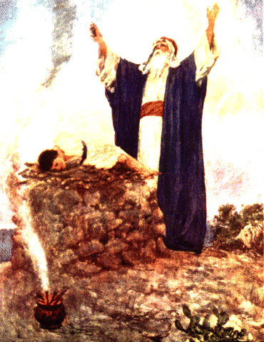
2.5 The Parallel Periods Determined by the Number of Generations
Adam
12
4
21
40
.
.
.
1600
10 generations
Noah
120
.
40
.
21
.
40
400
10 generations
Abraham
After the failure of the providence in Noah’s family, God waited ten generations and four hundred years before calling Abraham to carry the burden of the providence (p. 299-300).
Notes:
Part of Creation of Adam by Michelangelo – Ceiling of Sistine Chapel at Vatican;
The Dove Returns to Noah, by C.F. Vos;
Abraham offering up Isaac;

Slide 30
2.5 The Parallel Periods Determined by the Number of Generations
Adam
12
4
21
40
)
.
.
.
1600
10 generations
Noah
120
.
40
.
21
.
40
)
400
10 generations
Abraham

Set according to the number of generations, the period from Noah to Abraham was parallel to the period from Adam to Noah, and was to restore that earlier period through indemnity.

Slide 31


2.6 Providential Periods of Horizontal Restoration
through Indemnity Carried Out Vertically
Adam
)
1600
Noah
)
400
Abraham
120
40
21
40

Because Abraham failed in his offering, the indemnity periods could not be restored horizontally.

Slide 32
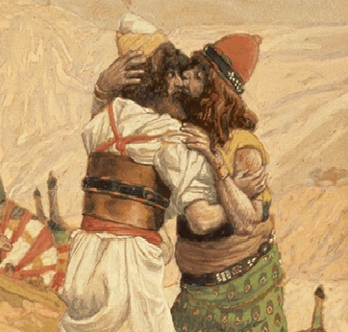
2.6 Providential Periods of Horizontal Restoration
through Indemnity Carried Out Vertically
Adam
)
1600
Noah
)
400
Abraham
)
120
40
21
40
120
40
Isaac
21
Jacob
40

They then had to be restored vertically: by prolonging the fulfillment of His Will through Isaac and Jacob, God worked to fulfill in succession indemnity periods to restore the numbers 12, 4, 21, and 40 (p. 301).
Notes:
Jacob and Esau meet after Jacob’s 21 years in Haran;

Slide 33
2.6 Providential Periods of Horizontal Restoration
through Indemnity Carried Out Vertically
Adam
)
1600
Noah
)
400
Abraham
)
120
40
21
40
120
40
Isaac
21
Jacob
40

The age from Adam to Jacob is called the Age of the Providence to Lay the Foundation for Restoration.

Slide 34
Section 3
The Periods in the Age
of the Providence
of Restoration
and Their Lengths

Slide 35
Age
of Foundation
for Restoration
Age
of Restoration
Adam
400
Noah
400
Abraham
120
40
21
40
Jacob

The Age of the Providence of Restoration, which was the age of image parallels, was to restore through indemnity the
Age of the Providence to Lay the Foundation for Restoration, the age of symbolic parallels (p. 302).

Slide 36
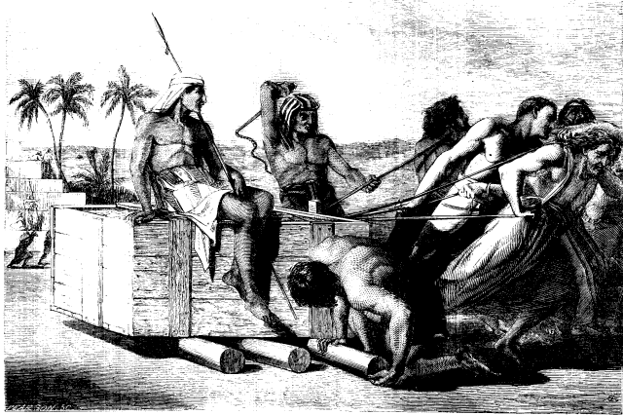
Age
of Foundation
for Restoration
Age
of Restoration
Adam
Abraham
Slavery in Egypt
400
400
400
Noah
Moses
400
400
400
Abraham
120
40
21
40
Jacob

The 400-year period of slavery in Egypt was the time in which God had the Israelites separate Satan once more in order to recover the foundation of 400 years defiled by Satan due to Abraham’s mistake.
Notes:
Egyptian taskmasters;

Slide 37
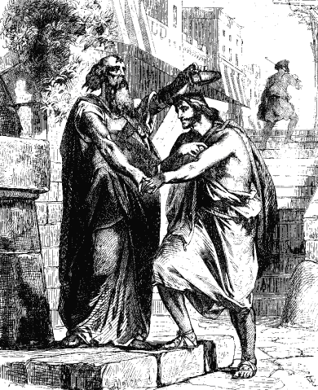
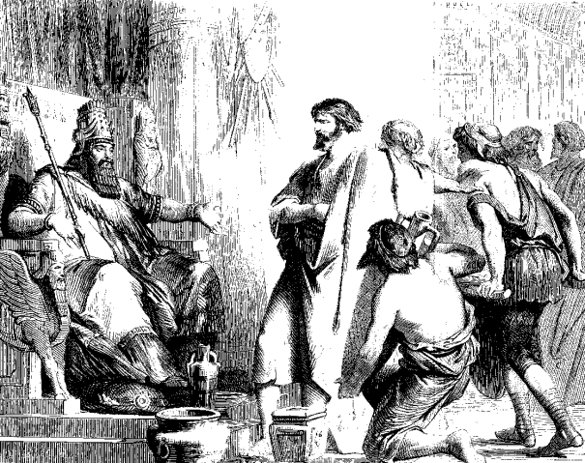
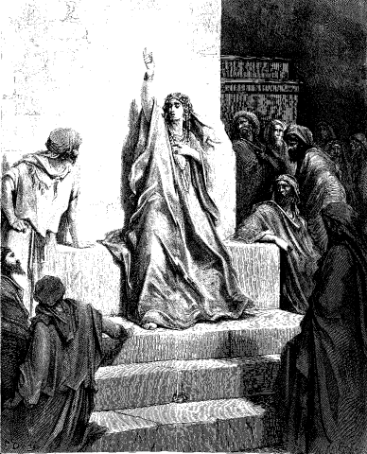
Age
of Foundation
for Restoration
Age
of Restoration
Adam
Abraham
Slavery in Egypt
400
400
400
Noah
Moses
400
Period of judges
400
400
Abraham
Saul
120
40
21
40
Jacob

The 400-year period of the judges was from the time the Israelites entered Canaan until the enthronement of King Saul (p. 303).
Notes:
Ehud and Eglon;
Deborah (Engraving by Gustaf Dore);
Samuel anointing Saul;

Slide 38
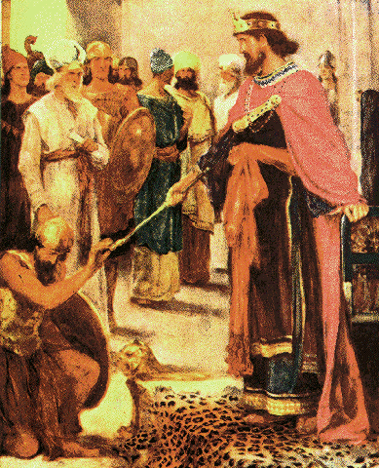
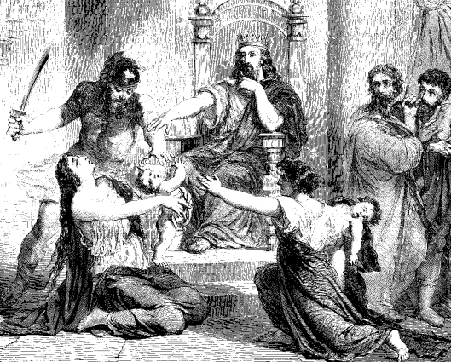
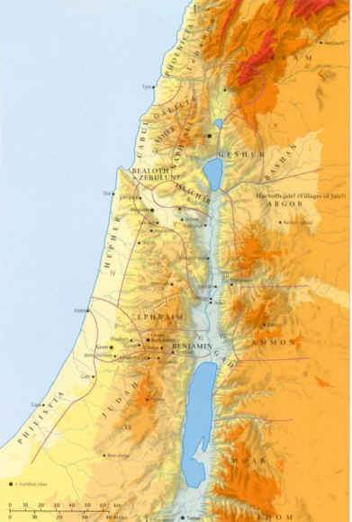
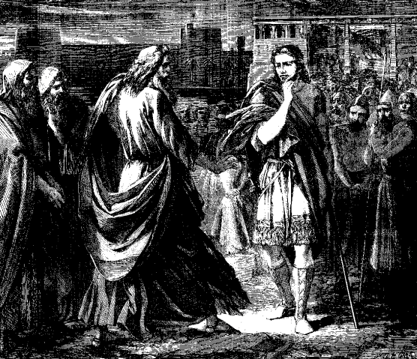
Age
of Foundation
for Restoration
Age
of Restoration
Adam
Abraham
Slavery in Egypt
400
Noah
Moses
400
Period of judges
United
Kingdom
of
Israel
Abraham
Saul
120
United kingdom
Jacob

The 120-year period of the united kingdom was formed as King Saul became faithless, and God’s Will to build the Temple was prolonged through the two 40-year reigns of King David and King Solomon (p. 305).
Notes:
David King over Israel, by C.F. Vos;
The judgement of Solomon;

Slide 39
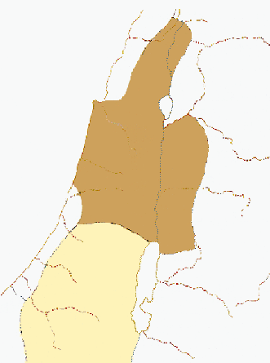
Age
of Foundation
for Restoration
Age
of Restoration
Adam
Abraham
Phoenicia
Slavery in Egypt
400
Noah
Moses
400
Period of judges
Abraham
Saul
Kingdom
of
Israel
United kingdom
120
400
Divided kingdoms
Philistia
Kingdom
of
Judah
Dead Sea
Jacob

The 400-year period of the divided kingdoms of north and south was the time when the united kingdom was divided into Israel in the north and Judah in the south due to their faithlessness.

Slide 40
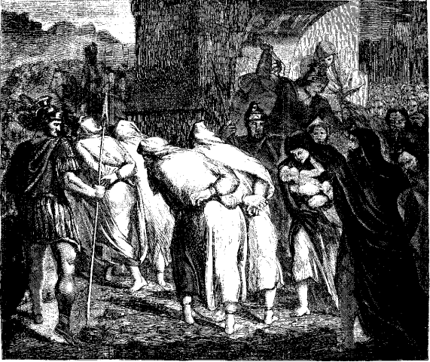
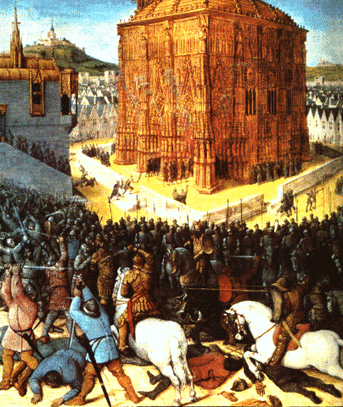
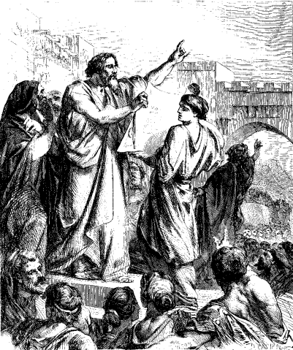
Age
of Foundation
for Restoration
Age
of Restoration
Adam
Abraham
Phoenicia
Slavery in Egypt
400
Noah
Moses
400
Period of judges
Abraham
Saul
Kingdom
of
Israel
United kingdom
120
400
Divided kingdoms
210
Israel’s exile and return
Philistia
Kingdom
of
Judah
Dead Sea
Jacob

The 210-year period of Israel’s exile and return was the time when the Jewish people were taken as captives in Babylon for 70 years and then gradually returned to their homeland for 140 years (p. 306).

Slide 41
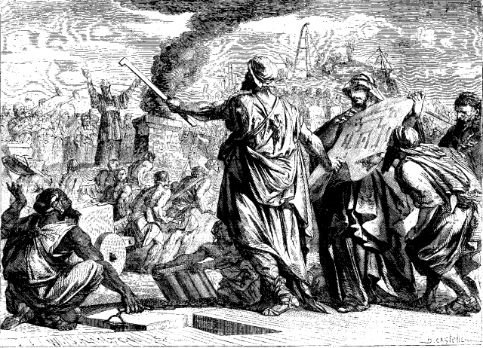
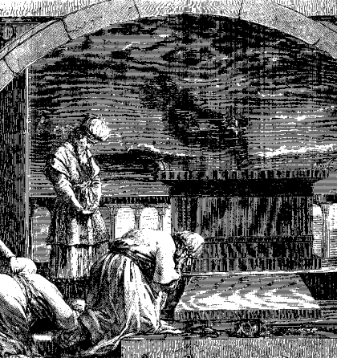
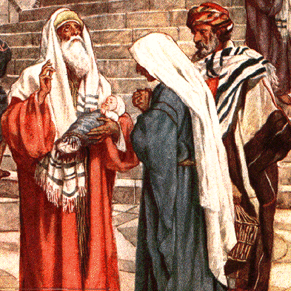
Age
of Foundation
for Restoration
Age
of Restoration
Adam
Abraham
Slavery in Egypt
400
Noah
Moses
400
Period of judges
Abraham
Saul
120
United kingdom
400
Divided kingdoms
210
Israel’s exile and return
Malachi
Preparation for the
advent of the Messiah
400
Jacob
Jesus

The 400-year period of preparation for the advent of the Messiah was from the time the Jewish people returned from exile to their homeland of Israel and, based on Malachi’s prophecy, began as a nation to prepare for the Messiah until the birth of Jesus.
Notes:
Ezra reading the Law in the hearing of the people;
The Jewish people rejoicing on their return from captivity, and on their laying the foundation of the second temple;
Malachi - You flood the altar with your tears´ - Mal.2.13;
Simeon blessing Jesus in the Temple - by William Hole;

Slide 42
Section 4
The Periods in the Age
of the Prolongation
of the Providence
of Restoration
and Their Lengths

Slide 43
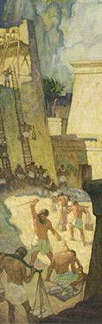
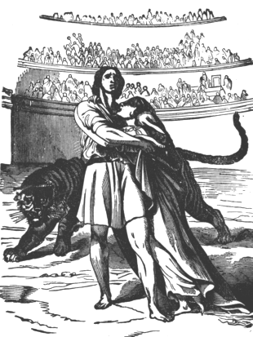
Age
of Foundation
for Restoration
Age
of Restoration
Age
of Prolongation
of Restoration
Adam
Jacob
Jesus
Roman Persecution
400
400
Noah
Moses
Augustine
400
Abraham
Saul
120
400
210
Malachi
400
Jacob
Jesus

The 400-year period of persecution in the Roman Empire, until Christianity was established as the state religion in 392 A.D., was the substantial parallel to the Israelites’ 400-year period of slavery in Egypt.

Slide 44
Age
of Foundation
for Restoration
Age
of Restoration
Age
of Prolongation
of Restoration
Adam
Jacob
Jesus
Roman Persecution
400
400
Noah
Moses
Augustine
400
Abraham
Saul
120
400
210
Malachi
400
Jacob
Jesus
Its purpose was to restore that earlier period through parallel indemnity conditions.

Slide 45
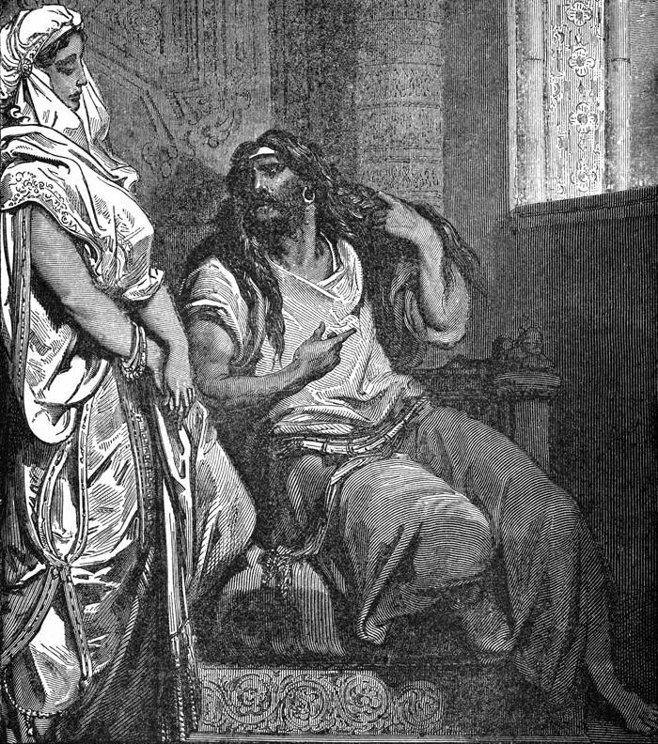
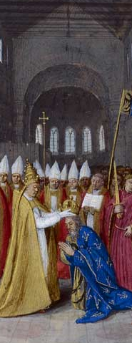
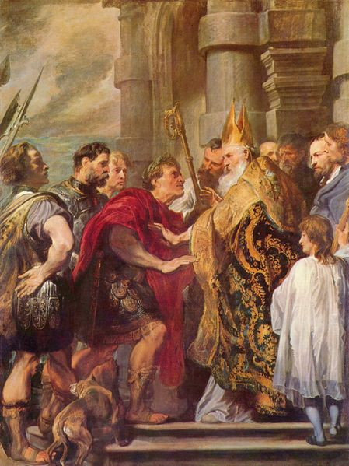
Age
of Foundation
for Restoration
Age
of Restoration
Age
of Prolongation
of Restoration
Adam
Jacob
Jesus
Roman Persecution
400
400
Noah
Moses
Augustine
400
Regional Leadership
400
Abraham
Saul
Charle-
magne
120
400
210
Malachi
400
Jacob
Jesus

The 400-year period of regional church leadership, until the enthronement of Charlemagne in 800 A.D., was to restore the 400-year period of the judges through parallel indemnity conditions (p. 308).
Notes:
Delilah and Samson;
Coronation of Charles, 800 C.E.;
Saint Ambrose and emperor Theodosius by Van Dyck. Saint Ambrose (c. 338 – 4 April 397), was a Frankish bishop of Milan (Italy);

Slide 46
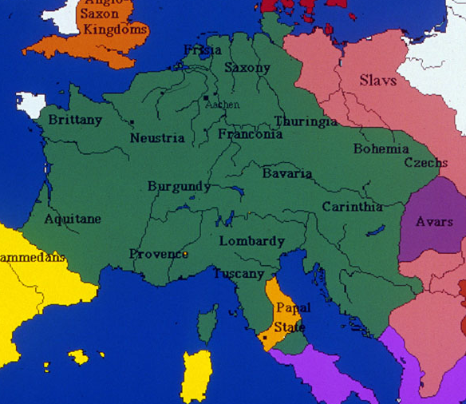
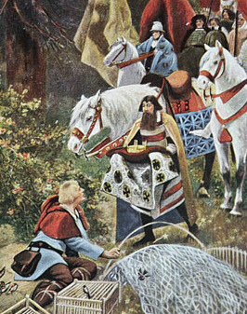
Age
of Foundation
for Restoration
Age
of Restoration
Age
of Prolongation
of Restoration
Adam
Jacob
Jesus
Roman Persecution
400
400
Noah
Moses
Augustine
United
Kingdom
of
Israel
Regional Leadership
400
Regional Leadership
400
Abraham
Saul
Charle-
magne
120
120
Christian Empire
400
210
Malachi
400
Jacob
Jesus

The 120-year period of the Christian empire, until Henry I was elected king of the German lands in 919 A.D., was to restore the 120-year period of the united kingdom through parallel indemnity conditions.
Notes:
Frankish Holy Roman Empire of Charlemagne 800-814;
Henry met by a delegation offering the crown while trapping birds;
Solomon’s United Monarchy;

Slide 47
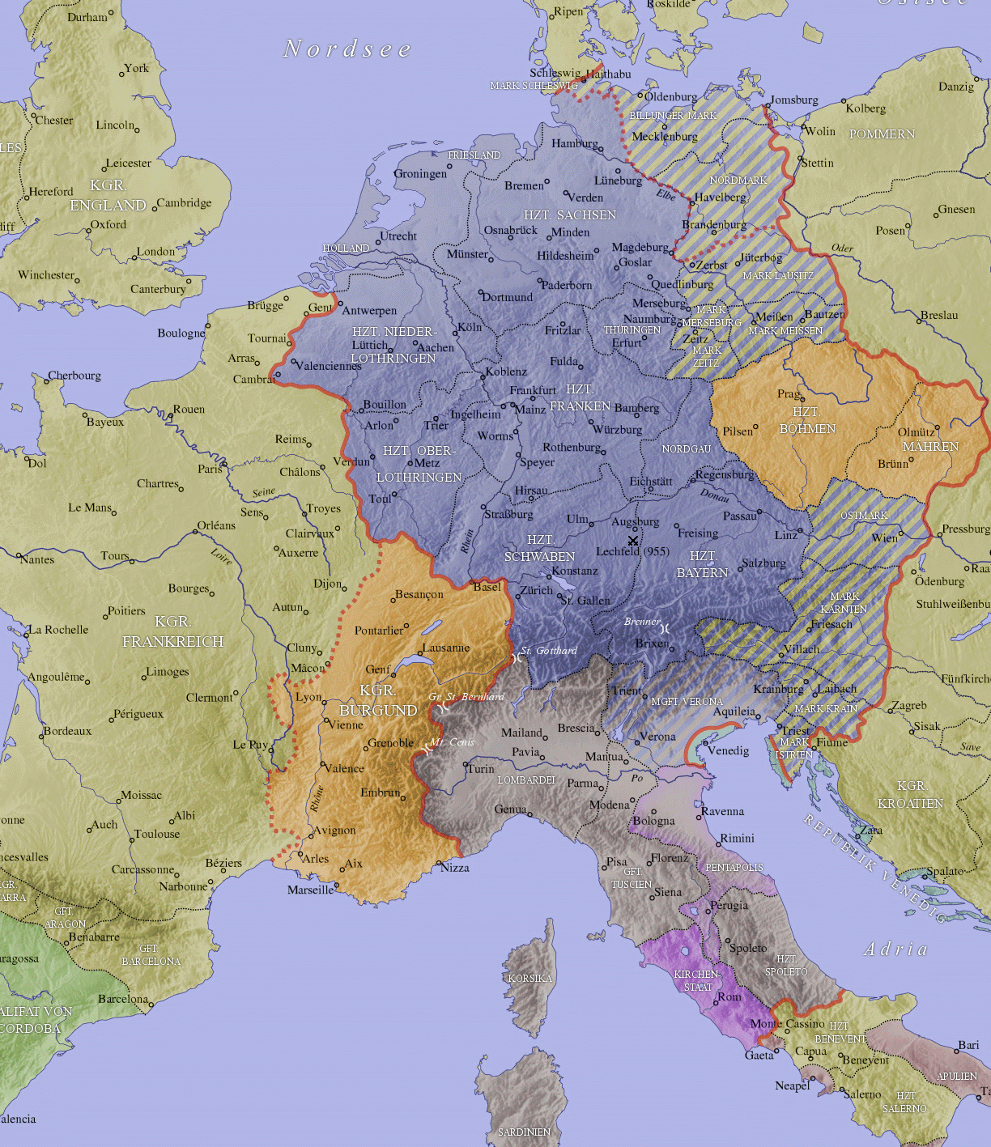
Age
of Foundation
for Restoration
Age
of Restoration
Age
of Prolongation
of Restoration
Adam
Jacob
Jesus
Roman Persecution
400
400
Noah
Moses
Augustine
United
Kingdom
of
Israel
400
Regional Leadership
East Franks
400
Abraham
Saul
Charle-
magne
(Holy
Roman
Empire)
Christian Empire
120
120
West Franks
(France)
400
Divided Kingdom
400
I t al y
210
Avignon
Malachi
400
Jacob
Jesus
Rome

The 400-year period of the divided kingdoms of east and west began with the division of the Christian empire in 919 and ended in 1309, when the papacy moved to Avignon, in what is now southern France.
Notes:
Holy Roman Empire - 11th Century;

Slide 48
Age
of Foundation
for Restoration
Age
of Restoration
Age
of Prolongation
of Restoration
Adam
Jacob
Jesus
Phoenicia
Roman Persecution
400
400
Noah
Moses
Augustine
400
Regional Leadership
East Franks
400
East Franks
Abraham
Saul
Charle-
magne
(Holy
Roman
Empire)
(Holy
Roman
Empire)
Kingdom
of
Israel
120
120
Christian Empire
West Franks
(France)
West Franks
(France)
400
Divided Kingdom
400
I t al y
210
I t al y
Philistia
Malachi
Kingdom
of
Judah
Dead Sea
Avignon
400
Jacob
Jesus
Rome
Its purpose was to restore the 400-year period of the divided kingdoms of north and south through parallel indemnity conditions (p. 309).

Slide 49
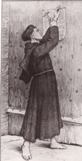
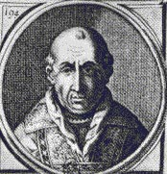
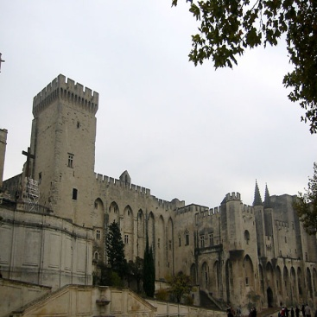
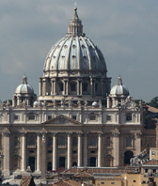
Age
of Foundation
for Restoration
Age
of Restoration
Age
of Prolongation
of Restoration
Adam
Jacob
Jesus
Phoenicia
Roman Persecution
400
400
Noah
Moses
Augustine
400
Regional Leadership
400
East Franks
Abraham
Saul
Charle-
magne
(Holy
Roman
Empire)
Kingdom
of
Israel
120
120
Christian Empire
West Franks
(France)
400
Divided Kingdom
400
Papal exile and return
210
210
I t al y
Philistia
Malachi
Kingdom
of
Judah
Dead Sea
400
Jacob
Jesus

The 210-year period of Papal exile and return began in 1309 A.D., when Pope Clement V was forced to move the papacy from Rome to Avignon, and ended with the Protestant Reformation in 1517.
Notes:
Martin Luther at Wittenberg; Pope Clement V (1305-1314);
Papal palace in Avignon; St. Peter's Basilica in Rome seen from the roof of Castel Sant'Angelo;

Slide 50
Age
of Foundation
for Restoration
Age
of Restoration
Age
of Prolongation
of Restoration
Adam
Jacob
Jesus
Roman Persecution
400
400
Noah
Moses
Augustine
400
Regional Leadership
400
Abraham
Saul
Charle-
magne
120
120
Christian Empire
400
Divided Kingdom
400
210
210
Papal exile and return
Malachi
400
Jacob
Jesus
Its purpose was to restore the 210-year period of Israel’s exile and return through parallel indemnity conditions.

Slide 51
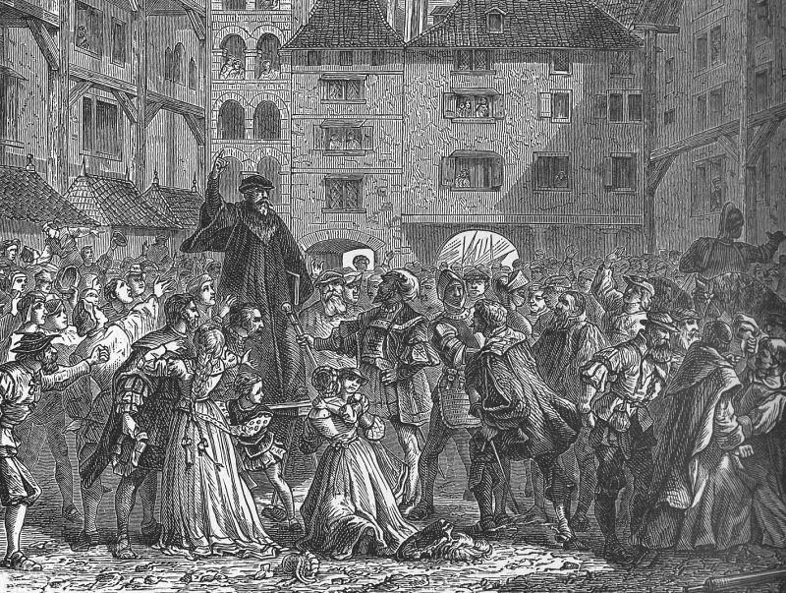
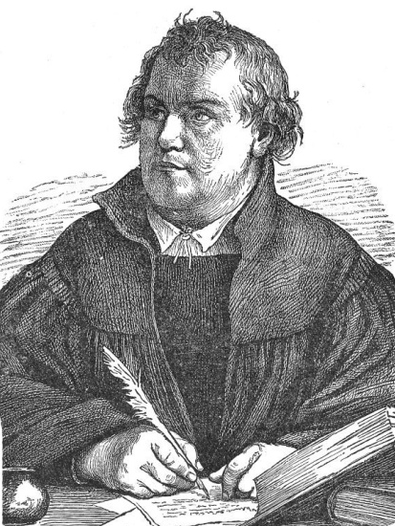
Age
of Foundation
for Restoration
Age
of Restoration
Age
of Prolongation
of Restoration
Adam
Jacob
Jesus
Roman Persecution
400
400
Noah
Moses
Augustine
400
Regional Leadership
400
Abraham
Saul
Charle-
magne
120
120
Christian Empire
400
Divided Kingdom
400
210
210
Papal exile and return
Malachi
Luther
Preparation for the
second advent
400
400
Jacob
Jesus
Returning
Messiah

The 400-year period of preparation for the second advent of the Messiah began in 1517 with Martin Luther and the Protestant Reformation and has lasted until the eve of the Second Advent of Christ on the earth.
Notes:
Preacher of the Reformation;

Slide 52
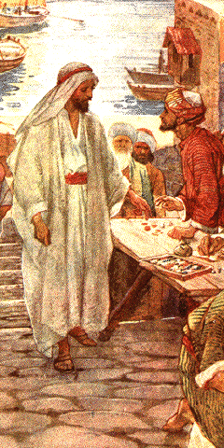
Age
of Foundation
for Restoration
Age
of Restoration
Age
of Prolongation
of Restoration
Adam
Jacob
Jesus
Roman Persecution
400
400
Noah
Moses
Augustine
400
Regional Leadership
400
Abraham
Saul
Charle-
magne
120
120
Christian Empire
400
Divided Kingdom
400
210
210
Papal exile and return
Malachi
Luther
Preparation for the
second advent
400
400
Jacob
Jesus
Returning
Messiah
Jesus calls Levi, the tax collector
Its purpose has been to restore the 400-year period of preparation for the advent of the Messiah through parallel indemnity conditions (p. 310).
Notes:
Jesus calls Levi (Matthew), the tax collector - by William Hole;

Slide 53
For more information visit
http://www.unificationstudy.com
Pictures from
www.biblepicturegallery.com
www.classroomclipart.com
http://karenswhimsy.com
http://en.wikipedia.org

